Slide 1
Extracorporeal Photopheresis
Michael Susman, MD PhD
12/13/17

Slide 2
Objectives
Define ECP
History of ECP
Current clinical applications
Proposed mechanisms of ECP

Slide 3
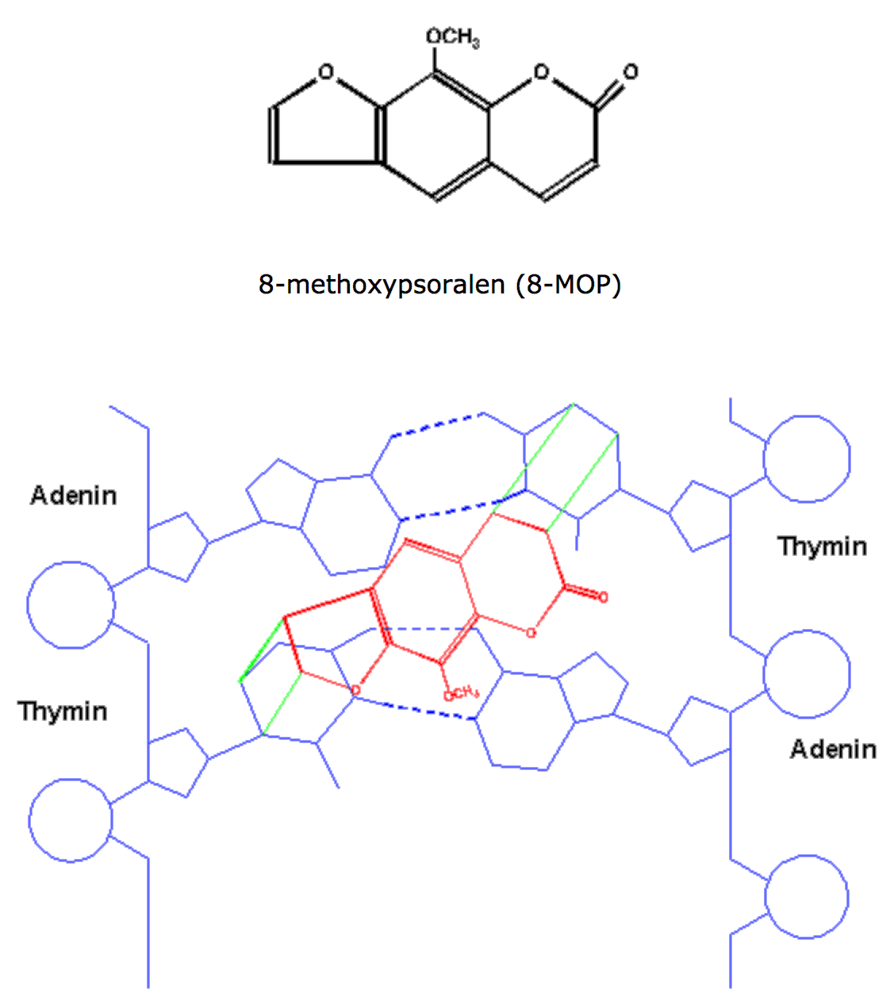
What is ECP?
Apheresis of buffy coat (WBCs and platelets)
Treatment with photosensitizing agent
Penetrates cell membranes
Intercalates into DNA
Hydrogen bonds with pyrimidine bases
UVA activation
8-MOP covalently binds DNA
Reinjection into patient
Image: http://www.physik.uni-regensburg.de/forschung/maier/sauerstoff/singulett_e.html

Slide 4
History of ECP
Cutaneous T cell lymphoma (CTCL)
Clonal proliferation of skin-homing T cells in migratory equilibrium between skin and blood
Tumor cells accessible for study
Clonotypic TCR as a tumor specific antigen
Regularly fatal
Failed immunotherapies
Leukopheresis (daily)
Anti-thymocyte globulin
Phototoxic liposomes coated with CD-4 monoclonal antibodies
Extracorporeal cytoreductive step
Reduce body’s load of CTCL cells
Leukopheresis + 8-MOP + UVA
Cross-links DNA, killing cells or blocking replication
Cautiously re-infused, but did not cause tumor lysis syndrome

Slide 5
Edelson et al., N Engl J Med 1987
FDA approved ECP for CTCL in 1988

Slide 6
ECP is well-tolerated and safe
No widespread immunosuppression
No increased incidence of infection or organ damage
Side effects (usually mild and transient)
Photosensitivity
Hypotension
Anemia
Catheter-related complications
Hypersensitivity to 8-MOP
Transfusions may be required
Platelets < 20000

Slide 7
Indications for ECP
Indications for extracorporeal photopheresis as per the American Society of Apheresis guidelines 2016

Slide 8
Systematic review of ECP for steroid-refractory GVHD
Abu-Dalle et al., Biol Blood Marrow Transplant 2014

Slide 9
Meta-analysis of ECP for steroid-refractory GVHD
Abu-Dalle et al., Biol Blood Marrow Transplant 2014

Slide 10
How does ECP work?
Still not clear
Treats diseases of T cells
UVA-exposure system is crucial
Only difference from simple leukapheresis
Paradox of anti-tumor and tolerogenic effects

Slide 11
ECP induces apoptosis of pheresed cells
Yoo et al., J Invest Dermatol 1996

Slide 12
Cells undergo apoptosis at different rates
Hannani et al., Transplantation 2010(b)
Hannani et al., Transplantation 2010(a)

Slide 13
Induction of apoptosis is insufficient to explain clinical effects
Must involve more than direct cytotoxicity
Rapid clinical responses sometimes seen with ECP of only a minority of WBCs
Skin-directed PUVA only acts locally
Points to some other process in the ECP-treated blood

Slide 14
Apoptotic cells are phagocytosed by monocytic cells
Yoo et al., J Invest Dermatol 1996
Hypothesis: antigens in apoptotic cells must be presented to the immune system via cross-presentation (MHC I)
Does this occur in cells processed by ECP?

Slide 15
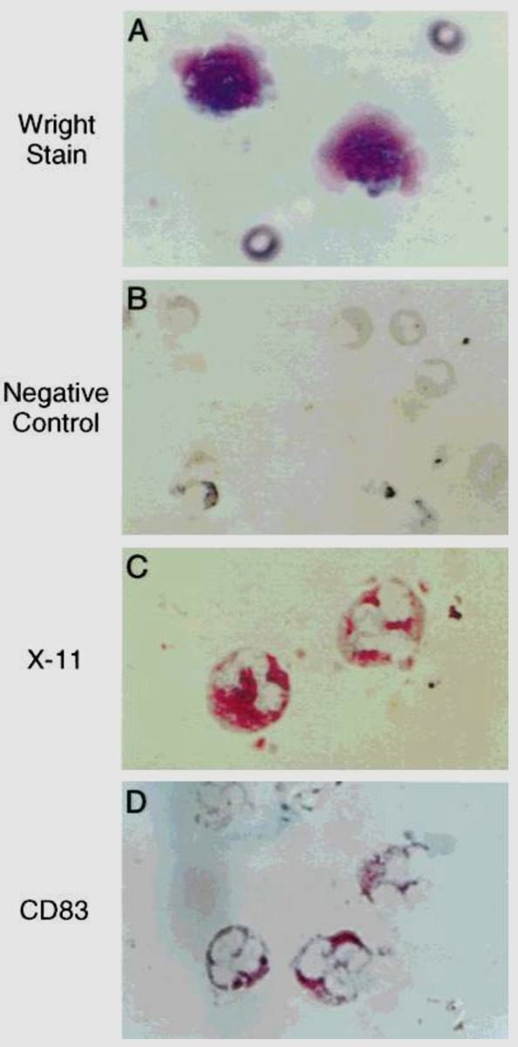
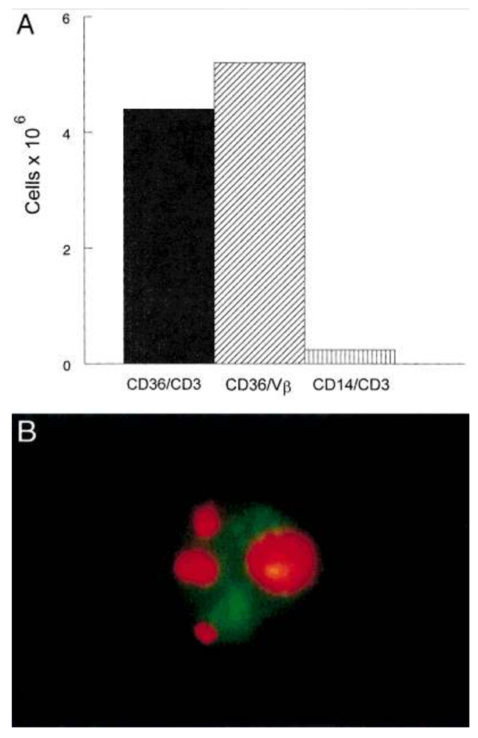
Induction of antigen presenting cells (dendritic cells)
Class II
CD3
Berger et al., Int J Cancer 2001

Slide 16
Platelets enhance conversion of monocytes to dendritic cells
Durazzo et al., Transfus Apher Sci 2014

Slide 17
ECP and immunomodulation
ECP increases Tregs in peripheral blood (?)
Biagi et al., Transplantation 2007

Slide 18
ECP and immunomodulation
ECP increases Tregs in peripheral blood (??)
Rubegni et al., Int J Immunopathol Pharmacol 2007

Slide 19
ECP and immunomodulation
Does ECP enhance pro- or anti-inflammatory cytokines (?)
Gorgun et al., Blood 2002
Yakut et al., J Immunol 2015

Slide 20
How does ECP mediate both anti-tumor and tolerogenic responses?
Hypothesis: immature and mature DCs
Immature DCs may be tolerogenic
Mature DCs may be immunogenic
Not much supporting evidence
Hypothesis: anti-clonotypic response
ECP trains the immune system to remove/control pathologic clones of T cells

Slide 21
T cell clonality is required for response to ECP in cGVHD
French et al., Bone Marrow Transplant. 2002

Slide 22
Hannani D., Front Immunol 2015

Slide 23
Future directions
Clarify mechanism of action required for clinical effects of ECP
Clinical trials to establish efficacy/safety relative to other treatment modalities
Better studies for current indications
Expand to new indications (e.g. prophylaxis prior to transplant)
Improve technique or devise new therapies based on mechanistic insights from studies

