Slide 1
Allergic Transfusion Reactions
and Passive Transfer of Allergy
Margaret Compton, MD
Notes:
1

Slide 2
Importance of Allergic Transfusion Reactions
The most common reaction associated with transfusion of platelets and plasma products
About 2% of platelet transfusions
Second-most common reaction with PRBCs
About 0.1-0.5% of PRBC transfusions
Most common reaction is febrile transfusion reaction
Morbidity for the patient, energy and time of BB staff, product wastage
Transfusion. 2013 June 53(6): 1361-1371

Slide 3
But... to put things in perspective
Estimates for rates of anaphylaxis due to blood products range were reported to be 1:9630 for platelets, 1:28,831 for FFP, and 1:57,869 for RBC transfusions
Contrast media- 1:450
Penicillins- 1:2500 to 1:6000
Muscle Relaxers- 1:13,000
Current Opinion Hematol: 2003 vol:10 iss:6 pg:419-23

Slide 4
Definition of Allergic Transfusion Reaction
CDC National Healthcare Safety Network (NHSN) Manual
Definitive: 2 or more of the following occurring during or within 4 hours of transfusion
Conjunctival edema, Edema of lips, tongue and uvula, Erythema and edema of the periorbital area, Generalized flushing, Hypotension, Localized angioedema, Maculopapular rash, Pruritus, Respiratory distress; bronchospasm, Urticaria
Probable: 1 or more of the following occurring during or within 4 hours of transfusion
Conjunctival edema, Edema of lips, tongue and uvula, Erythema and edema of the periorbital area, Localized angioedema, Maculopapular rash, Pruritus, Urticaria
Notes:
4

Slide 5
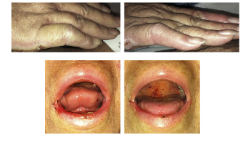
ISBT Grading
Mucocutaneous symptoms only
Grade 1 non-severe
Airway compromise or severe hypotension:
Grade 2 Severe
Grade 3 Life threatening
Grade 4 Death
Mucocutaneous Manifestations (defined by criteria as non-severe, but still causing significant morbidity)
http://www.isbtweb.org/working-parties/haemovigilance/
Transfusion. 2014 Aug;54(8):1916.

Slide 6
Why do Allergic Reactions Occur?
Notes:
6

Slide 7
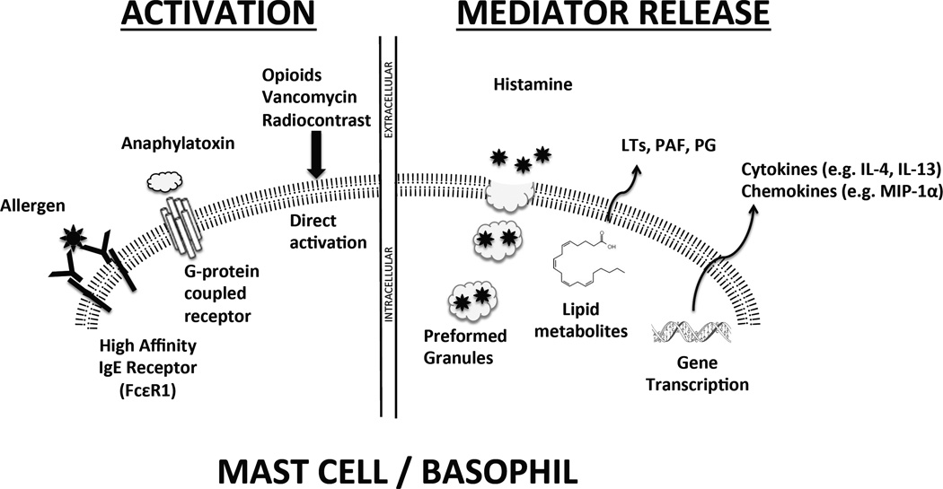
Mechanism
Same clinical manifestations as other types of allergic reactions, so assumed to be Type 1 IgE mediated hypersensitivity
Transfusion 2013 June: 53(6): 1361-1371

Slide 8
Four Proposed Types of Mechanisms
1) IgE mediated reaction against foreign proteins
2) IgE mediated reactions against protein-hapten complexes (e.g. penicillin)
3) Activation of complements and generation of endogenous anaphylotoxins (high titer anti-IgA IgG in IgA deficiency)
4) Direct activation of basophils/mast cells (contrast)

Slide 9
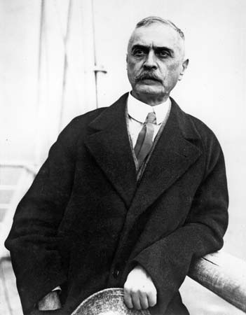
Fin de Siècle Immunology
1890 Emil Behring and Kitasato Shibasaburo discover diphtheria antitoxin
1892 Paul Ehrlich begins to hypothesize the crossing of antibodies via the placenta and breastmilk
Many additional experiments about antibody kinetics
1900 Karl Landsteiner discovers the existence of blood groups
Karl Landsteiner: Brittanica.com
Nature Immunology 2000: 1, 453 - 455

Slide 10
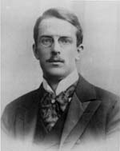
A Brief History of Allergy Research
1903: Von Pirquit and Schick performing work on antitoxin in Vienna
Observed that some children have an immediate reaction when injected with horse serum
Coined the term “Allergy” from the Greek allos (other) + ergon (reaction)
This concept also proposed by Nicolas Arthus in the same year (induced edema and necrotizing skin lesions after repeatedly injecting rabbits with horse serum)
Clemens Von Pirquit (Nature Immunology)
Bela Schick (Library of Congress)
Transfusion 2013 June: 53(6): 1361-1371
Nature Immunology 2000: 1, 453 - 455

Slide 11
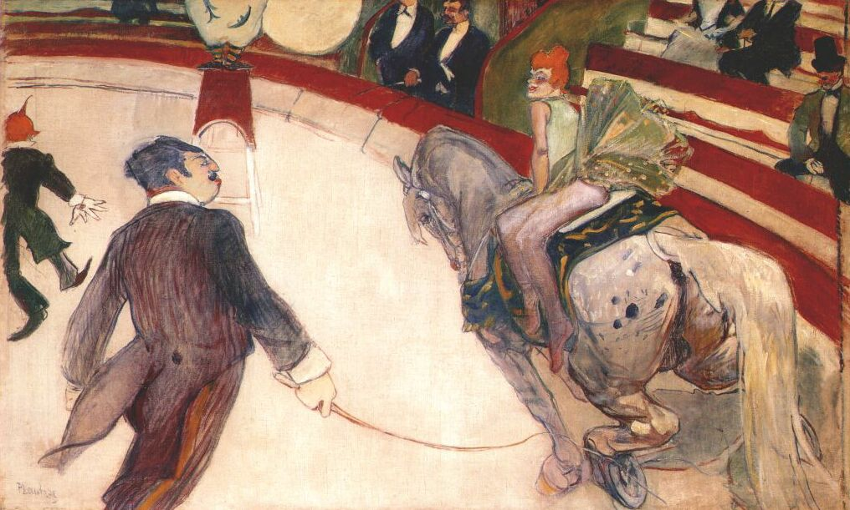
Passive Transfer of Allergy by Transfusion
1919: Maximilian Ramirez publishes an account in JAMA
35 y/o male without history of allergies receives a blood transfusion
2 weeks later, patient goes for a carriage ride in Central Park, develops anaphylaxis requiring epinephrine administration
Both patient and donor are skin tested and found to be allergic to horse dander
He notes “This phenomenon did not occur in another patient to whom this donor had previously given blood, although a larger amount (800 cc) was transfused”
JAMA 1919; 73:854-855

Slide 12
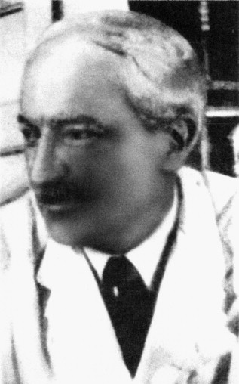
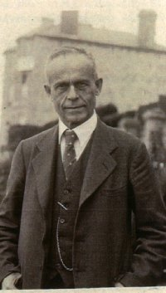
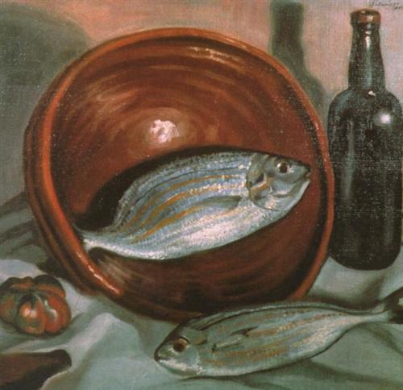
Passive Transfer of Allergy: Further Proof
1921: Prausnitz and Küstner demonstrate passive transfer of allergy (PK test)
Otto Praunitz injects different dilutions of serum from Heinz Küstner (allergic to fish) under the skin of his forearm, then subsequently injects fish extract into these places.
He develops a localized reaction, having acquired Küstner's allergy
J Allergy Clin Immunol. 2004 Sep;114(3):700-4.
Notes:
“An interesting paper by Ramirez had just appeared. A man had developed asthma after contact with horse dander late in life. Ramirez found that this man had just been transfused with the blood of a man suffering from asthma after inhalation of horse dander. That seemed to me to be a most interesting experiment, but I did not wish to become permanently allergic to fish. So I decided to carry out an experiment by injecting intradermally to myself various dilutions of Küstner's serum, and the following day, to inject each of those places, as well as control places in my skin with fish extract.”
12

Slide 13
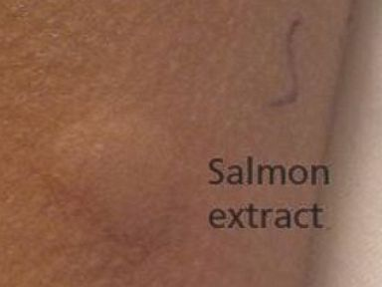
Passive Allergy Transfer
2015: an 8 year old boy undergoing chemotherapy for a brain tumor
Received several transfusions, including platelets
Developed anaphylaxis after eating salmon, then again after eating peanuts
Platelet donor was identified, had several severe food allergies
Allergies in patient resolved after several months
Skin testing of patient (accessed via ABCnews.com)
CMAJ. 2015 Apr 7
ABCnews.com
Notes:
13

Slide 14
Passive Allergy Transfer
15 year old deceased organ donor with history of anaphylaxis to peanuts
Four solid organ recipients (liver, heart, and 2 kidneys)
Recipient of the liver is a 28 year old female with no history of peanut allergy
New onset itching, rash, and hives with peanut ingestion
Skin testing showed sensitivity to peanuts
No anaphylaxis or other allergic symptoms to peanuts in heart and kidney recipients
Liver Transpl. 2001 Dec;7(12):1088-9.
Notes:
14

Slide 15
Multiple Case Reports
Liver
N Engl J Med. 1998 Jan 15;338(3):202-3.
Liver Transpl. 2001 Dec;7(12):1088-9.
Arch Intern Med. 2003 Jan 27;163(2):237-9.
Clin Transplant. 2012 Jul-Aug;26(4):E365-71.
Liver plus other organ(s)
N Engl J Med. 1997 Sep 18;337(12):822-4.
Am J Transplant. 2011 Jul;11(7):1531-4.
Other Organs (Pancreas/Kidney)
Clin Exp Allergy. 2014 Aug;44(8):1020-2.
Lung
BMJ. 2008 Sep 2;337
J Heart Lung Transplant. 2008 Oct;27(10):1162-4.
Can Respir J. 2011 May-Jun;18(3):154-6.
Transplant Proc. 2011 Dec;43(10):4032-5
Bone Marrow
Ann Allergy Asthma Immunol. 1997 May;78(5):513-6.
Cytotherapy. 2013 Oct;15(10):1259-65. (Cord Blood?!)
Bone Marrow Transplant. 2014 Jul;49(7):993-4.
Blood. 2004 Nov 15;104(10):3086-90.
N Engl J Med. 1988 Dec 22;319(25):1623-8.
Notes:
15

Slide 16
Discovery of IgA Deficiency
Anaphylaxis in IgA deficient recipients described in 1968 by Vyas
IgA deficiency most common primary immunodeficiency (ranges from 1 in 600 in Caucasian population to 1 in 18,000 in Japanese)
Absolute IgA deficiency defined as <0.05 mg/dL (far below the limit of detection for most labs)
Small series of patients with relative IgA deficiency (less that the limit of detection, but greater than 0.05) showed severe allergic reactions in 10% (4/39 patients) compared to 0.052% in IgA replete
Vox Sang. 2014 Nov;107(4):389-92
Notes:
16

Slide 17
Anaphylactic Reactions
Reactions involving preformed recipient antibodies against plasma proteins (as in IgA deficiency) tend to be severe
Other proteins with this mechanism include:
Haptoglobin
Complement components
Rates of reactions are higher for platelets than other plasma products
Curr Opin Hematol. 2003 Nov;10(6):419-23
Notes:
17

Slide 18
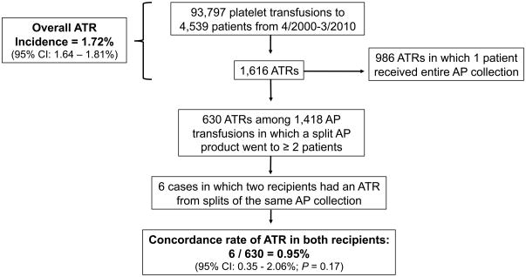
Combination of donor and recipient factors
Transfusion. 2011 Aug;51(8):1716-22.

Slide 19
Recipient Factors
Age: Pediatric population almost 2x more likely to have an ATR than adult population

Slide 20
Recipient Factors
Risk of ATR for primary infusion of pRBCs increases with parity (Nigerian Postgrad Med J. 2002; 9:137-139)
0% (0-1 child), 3.8% (2), 8.3% (3), 21.7% (4), 37.5% (5)
Atopic Predisposition
Food or drug allergy?
Peanuts ingested by blood donors: are the peptides still present?
N Engl J Med. 2011 Sep 1;365(9):867-8

Slide 21
Product Factors
Plasma reduced products have a lower rate of ATR
Platelet additive solution has lower rate of ATRs
Platelet products have higher rates of ATRs than acellular plasma
Rates of allergic reactions lower in patients who received apheresis, rather than pooled platelets
Some sort of storage lesion perhaps?
No association with storage time
Higher rate of ATR among ABO incompatible platelet transfusion?
Transfusion 2013 Jun 53(6):1361-1371
Transfusion. 2011 Jan;51(1):125-8.
Transfusion. 2012 Mar;52(3):635-40.

Slide 22
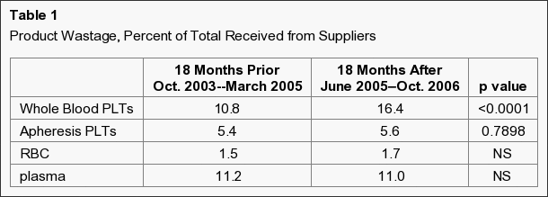
ABO Matching Platelets
Transfusion. 2012 Mar;52(3):635-40.

Slide 23
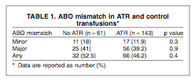
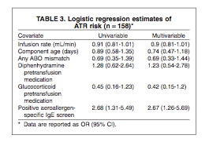
Other Characteristics
Transfusion 2015 Feb;55(2):296-300.

Slide 24
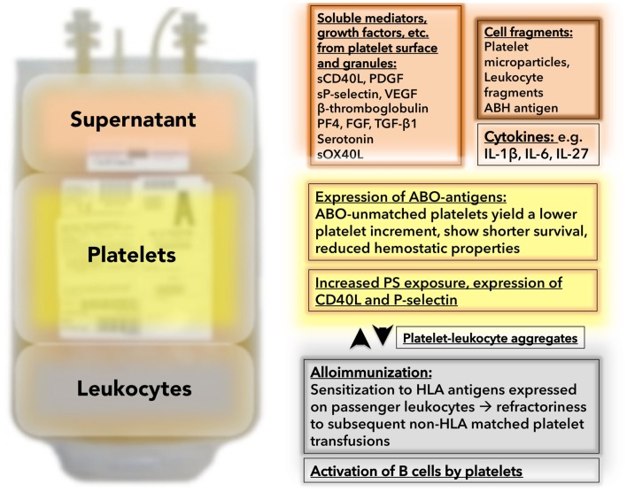
“Unwanted Passengers”
Front Immunol. 2015 Feb 2;6:28.

Slide 25
Allergic Reaction to Food Antigens From Donor
Patient allergic to shrimp
Receives transfusion
Level of shrimp specific IgE in pre-transfusion sample vs. post-transfusion sample from the patient shows post-transfusion elevation
13 year old with multiple food allergies (carrots, celery, hazelnuts, peanuts, and many others)
Allergic reactions to transfusions
Donor had eaten both hazelnuts and carrots the night prior to donating
Transfus Apher Sci. 2014 Feb;50(1):68-70.
Dtsch Med Wochenschr. 2012 Jul;137(28-29):1465-7.
Notes:
25

Slide 26
Presence of Drugs in Blood Products
Netherlands:
- Medication history specifically elicited in plasma donors
- 1000 drugs and drug metabolites tested by HPLC in plasma samples, 14/87 samples contained detectable levels of medications
- At least 8 of the drugs detected have been known to cause anaphylaxis
Presence of Illegal drugs?
Vox Sang. 2015 May;108(4):323-7

Slide 27
Should Blood Donors Be Screened for Allergic Symptoms?
Hypothesis: passive transfer of IgE to common allergens causing allergic transfusion reaction
Eliminate atopic donors at the time of screening so that they do not pass on pre-formed IgE to recipient
24.9% of donor pop. reported allergic symptoms
54.5% of allergic had IgE to common food and aeroallergens
12.3% of “non-allergic” had IgE
Vox Sang. 1995;69(2):114-9.

Slide 28
Should Donors Be Screened for Antigen Exposure?
Donors may have lots of different potential food allergens, pharmaceuticals, etc. that may cause allergic reaction in recipient
Should donors be screened on a questionnaire whether or not they had exposure?
Logistical challenge (which allergens?)
Decrease donor population

Slide 29
Allergic Transfusion Reactions At VUMC
Nov 2013-Sept 2014 (10 months)
244 total reactions, 86 allergic
14% PRBCs, 66.3% Platelets, 19.7% FFP
Notes:
29

Slide 30
Additional Symptoms
52.3% of patients

Slide 31
Prior Allergic Reactions

Slide 32
Additional Transfusions
54.7% (47 patients) required more blood products

Slide 33
Summary
Mechanism for most allergic reactions is unknown.
Complex reaction with many possible factors related to both the blood product (presence of donor IgE, ingestion of allergen by donor, donor medications, component released by platelets?, components of additive solution, etc.) and the recipient (atopic predisposition, pre-formed IgE to particular protein, pre-formed IgG to particular protein)
Not entirely clear how the rate of these reactions can be reduced

Slide 34
Questions?

