Slide 1
Transfusion Transmitted Cytomegalovirus Infection: REVIEW AND IMPLICATIONS
Benjamin K. Chamberlain, MD
30 May 2014

Slide 2
Overview
CMV Infection and Epidemiology
Indications for CMV(-) products
Traditional efforts to mitigate TT-CMV
Seronegative donation
Leukoreduction
Future directions

Slide 3
Human Cytomegalovirus
i.e. human herpes virus 5 (an enveloped DNA virus)
After primary infection, establishes a lifelong latent infection which occasionally reactivates
Both primary infection and reactivation are typically asymptomatic
Seropositivity (i.e. anti-CMV antibodies = past infection)
Seropositivity varies widely from study to study, 45-100%
Notes:
Rev Med Virol. 2010 Jul;20(4):202-13

Slide 4
Risk Factors for Seropositivity
Age
Female Sex
Increased household size/child care
Lower SES
Regional differences/country of origin
Notes:
Clin Infect Dis. 2010;50(11):1439
BMC Infect Dis. 2007;7:71

Slide 5
Modes of Transmission
Contact with individuals shedding the virus, with highly variable modes of transmission
Close contact
Muco-oral contact
Sexual activity
Other body fluids (e.g. urine)
Blood transfusion
Organ transplantation
Vertical transmission in pregnancy (‘C’ in ‘TORCH’) and breast milk
Notes:
Am J Med Sci. 1978;276(3):325
J Infect Dis. 1985;151(2):344.

Slide 6
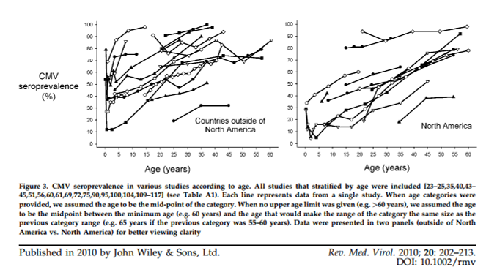
Age

Slide 7
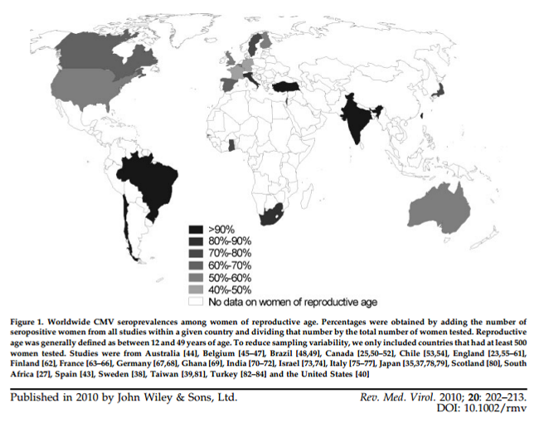
Notes:
Note that many countries had no data available, but the trend is for higher rates in developing nations compared to developed nations.

Slide 8
Types of CMV Disease
Immunocompetent:
CMV Mononucleosis
Immunocompromised:
Organ-specific manifestations of acute CMV infection
Role in allograft loss
CMV retinitis
Congenital CMV

Slide 9
CMV Mononucleosis
Fever/constitutional symptoms/fatigue/ myalgias/rash/loss of appetite/sore throat
Exudative pharyngitis, LAD, and splenomegaly are uncommon
Heterophile Ab(-)
Absolute lymphocytosis, atypical lymphs, cytopenias, cold agglutinins, low haptoglobin levels, RF+, ANA+
Notes:
Via google image search

Slide 10
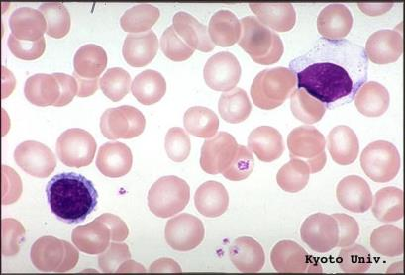
Microscopy
http://pathy.med.nagoya-u.ac.jp/atlas/doc/node10.html

Slide 11
Symptomatic infection in the Immunocompromised
Virtually any organ system can be affected
Common sites:
GI: especially colitis, esophagitis
Hepatitis
Encephalitis/Guillane-Barré syndrome
Retinitis
Pancreatitis
Pneumonitis (50-90% mortality)

Slide 12
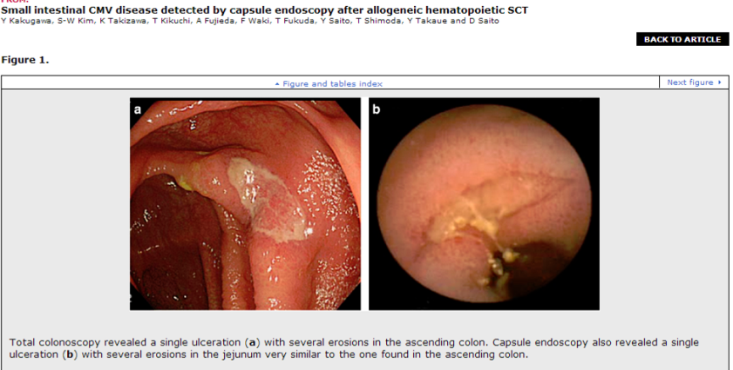
58 year old male with MDS who underwent allo-HSCT successfully; after 7 months developed epigastric pain and watery diarrhea

Slide 13
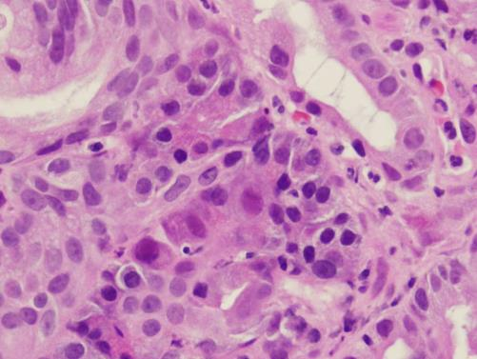
Microscopy
Biopsy of ulcerating “mass” in the duodenum of an elderly male veteran with recent kidney transplant
Notes:
VA Medical Center, Nashville, TN, Dept. of Pathology

Slide 14
Allograft disease
http://www.cmm.ki.se/en/Research/Cardiovascular-and-Metabolic-Diseases/Cell-and-Molecular-Immunology/Cia/Our-research/CMV-infection-in-organ-transplant-patients/

Slide 15
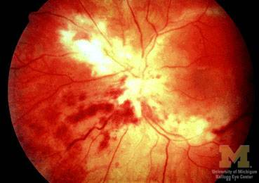
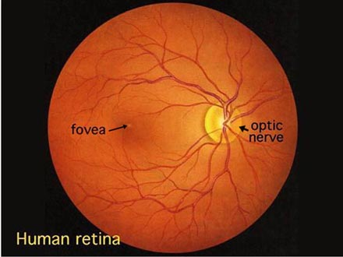
CMV Retinitis
AIDS patient with blurry vision, CD4 count 50-100 cells/ml
http://www.kellogg.umich.edu/theeyeshaveit/congenital/cmv-retinitis.html
Notes:
White fluffy lesions and hemorrhage in CMV retinitis
The first cases of CMV retinitis in AIDS patients were reported in 1982.34 It is now recognised as the most common retinal infection in patients with AIDS (table 1).56 It tends to occur late in the course of the disease, and is associated with peripheral blood absolute CD4+ T-lymphocyte (CD4) counts below 50 cells/μl (box FB2). Kuppermann and associates found that 30% of their patients with CD4 counts of less than 50 cells/μl had CMV retinitis.7 Postgrad Med J1999;75:585-590
You are looking at a mixture of cotton wool spots, infiltrates, and hemorrhages. This combination spells death for the retina. The virus gets into the vascular endothelium, closes off blood vessels, and spreads through tissue like wildfire. The entire retina can be destroyed within weeks.

Slide 16
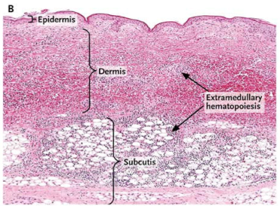
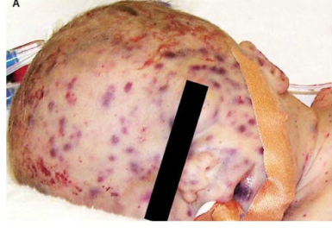
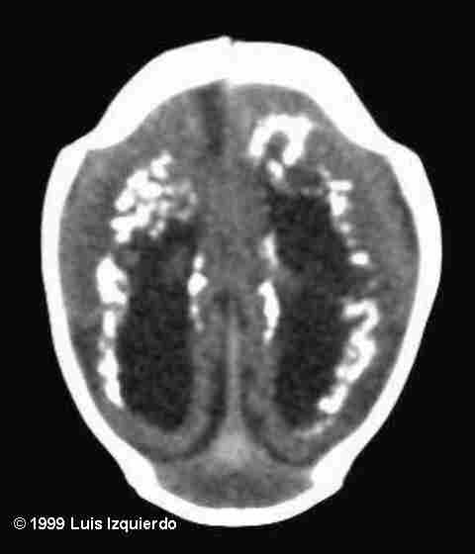
N Engl J Med 2010; 362:833March 4, 2010

Slide 17
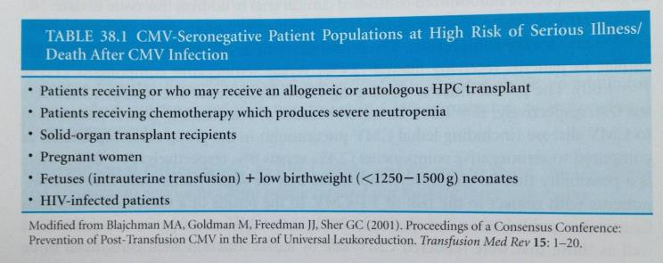
Indications
In immunocompetent populations, this in unnecessary

Slide 18
Misc.
CMV infection may be a reactivation or reinfection
No vaccine available
Treatment includes antivirals (e.g. ganciclovir) halts replication but doesn’t eradicate the virus
Viable white cells harboring the virus must be present in the transfused product for a recipient to potentially acquire CMV

Slide 19
Blood Bank Screening
Essentially limited to donor screening
“Are you feeling healthy and well today?”
Vital signs
May exclude occasional cases of acute infection, but is otherwise not an effective screening tool
No routine serologic or nucleic acid testing for the virus
If requested, seronegative donors can be identified
Similarly, no serologic testing is performed during the prenatal care of pregnant females
Notes:
American College of Obstetricians and Gynecologists: Perinatal viral and parasitic infections. Practice Bulletin No. 20. September 2000.

Slide 20
Risk of Transmission
Estimated 1 in 500 units
By comparison,
1 in 200,000-400,000 for Hep B
1 in 1,800,000 for Hep C
1 in 2,000,000 for HIV
Roback JD, Drew WL, Laycock ME, Todd D, Hillyer CD, Busch MP. (2003) CMV DNA is rarely detected in healthy blood donors using validated PCR assays. Transfusion. 43(3):314-321.

Slide 21
Implications for Blood Banking
By the early 1970s, it was widely recognized that transfusion-transmitted CMV represented a serious problem for immunocompromised patients
Historically, rates of transmission in BMT patients and neonates were reported as high as 13-38% (Rahbar et al.)…today <3%

Slide 22
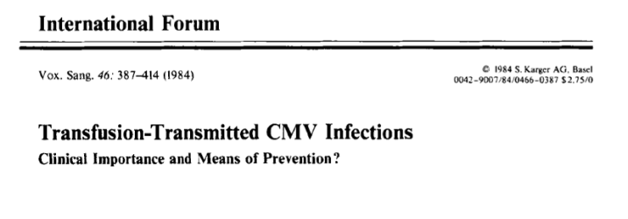
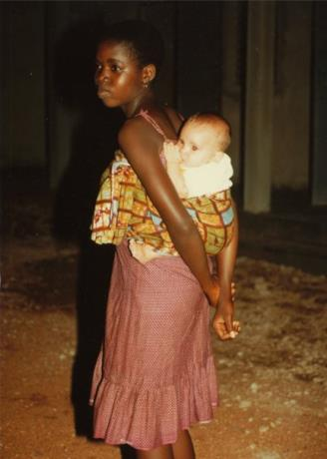
The author of this presentation in Côte d’Ivoire, 1984

Slide 23
Methods
Seronegative Donation
When CMV seronegative units are requested, screening of donor units for seronegative products was initiated, or information drawn from a database
IgM(-)/IgG(-)
Window period of 6-8 weeks
Leukoreduction
Originally bedside leukoreduction
Today, this usually means re-storage leukoreduction, in which leukocytes are removed from blood products by filtration of the donated unit of whole blood, or during apheresis
For RBCs and apheresis platelets, <5 x10⁶ WBCs
“CMV Safe”

Slide 24
Methods
Today, a CMV seronegative unit that has also undergone leukoreduction is called “CMV-seronegative”
However, these methods are not additive in their effects
Patients with CMV viremia may have high viral loads in the plasma not affected by leukoreduction
Patients with active CMV infection may not have detectable antibodies during the “window period” prior to seroconversion

Slide 25
General Benefits of Leukoreduction Were Recognized Long Ago
In addition to decreased TT-CMV
Decreased incidence of febrile non-hemolytic transfusion reactions
Decreased incidence of HLA alloimmunization (particularly important in the transplant population)
“We believe it is advantageous to provide leukocyte-reduced components to reduce such adverse events.”
FDA, Guidance for Industry: Pre-Storage Leukocyte Reduction of Whole Blood and Blood Components Intended for Transfusion, Sept 2012

Slide 26
Bowden et al. (Blood. 1995 Nov 1;86(9):3598-603.)
This famous study found no differences in CMV documented disease between the two methods in days 21-100 after transfusion in the primary analysis, but secondary analysis showed over days 0-100 showed more severe disease in the LR cohort (see table and abstract on following slides)
Nevertheless, the authors conclude that LR is an effective alternative the use of CMV seronegative products

Slide 27
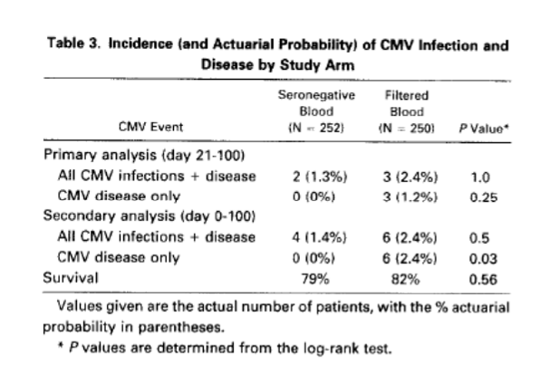

Slide 28
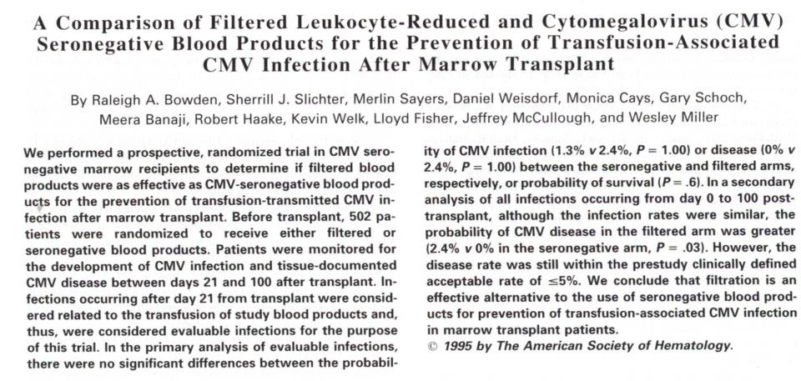

Slide 29
With continued improvement in filtration systems over time, some organizations recognized the cost-effective nature of LR as a stand-alone method of TT-CMV prevention
Canadian consensus guidelines from 1999
“evidence suggests that the use of leukoreduced blood products, prepared with 3rd generation filters, is at least equivalent to the provision of CMV negative units in preventing CMV disease transmission, and may be less expensive than maintaining a CMV negative inventory.”
-Graham Sher, Leukoreduction of the Blood Supply, Canadian Blood Services, May 1999
Notes:
4. British Committee for Standards in Hematology, Blood Transfusion Task Force.
Guidelines on the clinical use of leukocyte-depleted blood components. Transf Med
1998;8:59-71
5. Canadian Coordinating Office for Health Technology Assessment. Leukoreduction:
the techniques used, their effectiveness and costs. CCOHTA Report 1998:6E
6. Freedman JJ, Blajchman MA and McCombie N. Canadian Red Cross Society
Symposium on leukodepletion: report of proceedings. Transf Med Rev
1994;VIII(1):1-14

Slide 30
Survey Says…
In the US, 65% of institutions surveyed report considering the methods equivalent
71% of academic hospital use them interchangeably
Government and community centers more likely to prefer CMV-, particularly in neonates
Smith et al.
Vox Sanguinis
Volume 98, Issue 1, pages 29–36, January 2010

Slide 31
But is there residual risk?
Several relevant studies performed from the last decade…..

Slide 32
Rahbar et al. (Transfusion 2004;44:1059-1066)
Up to 20% of CMV-seronegative donors have detectable levels of CMV-DNA
Routinely utilized laboratory strain AD 169/antigen A2 was compared with alternate clinical strains. Of 30 “seronegative” donors,
1/30 seropositive with C(clinical isolate)1, C5
0/30 seropositive with C2
11/30 seropositive with C6
Some clinical isolates contain at least 19 additional genes

Slide 33
Ziemann et al. (Transfusion 2007;47:1972-1983)
-High levels of viremia in newly seropositive donors
-Window phase donations occurred in 3% of seroconversion cases
-High levels of residual viremia in leukoreduced products may be secondary to free CMV virions

Slide 34
Ziemann et al. (Transfusion 2013:53:2183-2189)
-Marked increase in viral load in newly seropositive donors
-BUT, no culture data to support viability/infectivity
-No patient data to support these findings
-Recommend seropositive >1 year or seronegative units to limit TT-CMV

Slide 35
What about studies with patient data?….

Slide 36
Vamvakas (Transf Med Rev. 2005 Jul;19(3):181-99)
One meta-analysis on the subject
Looked at 829 in 11 studies receving CMV- blood and 878 in 12 studies receiving LR blood
Studies were from 1986 to 2003
Overall risk reduction:
CMV(-) 93.1%
LR 92.3%
Found to be statistically significant
Furthermore, 3 studies compared these methods head-to-head, with a 58% risk reduction with CMV(-) products

Slide 37
Vamvakas (Transf Med Rev. 2005 Jul;19(3):181-99)
No changes in 100 day mortality in these studies
These studies are difficult to interpret given the lack of uniformity in LR methods (beside vs. pre-storage); furthermore, no uniform adherence to <5x10⁶ standard
Commented on Rahbar’s study, suggesting it probably wasn’t relevant clinically
Are the differences noted in this study irrelevant clinically?
It’s difficult to conclude and is a lingering concerns for BMT patients

Slide 38
Wu et al. (Transfusion 2010;50:776-786)
Followed 46 baselines seronegative recipients of 1316 transfusions
3/46 seroconverted
6.5% calculated overall risk of TT-CMV for transfusion recipients
0.23% overall risk of TT-CMV for blood components
2/3 were asymptomatic; none fatal
Cannot exclude community-acquired infection

Slide 39
Thiele et al. (Transfusion 2011;51:2620-6)
Followed a cohort of 23 SCT patients
Received 1847 components from 3180 donors
No identified cases of TT-CMV
17/23 temporarily seroconverted
IgG only
Antibodies diminished with time

Slide 40
Kekre et al. (Biol Blood Marrow Transplant 2013;19:1719-24)
Retrospective study following 89 HSCT patients who prior to 2007 received CMV- blood and 77 HSCT patients who since 2007 received LR blood
3 pt in the former (2/3 symptomatic—both died of concomitant infections) and 1 (0/1 symptomatic) in the latter group infected with CMV
No changes in length of hospital stay, ICU admission rate, 100 day mortality, and acute and chronic GVHD

Slide 41
Nash et al. (Transfusion 2012;52:2270-2272)
University of Michigan review of 100 patients during a shift in policy to LR only as the primary strategy
All patients CMV neg and received a CMV neg SCT
11-15% of components were CMV-
Only 5 patients received CMV- products only
Two cases of IgG seroconversion only
No cases of viral transmission

Slide 42
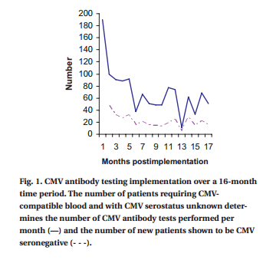
Fontaine et al. (TRANSFUSION, Volume 50, August 2010, 1685-9)
Alternatively, Stanford University, which has long maintained a CMV seronegative inventory, performed a study whereby immunocompromised patients of unknown CMV status were reflexively tested and allocated blood accordingly
They contend that this is a cost-effective measure for an institution of their size and requirements for CMV seronegative products.

Slide 43
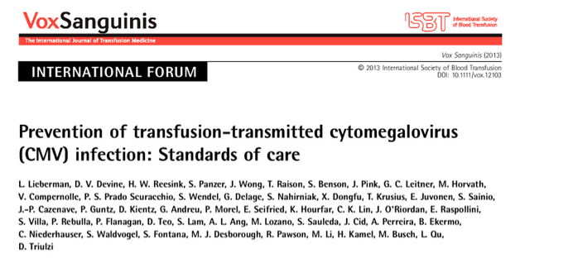
Recently, a follow-up forum survey was done

Slide 44
General Conclusions from the Survey
Leukoreduction as a means of reducing CMV risk is widespread
No recent studies suggest that this practice needs modification
Modern pre-storage leukoreduction filters are superior to previous models, producing a 4-log reduction (i.e. removing 99.99% of all WBC’s), and are likely to continue to improve with time
There are additional benefits to LR, as described above
LR is very cheap

Slide 45
General Conclusions contd.
Pre-storage leukoreduction with current filters is most likely equivalent to CMV seronegative products
There is a small but intractable risk of TT-CMV, approximately 1.5-3% risk per SCT recipient—regardless of the primary strategy of prevention
This difference is of unclear, if any, clinical significance
A modern, randomized control trial would be ideal, but is probably impractical and would require huge numbers of patients to effectively discern which method of prevention is better

Slide 46
General Conclusions contd.
Most institutions surveyed still offer seronegative products. Those which
In addition, a 2011 review of practices in the Netherlands and the literature concluded that leukoreduction was safe option (Bilgin et al.)
There are two notable exceptions: the Finnish Red Cross Blood Service and the University of Michigan Health System no longer provide seronegative units and only provide LR units.
They argue that maintaining an CMV(-) inventory is expensive, laborious and not cost-effective compared to universal LR as the primary strategy

Slide 47
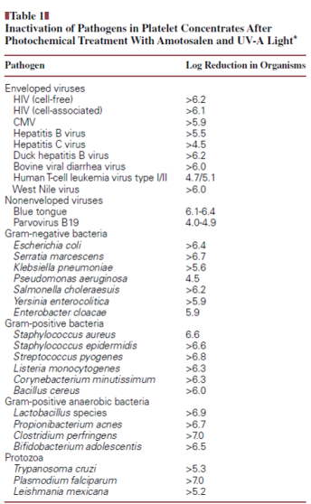
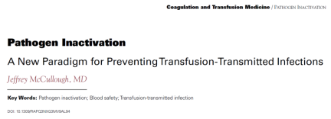
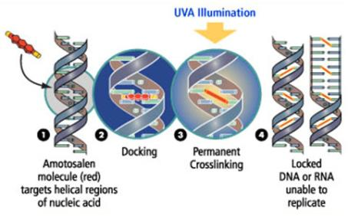
With effective pathogen reduction, most centers surveyed agree that CMV serology could be abandoned entirely.
http://www.mavietonsang.ch/scientifiques/node/25

Slide 48
Summary
CMV can cause severe and fatal disease in the immunocompromised (particularly SCT patients who may be dependent upon transfusion)
In the general population it is usually an asymptomatic infection and so doesn’t require monitoring
There is a small but intractable risk of TT-CMV, approximately 1.5-3% risk per SCT recipient—regardless of the primary strategy of prevention
Seronegative donors may transmit virus during the window period
Recipients may benefit from passive transmission of anti-CMV antibodies from seropositive donors and donors >1 yr after seroconversion may actually be the safest donors, but this has not been further studied or implemented

Slide 49
Summary
Most agree that both LR and the use of CMV-seronegative products are probably equivalent in terms of risk reduction. However, many institutions are reluctant to abandon serologic testing outright
In large centers, maintaining a seronegative inventory may be cost-effective, but this is probably not practical for many smaller institutions
Even if there is a slightly increased risk of CMV transmission in LR products, this is unlikely to result in clinical differences with current transplant medical practices
Clinical monitoring of CMV viremia and prophylactic treatment with ganciclovir likely makes the differences in these methods clinically insignificant
No clear mortality cases in recent studies

Slide 50
References
Cannon et al. Review of cytomegalovirus seroprevalence and demographic characteristics associated with infection. Rev. Med. Virol. 2010; 20: 202–213.
Kakugawa et al. Small intestinal CMV disease detected by capsule endoscopy after allogeneic hematopoietic SCT. Bone Marrow Transplantation (2008) 42, 283–284.
http://www.cmm.ki.se/en/Research/Cardiovascular-and-Metabolic-Diseases/Cell-and-Molecular-Immunology/Cia/Our-research/CMV-infection-in-organ-transplant-patients/
http://www.kellogg.umich.edu/theeyeshaveit/congenital/cmv-retinitis.html
Mohamed El-Amin Abdel-Latif, M.D et al. Congenital Cytomegalovirus Infection. N Engl J Med 2010; 362:833March 4, 2010
Hillyer (Ed.) et al. Transfusion Medicine and Hemostasis: Clinical and Laboratory Aspects. Elsevier Science; 1 edition (June 22, 2009)
American College of Obstetricians and Gynecologists: Perinatal viral and parasitic infections. Practice Bulletin No. 20. September 2000.
Roback JD, Drew WL, Laycock ME, Todd D, Hillyer CD, Busch MP. (2003) CMV DNA is rarely detected in healthy blood donors using validated PCR assays. Transfusion. 43(3):314-321.
Rahbar et al. (Transfusion 2004;44:1059-1066)
Adler et al. Transfusion-Transmitted CMV Infections Clinical Importance and Means of Prevention? Vox Sanguinis, Volume 46, Issue 6, pages 387–414, June 1984
FDA, Guidance for Industry: Pre-Storage Leukocyte Reduction of Whole Blood and Blood Components Intended for Transfusion, Sept 2012
Graham Sher, Leukoreduction of the Blood Supply, Canadian Blood Services, May 1999
Ziemann et al. (Transfusion 2007;47:1972-1983)
Ziemann et al. (Transfusion 2013:53:2183-2189)
Vamvakas (Transf Med Rev. 2005 Jul;19(3):181-99)
Wu et al. (Transfusion 2010;50:776-786)
Thiele et al. (Transfusion 2011;51:2620-6)
Kekre et al. (Biol Blood Marrow Transplant 2013;19:1719-24)
Bilgin et al. Neth J Med. 2011 Oct;69(10):441-50.
Nash et al. (Transfusion 2012;52:2270-2272)
Fontaine et al. (TRANSFUSION, Volume 50, August 2010, 1685-9)
Lieberman et al. Prevention of transfusion-transmitted cytomegalovirus (CMV) infection: Standards of care. International Society of Blood Transfusion. Vox Sanguinis (2013)
www.mavietonsang.ch/scientifiques/node/25
McCullough J. Pathogen inactivation: a new paradigm for preventing transfusion-transmitted infections. Am J Clin Path 2007; 128:945-955.
Chamberlain, Benjamin K. et al. Alveolar soft part sarcoma and granular cell tumor: an immunohistochemical comparison study. Human Pathology , Volume 45 , Issue 5 , 1039 – 1044. (a completely irrelevant and shameless plug for the author)

Slide 51
Notes:
“In the Blue Canadian Rockies”

