Slide 1
SICKLE CELL DISEASE AND NEUTROPHIL TRAPS
Ashley Jones-Ragle, MD
12/10/2014

Slide 3
SICKLE CELL DISEASE

Slide 4
e.a.
24 year old kurdish female presents to vumc ed with severe back pain and left leg pain complicated by severe tachycardia (170s).
Past Medical history: sickle cell anemia (sickle-beta thalessemia)
Medications: hydroxyurea

Slide 5
Clinical symptoms
symptoms
Vaso-occlusive crises
Bone pain
Abdominal pain
dactylitis
Acute chest syndrome
cvas
Triggers
Infection
Hypoxia
dehydration

Slide 6
Clinical signs
Labs
Elevated wbc count (17.2, absolute neutrophil count-15.3)
hemolytic anemia w/ reticulocytosis (hgB-7.6)
Hyperbilirubinemia
Peripheral smear
Sickle cells
Reticulocytes
Target cells
Howell jolly bodies

Slide 7
TREATMENT
Oxygenation
Pain control
fluids

Slide 8
What is the pathogenesis of sickle cell disease?

Slide 9
SICKLE CELL DISEASE (scd)
An autosomal recessive hemoglobinopathy seen commonly in people of mediterranean and African descent
It is caused by a point mutation in the sixth codon replacing glutamic acid with valine
Approx. 300k children are born with sickle cell disease each year with the majority occurring in sub-Saharan Africa
Prevalance of sickle cell disease and trait is increased in Africa because of protection it provides against malaria
In the us, There is approx. 1 in 500 blacks and 1 in 36000 Hispanic children born with sickle cell disease each year

Slide 10
PATHOGENESIS
hBs MOLECULES UNDERGO POLYMERIZATION WITH DEOXYGENATION
With continued deoxygenation, hbs aggegates form into long spindle shape fibers which gives a sickled appearance to the red cells
Sickling can lead to major consequences including hemolysis and microvascular occlusions

Slide 11
hemolysis
Membrane derangement leads to an influx of ca2+ which leads to crosslinking and efflux of K+ and h2o.
Red cells become increasingly dehydrated, dense, and rigid.
The severely damaged cells become irreversibly sickled
These cells are rapidly sequestered and leads to removal by macrophages

Slide 12
Microvascular occlusions
Not well understood
Believed to be associated with inflammation that slows and/or arrests red cell circulation through microvascular beds
Sickle cells express an increased number of adhesion molecules and inflammatory cells release mediators which cause endothelial cells to express more adhesion molecules
These “sticky” adhesions leads to cellular arrest which is thought to cause occlusion
so how exactly does inflammation play a role in vaso-occlusion?

Slide 13
What are NEUTROPHIL EXTRACELLULAR TRAPS and what role do they play in sickle cell disease?

Slide 14
Neutrophil activation
Neutrophils are a first line of defense that protect the body from invading pathogens by
Engulfment
Secretion of anti-microbials
Net formation

Slide 15
Neutrophil extracellular trap (net) formation
UPON ACTIVATION, NEUTROPHILS RELEASE GRANULES AND CHROMATIN THAT FORM NETS
NETS ARE network of extracellular fibers which TRAP AND disarm pathogens with antimicrobials including neutrophil elastase, MYELOPEROXIDASE and histones (innate immunity)
Nets are able to kill microbes independent of phagocytic uptake
Believed to play an integral role in infectious, inflammatory and thrombotic processes

Slide 16
NETS

Slide 17
Heme-induced neutrophil extracellular traps contribute to the pathogenesis of sickle cell disease Grace Chen, Dachuan Zhang, Tobias A. Fuchs, Deepa Manwani, Denisa D. Wagner, Paul S. Frenette BloodJun 2014,123(24)3818-3827;DOI: 10.1182/blood-2013-10-529982
A study that proposed that neutrophil activation is a major component in recurrent episodes of vaso-occlusion in sickle cell disease
Used human blood samples and mouse models with sickle disease at steady state and crisis state and compared to non-sickle disease samples to determine whether hemolysis and proinflammatory cytokines played a role in vaso-occlusion in sickle cell disease

Slide 18
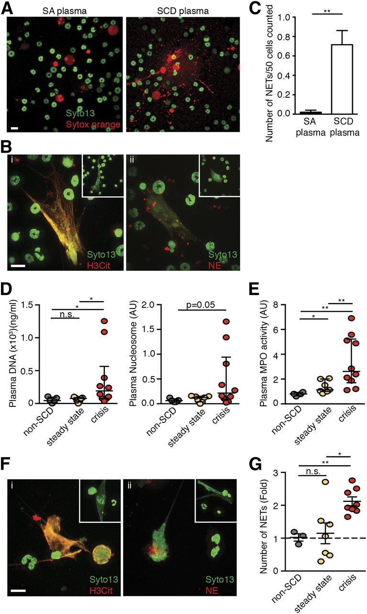
Plasma from TNF-α–stimulated SCD mice and crisis SCD patients induce NET formation in TNF-α–primed neutrophils.
Chen G et al. Blood 2014;123:3818-3827
©2014 by American Society of Hematology
Notes:
Plasma from TNF-α–stimulated SCD mice and crisis SCD patients induce NET formation in TNF-α–primed neutrophils. (A) Representative immunofluorescence images of NETs released by TNF-α–primed wild-type BM neutrophils. DNA was stained with SYTO13 (cell-permeable nuclear acid dye, green) and Sytox orange (cell-impermeable nuclear acid dye, red). Primed wild-type neutrophils were stimulated with plasma of either TNF-α–treated SA mice (left) or TNF-α–treated SCD mice (right). Scale bar, 10 μm. (B) Representative immunofluorescence images of DNA (green/SYTO13), H3Cit (red/Alexa Fluor 568, i), or NE (red/Alexa Fluor 568, ii) of NETs generated by TNF-α–primed wild-type neutrophils that were stimulated with plasma of TNF-α–treated SCD mice. Insets show NETs stained with DNA dye (green/SYTO13) and isotype control antibodies for H3Cit and NE. Scale bar, 10 μm. (C) Quantification of NETs released by TNF-α–primed wild-type BM neutrophils stimulated with plasma of TNF-α–treated SA mice (black bar) and TNF-α–treated SCD mice (white bar). Results are average values from 4 independent experiments (mean ± SEM, **P < .01). (D) Quantification of NET biomarkers, plasma DNA (left), and nucleosome (right) of non-SCD individuals (gray circle, n = 5), steady-state SCD patients (yellow circle, n = 7), and crisis SCD patients (red circle, n = 10; Mann-Whitney test, median [IQR], *P < .05). (E) Quantification of plasma MPO activity of non-SCD individuals (gray circle, n = 4), steady-state SCD patients (yellow circle, n = 7), and crisis SCD patients (red circle, n = 10; Mann-Whitney test, median [IQR], *P < .05, **P < .01). (F) Representative immunofluorescence images of DNA (green/SYTO13), H3Cit (red/Alexa Fluor 568, i), or NE (red/Alexa Fluor 568, ii) of NETs generated by TNF-α–primed human neutrophils that were stimulated with plasma of crisis SCD patient. Insets show NETs stained with DNA dye (green/SYTO13) and isotype control antibodies for H3Cit and NE. Scale bar, 10 μm. (G) Quantification of NETs released by TNF-α–primed human neutrophils stimulated with plasma of non-SCD individuals (gray circle, n = 3), steady-state SCD patients (yellow circle, n = 7), and crisis SCD patients (red circle, n = 8; mean ± SEM, *P < .05, **P < .01).

Slide 19
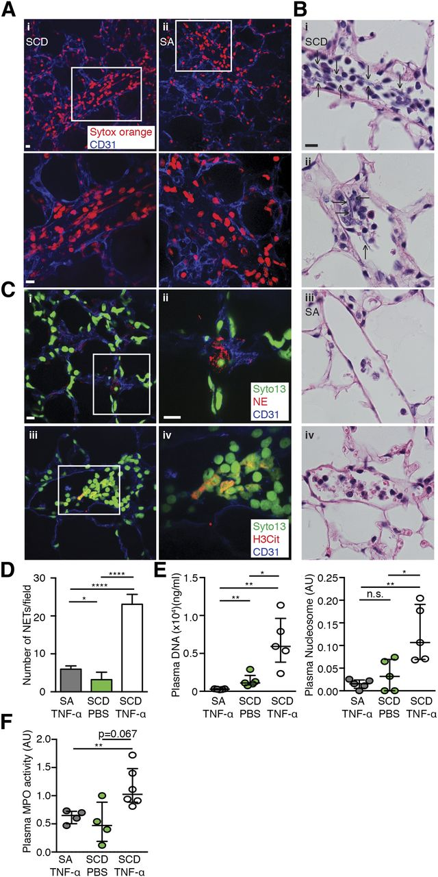
NETs are present within pulmonary vessels of TNF-α–stimulated SCD mice.
Chen G et al. Blood 2014;123:3818-3827
©2014 by American Society of Hematology
Notes:
NETs are present within pulmonary vessels of TNF-α–stimulated SCD mice. (A) Representative images of NETs (DNA/red/Sytox orange) detected in the lungs of TNF-α–stimulated SCD mice (i) and the lack of NETs in TNF-α–stimulated SA mice (ii). CD31 (blue/Alexa Fluor 647) labeled the endothelial cells. Scale bar, 10 μm. For imaging, different areas along the dissection were scanned down to an approximate 70 to 80 μm depth using an Axio Examiner.D1 microscope (Zeiss) equipped with a Yokogawa CSU-X1 confocal scan head with a 4-stack laser system (405-nm, 488-nm, 561-nm, and 642-nm wavelengths). Images were obtained using a 20× water immersion objective and as 3-dimensional stacks using Slidebook software (Intelligent Imaging Innovations). (B) Representative histological images of NETs in the lungs of TNF-α–stimulated SCD mice (i,ii, arrows indicate NETs) and the lack of NETs in TNF-α–stimulated SA mice (iii,iv). Scale bar, 10 μm. Images were captured using a Zeiss Axio Observer Z1 microscope equipped with a Zeiss Axiocam HRc camera (color) and a 63× oil immersion objective. (C) Representative immunofluorescence images of the lung sections of TNF-α–stimulated SCD mice showing colocalization of extracellular DNA (green/SYTO 13) and NE (red/Alexa Fluor 568, i,ii) or H3Cit (red/Alexa Fluor 568, iii,iv). CD31 (blue/Alexa Fluor 647) labeled the endothelial cells. Scale bar, 10 μm. Images were captured using an Axio Examiner.D1 microscope equipped with a Yokogawa CSU-X1 confocal scan head with a 4-stack laser system (405-nm, 488-nm, 561-nm, and 642-nm wavelengths) and a 20× water immersion objective. Images were obtained using Slidebook software. (D) Quantification of NETs in the lungs of TNF-α–stimulated SA mice (gray bar, n = 3), SCD mice (white bar, n = 3), and PBS-treated SCD mice (green bar, n = 3). Results presented are the average values (mean ± SEM) of independent experiments with sex- and age-matched mice. *P < .05, ****P < .0001. (E) Quantification of NET biomarkers, plasma DNA (left), and plasma nucleosome (right) of TNF-α–treated SA mice (gray circle, n = 5), SCD mice (white circle, n = 5), and PBS-treated SCD mice (green circle, n = 5; Mann-Whitney test, median [IQR], *P < .05, **P < .01). (F) Quantification of plasma MPO activity of TNF-α–treated SA mice (gray circle, n = 4), SCD mice (white circle, n = 6), and PBS-treated SCD mice (green circle, n = 4; Mann-Whitney test, median [IQR], **P < .01).

Slide 20
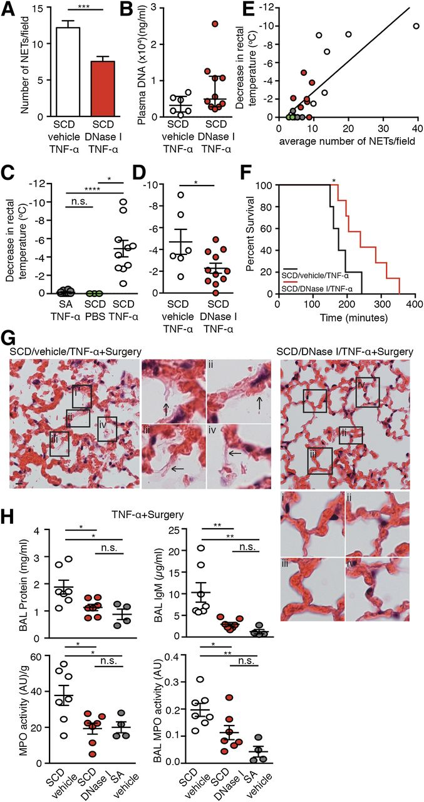
DNase I treatment significantly reduces NETs in TNF-α–stimulated SCD mice, protects SCD mice from NET-associated hypothermia, and prolongs their survival by reducing acute lung injury.
Chen G et al. Blood 2014;123:3818-3827
©2014 by American Society of Hematology
Notes:
DNase I treatment significantly reduces NETs in TNF-α–stimulated SCD mice, protects SCD mice from NET-associated hypothermia, and prolongs their survival by reducing acute lung injury. (A) Quantification of NETs in the lungs of TNF-α–stimulated SCD mice pretreated with vehicle (white bar, n = 3) or DNase I (red bar, n = 7). Results presented are the average values of independent experiments with sex- and age-matched mice (mean ± SEM, ***P < .001). (B) Quantification of NET biomarker, plasma DNA, of TNF-α–stimulated SCD mice pretreated with vehicle (white circle, n = 6) or pretreated with DNase I (red circle, n = 10) (Mann-Whitney test, median [IQR]). (C) Reduction in rectal temperature of TNF-α–stimulated SA mice (gray circle, n = 10), PBS-treated SCD mice (green circle, n = 3), and TNF-α–stimulated SCD mice (white circle, n = 10; mean ± SEM, *P < .05, ****P < .0001). (D) Reduction in rectal temperature of TNF-α–stimulated SCD mice, pretreated with vehicle (white circle, n = 6) or DNase I (red circle, n = 11; mean ± SEM, *P < .05). (E) Relationship between decrease in body temperature and number of NETs presented in the lungs of SA and SCD mice (r = 0.79, P < .0001, different color circles represent different treatments as stated in Figure 2C-D). (F) Kaplan-Meier survival curves after TNF-α treatment and surgical trauma in vehicle-treated (black line, n = 5) and DNase I–treated (red line, n = 7) groups (log-rank test, *P < .05). (G) Representative histology of lungs from vehicle-infused (arrows indicate the fibrillar appearance of alveolar walls) and DNase I–infused SCD mice after TNF-α administration and surgical procedure. Scale bar, 10 μm. Images were captured using Zeiss Axio Observer Z1 microscope equipped with Zeiss Axiocam HRc camera (color) and a 40× oil immersion objective. (H) (Top) Total protein (left) and IgM concentration (right) in BAL fluid of vehicle- (white circle, n = 7) and DNase I–treated (red circle, n = 7) SCD mice and vehicle-treated SA mice (gray circle, n = 4) after TNF-α administration and surgical procedure (mean ± SEM, *P < .05, **P < .01). (Bottom) MPO activity per gram of tissue in lung homogenates (left) and in cell-free BAL fluid (right) of vehicle- (white circle, n = 7) and DNase I–treated (red circle, n = 7) SCD mice and vehicle-treated SA mice (gray circle, n = 4) after TNF-α administration and surgical procedure (mean ± SEM, * P < .05, **P < .01).

Slide 21
Article summary (human studies)
With TNF-alpha treated neutrophils, DNA concentration, nucleosome content, and MPO activity levels were significantly higher in crisis plasma than in non-sickle and steady state plasma
These elevated levels suggest increased neutrophil activity and a potentiator of increased net formation in crisis patients

Slide 22
Article summary (mice studies)
ELEVATED PLASMA HEME IN SCD MICE CAN INDUCE NET FORMATION (via ros formation) IN THE PRESENCE OF TNF-alpha
The formation of nets in the lungs of scd mice is associated with hypothermia which can rapidly lead to death
Nets can be cleared and thus drastically decreased by dnase I leading to less severe symptoms
Nets may serve as a therapeutic target for treating sickle cell disease and other pathological states involving severe hemolysis

Slide 23
Nucleosomes and neutrophil activation in sickle cell disease painful crisis Marein Schimmel, Erfan Nur, Bart J. Biemond, Gerard J. van Mierlo, Shabnam Solati, Dees P. Brandjes, Hans-Martin Otten, John-John Schnog, Sacha Zeerleder HaematologicaNov 2013,98(11)1797-1803;DOI: 10.3324/haematol.2013.088021
This is a prospective cohort study that was conducted to determine neutrophil extracellular trap formation in sickle cell patient in steady state and painful crisis
Activated neutrophils form net which extrude dna and binding proteins exposing nucleosomes, histones, and neutrophil proteases such as elastase
The study compared 74 sickle cell patients in steady state, 70 sickle cell patients in pain crises, and 24 healthy race matched controls and the plasma levels of nucleosomes and elastase antitrypsin complexes were used as a measure of net formation; 1 patient was admitted with acute chest syndrome (Acs) and 5 other patients developed acs w/in 48-60 hours of admission

Slide 24
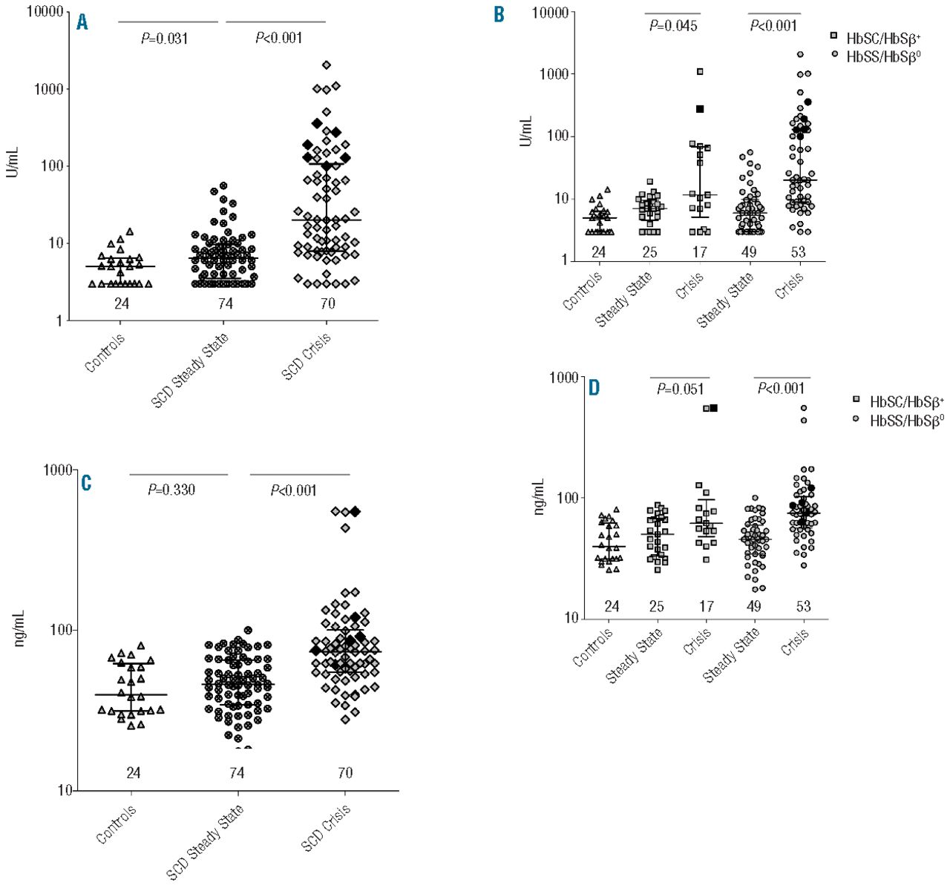
Levels of nucleosomes (A and B) and elastase-α1-antitrypsin complexes (C and D) in healthy controls and in sickle cell patients in steady state and during painful crisis.
Schimmel M et al. Haematologica 2013;98:1797-1803
©2013 by Ferrata Storti Foundation
Notes:
Levels of nucleosomes (A and B) and elastase-α1-antitrypsin complexes (C and D) in healthy controls and in sickle cell patients in steady state and during painful crisis. Results are shown for all patients (A and C) and for the subgroups containing HbSS/HbSβ⁰-thalassemia and HbSC/HbSβ⁺-thalassemia patients (B and D). The number of patients in each group is indicated above the x-axis. Patients who developed an acute chest syndrome during admission were among those with the highest nucleosome and EA levels. The corresponding levels are indicated in black. Results are indicated as median with interquartile range. Comparison of the groups was performed by means of Mann Whitney rank sum test. P<0.05 was considered statistically significant.

Slide 25
Article summary
Patients with Painful vaso-occlusive crises were found to have higher levels of circulating nucleosomes and neutrophil activation (EA complexes)
The highest levels were seen in patients with severe complications such as acute chest syndrome
The levels seen in acs were comparable to patients with severe sepsis

Slide 26
conclusion
Vasocclusion is a Complex multistep process that involves multiple factors including:
Heme from hemolyzed sickle cells
Endothelial cells
Leukocytes
Cytokines, chemokines, reactive oxygen species (ROS), etc.

Slide 27
Inflammatory Mediators of Endothelial Injury in Sickle Cell Disease
Carolyn C. Hoppe MD
Inflammatory Mediators of Endothelial Injury in Sickle Cell Disease, 2014-04-01Z, Volume 28, Issue 2, Pages 265-286, Copyright © 2014 Elsevier Inc

Slide 28
conclusion
these factors lead to net formation which can exacerbate vaso-occlusion and lead to severe complications such as acs and cvas.
These findings make nets a possible therapeutic target in the management of sickle cell disease

Slide 29
additional areas of research
Regulation and resolution of net formation
Net over/ underproduction
Net formation and autoimmune disease

