Slide 1
Pregnancy Induced
Autoimmune Hemolytic Anemia
An interesting phenomenon of rare numbers.
Meghan E. Kapp, MD MS
30 June 2014

Slide 2
Hemolytic Anemia
Red Blood Cells are destroyed and removed from the bloodstream before their normal lifespan is over
Incidence 4 cases per 1000

Slide 3
Sickle Cell Anemia
Thalassemias
Hereditary Spherocytosis
Inherited
Hereditary Elliptocytosis
G6PD deficiency
Pyruvate Kinase Deficiency
Hemolytic Anemia
Autoimmune
Immune
Alloimmune
Acquired
Drug Induced
Mechanical
Paroxysmal Nocturnal Hemoglobinuria
Other

Slide 4
Autoimmune Hemolytic Anemia
Increased destruction of erythrocytes due to anti-erythrocyte autoantibodies
Incidence is estimated 1-3 cases per 100,000

Slide 5
Pregnancy induced AIHA
A positive DAT is rarely seen in pregnancy
  1:50,000
  1/3 of these women have anemia
  May occur in the first or in the third trimester of pregnancy
  Newborns of mothers with AIHA may have a positive DAT, but do not have hemolytic anemia

Slide 6
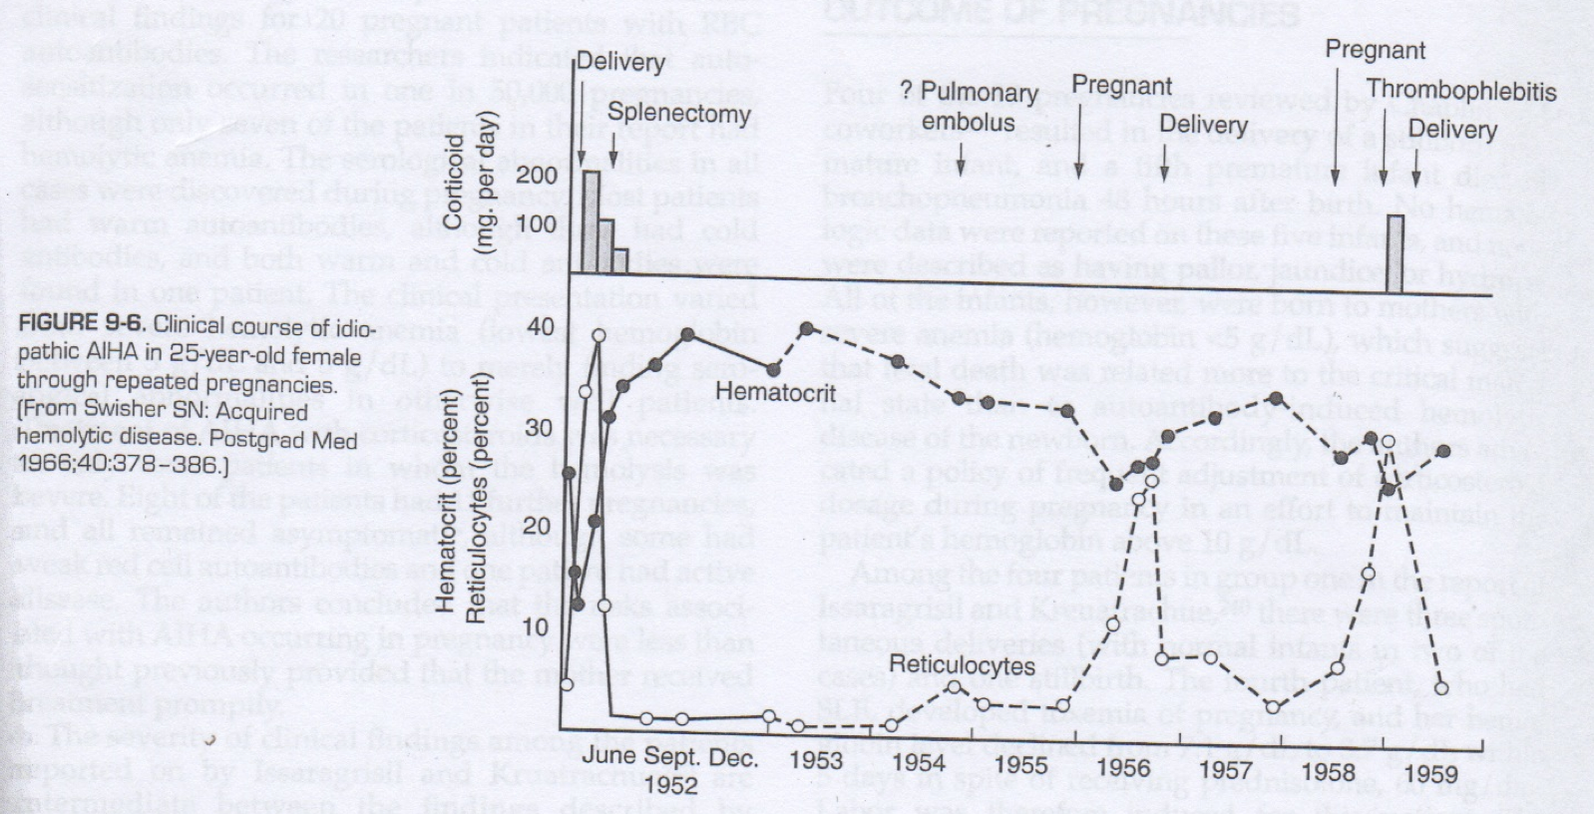
Clinical Course

Slide 7
Hugh Jr Chaplin, Robert Cohen, Gordon Bloomberg, Harold J. Kaplan, Joy A. Moore and Irene Dorner
Pregnancy and Idiopathic Autoimmune Haemolytic Anaemia: A Prospective Study during 6 Months Gestation and 3 Months Post-Partum
British Journal of Haematology
Volume 24, Issue 2, pages 219–229, February 1973

Slide 8
Chaplin et al.
A 31-yr-old woman with a 12 yr history of relapsing idiopathic autoimmune hemolytic anemia was studied prospectively during her first pregnancy.
Her serum contained a warm incomplete autoantibody as well as an elevated cold agglutinin; her red blood cells were strongly coated with IgG and complement (chiefly α2D).
Hemolysis was active throughout pregnancy, accelerating from the 34th to 40th week, with developing thrombocytopenia.
Amniocentesis in the 8th and 9th months suggested minimal fetal hemolysis.
The maternal hemolytic process went into complete clinical remission following delivery of a healthy appearing infant whose red cells were coated with IgG.
  The infant developed mild hyperbilirubinaemia within 48 hr
  Fall in hemoglobin to 50% of the cord level by the 8th week.
  Abnormalities of maternal and infant C4 levels were observed.

Slide 9
Chaplin et al.
Review of 19 reported instances of presumed autoimmune hemolysis during pregnancy
All had unequivocal evidence of acquired hemolysis
  Evidence of autoimmune etiology incomplete
    Maternal DAT
      +7
      -5
        4 treated with corticosteroids and improved
      NT7

Slide 10
Chaplin et al.
Life-threatening anemia in nearly 50% of mothers
  Hb <5 g/dL: 9 patients
  Hb 5-8 g/dL: 8 patients
  Leukopenia: 4 patients
  Thrombocytopenia: 3 patients
Vigorous transfusion therapy, high dose steroids +/- labor induction were employed as life-saving measures for critically ill patients
Hemolysis worsened as pregnancy progressed in 18/19 patients
Complete or partial remission occurred in 16 patients within 3 months postpartum
  2 subsequently diagnosed with SLE

Slide 11
Chaplin et al.
Pregnancy Outcomes
  4 still-births,
  1 neonatal death (bronchopneumonia at 48 hours)
    No hematologic data
    Born to mothers with severe anemia (Hb <5g/dL)
  3 seriously affected infants

Slide 12
Chaplin et al.
AIHA in pregnancy
  50% of mothers
  40% of infants

Slide 13
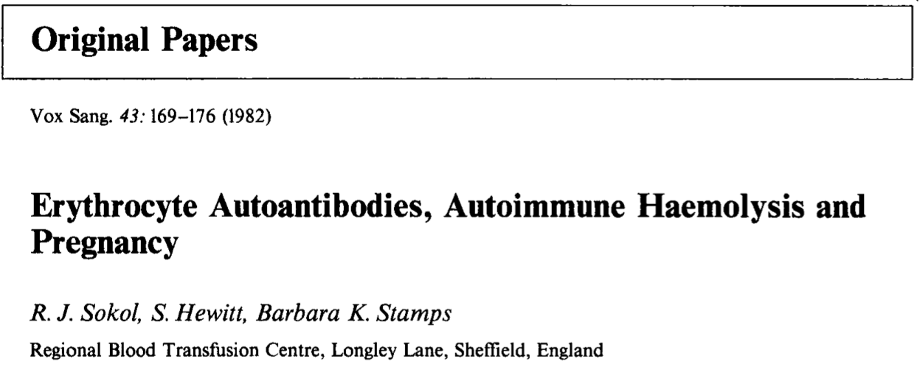

Slide 14
Sokol et al.
Clinical and serological records
  20 patients aged 19-34 years
  Erythrocyte autoantibodies found during pregnancy or immediate postnatal period
  May 1956 – April 1982

Slide 15
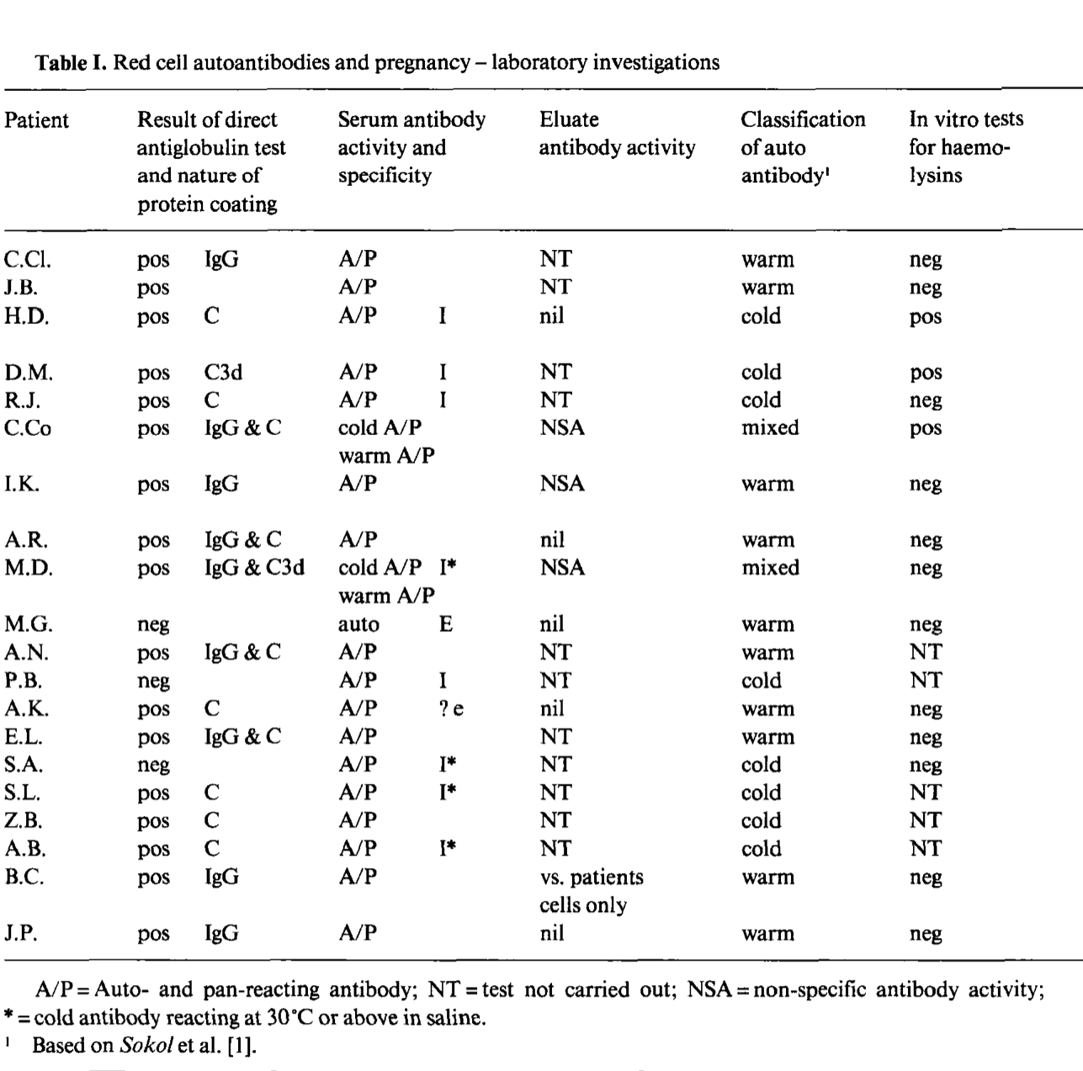

Slide 16
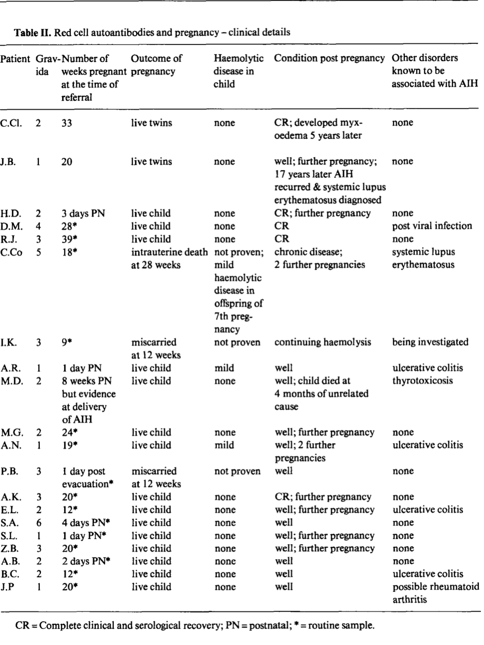

Slide 17
Sokol et al. Conclusions
Clinical presentation varied from severe hemolytic anemia to merely serological abnormalities
  Lowest Hb 5-8 g/dL
Treatment with corticosteroids was necessary in 3 patients
8 had 11 future pregnancies and all remained asymptomatic
  Weak red cell autoantibodies
  1 active disease

Slide 18
Sokol et al. Conclusions
Autoantibodies to RBCs during pregnancy was suggested to occur in 1 of 50,000 pregnancies on average
Four times as often as in nonpregnant females in the same age range
Unlikely that the association of AIHA with pregnancy is a mere coincidence

Slide 19
Surapol Issaragrisil and Mongkol Kruatrachue
An Association of Pregnancy and Autoimmune Haemolytic Anaemia
Scandinavian Journal of Haematology
Volume 31, Issue 1, pages 63–68, July 1983

Slide 20
Issaragrisil and Kruatrachue
14 cases
2 groups
  One
    4 patients diagnosed during pregnancy
      2 at term
      2 during 7th month
  Two
    10 patients who became pregnant during the remission period of previously diagnosed AIHA

Slide 21
Issaragrisil and Kruatrachue
2 groups
  One: 4 patients diagnosed during third trimester
    3 spontaneous deliveries
      2 normal infants
      1 stillbirth
    4th with SLE developed toxemia
      Labor induced with low-birth-weight infant
      Both mom and infant survived

Slide 22
Issaragrisil and Kruatrachue
2 groups
  Two: 10 pregnancies during the remission of AIHA
    6 developed Hb <6.7 g/dL
      3 spontaneous abortions
      2 therapeutic abortions due to lack of response to prednisolone therapy
      1 spontaneous delivery
        Following termination of pregnancies, mothers’ Hb levels responded to glucocorticoid therapy

Slide 23
Issaragrisil and Kruatrachue
2 groups
  Two: 10 pregnancies during the remission of AIHA
    5 continued to third trimester
      2 responded well to prednisolone
      1 did not require corticosteroids
        3 spontaneous deliveries with normal infants
      1 C-section due to severe preeclampsia and fetal distress
        Both survived
      1 SLE and nephrotic syndrome
        Spontaneous abortion
        Acute renal failure
        death

Slide 24
Issaragrisil and Kruatrachue
Corticosteroids generally started only after significant anemia occurred
Patients with hemolytic anemia were not treated if Hb >9.0 g/dL
More favorable outcomes may have occurred if treatment implemented earlier

Slide 25
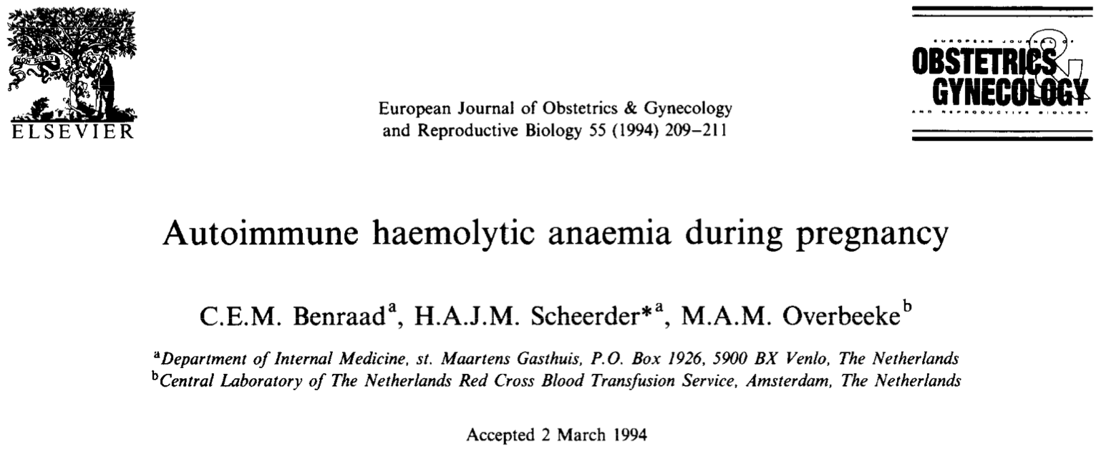

Slide 26
Benraad et al
31 year old female presented with severe AIHA with her first pregnancy
IgG and warm–acting IgM
  Treated with corticosteroids
  Second pregnancy treated similarly
  Two healthy children were born

Slide 27
Benraad et al.
IgG warm autoimmune antibodies generally tend to be involved in the idiopathic form of AIH
IgM warm or cold autoimmune antibodies are also found regularly
Both can cause severe hemolysis
Treatment with prednisone will prove effective
Hemolysis generally disappears spontaneously after pregnancy has ended
Relevant hemolysis is rarely seen in the newborn
AIH clinically relevant prior to precnancy or secondary to an associated disease is generally more severe
Pregnancy more often ends in spontaneous abortion or miscarriage

Slide 28
Hemolytic Anemia of Pregnancy with a Negative DAT and Frequent Recurrences

Slide 29
Kumar et al.
21 year old primigravida female present with severe hemolytic anemia detected near full term, resolved spontaneously 11 weeks after delivery
  Recurred at 32 weeks EGA
  Recurred at 30 weeks EGA
    Resolution 11-12 weeks postpartum

Slide 30
Kumar et al.
Direct (DAT) and indirect (IAT) antiglobulin tests with polyclonal and monoclonal antisera and search for cold reactive autoantibody were negative.
Congenital hemolytic anemias were negative
No red cell membrane defects identified
Corticosteroids and high dose IVIG were ineffective
  Treated with blood transfusion

Slide 32
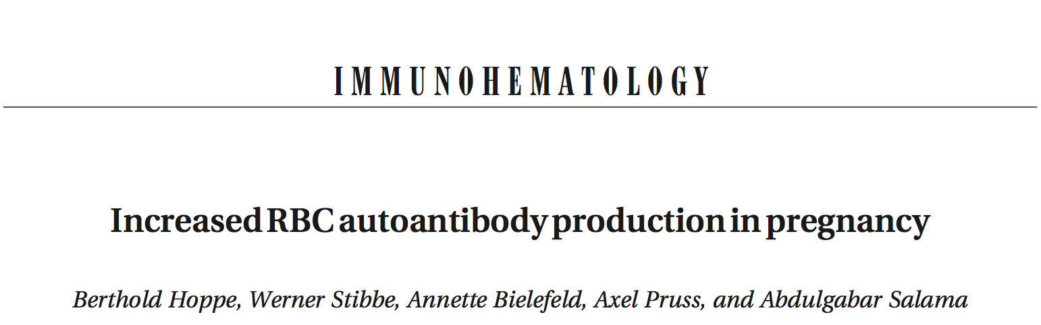
Transfusion(2001);41:1559-1561

Slide 33
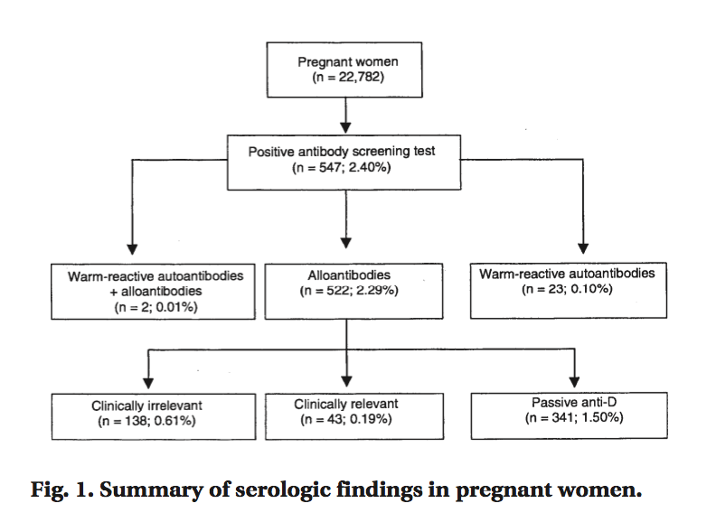
Hoppe et al.
22,782 pregnant women
547 with positive antibody screening tests
25 with autoantibodies

Slide 34
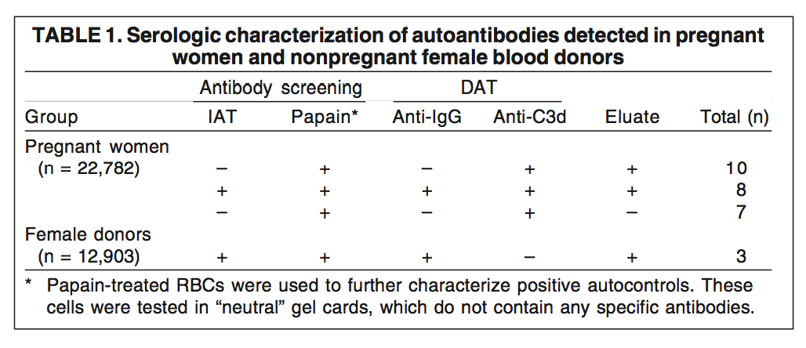
25 with autoantibodies
All with autoantibodies had an IgG+ +/- C3d+ DAT
18 cases had eluates that reacted with all RBCs tested in the IAT
true autoantibodies
NOT nonimmune adsorption of IgG
7 only detectable when enzyme-treated RBCs used
resemble incomplete warm hemolysins

Slide 35
Hoppe et al.
Occurrence of RBC autoantibodies in 25/22,782 pregnancies
  1 in 900 cases
  5x as frequent as in the control group (3/12,903)
Pregnancy-induced autoantibodies are largely incapable of causing significant RBC destruction
Autoantibodies in AIHA frequently lead to the aggravation of hemolysis during pregnancy

Slide 36
Pathogenesis
Idiopathic AIHA of pregnancy
Unexplained hemolytic anemia associated with pregnancy
Pregnancy-induced hemolytic anemia

Slide 37
Pathogenesis
Placental driven event
  Immunological
  Hormonal
  Microchemical

Slide 38
CD47
Integrin-associated protein ubiquitously expressed cell surface glycoprotein
First identified in placenta and in neutrophil granulocytes
Erythrocytes do not express integrins, but have high levels of CD47
  Suggesting integrin-independent functions for CD47
Can function as ligand for inhibitory macrophage receptor Signal Regulatory Protein alpha
  Interaction prevents phagocytosis of circulating cells by splenic macrophages
  Erythrocytes from CD47 deficient mice were rapidly cleared from circulation
Placenta is paternal

Slide 39
Alpha-methyldopa-induced AIHA

Slide 40
Alpha-methyldopa
Aldomet, Aldoril, Dopament, Dopegyt
Alpha-adrenergic agonist
  Selective for alpha2-adrenergic receptors
  Used as a sympatholytic or antihypertensive
Safe for use during pregnancy
  Used to treat gestational hypertension

Slide 41
Alpha-methyldopa
Adverse side effects
  Psychological
    Depression +/- suicidal ideation, as well as nightmares
    Apathy +/- anhedonia, dysphoria
    Anxiety, esp social anxiety
    Decreased awareness, alertness, wakefulness
    Fatigue and lethargy
    Sexual dysfunction

Slide 42
Alpha-methyldopa
Adverse side effects
  Physiological
    Dizziness, lightheadedness, vertigo
    Miosis/pupil constriction
    Xerostomia/dry mouth
    GI disturbance including diarrhea +/- constipation
    Headache or migraine
    Myalgia, arthralgia, paresthesia
    Restless leg syndrome
    Parkinsonian symptoms
    Ataxia
    Bradycardia
    Orthostatic hypotension
    Pancreatitis
    Skin rashes
    Bone marrow suppression
    Hemolytic anemia

Slide 43
Alpha-methyldopa-induced AIHA
Production of antibodies in ~15% of patients receiving the drug for longer than 4 months
  Autoantibodies targeted against red blood cells
    Rh system>>>Jka and U
0.5-1% developing hemolytic anemia
True autoimmune and drug-independent antibody
  Antibody is in vitro reactive, even in the absence of the drug
  IgG-mediated
  Extravascular hemolysis
  Slow onset – 1 to 3 months after starting medication
  Years until a negative DAT is achieved

Slide 44
Alpha-methyldopa-induced AIHA
Treatment for hemolytic anemia
  Stop medication
  Corticosteroids
  Rarely blood transfusions
  Reintroduction of medication is contraindicated

Slide 45
Alpha-methyldopa-induced AIHA
Treatment for positive DAT without hemolysis
  No treatment is required
  Usually acceptable to continue therapy
  Positive IAT will interfere with crossmatching and may obscure clinically relevant alloantibodies

Slide 46
Alpha-methyldopa-induced AIHA
Symptoms
  Mild fatigue
  Dyspnea
  Respiratory failure
  Death
    Hb 5g/dL

Slide 47
Alpha-methyldopa-induced AIHA
Lab findings similar to WAIHA
  Positive DAT
  Positive indirect antiglobulin test
  Positive elutions

Slide 48
Summary

Slide 49
Features of Idiopathic Pregnancy-Induced Hemolytic Anemia
No identifiable mechanism
Anemia becomes apparent in the third trimester
Anemia remits completely within 2 months of delivery
Anemia generally recurs in subsequent pregnancies
Anemia is usually severe, even life threatening
Corticosteroids and IVIg are sometimes helpful
Erythrocyte transfusions are the mainstay of treatment for severe anemia
Donor cells have shortened survival
Neonates generally have transient nonsevere hemolysis

Slide 50
References
Benraad CEM, Scheerder HAJM, Overbeeke MAM. Autoimmune haemolytic anaemia during pregnancy. Eur J of Obstetrics and Gynecolgoy (1994)55:209-211.
Chaplin H, Cohen R, Bloomberg G, et al. Pregnancy and idiopathic autoimmune haemolytic anaemia: a prospective study during 6 months gestation and 3 months post-partum. Br J Haematol (1973)24(2):219-229.
Grigoriadis D, Tympa A, Liapis A, et al. Alpha-Methyldopa-Induced Autoimmune Hemolytic Anemia in the Third Trimester of Pregnancy. Case Reports in Obstetrics and Gynecology(2013):1-2
Hoppe B, Stibbe W, Bielefeld A, et al. Increased RBC autoantibody production in pregnancy. Transfusion (2001);41:1559-1561.
Kumar R, Advani AR, Sharan J, et al. Pregnancy induced hemolytic anemia: an unexplained entity. Ann Hematol (2001)80:623-626.
Murphy WG and Kelton JG. Methyldopa-induced autoantibodies against red blood cells. Blood Reviews (1988)2:36-42.
Ong M, Hawthorne L. Autoimmune Hemolytic Anemia in Pregnancy. LabMedicine (2010)42(5):264-266.
Semple JW and Freedman J. Autoimmune Pathogenesis and Autoimmune Hemolytic Anemia. Seminars in Hematology (2005)42:122-130.
Sokol RJ, Hewitt S, Stamps B. Erythrocytes Autoantibodies, Autoimmune Hemolysis and Pregnancy. Vox Sang (1982)43:169-176.
Valent P and Lechner K. Diagnosis and treatment of autoimmune haemolytic anaemias in adults: a clinical review. Wien Klin Wochesnschr (2008)120/5-6:136-151.

