Slide 1
Interesting Case Conference
8-8-14

Slide 2
Case #1
60 y/o male with history of diabetes mellitus, atrial fibrillation, hypertension, and ischemic cardiomyopathy, s/p LVAD placement 10/2013.
No history of IV drug use, no known tatoos, no known risk factors for viral hepatitis.
At the time of LVAD placement, the patient was a possible candidate for heart transplant and a full infectious disease work-up was performed, including:

Slide 3
Case #1
10/9/13:
HBV Surface Antigen negative
HBV Total Core Ab negative
HBV Surface Antibody negative
9/30/13:
HAV IgM negative
HAV IgG positive
HBV Total Core Ab negative
HBV Core IgM negative
HCV Ab Negative

Slide 4
Case #1
The patient had multiple admissions between October 2013 and July 2014, mostly related to GI bleeding and/or congestive heart failure exacerbations.
He received a total of 29 blood product transfusions during that time.
The patient’s condition gradually deteriorated and he was ultimately placed on comfort care. He died in the hospital on July 17, 2014.
An autopsy was not performed.
He was a tissue donor through Tennessee Donor Services.

Slide 5
Case #1
Tissue testing through TDS was positive for Hepatitis B and Hepatitis C, so his tissue was not used for donation.
Test results 7/18/14
HBV Total Core Ab positive
HCV Ab positive
The patient’s wife and his cardiologist both called the blood bank questioning whether the patient might have been infected with Hepatitis B and C through blood transfusion.
The wife’s initial testing for HBV/HCV is reportedly negative.

Slide 6
Possibilities
Patient did not truly have infection.
1. False positive results on post-mortem tissue donor screening.
2. Incorrect patient tested at post-mortem donor testing site.
Patient did truly have infection.
3. Patient was infected after 10/2013 through blood transfusion or another undetermined source.
4. Patient was infected prior to 10/2013 and had false negative screening tests at that time.

Slide 7
Patient did not truly have infection.

Slide 8
1. False positive results on post-mortem donor screening
Screening tests for both HBV and HCV have a high false positive rate and require confirmatory testing with more specific methods (NAT) before a diagnosis can be made.
HCV EIA or CIA
Among immunocompetent populations with HCV prevalence <10%, false positive/total positive averages 35% (range 15-60%).
Among immunocompromised populations (dialysis), false positive/total positive is approximately 15%.
HBV Total Core Ab
Among healthy blood donors who test positive on HBV total core ab test, 37% false positives.
Kesli R. Evaluation of assay methods and false positive results in the laboratory diagnosis of hepatitis C virus infection. Archives of Clinical Microbiology. 2011;2(4):1-4.
Katz L, et al. Performance of an algorithm for the reentry of volunteer blood donors deferred due to false—positive test results for antibody to hepatitis B core antigen. Transfusion. 2008 Nov;48(11):2315-22.

Slide 9
1. False positive results on post-mortem donor screening
What if he received the HBV vaccine while he was in the hospital before he died…could that cause a false positive test (at least for the hepatitis B)?
HBV vaccine can cause a false positive HBV Surface Antigen test for up to 14 days after vaccination.
But, he didn’t receive an HBV vaccine.
And even if he did, the post-mortem testing only looked at HBV Core Ab, not surface antigen.
Rysgaard CD, et al. Positive hepatitis B surface antigen tests due to recent vaccination: a persistent problem. BMC Clin Pathol 2012 24;12:15.

Slide 10
2. Incorrect patient tested at post-mortem donor testing site
No way for us to prove this, since we don’t have access to their lab/records/retained samples (if any).
If this is the explanation, then the only harm to our patient and his family is that his tissue was unnecessarily destroyed instead of being used for someone else in need.
BUT WHAT ABOUT THE RECIPROCAL PATIENT INVOLVED IN THE SWITCH—DID THAT DONOR HAVE FALSELY NEGATIVE ORGANS OR TISSUE THAT WAS TRANSPLANTED INTO SOMEONE ELSE??

Slide 11
Patient did truly have infection.

Slide 12
3. Patient was infected after 10/2013 through blood transfusion or other undetermined source
ARC is performing a look back for all 29 products.
If infection occurred through blood transfusion, this would mean that there were false negative results for ALL FOUR required blood donor screening tests:
HBV Surface Ag and HBV Core Ab
Estimated risk of HBV transmission despite negative results for both tests, (most likely due to donation during window period): 1/280,000 to 1/357,000 units.
Actual reported cases of HBV infection through blood transfusion have been much lower than estimated risk; possibly related to increasing percentage of population immune to HBV through vaccination (or underreporting of cases?).
HCV Ab and HCV NAT
Estimated risk of HCV transmission by transfusion is 1 in 1,149,000 units.
Zou S, et al. Current incidence and residual risk of hepatitis B infection among blood donors in the United States. Transfusion. 2009;48(8):1609-1620.
AABB Technical Manual, 17th Ed.

Slide 13
3. Patient was infected after 10/2013 through blood transfusion or other undetermined source
That would mean that he was acutely infected and nobody noticed, despite multiple admissions?
If he was acutely infected with viral hepatitis during this time frame, what did his LFTs look like?

Slide 14
In acute viral hepatitis, ALT can be elevated up to 20 x ULN; AST up to 10x ULN, peak occurs an average of 120 days after initial infection and may remain elevated for up to 6 months from the time of initial infection.
In HBV/HCV coinfection, a biphasic peak in ALT may be seen with average peak of 326 between days 58-102. After a period of resolution, a higher peak is then seen at 10-12 months after infection.
In acute viral hepatitis, the AST/ALT ratio is usually less than 1. The AST/ALT ratio is usually greater than 1 in alcoholic hepatitis, cirrhosis, and heart or muscle injury.
Mimms LT et al. Effect of concurrent acute infection with hepatitis C virus on acute hepatitis B virus infection. BMJ. 1993;307(6912):1095-1097.

Slide 15
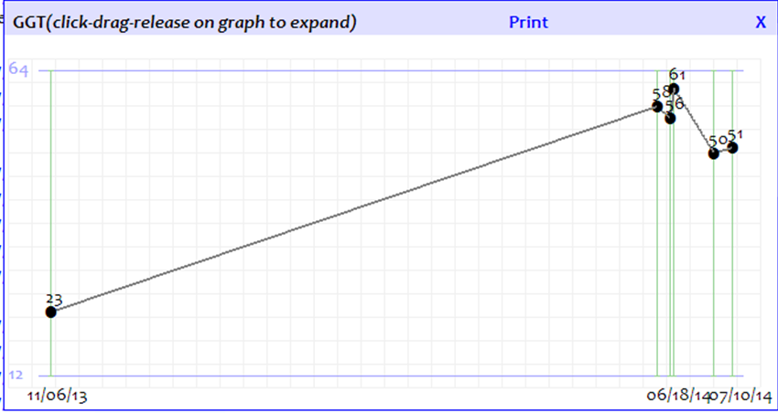

Slide 16
3. Patient was infected after 10/2013 through blood transfusion or other undetermined source
Multiple LFTs between 10/2013 and 7/2014 do not support acute viral hepatitis infection during this time frame.
Acute viral hepatitis is usually more severe in patients > 60.
HBV and HCV have incubation periods from 2 to 23 weeks from time of exposure; maybe he was acutely infected by one of the more recent units transfused, so we didn’t have time to see changes in his LFTs?
The post-mortem screening tests used:
HBV total core – may be seen as early as 3 months after initial infection.
HCV antibody – may be seen by 1.5 to 2 months after initial infection.
These tests could potentially be positive, though, in the setting of acute infection when blood donor antibodies against HBV/HCV are still circulating in the recipient.

Slide 17
4. Patient was infected prior to 10/2013
His LFTs would be more consistent with chronic hepatitis than with acute hepatitis…but this would mean that the screening tests at VUH in September and October were falsely negative:
HBV Surface Antigen, HBV Total Core Ab (x2), HBV Surface Antibody, HBV Core IgM—most false negatives attributed to “window period”
False negatives may also occur in up to 33% of chronic HCV patients with occult HBV infection. Liver function tests are usually higher in these patients.
HCV Ab—most false negatives attributed to “window period”; one study of blood donors with ALT>100 found no false negatives compared to NAT (benefit of NAT screening is to shorten window period).
FYI, he also had all these same tests drawn in 2012 and all were negative at that time as well.
Cacciola I, et al. Occult hepatitis B virus infection in patients with crhonic hepatitis C liver disease. NEJM. 1999;341(1):22-6.
Prince, AM et al. A search for hepatitis C virus polymerase chain reaction-positive but seronegative subjects among blood donors with elevated alanine aminotransferase. Transfusion. 1997;37(2):211-4.

Slide 18
Summary
Patient did not truly have infection.
False positive results on post-mortem donor screening.
Estimated 2-12% chance of having 2 false negative test results, depending on prevalence.
Incorrect patient tested at post-mortem donor testing site.
??? uknown likelihood, but most terrifying option!
Patient did truly have infection.
Patient was infected after 10/2013 through blood transfusion or another undetermined source.
Estimated significantly <1% chance of being infected with HBV and HCV through transfusion of 29 units (even though HBV and HCV may coexist in up to 33% of cases).
LFTs during that time not consistent with acute viral hepatitis infection, although very recently transfused units might have contained blood donor antibodies against HBV/HCV that could have caused a positive test before any elevation in LFTs was clinically detected.
Patient was infected prior to 10/2013 and had false negative screening tests at VUMC.
False negatives are unlikely, but may occur particularly in cases of occult HBV (although LFTs are usually higher) or in immunosuppressed patients. Significantly less likely given that he had multiple rounds of negative tests.

