Slide 1
Interesting case conference
6-16-15

Slide 2
Case #1
40 y/o female with APL and secondary AML, s/p PBSCT on 4/23/15
Day +5, WBC < 0.1 x 10^3/mcL, hemoglobin 9.1 g/dL, platelet count 7 x 10^3/mcL
Platelet transfusion ordered, pretreated with Tyelenol 650mg oral and 12.5mg IV Benadryl
Developed chills, rigors, and hypertension after 226 mL of platelets over 1 hour and 18 minutes.
Treated with dilaudid and hydrocortisone

Slide 3
Vitals
11:41 | 122 | 20 | 100/58 | 37.1 |  | 98.8
23:42 | 105 | 20 | 105/65 | 38.1 |  | 100.5

Slide 4
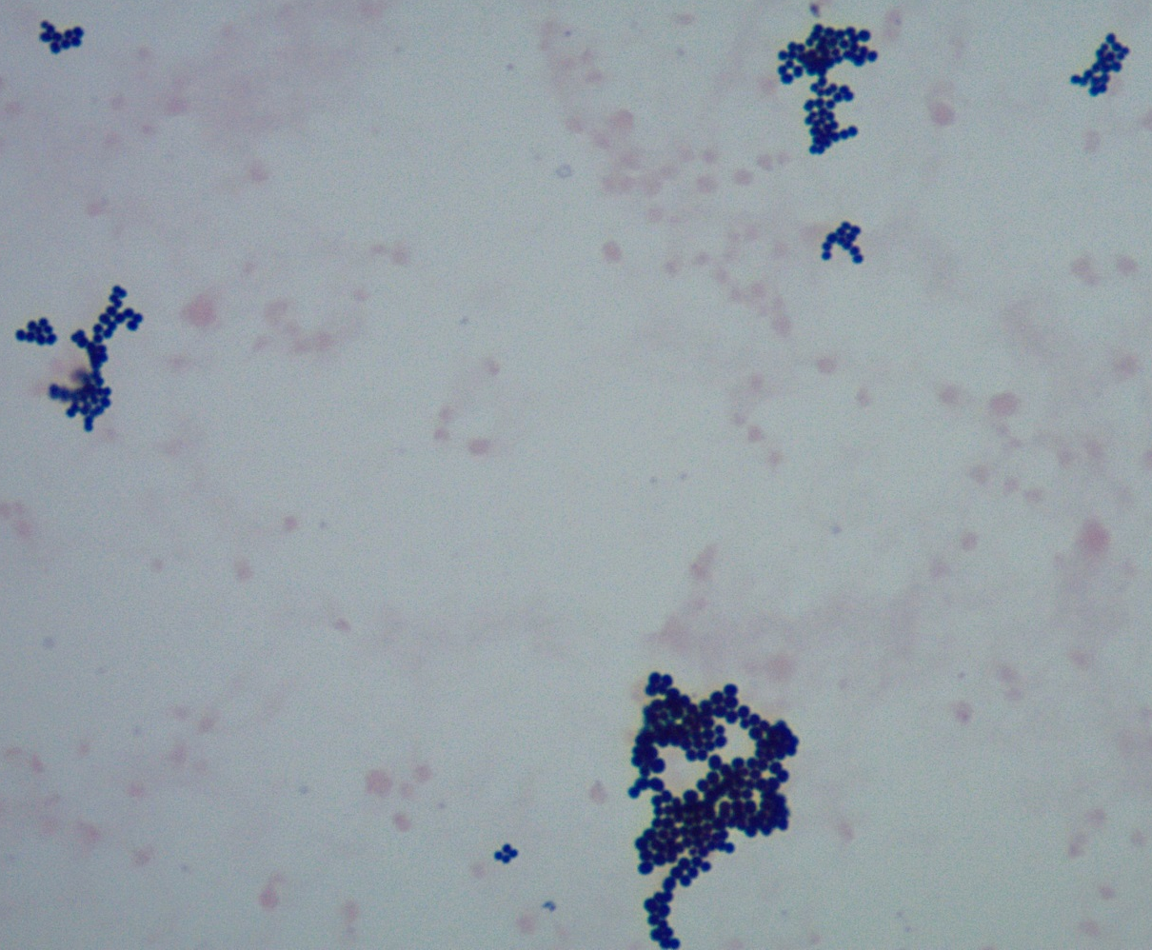
Gram stain of platelet bag
Cultures of bag and line grew pan sensitive S. aureus

Slide 5
Transfusion 2007;47.
Transfusion 2011;51.

Slide 6
Case #2
61 year old male with rectal carcinoma admitted for ileostomy takedown
Previous antibody screens at an outside hospital were negative in 2006 and subsequently identified a cold autoantibody (anti-IH) in 2009; transfused in 2009
Antibody screen 2/5/15: blood type A positive, DAT negative for IgG and complement

Slide 8
Case #2
Panagglutinin in plasma, present in LISS, recommend least incompatible units if transfusion is required
No transfusion ordered
Repeat antibody screen 4/28/15; DAT negative for IgG, positive for C3, eluate negative

Slide 10
Case #2
Expired k negative antisera showed that the patient is k negative (positive and negative controls worked)
Sample sent to reference lab:

Slide 11
Case #2
Plasma shows rouleaux at saline IS, resolves with saline replacment
Anti-E and anti-k present in plasma
Plasma reacts with 2 of 7 E-, k- cells, possible additional alloantibodies to low frequency antigens
6/10,000 donors will be E and k negative

Slide 12
Case #2
Educated clinicians, patient and family
Advance notice is required for transfusion in order to acquire rare donor units
Recommended siblings be tested by ARC as potential rare donors
Recommended patient wear a medical alert bracelet

Slide 13
Case #3
3 day old F infant born via CS at 27 2/7 wga to a G1P1 28 yo mother
Maternal history- SLE, thrombocytopenia (49,000/µL), anemia, HELLP, pre-eclampsia
Infant required intubation and was admitted to NICU, with leukopenia (4,500/µL), anemia (Hgb 12.8 g/dL, HCT 39%), and thrombocytopenia (26,000/µL)
Maternal platelet count 55,000/µL after transfusion of apheresis platelets

Slide 14
Case #3
Date and Time | Platelet Count | Platelet Transfusion
5/29/15 @ 1140 | 26,000/µL
5/29/15 @ 1502 |  | 1 apheresis platelets
5/30/15 @ 0030 | 36,000/µL
5/30/15 @ 0355 |  | 1 apheresis platelets
5/30/15 @ 0925 | 93,000/µL
5/31/15 @ 0520 | 38,000/µL
5/31/15 @ 0743 |  | 1 apheresis platelets
6/01/15 @ 1430 | 29,000/µL
6/01/15 @ 1830 |  | 1 apheresis platelets
6/02/15 @ 0530 | 80,000/µL
6/03/15 @ 0420 | 55,000/µL

Slide 15
Case #3
Received pRBC transfusion on 5/31/15 and 6/4/15
DDx of pancytopenia
Chronic in utero hypoxia vs preeclampsia vs. immune-mediated thrombocytopenia

Slide 16
Case #3
NAIT unlikely as mother also thrombocytopenic
Maternal platelet transfusion not indicated as unlikely NAIT, and would require approval from Red Cross Medical Director- unlikely given maternal thrombocytopenia
HPA-1a(-),5b(1) platelets also not indicated as unlikely NAIT
Received IVIG 6/3/15, platelet count since then 82-221,000/µL, goal >50,000/µL

Slide 17
Case #4
23 yo M with h/o ALL s/p BMT in 2003 and kidney transplant in 2008 (?aHUS), and cirrhosis due to hep C resulting from prior transfusion, undergoing eval for liver and kidney transplant
Forward type O, reverse type A

Slide 18
Case #4

