Slide 1
Interesting Case Conference
4/21/15

Slide 2
Case #1
31 month old male
Laminectomy for tethered cord, type and screen ordered 4/6/15: O negative
No blood products given
Continued CSF leak, scheduled for external ventricular drain placement
Type and screen 4/13/15: A negative
Repeat sample requested, confirmed A negative

Slide 3
Case #1
Reviewed all types and screens received from Children’s Hospital on 4/6/15 that had no prior historical blood type
One patient identified: 4 month old female scheduled for cranial reconstruction for cranial synostosis
Type and screen 4/6/15: A negative
Received 1 unit A negative PRBCs on 4/7/15, discharged home 4/11/15
Scheduled for f/u clinic appointment with plastic surgery in a couple weeks

Slide 4
Case #1
If this baby had sample switched with original WBIT patient, this baby could actually be O negative
Nobody noticed/documented signs or symptoms of a hemolytic transfusion reaction prior to discharge, but could it have been missed?
Post surgical pain, hematuria due to catheter
What should we do?!?

Slide 5
Transfusion. 2010;51(5).
Transfusion. 1993;33(11).

Slide 6
Case #1
What we did:
Initially placed a stop in Soft requiring a second sample prior to transfusion on baby #2
Mary contacted area hospitals; Summit Medical Center had type and screen from birth: A negative

Slide 7
Case #2
56 y/o previously healthy female with 2 week history of malaise, nausea, vomiting, diarrhea, rhinorrhea, cough
PCP had started doxycycline and keflex with no improvement
Admitted with hypotension
Admission labs showed elevated total bilirubin (3.0 mg/dL); remote history of cholecystectomy
Multifocal pneumonia on CXR/CT scan

Slide 8
Case #2
Additional labs: Haptoglobin <8 mg/dL, LDH 547 units/L, PCV 24%
DAT negative for IgG, 3+ positive for complement
Peripheral smear:

Slide 9
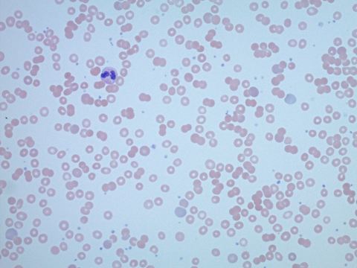
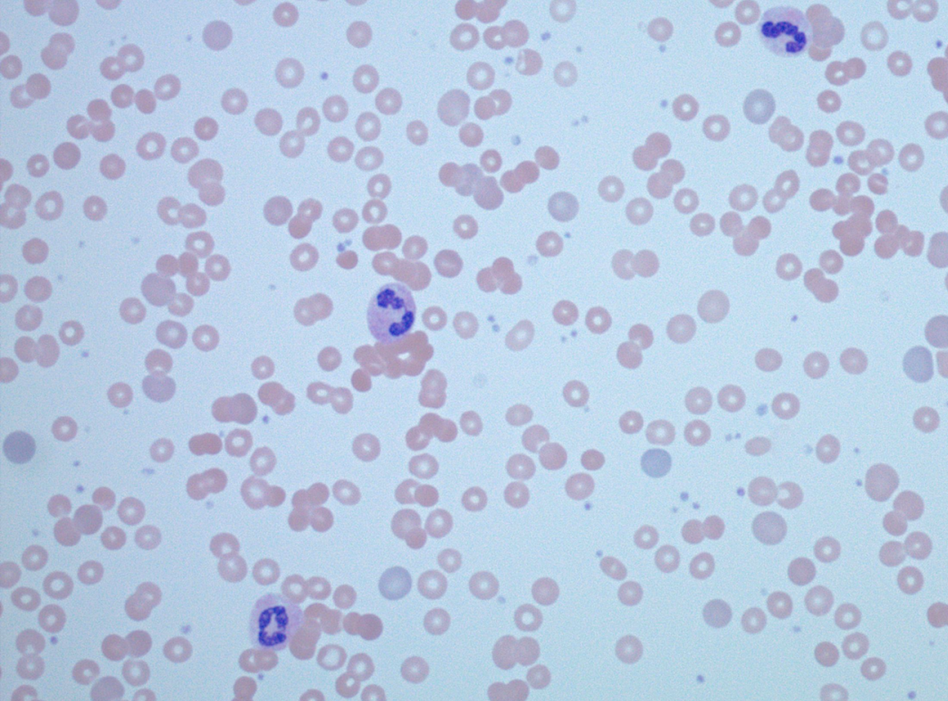

Slide 10
Case #2
Cold agglutinin titer (anti-I) at 4C was 1:512
The titer at 37C (high thermal amplitude) was 1:16
INTERPRETATION: The results are consistent with cold agglutinin syndrome (CAS)

Slide 11
Case #2
Cold agglutinin disease
15% of AIHA cases
Incidence 1 per million people
More common in women in 7th decade
Acute/polyclonal form is usually associated with Mycoplasma, EBV, or Legionella, also reported with Varicella, Citrobacter, and influenza
Acute/polyclonal form is generally self-resolving
Blood. 2013;122(7).

Slide 12
Case #2
What we did:
Talked to primary team, recommended that they keep patient warm, use blood warmer (obtain from clinical engineering) if transfusion was required
Antibiotics were switched to Levaquin to cover Mycoplasma
Patient improved, hemoglobin remained stable without transfusion, and patient was discharged home

Slide 13
Patient KT
30 y/o G3P2002 admitted at 32w6d for planned Cesarean section at 34 weeks in the setting of placenta previa, suspected placenta increta, and pre-eclampsia
Severe pre-eclampsia necessitated delivery at 33 5/7 weeks
Underwent supracervical hysterectomy for placenta percreta
Intraoperatively, received 3 units PRBCs (B negative), 3 units FFP, and 1 unit platelets (A negative), Hct 31% →28%
Maternal blood type B-, Infant blood type O+

Slide 14
Patient KT: Clinical Question
Should patient receive RhIG, given the fact that she has had a hysterectomy (and therefore completed childbearing)?

Slide 15
Patient KT: Discussion
How likely is it that this patient will develop an anti-D antibody?
Amount of fetomaternal hemorrhage
FMH >30 mL occurs in 3/1,000 women, often no antecedent risk factors, conflicting data about C-section vs. vaginal delivery (1)
Newer study found only significant risk factor to be twin pregnancy, mode of delivery was not significant (2)
No data regarding amount in post C-section hysterectomy or in cases of placenta increta/percreta
This patient had a large degree of intraoperative hemorrhage
Baby, however, was not anemic at birth (PCV: 69%)
Seroconversion with Rh incompatible platelet transfusion
Up to 2 mL of RBCs allowed in a unit of apheresis platelets
ADAPT study: 485 patients, rate of anti-D formation: 1.44% (95% CI: 0.58–2.97%) (3)
Very little red cell exposure: 0.036 mL (whole blood) and 0.00043 mL (apheresis)
Additional study: 1.3% for all allo-antibody formation (not just D)
How likely is it that the patient will need a transfusion is the future?
In any year, the chance of needing a transfusion was 0.89 percent (0.83% for men and 0.94% for women) (4)
(1) Sebring ES, Transfusion, 1990
(2) David J, Perinat Med, 2004
(3) Cid J, Br. J Haemotol, 2015
(4) Moncharmont, Blood Transfus. 2014
(5) Vamvakas, Transfusion 1994
Notes:
ACOG risk factors antepartum fetal death, antepartum bleeding, intrauterine manipulation, placenta previa, abruptio placenta, cesarean section, and manual removal of the placenta

Slide 16
Patient KT: What Was Done
Clinical team decides to administer RhIG
Baby doing well, discharged on DOL #11

Slide 17
Patient TH
44 year old male with cirrhosis presents to VUMC for liver transplant evaluation.
The patient’s DAT was positive. A panagglutinin was present in both the plasma and the eluate.
Phenotypically positive for (little) c, E, e, Jka, and Jkb antigens and negative for C, K1, and S antigens
Autoadsorption: anti-Fya antibody present

Slide 18
Patient TH: Clinical Question
Because of the presence of pan-agglutinin (as well as the anti-Fya) what should we recommend if the patient requires transfusion?

Slide 19
Patient TH: Discussion
Allo-antibody formation in liver transplant patients
One series: 6.8% of patients had clinically significant RBC allo-antibodies (1)
31 patients at time of listing, 10 patients at time of transplant, 9 patients post-op
Anti-Rh and K antibodies most common
Patients with allo-antibodies tend to have worse outcomes (2)
Despite immunosuppression, patients may form allo-antibodies following transplant (3, 4)
Number of patients on the waiting list who receive a liver
Waiting period is second longest of all organs: 11 months (5)
As of Sunday (4/19/15), 15,264 patients waiting for liver
Depending on age group, between 44-66% of patients listed at Vanderbilt received a liver transplant
Blood transfusion while on the wait list
No information regarding amount of transfusions while on wait list, highly dependent on a number of factors: bleeding related to varices or ruptured HCC, folate deficiency, hypersplenism, bone marrow suppression due to viruses or ethanol, renal insufficiency, etc. (6)
Mushkbar, Vox Sang, 2013
Boyd, Liver Transpl, 2007
Shariatmadar, Transplantation, 2007
Blomquist, Transplant Proc, 1991
(http://optn.transplant.hrsa.gov/)
Thachil J, Hepatol, 2005

Slide 20
Patient TH: What Was Done
Recommended least incompatible units that are negative for the Fya antigen and, if possible, phenotypically matched for the C, K1, and S antigens

