Slide 1
AF Allergic Reaction to FFP
Allison Paroskie, MD

Slide 2
Clinical History
57 year old male (blood type: O –) referred to Vanderbilt for orthotopic liver transplant
07/12/2013 – intra-operative reaction
5 units pRBCs and 4 units of FFP
Profound hypotension requiring epinephrine, additional pressors & ventilator support
07/17/2013 – challenge
Premedication: prednisone, diphenhydramine, famotidine
1 unit of FFP
Chills, urticaria requiring diphenhydramine, epinephrine, norepinephrine and hydrocortisone
07/19/2013 – challenge
Premedication: prednisone, diphenhydramine, famotidine
1 unit cryoprecipitate

Slide 3
Allergic Transfusion Reactions
Most common adverse event associated with platelet and plasma transfusion
~ 2% of platelet transfusions
Range of severity
Mild: localized pruritus and/or urticaria
Severe (<10%): angioedema, bronchospasm, hypotension
1:9,630 platelet transfusions
1:28,831 FFP transfusions
1:57,896 RBC transfusions
IgE- and non-IgE mediated mechanisms of mast cell / basophil activation and mediator release
Notes:
IgE mediated hypersensitivity reaction against foreign proteins
IgE mediated reaction against protein-hapten conjugates
IgG mediated activation of complement activation → generation of anaphylotoxins
Direct activation of mast cells or complement
Exogenous anaphylatoxins in blood products

Slide 4
DDX of Severe Allergic Reactions
Exposure to foreign protein / molecule – IgE > IgG
IgA (deficiency)
Haptoglobin (deficiency)
Albumin
Complement component
Methylene blue
Ethylene oxide
Drugs
Passive transfer of IgE from allergic donor
Direct effect on allergic effector cells / mediators [produced during blood storage]
Histamine
Cytokines
Bradykinin
Chemokine ligand 5 [released from platelet granules]
Anaphylatoxins (C3a and C5a)
Mast cell activation secondary to Mastocytosis
Leukoreduction filter → complement activation & platelet granule release
Notes:
Blue: allotypic serum proteins
Purple: allergens or proteins

Slide 5
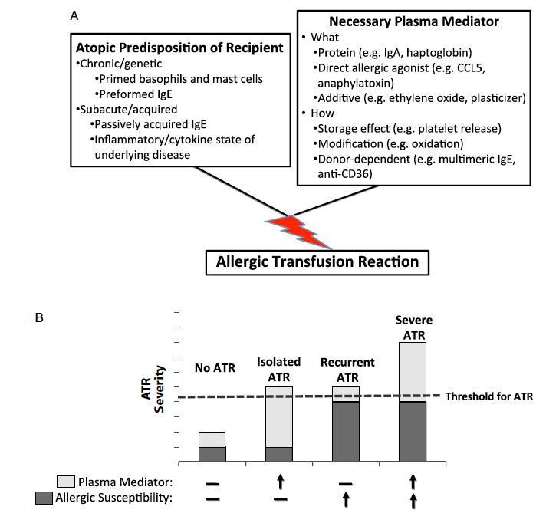

Slide 6
Considerations & Outcome
Allergen induced IgE development – desensitization
Free histamine in plasma – Octaplas
Additional substance in plasma
Kcentra (factors II, VII, IX and X)
Cryoprecipitate (fibrinogen, VIII, vWF, XIII)
Fibrinogen concentrate
Liver Transplant
PT 20.4 sec, aPTT 36.5 sec, Fibrinogen 224 mg/dL
Fibrinogen concentrate (4400 mg)
Washed pRBCs x 3 units & platelets x 1 unit

