Slide 1
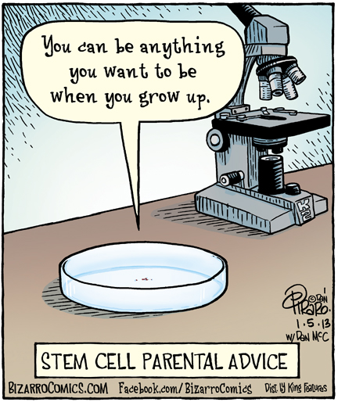
Hematopoietic Stem Cell Transplantation Apheresis and Mobilization
Donna Ferguson, M.D.
July 16, 2015

Slide 2
Overview
History
Bone marrow versus apheresis
Stem cell transplantation
Donor and recipient
Indications
Adverse events
HPC, Apheresis
HPC, Bone marrow
Mobilization
Commonly used drugs
Possible targets
Autologous
Allogeneic

Slide 3
History of Stem cell transplantation

Slide 4
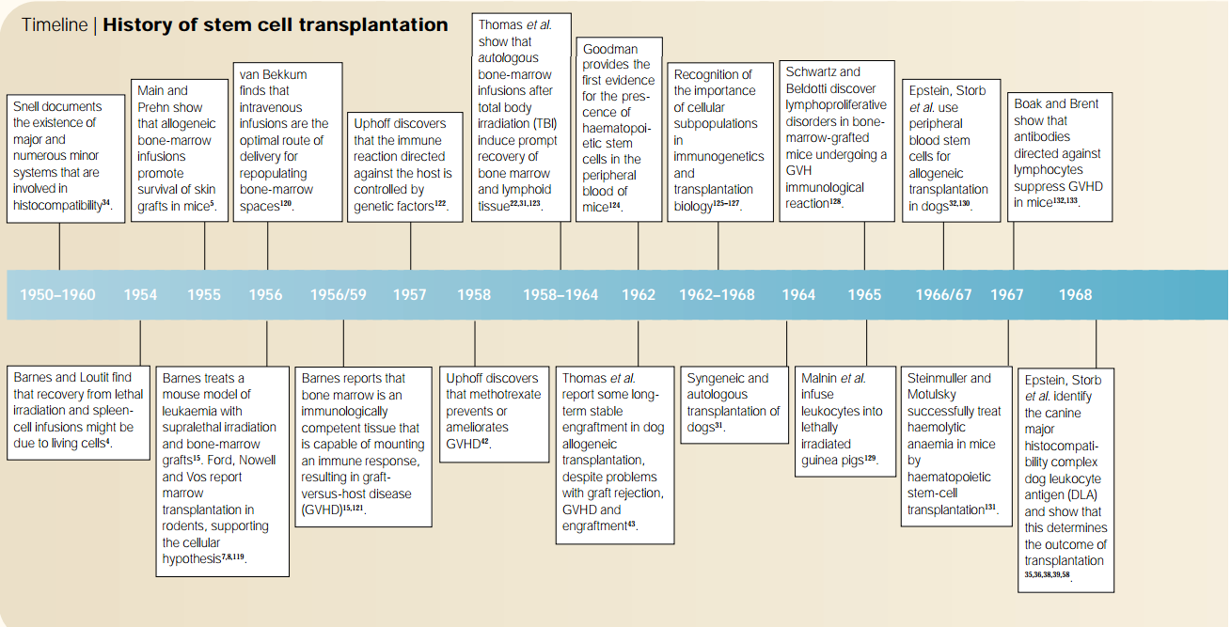
Stem Cell Transplantation –
the history
1955: Human bone marrow grafting program
1957: Human hematopoietic stem cell transplants were mostly unsuccessful, with only one patient undergoing transient engraftment.
Removal of fat and bone particles resulted in infusion without serious side effects.
1956: Graft versus Tumor. Leukemic cells eradicated in irradiated mice that received allogeneic transplants.
Reaction of the donor BM against host leukemia might kill cancer cells.
“Adoptive immunotherapy” by Mathe in 1965.
Thomas, ED., et al. Intravenous infusion of one marrow in patients receiving radiation and chemotherapy. N. Engl. J. Med. 257.
Little, MT, et al. “History of haematopoietic stem-cell transplantation.” Nature Reveiws. Cancer. Vol 2, March 2002.

Slide 5
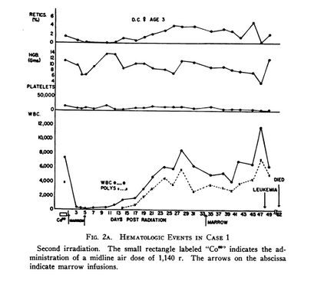
Stem Cell Transplantation –
the history
1956
1959: Two patients with ALL given TBI followed by BM grafts from twin siblings.
Leukaemia recurred after a few months; however, first example of prompt clinical and hematologic recovery.
Irradiation does not eliminated the leukaemia.
Thomas, ED., et al. Supralethal whole body irradiation and isologous marow transplantation in man. J. Clin. Invest. 38. 1959.
Little, MT, et al. “History of haematopoietic stem-cell transplantation.” Nature Reveiws. Cancer. Vol 2, March 2002.

Slide 6
Stem Cell Transplantation –
the history
1965: Rescue victims of accidental irradiation exposure with allogeneic bone marrow.
4/5 patients survived, although their chimerism was only partial and transitory.
Before histocompatibility: probably due to autologous reconstitution.
First to describe survival of allogeneic bone marrow graft in leukemic patient.
Mathe, G., et al. Adoptive immunotherapy of acute leudkemi: experimental and clinical results. Cancer Res. 25. 1965
Little, MT, et al. “History of haematopoietic stem-cell transplantation.” Nature Reveiws. Cancer. Vol 2, March 2002.

Slide 7
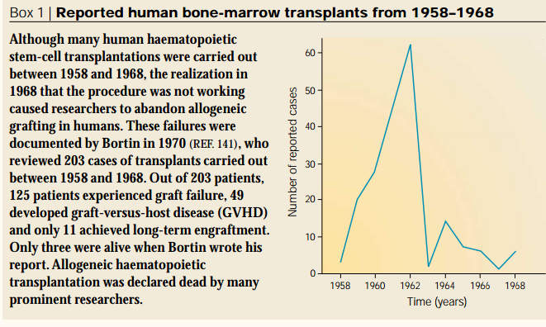
Graft was rejected by the recipient
Severe GVHD
Probably because the procedures were based on work in inbred mice that do not require histocompatibility testing.
“Crossing the allogeneic barrier” was seriously doubted.
Little, MT, et al. “History of haematopoietic stem-cell transplantation.” Nature Reveiws. Cancer. Vol 2, March 2002.

Slide 8
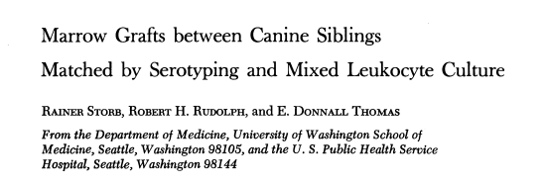
Stem Cell Transplantation –
the history
1968: Canine in vitro histocompatibility typing system was developed.
Dogs received high-dose TBI and then grafts from DLA (dog leukocyte antigen) matched littermates or unrelated donors.
Survived significantly longer than their DLA-mismatched counterparts.
Epstein, RB., et al. Cytotoxic typing antisera for marrow grafting in littermate dogs. Transplantation 6, 1968.
1971
Storb, T., et al. Marrow grafts between canine siblings matched by serotyping and mixed leukocyte culture. J. Clin. Invest. 50. 1971.
Little, MT, et al. “History of haematopoietic stem-cell transplantation.” Nature Reveiws. Cancer. Vol 2, March 2002.

Slide 9
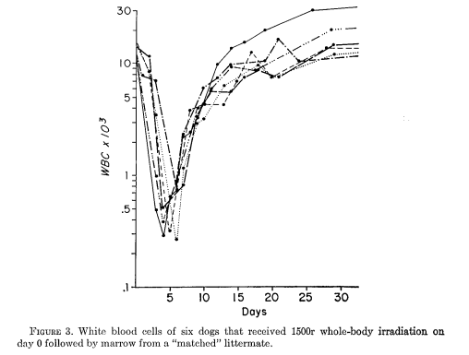
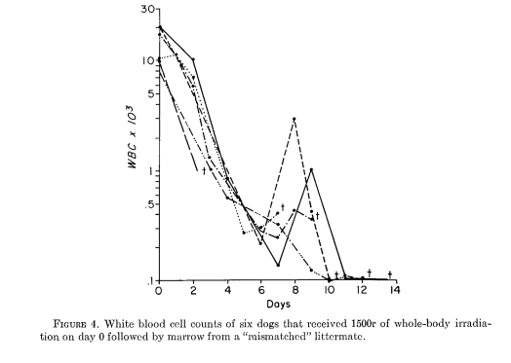
Stem Cell Transplantation –
the history
1968: Canine in vitro histocompatibility typing system was developed.
Dogs received high-dose TBI and then grafts from DLA (dog leukocyte antigen) matched littermates or unrelated donors.
Survived significantly longer than their DLA-mismatched counterparts.
Little, MT, et al. “History of haematopoietic stem-cell transplantation.” Nature Reveiws. Cancer. Vol 2, March 2002.

Slide 10
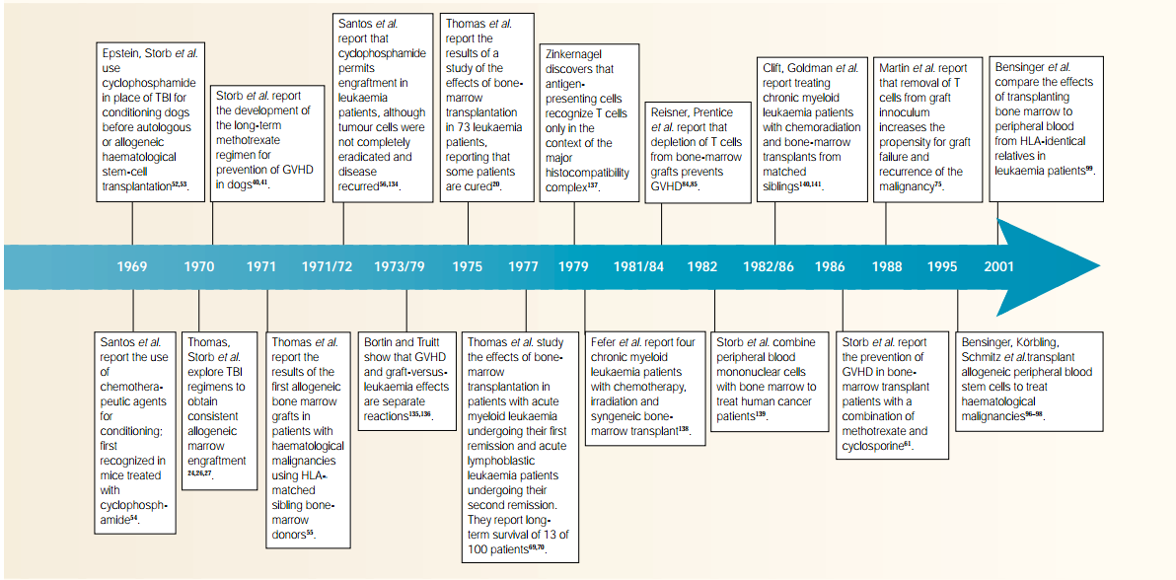
Stem Cell Transplantation –
the history
Late 1960’s
In dog models, DLA typing was recognized as important to reduce rejection and GVHD.
HLA antigens were starting to be understood.
Even when the donor and recipient were HLA matched, GVHD was still a concern unless postgrafting immunosuppression was administered with methotrexate; it could reduce and even prevent GVHD.
Little, MT, et al. “History of haematopoietic stem-cell transplantation.” Nature Reveiws. Cancer. Vol 2, March 2002.

Slide 11
Stem Cell Transplantation –
the history
Patients in good clinical condition before transplantation had better long term survival.
Disease recurrence was about 75% in advanced disease.
Transplantation should be performed earlier in the course of disease while tumor burden was low and the patient’s health was more optimal.
Thomas, ED. Et al. Bone-Marrow transplantation. N. Engl. J. Med. 292, 1975.
Little, MT, et al. “History of haematopoietic stem-cell transplantation.” Nature Reviews. Cancer. Vol 2, March 2002.

Slide 12
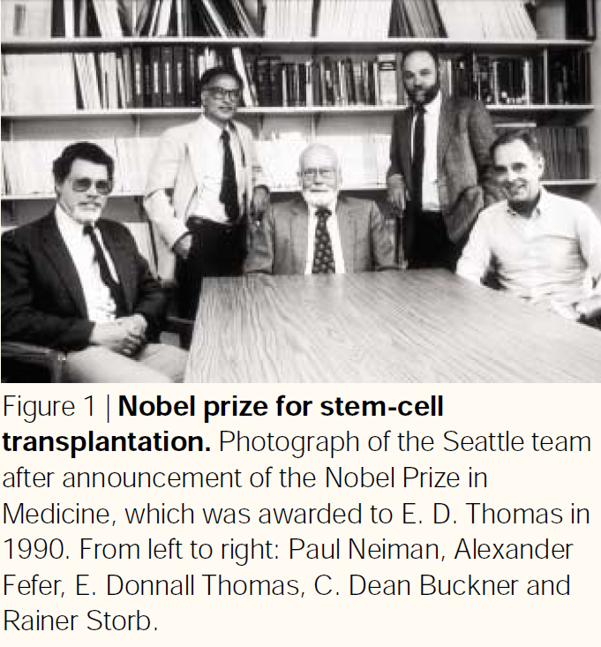
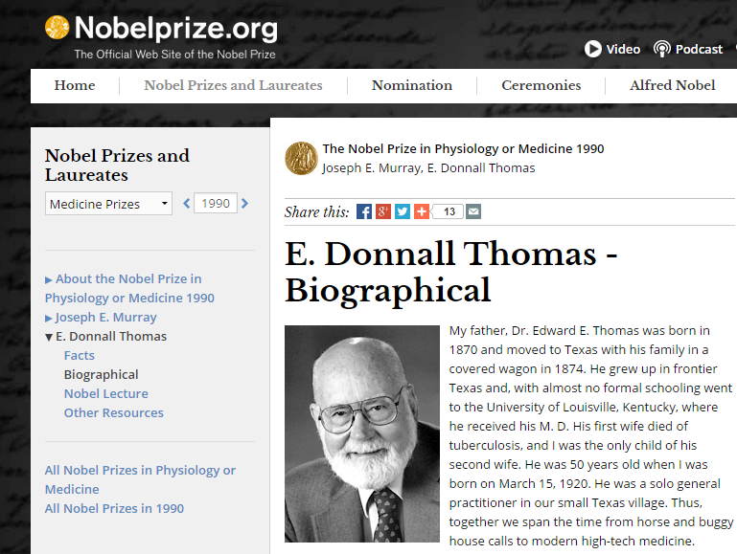

Slide 13
Bone marrow versus apheresis

Slide 14
Three main methods
Peripheral blood progenitor cell (PBPC) transplantation: HPC, apheresis or HPC-A
No general anesthesia, faster recovery and engraftment of neutrophils and platelets, less acute GVHD, can potentially be done with patients with marrow involvement of their malignancy, apheresis is in widespread use
Bone marrow transplantation: HPC, marrow or HPC-M
1 liter harvested from multiple posterior iliac aspirations
Requires general anesthesia
Umbilical cord blood transplantation: HPC, cord blood or HPC-C
Cord blood is rich in stem cells and progenitor cells
Harvested at delivery and stored
No risk to door, less susceptible to HLA mismatch problems, lower risk of GVHD

Slide 15
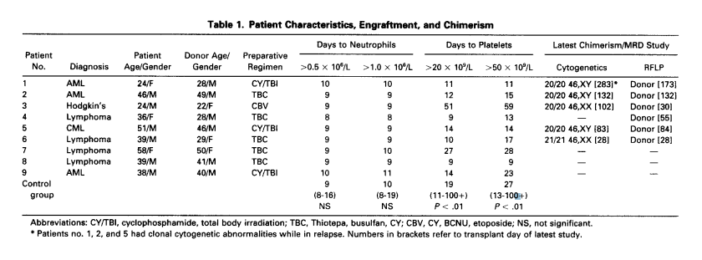
Bone marrow versus Apheresis – Korbling, 1995
“In conclusion, a number of considerations might favor the circulating blood as a stem cell source for allografting: (1) shorter duration of posttransplant aplasia, (2) faster hematopoietic andor immune-reconstitution, and (3) a potentially more pronounced GVL effect. In addition, general anesthesia is not necessary for collection and the procedure results in less discomfort for the donor. This experience shows that allo-PBSCT is feasible and warrants further clinical trials.”
9 patients with refractory leukemia or lymphoma receiving myeloablative therapy followed by allo-PBSCT from HLA-matched donor.
Filgrastim used pre- and post-trasnplant; cyclosporine and methylprednisolone used for GVHD prophylaxis.
Neutrophil recovery occurred a median of 9 days, similar to BMT.
More rapid platelet recovery than BMT.
Acute GVHD was minimal despite the infusion of 1 log more CD3 cells than with BMT.
Korbling, M., et al. “Allogeneic Blood Stem Cell Tranpllantation for Refractory Leukemia and Lymphoma: Potential Advantage of Blood Over Marrow Allografts.” Blood, Vol 85, No6 (March 15), 1995.

Slide 16
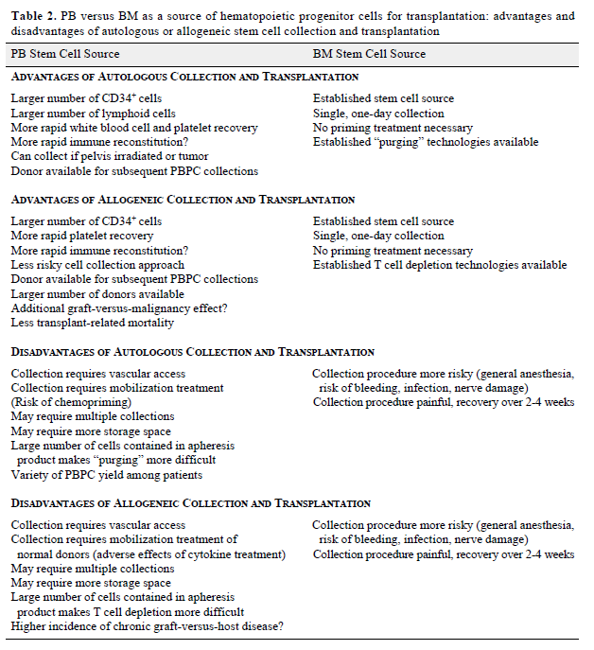
Bone marrow versus Apheresis – Korbling, 1996
Compared to BMT, use of PBSCT shortens WBC recovery and platelet following transplant.
No increase GVHD.
Possible more pronounced GVL effect.
PBSCT to eventually replace BMT.
Korbling, M. “Peripheral Blood Progenitor Cell Transplantation: A replacement for Marrow Auto- or allografts.” Stem Cells 1996; 14: 185-195.

Slide 17
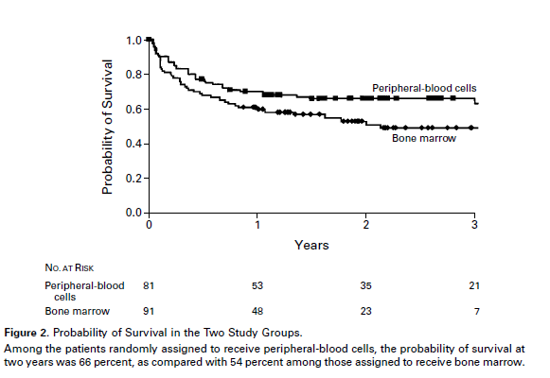
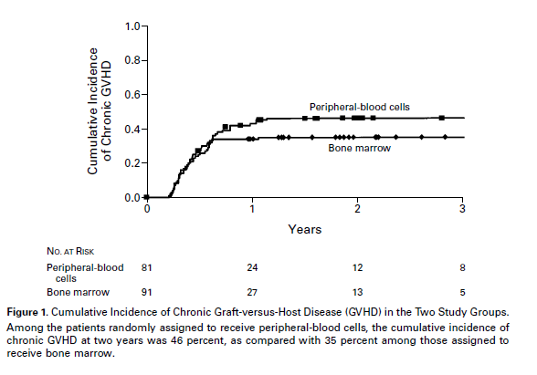
Bone marrow versus Apheresis – Besinger, 2001
Study
In 1995, initiated multicenter RCT to compare allogeneic marrow with PBSCT from HLA matched donor.
Primary endpoint: time to engraftment.
Since initiation, four RCT with 37-100 pts have been reported the same findings; however, size and/or design of those studies raised concerns.
175 patients: BM collected from 90 donors and PBSC collected from 82 donors with >5 million cells.
Conclusions
Transplantation related death at 2 years: 21% PBSCT vs 30% BMT
Survival at 2 years: 66% PBSCT vs 54% BMT
Disease free survival at 2 years: 65% PBSCT vs 45% BMT
Faster recovery of neutrophil and platelets and fewer platelet transfusions.
CD3+ cells were12 times higher in PBSCT, rates of acute and chronic GVHD was not significantly higher
Bensinger, WI., et al. “Transplantation of Bone Marrow as Compared with Peripheral-Blood Cells from HLA-Identical Relatives in Patients with Hematologic Cancers.” N Engl J Med, Vol.344, No. 3. January 18, 2001.

Slide 18
Donor and Recipient

Slide 19
Types of donors
Allogeneic: donor and recipient are different people that are genetically dissimilar
Leukemia
Aplastic anemia
Hemoglobinopathies
Immune deficiencies
Autologous: donor and recipient are the same person
Metastatic or recurrent solid tumors
Marrow malignancies
Syngeneic: donor and recipient are identical twins

Slide 20
Indications
Malignant diseases (>90%)
Acute leukemia: currently the most common diagnosis treated with this therapy
Chronic myelogenous leukemia
Lymphoma: Hodgkin’s and non-Hodgkin’s
Breast cancer (historically) and other solid tumors
Multiple myeloma
Childhood solid tumors (Wilm’s, Ewing’s, neuroblastoma)
Immune deficiency
Severe combined immunodeficiency disease
Aplastic anemia
Wiskott-Aldrich syndrome
Inborn metabolic disorders
Mucopolysaccharidoses
Lysosomal disorders: Niemann-Pick, Gaucher’s
Adrenoleukodystrophy
Other
Multiple sclerosis
Paroxysmal nocturnal hemoglobinuria

Slide 21
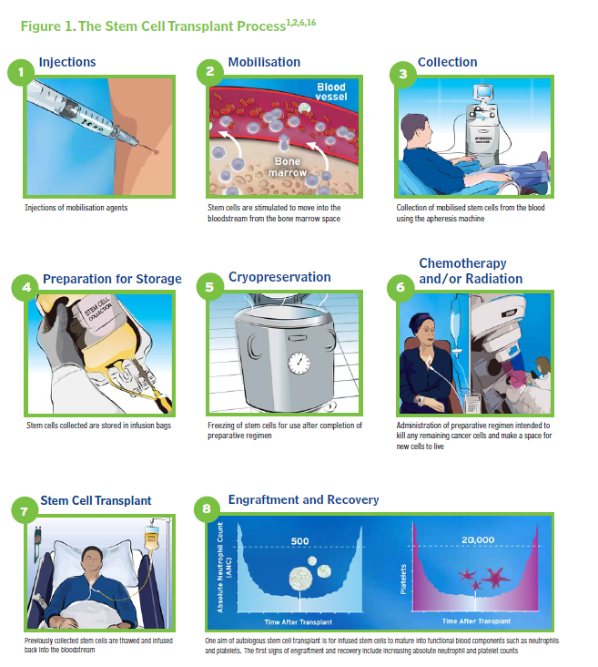
A practical guide for nurses and other allied health care professionals. European Group for Blood and Marrow Transplantation.

Slide 22
Allogeneic HSC donors
HSC donors provide grafts for >15,000 allogeneic hematopoietic stem cell transplants, annually.
70% related and 30% unrelated
PBSC account for 75% related and 50% unrelated donor donations in 2003: Center for International Blood and Marrow Transplant Research
Are the cells suitable for transplant into recipient?
Is the donor process safe for them?
Do they understand what they are being asked to do?
Horowitz, Mary, et al. “Evaluation of Hematopoietic Stem Cell Donors.” Hematology with AABB, 2005.

Slide 23
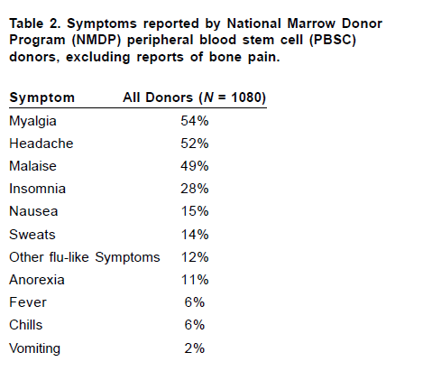
Allo/autogeneic HSC donors –
risk to donor
1080 donors surveyed by NMDP
Mobilization drugs:
Bone pain due to altered bone metabolism , increased bone derived alkaline phosphatase and decreased serum osteocalcin
Injection site reaction
Procedure:
Hematoma/bleeding
ACD causing hypocalcemia
Inadequate venous access requiring CVC in 20%
Post-procedure:
Pancytopenia for a few weeks, especially thrombocytopenia
Death in 9 donors - 3 PBSC due to sickle crisis
Horowitz, Mary, et al. “Evaluation of Hematopoietic Stem Cell Donors.” Hematology with AABB, 2005.

Slide 24
Allogeneic HSC recipients –
donor related risks
Donors are screened for risky sexual behaviors, drug use, skin breeching procedures and BSE exposure, amount others.
National Marrow Donor Program has a 57 question questionnaire found at www.marrow.org
Uniform Donor History Questionnaire for Hematopoietic Progenitor Cells, Apheresis or Marrow was recently drafted by FDA, Foundation for the Accreditation of Cellular Therapy (FACT) and the American Association of Blood Banks (AABB) on www.factwebsite.org
History and Laboratory tests for communicable diseases:
HBV
HCV
HIV
Syphilis
HTLV
CMV
VZV and EBV
SARS and WNV
Congenital or acquired conditions such as immune deficiencies
ABO and Rh incompatibility
May 25,2005 FDA new regulation – all companies involved in the “manufacture” of regulated products must file with FDA with for donor eligibility and documentation (Good Tissue Practices)
Difficult to get HLA donors from other countries
World Marrow Donor Association, 1994
Horowitz, Mary, et al. “Evaluation of Hematopoietic Stem Cell Donors.” Hematology with AABB, 2005.

Slide 25
Mobilization

Slide 26
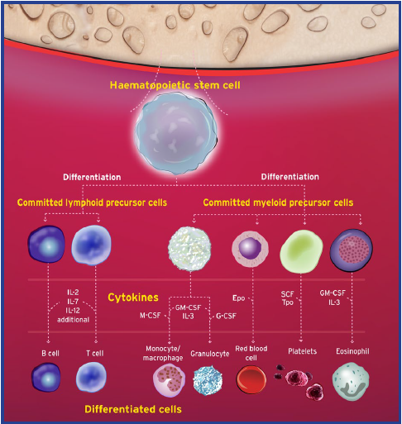
Mobilization –
Hematopoietic stem cells
Blood cells are derived from progenitor stem cells with the capacity for unlimited self renewal and differentiation into myeloid or lymphoid cells.
Cytokines initiate the maturation cascade to produce committed mature blood cell components.
Cytokines can be injected exogenously to yield stem cells in a short period of time.
A practical guide for nurses and other allied health care professionals. European Group for Blood and Marrow Transplantation.

Slide 27
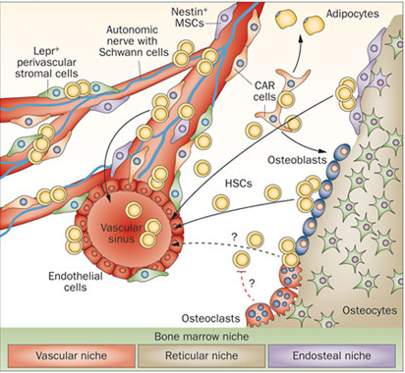
Mobilization –
Hematopoietic stem cells
BM niche is an organized microenvironment which anchors HSC and regulates their self renewal, proliferation, trafficking.
Vascular: sinusoidal endothelial cells and nestin+ mesenchymal stem cells (MSC) express adhesion molecules such as VCAM-1 (binds to a4B1) and SCF (binds to c-kit) that bind to HSC.
Depletion of nestin+ MSCs increases mobilization and decreases homing of the PBSC to the BM.
Nestin+ MSC associates with SNS - release of NT leads to MT1-MMP expression and MMP-2 activity which causes cleavage of tethers (CXCR4, VLA4, VCAM-1, SCF) holding the HSC in the BM niche.
Reticular: SDF-1 is produced by CAR cells (CXCL-12 abundant reticular cells), MSC and osteoblasts and interaction with CXCR4 plays role in retention.
Endosteal: ostoblasts produce Ang-1 (promotes adhesion) and TPO (quiescence).
Hopman, RK., et al. “Advances in Stem Cell Mobilization.” Blood Rev. 2014 January; 28 (1): 31-40.

Slide 28
Mobilization – CD34+ stem cell retrieval
Blood samples are assayed to determine the CD34+ cells present.
Optimal: >5 x 10⁶/kg cells
Tandem: >6 x 10⁶/kg cells
Minimum: 2 x 10⁶/kg cells
>4.3 x 10⁶/kg cells is associated with improved overall survival in matched unrelated donor without increase in GVHD
8-14 x 10⁶/kg cells is associated with increased risk of GVHD
A practical guide for nurses and other allied health care professionals. European Group for Blood and Marrow Transplantation.
Hopman, RK., et al. “Advances in Stem Cell Mobilization.” Blood Rev. 2014 January; 28 (1): 31-40.

Slide 29
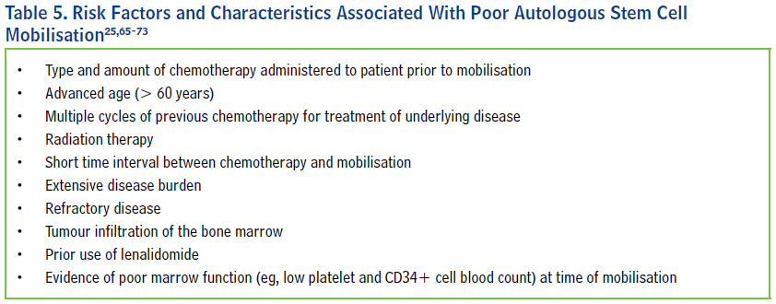
Mobilization –
Poor mobilizers
Remobilization
Increasing doses of chemotherapy agents and/or cytokines
Using a combination of cytokines
Extending time between chemo for disease treatment and apheresis
Plasma cell myeloma and non-Hodgkin lymphoma tend to be heavily pre-treated and mobilization with G-CSF alone has resulted in a 23% failure rate.
A practical guide for nurses and other allied health care professionals. European Group for Blood and Marrow Transplantation.

Slide 30
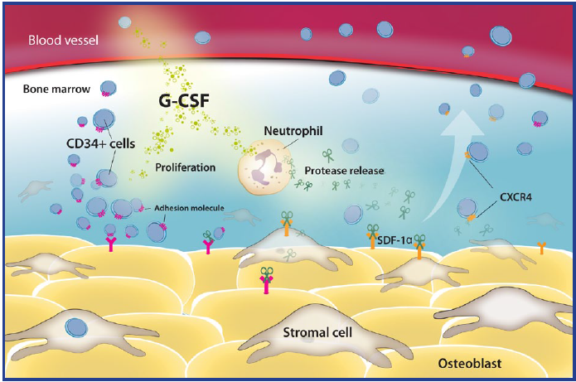
Commonly used drugs –
G-CSF
Most commonly used agent (Filgrastim, Lenograstim)
Mechanism
Release of proteolytic enzymes, neutrophil elastase and cathepsin in mice which cleave VCAM-1, SDF-1, CXCR4 and c-Kit
Reduce SDF-1 mRNA expression and inhibit osteoblast activity leading to decreased SDF-1 levels
Dose
10 mcg/kg/day as SQ injection for multiple days
Twice daily may yield higher result
Hopman, RK., et al. “Advances in Stem Cell Mobilization.” Blood Rev. 2014 January; 28 (1): 31-40.

Slide 31
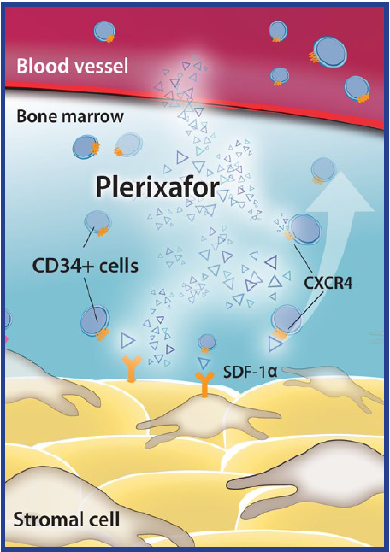
Commonly used drugs –
plerixafor
Mechanism: Reversibly inhibits SDF-1 binding to CXCR4, promoting HSC mobilization
Approved for use in combination with G-CSF for stem cell mobilization in patients with myeloma and lymphoma.
The first phase II trial: plerixafor G-CSF vs. G-CSF showed 50% more CD34+ cell and reduced number of apheresis procedures.
NHL trial: primary endpoint >5 x 10⁶ cells reached in 59% compared to 20% of controls (G-CSF + placebo). Mean time for engraftment was similar in both groups.
Timing: Initial studies showed a peak CD34+ cells 9-10 hours following administration; later studies on poor mobilizers showed peak at 3 hours with decline at 8-12 hours.
Cost: Used for high-risk mobilization failure patients only; determined by CD34+ count <10-15 x 10⁶/L of blood following 4-5 days G-CSF.
Hopman, RK., et al. “Advances in Stem Cell Mobilization.” Blood Rev. 2014 January; 28 (1): 31-40.

Slide 32
Approved drugs –
GM-CSF
Sargramostim, Leukine
Limited role
Mobilizes significantly fewer CD34+ cells than G-CSF
More CD14+ monocytes, dendritic cells and CD4+ CD25+ T cells
Potential lower rate of GVHD
Limited evidence
Hopman, RK., et al. “Advances in Stem Cell Mobilization.” Blood Rev. 2014 January; 28 (1): 31-40.

Slide 33
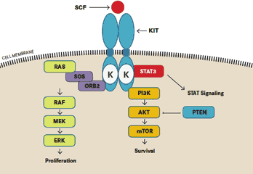
Approved drugs –
Stem cell factor
SCF/ c-kit ligand/ KITL
endothelial cells and perivascular stromal cells
Membrane bound c-Kit receptor: VLA-4 mediated BM HSC adhesion
Soluble s-Kit receptor: Binding to SCF blocks c-Kit/SCF interaction
Recombinant SCF (Ancestim: Stemgen) used with G-CSF has been shown to increase yield in poor mobilizers.
France: 550 patients that failed G-CSF +/- chemotherapy showed success in 31% of patients that also took Ancestim
Approved in Canada and New Zealand
Hopman, RK., et al. “Advances in Stem Cell Mobilization.” Blood Rev. 2014 January; 28 (1): 31-40.

Slide 34
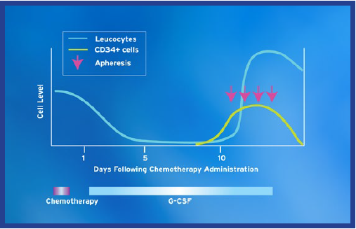
Approved drugs –
Chemotherapy
Reduce tumor burden and enhance mobilization. Works synergistically with G-CSF.
Autologous transplants for Lymphoma:
DHAP
ESHAP
CY, G-CSF and etoposide
ifosphamide, epirubicin, etoposide
Cylophosphamide commonly used for Myeloma
Hopman, RK., et al. “Advances in Stem Cell Mobilization.” Blood Rev. 2014 January; 28 (1): 31-40.
A practical guide for nurses and other allied health care professionals. European Group for Blood and Marrow Transplantation.

Slide 35
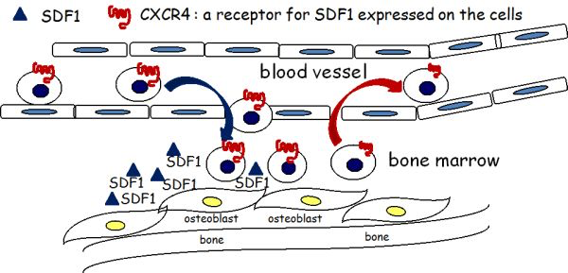
Experimental drugs –
SDF-1/CXCR4 targets
POL6326 (Polyphor) reversibly inhibits CXCR4
phase I: well tolerated and effective
Phase II: 66% MM patients sufficient in 1-2 sessions
BKT 140 (4F-benzoyl-TN14003) is a highly selective CXCR4 antagonist originally designed to inhibit binding of HIV to CXCR4.
10 fold increase in PB progenitor cells 1-2 hrs after dose
BKT 140 + G-CSF = 78 fold increase in PB vs control
Phase I/IIA trial: well tolerated
TG-0054
Phase I: 3-14 fold increase in PB count at 2-6 hrs
Plateau with higher doses
NOX-A12 binds to SDF-1 inhibiting binding to CXCR4
Mouse model: reversible mobilization
Phase I: NOX-A12 with and without G-CSF complete
Sensitizing malignant cells to chemotherapy in CLL
Inhibiting myeloma dissemination
Hopman, RK., et al. “Advances in Stem Cell Mobilization.” Blood Rev. 2014 January; 28 (1): 31-40.

Slide 36
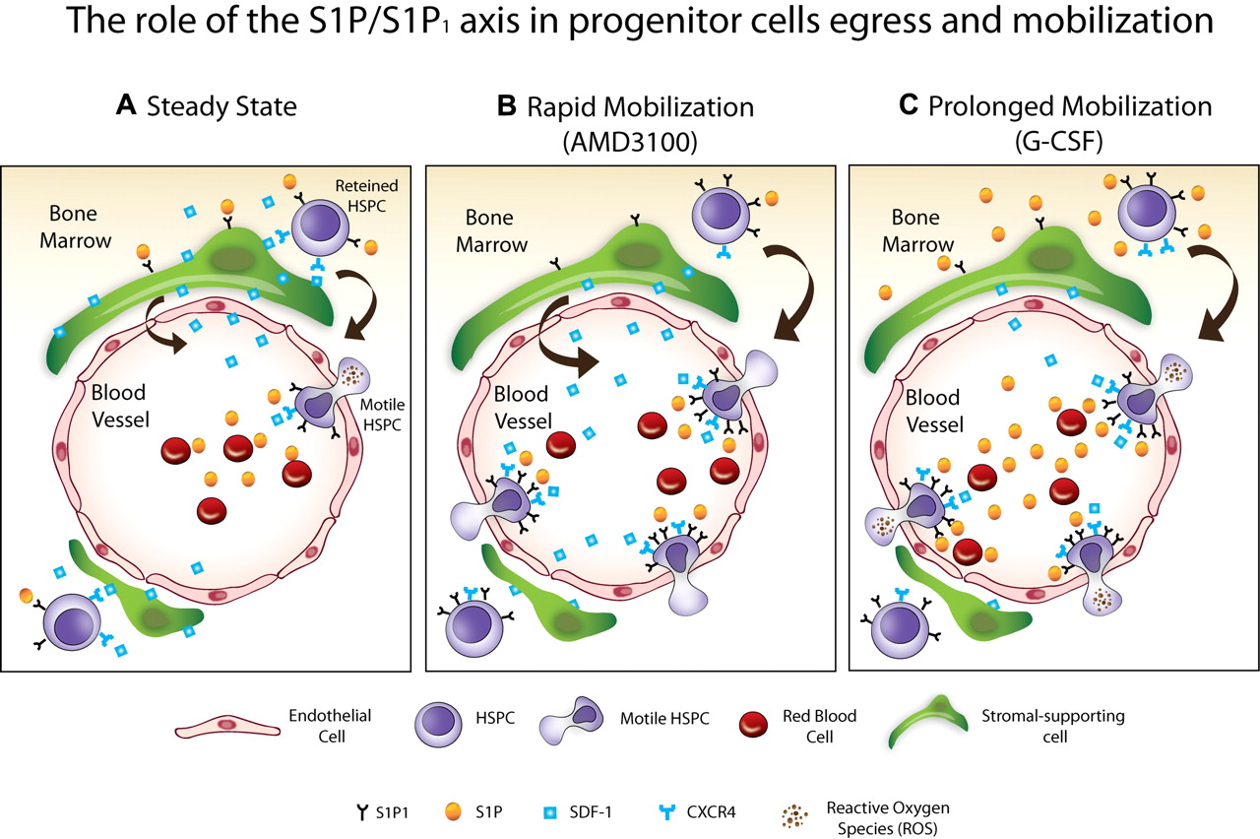
Experimental drugs –
Sphingosine-1-phosphate (S1P) agonists
S1P is a bioactive phospholipid stored and released into peripheral blood by erythrocytes where it acts as a ligand to five G-protein-coupled receptors: immune surveillance and differentiation.
HSC express S1P receptors: mobilization enhancement from non-lymphoid peripheral tissues to draining lymphatics.
Steady gradient of S1P in plasma continuously attracts HSC.
Juarez et al., S1P agonist SEW2871 + AMD3100 caused dose dependent mobilization of HSC, further increased by G-CSF in mice. This was not seen in the absence of AMD3100.
Mierzejewska et al., C5-mediated increase in BM proteolysis leads to HSC egress into peripheral blood. MAC, leading to erythrocyte lysis, leads to increased S1P in blood in mice.
Golan, K. et al. “S1P promotes murine progenitor cell egress and mobilization via S1P1-mediated ROS signaling and SDF-1 release.” Blood. 119 (11) 2012.
Mierzejewska, K., et al. “Novel Evidence That Hematopietic Stem/Progenitor Cells are Mobilized During Hemolysis in an Erythrocyte Lysis Derived, S1P-dependent manner – the Crucial Involvement of the Complement Cascade Activation and Attenuation of CXCR4 Retention Signaling. ASH Annual Meeting Abstracts; 2012.
Juarez JG, et al. “S1P facilitates trafficking of hematopietic stem cells and their mobilization by CXCR4 antagonists in mice. Blood. 2012.

Slide 37
Experimental drugs –
VCAM/VLA4 inhibitors
VLA-4 mediates HSC adhesion to VCAM-1 within the BM.
Preclinical trials: Anti-VLA-4 antibodies results in mobilization of HSC into blood.
Natalizumab: recombinant humanized monoclonal antibody against VLA-4 increases CD34+ cells in peripheral blood.
Up to a 7 fold increase in MS patients
VLA-4 + CXCR4 block has greater than additive effect in primates
Persists > 1 month, limiting use in healthy donors
BIO5192: inhibitor VLA-4
Rapid 30 fold increase that peaked at 30-60 minutes
Additive effect + plerixafor +/- G-CSF
Not yet studied in humans
Hopman, RK., et al. “Advances in Stem Cell Mobilization.” Blood Rev. 2014 January; 28 (1): 31-40.

Slide 38
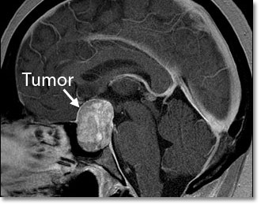
Experimental drugs –
Parathyroid hormone (PTH)
Patients with PTH secreting pituitary adenomas found to have increased levels of circulating HSCs, which decrease to normal after resection.
Brunner et al: compared effects of PTH and G-CSF on HSC
1.5-9.8 fold increase, compatible with G-CSF
Phase I: failed mobilization patients took 14 days PTH
Well tolerated
47% success in patients who failed once
40% success in patients who failed twice
Brunner, S. et al. “Primary hyperparathyroidism is associated with increased circulating bone marrow derived progenitor cells.” Am J Physiol Endocrinol Metab. 2007; 293: E1670-5.
Hopman, RK., et al. “Advances in Stem Cell Mobilization.” Blood Rev. 2014 January; 28 (1): 31-40.

Slide 39
Experimental drugs –
Proteosome inhibitors
New treatment for plasma cell myeloma.
Bortezomib: efficacy in stem cell mobilization.
6.8 fold incrase in PB CFU-Cs in mice
No difference in mobilization in VLA-4 knockout mice.
Phase II: 38 myeloma patients with incomplete response.
Enhanced CD34+ SC with bortezomib + CY + G-CSF
85% collected median 23.3 x 10⁶ cells in 1-5 days
Niesvizky, R., et al. “Overcoming the response plateau in multiple myeloma: a novel bortezomib-based strategy for secondary induction and high-yield CD34+ stem cell mobilization. Clin Cancer Res. 2013; 19:1534-46.

Slide 40
Experimental drugs –
GroB
Member of the CXC chemokine family which stimulates chemotaxis and activation of neutrophils by binding to the CXCR2 receptor.
SB-251353 Preclinical trials: recombinant N-4AA form GroB mobilized HSC within 15 minutes.
One day G-CSF + SB-251353 = 4 days G-CSF
Faster neutrophil and platelet recovery in mice
King, AG., et al. “Rapid mobilization of murine hematopoietic stem cells with enhanced engraftment properties and evaluation of hematopoietic progenitor cell mobilization in rhesus monkeys by a single injection of SB-251353, a specific truncated form of the human CXC chemokine GRObeta.” Blood. 2001; 97:1534-42.

Slide 41
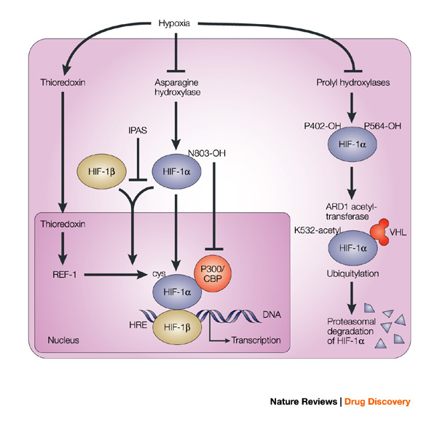
Experimental drugs –
Stabilization of Hypoxia-inducible factor (HIF)
Quiescence is supported by HIF; HIF-a is expressed in hypoxic conditions and associates with the B subunit which then translocates to the nucleus to act as a TF (SDF-1 and VEGF-A).
FG-4497: Stabilizes HIF-a which increases VEGF-A leading to vasodilation and increased HSC mobilization.
FG-4497 + G-CSF + Plerixafor = 6 fold increase in HSC
Levesque JP., et al. “Hematopoietic progenitor cell mobilization results in hypoxia with increased hypoxia-inducible transcription factor-1 alpha and vascular endothelial growth factor A in bone marrow.” Stem Cells. 2007; 25:1954-65.

Slide 42
References
A practical guide for nurses and other allied health care professionals. European Group for Blood and Marrow Transplantation.
Little, MT, et al. “History of haematopoietic stem-cell transplantation.” Nature Reveiws. Cancer. Vol 2, March 2002.
Thomas, ED., et al. Intravenous infusion of one marrow in patients receiving radiation and chemotherapy. N. Engl. J. Med. 257.
Thomas, ED., et al. Supralethal whole body irradiation and isologous marow transplantation in man. J. Clin. Invest. 38. 1959.
Mathe, G., et al. Adoptive immunotherapy of acute leukemia: experimental and clinical results. Cancer Res. 25. 1965
Epstein, RB., et al. Cytotoxic typing antisera for marrow grafting in littermate dogs. Transplantation 6, 1968.
Storb, T., et al. Marrow grafts between canine siblings matched by serotyping and mixed leukocyte culture. J. Clin. Invest. 50. 1971.
Thomas, ED. Et al. Bone-Marrow transplantation. N. Engl. J. Med. 292, 1975.
Korbling, M., et al. “Allogeneic Blood Stem Cell Transplantation for Refractory Leukemia and Lymphoma: Potential Advantage of Blood Over Marrow Allografts.” Blood, Vol 85, No6 (March 15), 1995.
Korbling, M. “Peripheral Blood Progenitor Cell Transplantation: A replacement for Marrow Auto- or allografts.” Stem Cells 1996; 14: 185-195.
Bensinger, WI., et al. “Transplantation of Bone Marrow as Compared with Peripheral-Blood Cells from HLA-Identical Relatives in Patients with Hematologic Cancers.” N Engl J Med, Vol.344, No. 3. January 18, 2001.
Golan, K. et al. “S1P promotes murine progenitor cell egress and mobilization via S1P1-mediated ROS signaling and SDF-1 release.” Blood. 119 (11) 2012.
Mierzejewska, K., et al. “Novel Evidence That Hematopoietic Stem/Progenitor Cells are Mobilized During Hemolysis in an Erythrocyte Lysis Derived, S1P-dependent manner – the Crucial Involvement of the Complement Cascade Activation and Attenuation of CXCR4 Retention Signaling. ASH Annual Meeting Abstracts; 2012.
Juarez JG, et al. “S1P facilitates trafficking of hematopoietic stem cells and their mobilization by CXCR4 antagonists in mice. Blood. 2012.
Brunner, S. et al. “Primary hyperparathyroidism is associated with increased circulating bone marrow derived progenitor cells.” Am J Physiol Endocrinol Metab. 2007; 293: E1670-5.
Hopman, RK., et al. “Advances in Stem Cell Mobilization.” Blood Rev. 2014 January; 28 (1): 31-40.
King, AG., et al. “Rapid mobilization of murine hematopoietic stem cells with enhanced engraftment properties and evaluation of hematopoietic progenitor cell mobilization in rhesus monkeys by a single injection of SB-251353, a specific truncated form of the human CXC chemokine GRObeta.” Blood. 2001; 97:1534-42.
Levesque JP., et al. “Hematopoietic progenitor cell mobilization results in hypoxia with increased hypoxia-inducible transcription factor-1 alpha and vascular endothelial growth factor A in bone marrow.” Stem Cells. 2007; 25:1954-65.

