Slide 1
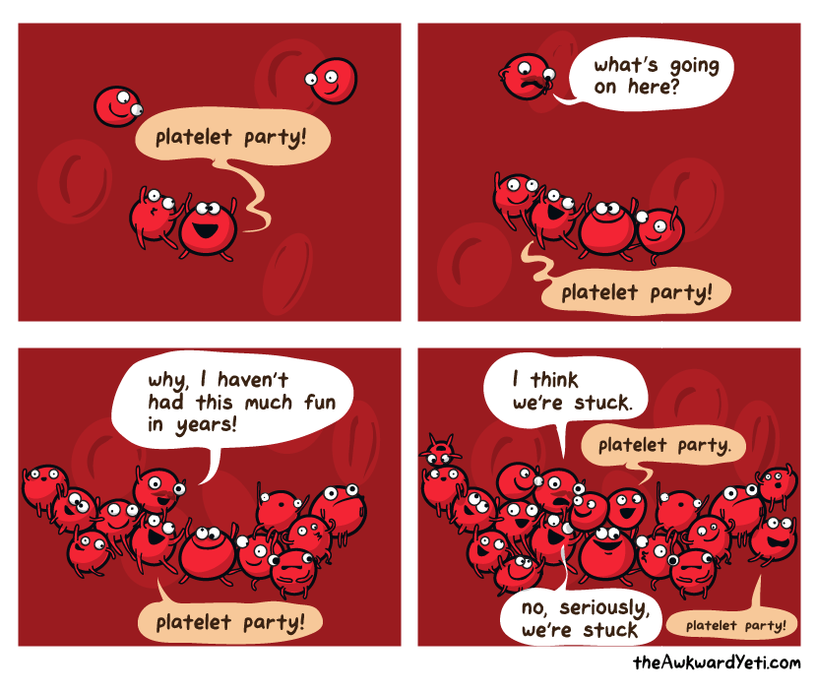

Slide 2
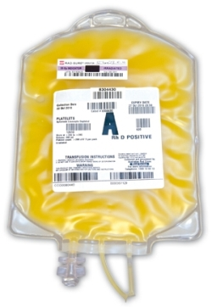
MANAGEMENT OF PLATELET REFRACTORINESS:
A look at cross-matched vs.
HLA-matched platelets
Stephanie N. David, MD

Slide 3
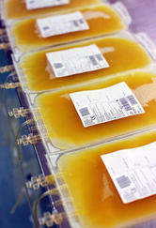
“We need cross-matched/HLA-matched platelets!”
A common request on the blood bank service
In my first 3 weeks of service, I had 4 requests for cross-matched/HLA-matched platelets

Slide 4
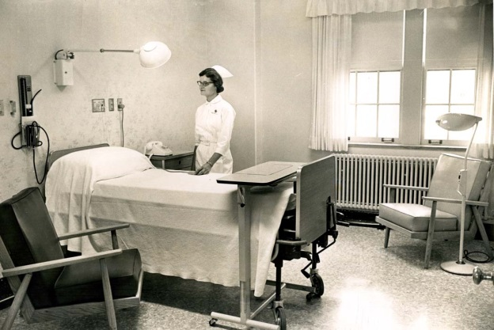
Patient SP
This is a 61 year-old female, diagnosed with myelofibrosis in November 2013 treated with ruxolitinib. Her siblings were HLA typed and her brother was found to be a 7/8 match. She went on to receive a related peripheral blood stem cell transplant from her brother on 8/8/14.
Her platelet count began to fall with the start of her preparative stem cell transplant chemotherapy (fludarabine and busulfan) and began to reach<5,000 platelets per ml around +13 days post transplant, despite daily platelet transfusions
The blood bank was consulted for thrombocytopenia, which was thought to be non-immune due to splenomegaly
Over the course of her hospital stay, her platelet count continued to drop. Her CCI reached <0 and we sent for cross-match compatible platelets. The first cross-match showed she was incompatible for most of the donor units, suggesting there was an immune-mediated etiology for her platelet refractoriness
What was the outcome?

Slide 5
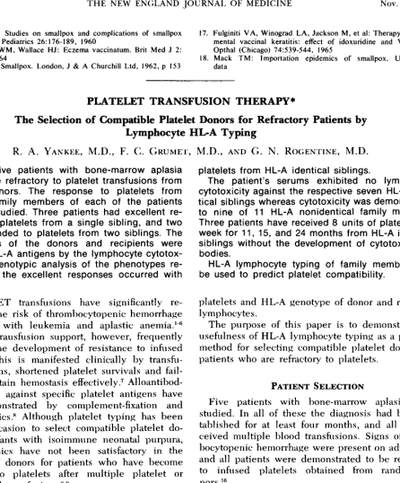
Platelet Refractoriness history
Platelet refractoriness was first identified as a major complication of chronic platelet transfusions in the 1960s
The beginning of HLA-matched platelets: In 1969, platelet refractory patients were transfused platelets from siblings. At this time the HLA antigen was only newly described, and the patients and their siblings were HLA-typed by the lymphocyte cytotoxicity test. Genotype analysis revealed better platelet responses in HLA identical siblings!

Slide 6
Over the last two decades, treatment-related mortality after aggressive chemotherapy and hematopoietic stem cell transplantation has improved. Unfortunately, many patients experience long periods of aplasia and a resultant increase in blood product utilization.
When these patients develop platelet refractoriness, clinicians will try cross-matched or HLA-matched products
Since these products and the testing for these products is significantly more costly than standard platelet units, and the products themselves are a limited resource, it is important that they be used appropriately

Slide 7
PLATELET REFRACTORINESS
  Definition: Failure to achieve an acceptable increment in platelet count following platelet transfusion on at least two occasions. The platelet count should be measured within one hour after transfusion.
  While there is a generalized belief that the 1 hour count can differentiate between an alloimmune cause for refractoriness vs. a non-immune cause, the evidence is variable
  What is an acceptable increment?
    1 unit of apheresis platelets should increase the platelet count by 30,000 to 50,000 platelets per mL in an average adult
    Correct Count Increment (CCI)
    Percent Platelet Recovery (PPR)

Slide 8
CCI
Normalizes the post-transfusion platelet counts according to the patient’s blood volume and platelet dose
CCI = [(Platelet count(post-transfusion) – Platelet count(pre-transfusion) )x BSA] / Number of platelets transfused (10¹¹)
1 unit of apheresis platelets contains ~3x10¹¹ platelets
Two consecutive CCIs of <5,000, has generally been accepted as an inadequate response to platelet transfusion
Example: A male weighing 96.5 kg, height 166 cm → BSA is 2m²
[17,000-11,000 x 2] / 3 = 4,000

Slide 9
PPR
PPR = [Total blood volume x Platelet Count Increment] / No of platelets transfused
Refractoriness is suspected if PPR <50%
Total blood volume for adults ~ 75 mL/kg
No of platelets transfused (3 x 10¹¹)
Example:
PPR = (96.5 kg x 75 mL/kg) x (17-6) / 3
= 26.5%

Slide 10
How common is platelet refractoriness?
Wide range, depending on which study
Between 20 to 70% of multi-transfused patients undergoing chemotherapy for AML can become refractory to platelet transfusions
Another study of multiply transfused patients found that of their 145 patients who had received three or more single-donor platelet concentrates during a 1 year period, forty patients (27.6%) had at least 1 episode of refractoriness
In hemato-oncological patients receiving leukoreduced blood products, only 15-25% were reported to have platelet refractoriness

Slide 11

ETIOLOGY
Refractoriness to platelet transfusion can be separated into three categories:
  62.5% due to non-immune causes: sepsis, fever, bleeding, splenomegaly, disseminated intravascular coagulation, hepatic sinusoidal obstruction syndrome, graft-versus host disease and medications (vancomycin, amphotericin, heparin, tacrolimus, cyclosporin)
  17.5% due to immune causes : alloimmunization to HLA and/or platelet specific antigens due to prior exposure from pregnancy, transfusions and/or transplantation
  20% due to combination of both

Slide 12
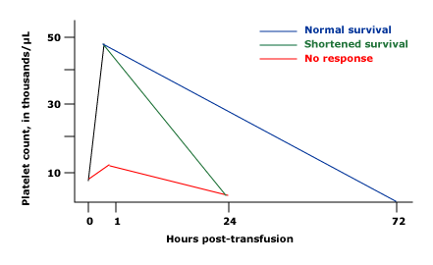
Distinguishing immune from non-immune causes
For non-immune cause:
    Normal increment at one hour following transfusion with return to baseline count within 24 hours
For immune cause:
    Little or no increment within one hour following transfusion

Slide 13
HLA class I antibodies
The most common immune cause of platelet refractoriness is due to HLA class I antibodies, estimated to be the cause of about 30-40% of the immune-related refractoriness
The generation of antibodies against HLA antigens occurs in 7% to 55% of patients after platelet transfusion, depending on the study, patient population, number and type of transfusions.
These antibodies are usually detected within the first 2 weeks of exposure. The amount of time they persist is variable.
In the Trial to Reduce Alloimmunization to Platelets (TRAP) study, 17% to 21% of recipients of leuko-reduced or ultraviolet-irradiated platelets and 45% of recipients of nonleuko-reduced platelets developed new antibodies against HLA antigens.

Slide 14
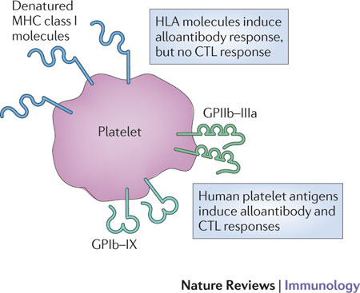

Platelets have significant levels of MHC class I molecules on their surface
Most of the molecules are MHC class I heavy chains that have been cleaved from other cells and adsorbed by platelets from the plasma
It has been estimated that 80,000 to 120,000 MHC class I heavy chains are associated with each platelet
These MHC class I molecules can be recognized by MHC-specific alloantibodies
The panel reactive antibody (PRA) represents the percentage of individuals with whom the patient’s HLA antibodies react; a PRA result >20% suggests HLA alloimmunization

Slide 15
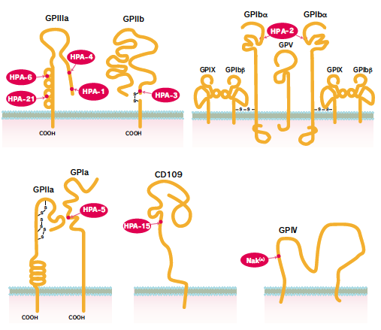
HPA antigens
There are also multiple HPA antigen types that can induce the production of anti-HPA antibodies and result in subsequent platelet transfusion refractoriness
To date, there are 24 platelet-specific alloantigens that have been identified
These antigens, however, appear to be less immunogenic than HLA antigens, and result in a lower frequency of HPA alloimmunization, with higher rates in patients who are additionally HLA alloimmunized

Slide 16
Compatible platelets for the Immune Refractory Patient
Procedures to provide compatible platelets in immune refractoriness include:
  Platelet Cross-match
  HLA-Matched
  Antibody Specificity Prediction Method (ASP)
  HLA Matchmaker

Slide 17
Platelet Cross-matching
Usually by solid-phase red-cell adherence (SPRCA) or enzyme-linked immunoabsorbent assay (ELISA)
The patient’s plasma is incubated with donor platelets in the test kit and compatibility is assessed
This method finds compatible platelets for patients with anti-HLA or anti-platelet antibodies
If several donors are compatible then immune-mediated refractoriness is unlikely, conversely, if most donors are incompatible the patient likely has an immune-mediated refractoriness

Slide 18
Platelet cross-matching
Advantages
  Used for both diagnosis and treatment, since antibody detection is inherent to the testing process
  Testing takes only several hours
  Products obtained more quickly than HLA-matched platelets
  Compared to HLA-matched platelets, there is a larger pool of compatible donors
Disadvantages
  While the test only takes several hours, there is still significant lag time from the time the sample is sent to the lab and the time compatible platelets become available to the blood bank. This is particularly concerning if the patient is actively bleeding
  Testing has to be repeated for each platelet search
  Testing is labor-intensive unless automated
  Commercial kids were temporarily unavailable

Slide 19
HLA-matched platelets
As discussed earlier, platelets have the HLA-A and HLA-B Class I antigens
The recipient’s HLA Class I antigens are typed
Donor platelets are selected from the database of donor HLA types that most closely match the recipient

Slide 20
Match grades for HLA-matched platelets
GRADE | ANTIGEN MATCHES
A | 4 antigen match
B | 2 or 3 antigen match Unmatched antigens are unknown or cross-reactive
B1U | 1 antigen unknown or blank
B1X | 1 cross-reactive group
B2UX | 1 antigen blank and 1 antigen cross-reactive
B2X | 2 antigens cross reactive
C | 1 mismatched antigen
D | 2 or more mismatched antigens
Grade A is the ideal match. Some B grade matches such as B1U or B2U can provide an adequate response, however grade C and D matches do not provide a better response than unmatched products

Slide 21
HLA-matched platelets
Advantages
  HLA type may already be on file for allogenic SCT candidates
  One-time test per patient
  Some haplotypes are relatively common
  Grade B matches can increase the number of donor possibilities
Disadvantages
  Testing takes up to 1 week to complete
  The cost per procedure of platelet concentrate preparation by HLA-matching is 5x that of the random donor concentrate
  The probability of finding a 4 antigen-matched product for patients is low, especially for those with uncommon HLA phenotypes

Slide 22
Antigen specificity prediction
Opposite approach of HLA matching
In this method, donors lacking the antigen to the antibody that the patient has are selected
This method of donor selection appears as effective as HLA-matching or cross-matching
The main advantage of this method is the increase in availability of donors compared to HLA-matched units

Slide 23

HLA Matchmaker
HLA Matchmaker is a computer program that determines HLA compatibility at the molecular level independent of identical HLA antigen matching, with the purpose of increasing the pool of donors whose products may be compatible for a given recipient
This is done by matching donor and recipient with the understanding that immunogenic epitopes are represented by amino acid triplets on antibody-accessible positions of protein sequences of HLA chains
Recent studies have shown that patients’ antibody reactivity correlates with the number of mismatched triplets against donor HLA antigens
Thus, the program can pair recipients with donors that have structurally compatible, even though distinct, HLA-antigen phenotypes

Slide 24
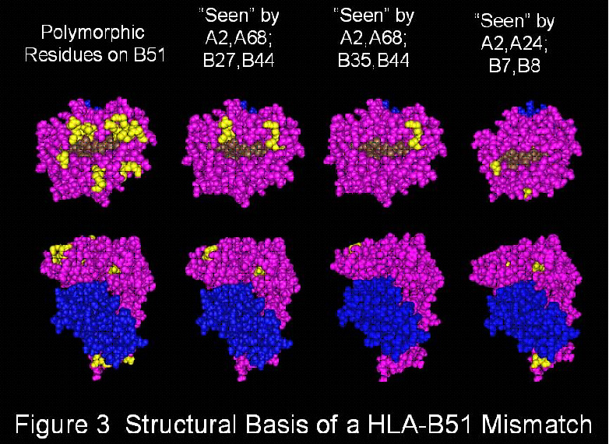
This figure shows how a mismatched antigen, here HLA-B51, has a different structural epitope pattern for each of the three HLA-A, B phenotypes shown below. For certain HLA phenotypes, a given mismatch has no or few mismatched epitopes while for other phenotypes, the same HLA antigen has many mismatched epitopes and is therefore structurally very incompatible.

Slide 25
Even with donors selected by any of these techniques, the transfusions may still have poor responses which may be related to:
  Non-immune causes of platelet refractoriness as described earlier
  Medications
  Failure to detect relevant antibodies because of insensitivity of assay systems
As patients lose their antibodies over time, it is important to do periodic assessments of antibody status to allow some patients to be returned to random donor platelet transfusions to avoid unnecessary use of more expensive and difficult to obtain products

Slide 26
Other options to consider if the platelets remain refractory to transfusion
Raising the hematocrit to 30% if the patient is also very anemic. The platelet will adhere to the vessel wall and function better as they are pushed by the red blood cells to the periphery of the vessel space (“rheostatic effect”)
Giving small-dose, frequent platelet transfusions may be helpful in maintaining vascular integrity even if there is no visible increase in the patient’s platelet count
Consider anti-fibrinolytic agents such as Amicar (aminocaproic acid). One study notes successfully managing bleeding episodes with Amicar in thrombocytopenic bone marrow transplant patients who were platelet refractory with known platelet antibodies
Can also consider NovoSeven (recombinant activated factor VII) in a patient with severe bleeding. There is a case report where it was used successfully to stop an acute bleeding episode in a patient with HLA class I antibodies with normal coagulation tests, refractory to cross-matched platelets

Slide 27
Transfusion. 2014 Jun 11

Slide 28
Utilization of cross-matched or HLA-matched platelets for patients refractory to platelet transfusion
Purpose: To evaluate the effect of cross matching and HLA matching in patients refractory to platelet transfusion
Methods:
  Retrospective analysis of blood bank records at the University of Minnesota Medical Center
  Identified 56 patients who received either cross-matched or HLA-matched platelet products over a 3 year-period
    4 excluded because of restricted patient record access
  Patients were only included if they had an inpatient hospitalization for chemotherapy or bone marrow transplant, had a confirmed positive immune-mediated platelet refractoriness work-up, and received transfusion with cross-matched and/or HLA-matched platelet units during that hospitalization
  The positive immune-mediated platelet refractoriness work-up was initiated when a patient had a post-transfusion CCI below 5,000 on at least 2 consecutive occasions
  The work-up was considered positive for immune-mediated platelet refractoriness if a platelet cross-match test result showed incompatibility with at least 1 unit tested or an HLA-antibody screen detected the presence of at least 1 HLA Class I antibody
  32 patients fit this criteria

Slide 30
Methods:
  CCI measured at 1-4 hours and 4-24 hours
  Cross-match incompatibility screen test was performed with solid phase system for the detection of IgG antibodies to the platelets
  HLA Class I antibody screen and the HPA antibody screen were performed with an assay
  Platelet products
    “random units” were matched based on ABO and Rh type
    HLA-matched units were group A, B1U, or B1X match only
    HLA-matched units were not all tested by cross-match incompatibility
  Also looked at the WHO-graded bleeding in these patients as a measure of clinical outcome (control/prevention of bleeding )

Slide 31
  Statistical analysis:
    Modeled as a Poisson variable, in which the transfusion events are independent, so that one transfusion neither diminishes nor increases the chance of another. This was appropriate for the small study size in comparing the average success rate between the 3 types of platelet transfusions (random, cross-match compatible, and HLA-matched)
    A generalized estimating equation model was used to allow for repeated observations on the same patient since in this study, most patients received more than one type of transfusion

Slide 32
  RESULTS
  All 32 patients were tested for HLA-antibodies, platelet-specific antibodies and also for cross-match incompatibility
  9 had platelet-specific antibodies
  Total of 354 transfusions for which pre-transfusion and post-transfusion 1 to 4 hr platelet counts were available
    45% (161) were random-donor units → median CCI= 0
    42% (152) were cross-matched units → median CCI= 1.7 x 10⁹/L
    13% (41) were HLA-matched units → median CCI= 1.2 x 10⁹ /L

Slide 33

    A 1-4 hr or 4-24 hr CCI of >5 x 10⁹/L was arbitrarily selected as representing a satisfactory response to a transfusion
    At 1-4hr:
      12% of random-donor units (88% poor response)
      25% of cross-matched units (75% poor response)
      29% of HLA-matched units (71% poor response)
    At 4-24 hr:
      6% of random-donor units (94% poor response)
      18% of cross-matched units (82% poor response)
      43% of HLA-matched units (57% poor response)

Slide 34

    Cross-matched platelets were 2.06 and 2.97 times more likely to give a successful transfusion at 1-4 hr and 4-24 hrs post-transplant, respectively, compared to random-donor platelets
    HLA-selected platelets were 2.47 and 6.86 times more likely to give a successful transfusion at 1-4 hr and 4-24 hrs post-transplant, respectively, compared to random-donor platelets
    HLA-selected units were 1.33 and 2.34 times more likely to give a successful 1-4 hr and 4-24 hr transfusion, respectively, compared to cross-matched units
    Are these values statistically significant?
    The average number of successful transfusions was still low

Slide 35
Interestingly, some HLA-matched transfusions did not give a good response while some mismatched-HLA units did give a good response

Slide 36
Clinical Outcome
Despite the lack of response to platelet transfusion, only 6 of the 32 patients experienced WHO grade 3 or 4 bleeding.
  WHO grade 1 and 2: mild bleeding
  WHO grade 2,3,4: clinically significant
  WHO grade 3 and 4: severe
5 of these were hemorrhagic cystitis
1 involved pulmonary hemorrhage
There were 7 fatalities in the 32 patients, 2 of which were related to hemorrhage (one to hemorrhagic cystitis, the other to pulmonary hemorrhage)

Slide 37

Recommendation
If it is clinically warranted, either or both HLA-matched and cross-matched platelets be attempted for two transfusions
If unsuccessful, regular random-donor units should be used

Slide 38
Limitations
Adequate power? The number of patients (32) and number of HLA-matched transfusions (41) was small.
Patients were not randomized to receive either HLA- or cross-matched platelets. Cross-matched platelets were usually given first because they were more readily available while HLA-matched donors had to be contacted and scheduled for donation
The “good” response to platelet transfusion was arbitrarily chosen as >5,000. Other studies have used 7,500 or 10,000 as the threshold. It is difficult to determine what number should be the cut-off for a “good” response.
Even small increases in platelet count or low numbers of circulating platelets can be effective in providing hemostasis so it is possible that the HLA or cross-match transfusions were more effective than what their numbers indicate
The patients in this study were all oncology patients and likely had many complex factors affecting their platelet counts and overall hemostasis. These complicating factors may have disrupted the results of the study.

Slide 39
Future studies
Do we need to do a larger prospective randomized controlled trial?
Is it feasible?
Even in patients with proven alloimmunization to platelet antigens, how can we separate the complex nonimmunological effects on platelet refractoriness to study the effectiveness of cross-matched vs HLA-matched platelets?

Slide 40
Alternative therapies that have been tried with little success or that need more investigation
Immunosuppressives
Rituximab
IVIG
Plasma exchange
Immunoadsorption

Slide 41
SP
Date | # cross-matched | Cost | # compatible
10/3 | 22 | 770 | 0
10/2 | 13 | 455 | 0
10/1 | 22 | 770 | 0
9/30 | 22 | 770 | 0
9/26 | 19 | 665 | 3
9/25 | 7 | 245 | 0
9/24 | 18 | 630 | 0
9/23 | 27 | 945 | 1
9/22 | 6 | 210 | 1
9/18 | 14 | 490 | 1
9/17 | 14 | 490 | 0
9/15 | 7 | 245 | 2
9/11 | 10 | 350 | 0
9/10 | 22 | 770 | 1
9/9 | 22 | 770 | 1
9/4-9/5 | 34 | 1190 | 3
9/3 | 16 | 560 | 0
9/2 | 22 | 770 | 2
9/1 | 37 | 1295 | 2
8/26 | 14 | 490 | 2
 | 368 | 12,880 | 19
Cross-matched platelet testing from 8/26 to 10/3
$35 per cross-match test at ARC
$740 per cross-matched unit sent to VUMC
Total $12,880 for testing at ARC
Total $14,060 for cross-matched units sent to VUMC
Final total for VUMC = ~ $26,940

Slide 42
SP
SP’s platelet counts were poor despite occasional cross-matched platelet transfusions. With the transfusions, her platelet counts would hover around 5,000 platelets per mL, but were often <5,000 platelets per mL and occasionally above >5,000 platelets per mL, peaking at 10,000 platelets per mL at one count.
According to her clinic notes, she continued to have nosebleeds about 3-4x a week, of about 20 minutes or less, able to stop on her own
Otherwise, no active bleeding
She received her last unit of cross-matched platelets on 9/26 with a poor response (platelet count remained <5,000 platelets per mL)
Cross-match testing was stopped after 10/3 due to lack of responsiveness to cross-matched product and persistent lack of compatible cross-matches over the last couple weeks
Clinical team decided they will try platelets from her HLA-matched brother instead, however in the meantime, her platelet count has increased to 11,000 platelets per mL on 10/13/14 with her last platelet transfusion on 9/29/14! ☺

Slide 43
Special Thanks
Dr. Allison Paroskie
Dr. Emily Coberly
Mary Johnson
Stephanie Sephel

