Slide 1
MG Neonatal Exchange Transfusion
A Paroskie

Slide 2
Prenatal History
27 year old G7P3 mom (multiple lost pregnancies) with anti-c antibody
Titer 1:4 → 1:256 → 1:128 @ 31-33 weeks GA
Titer 1: 512 @ 33 weeks GA
MCA Doppler measured serially starting at 32 weeks GA 1.4 – 1.6 MoM (multiples of median)
Mom admitted for consideration of PUBS/IUT
Monitored and baby delivered via C-section @ 36 weeks GA

Slide 3
Neonatal History
Born at 36 2/7 weeks GA, 3170 gm
APGARS 7, 8
Labs:
T bili 13.6
Hgb 6.3 / PCV 21, Retic 47.8
Antibody titer: anti-c, 1:32
Treatment:
2 x 1.5 total blood volume exchanges
IVIG x 2 days
Phototherapy

Slide 4
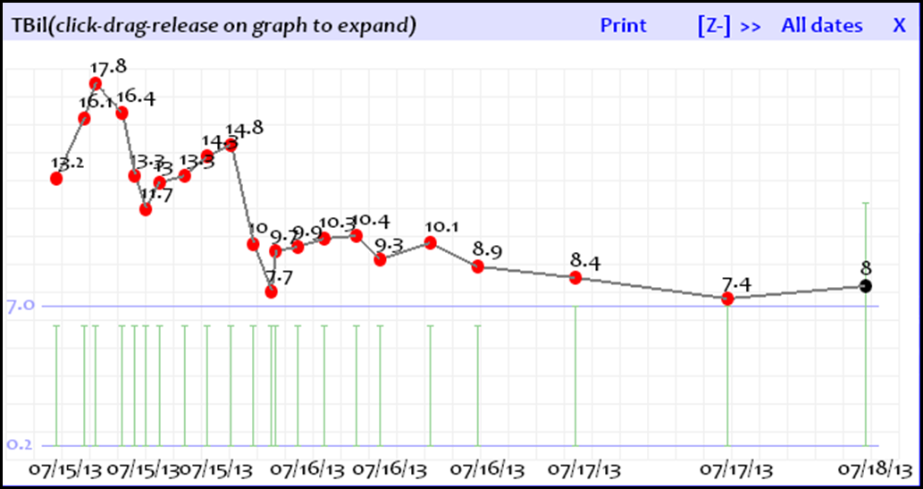
Neonatal Labs

Slide 5
Anti-c Antibodies
Rh CE blood system
Chromosome 1
Transmembrane, multi-pass protein
Highly immunogenic
c is present in 80% Caucasians, 96% Blacks, 47% Asians
Anti-c antibodies
Typically IgG (< IgM)
Results in severe hemolytic transfusion reactions and severe hemolytic disease of the newborn
Extravascular hemolysis

Slide 6
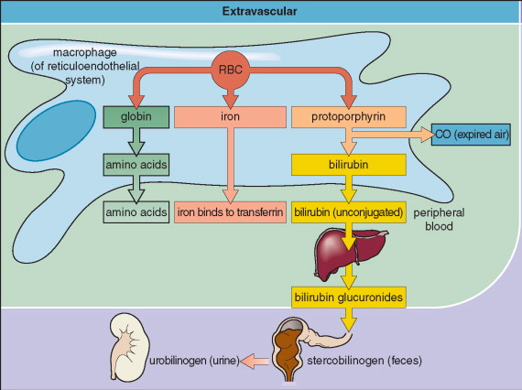
Extravascular Hemolysis
F_{C} region of antibody recognized by F_{C} receptors on monocytes and macrophages within the spleen
Monocytes and macrophages bite RBCs → spherocytes
Spherocyte RBCs are destroyed by reticuloendothelia system

Slide 8
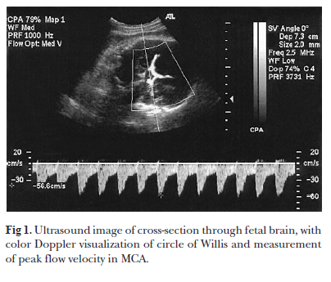
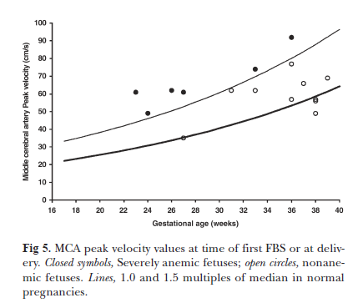
MCA Doppler

Slide 9
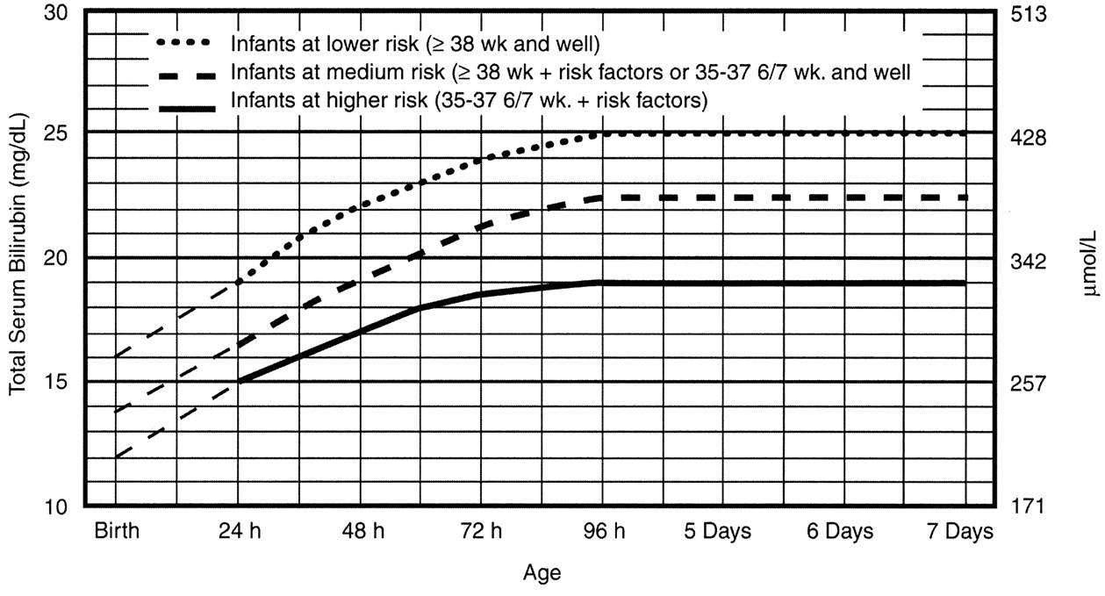
Exchange Transfusion Guidelines

Slide 11
Exchange Transfusion
Risks:
Mortality < 2%
Morbidity can reach 74%

Slide 12
Exchange Transfusion
1.5 x total blood volume
170 mL / kg = 540 mL total volume
O Rh-positive*, c-negative pRBCs
Resuspended in AB plasma
Irradiated
HCT 50-60%
* Infants < 4 months receive Rh-negative blood (per protocol), however Rh-negative (15%) + c-negative (20%) = ~ 3% of the donor population

