Slide 1
Transfusion & Sickle Cell Anemia in Pediatrics
Allison Paroskie

Slide 2
Outline
SCA: background
Transfusion therapy
  Acute treatment
    Acute anemia
    Acute chest syndrome
    Stroke
    Preoperative transfusion
  Chronic treatment
    Stroke
    Vaso-occlusive painful episodes
    Acute chest syndrome
Complications of transfusion
  Alloimmunization
  Iron overload

Slide 3
Sickle Cell Anemia

Slide 4
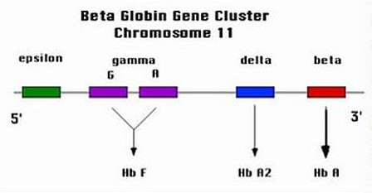
Sickle Cell Anemia
Inherited blood disorder of red blood cells
  1 in 500 African Americans (1 in 12 AA are carriers)
Autosomal recessive genetic disorder
  Defect in beta globin gene on chromosome 11
  Results in a substitution of valine for glutamic acid
Hemoglobin variants: SS, SC, S-β⁺thal, S-β⁰thal & rare variants
  Clinically heterogeneous
http://sickle.bwh.harvard.edu/hbsynthesis.html

Slide 5
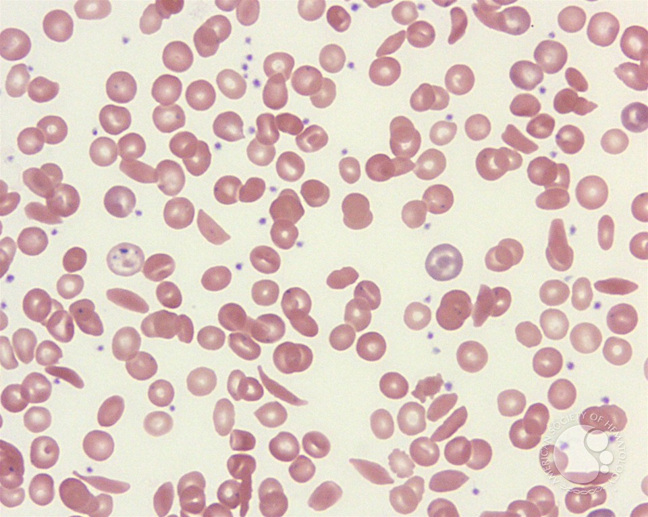
Pathogenesis
RBCs
  Irreversible sickling
  Increased blood viscosity
Hypercoagulability
  Increased thrombin generation
  Increased platelet activation
  Endothelial dysfunction
Increased adhesion to vascular endothelium
Increased inflammation
http://imagebank.hematology.org/AssetDetail.aspx?AssetID=3958&AssetType=Asset
Notes:
5

Slide 6
Clinical Complications
Bacterial infection osteomyelitis
  pneumonia
  sepsis (encapsulated organisms)
Acute pain crisis
Acute chest syndrome
Acute splenic sequestration
Aplastic crisis
Stroke
Priaprism
Ulcers
Avascular necrosis
Pulmonary hypertension
Dactylitis (painful swelling of hands & feet)
Hepatic & biliary complications
  Cholelithiasis & cholecystitis
  Hepatopathy
Ocular complications
  Retinopathy
  Vitreous hemorrhages
  Retinal detachment
Renal complications
  Acute papillary necrosis
  Chronic renal failure (hypertension, proteinuria)
Multi-organ failure

Slide 7
Transfusion Therapy

Slide 8
RBC Transfusions in SCA
Approximately 90% of patients with SCA will receive at least 1 RBC transfusion
Goals of RBC transfusion
  Improving oxygen carrying capacity by increasing Hgb level
  Decreasing blood viscosity and increasing oxygen saturation by decreasing Hgb S %
  Suppressing endogenous production of sickle RBCs by increasing tissue oxygenation

Slide 9
RBC Transfusions in SCA
Intermittent / Acute
versus
Chronic
Prophylactic
versus
Therapeutic
Simple
versus
Exchange

Slide 10
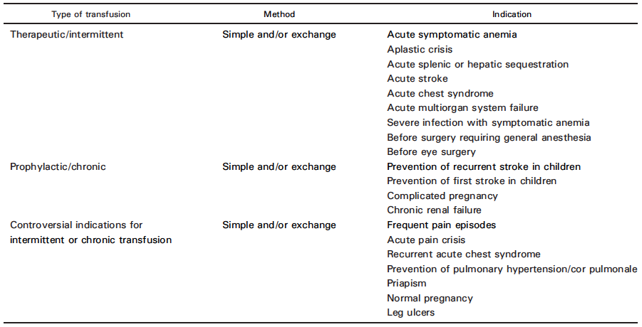
Clinical Indications
Transfusion Medicine Reviews. 2007; 21: 118-133.

Slide 11
Acute Transfusion

Slide 12
Acute Symptomatic Anemia
When / Why to Transfuse
How to Transfuse
Symptomatic anemia
  Blood loss
  Increased RBC destruction
  Suppression of erythropoiesis
    Reticulocytopenia
    Parvovirus B19
  Sequestration
Therapeutic intermittent simple RBC transfusion
  Improve symptoms of cardiac and respiratory compromise
  Slow and small volume +/- diuretic therapy
Second-line therapy
  Partial manual exchange transfusion (aplastic crisis)
  Chronic simple transfusion (recurrent splenic sequestration)

Slide 13
Acute Stroke
When / Why to Transfuse
How to Transfuse
Symptomatic stroke
  Transfusion ASAP
  Restore cerebral blood flow
  Maximize tissue O₂ delivery
  Reverse neurological injury
  Prevent ↑ neurological injury
Transfusion
  Hgb S% < 30%
  Hgb 9 – 10 g/dL
Exchange versus simple
  Optimal method for best neurologic outcomes is not clear
  ASFA Category I
  Recurrent stroke risk
Journal of Clinical Apheresis.2013; 28: 145-284.
The Journal of Pediatrics. 2006; 149: 710=712.
Notes:
Hubert et al.
Multicenter (14) study to retrospectively review exchange versus simple transfusion for acute stroke (1998 – 2000)
Patients with 5 years of chronic blood transfusion therapy after stroke
Stroke = acute neurologic symptoms and signs lasting longer than 24 hours or symptoms less than 24 hours with imaging
Exchange = manual or automated
Patients: 52
Recurrent strokes in 57% (8/14) who received simple and 21% (8/38) who received exchange transfusion
5 fold greater risk of second stroke with simple transfusion

Slide 14
Acute Chest Syndrome
When / Why to Transfuse
How to Transfuse
ACS: new pulmonary infiltrate + respiratory symptoms, chest pain or fever
  Mild respiratory symptoms
  Progressive decline in PaO₂ or O₂ saturation despite supplemental O₂
  Clinical deterioration
Exchange versus simple
  Mild symptoms: simple
  Severe symptoms: exchange
    Hgb S% < 30%
    Hgb 9 – 11 g/dL
  ASFA Category II
Transfusion results in improved oxygenation
Journal of Clinical Apheresis.2013; 28: 145-284
NEJM. 2000; 342: 1855-1865.
Notes:
Note: no randomized studies to determine need for simple versus exchange, however general practice is fairly uniform.
Exchange for patients who are not sufficiently anemic to accommodate simple transfusion or those with progressive respiratory decline or persistent hypoxia despite simple transfusion.

Slide 15
Preoperative
When / Why to Transfuse
How to Transfuse
Prophylactic preoperative
  Mortality < 10%
  Post-op complications < 5%
    Hypoxia, hypoperfusion & acidosis promote sickling
    Vaso-occlusion & organ dysfunction
TAPS
Exchange versus simple
  Aggressive regimen – exchange
    Hgb 9 – 11 g/dL
    Hgb S% < 30%
  Conservative regimen – simple
    Hgb 9 – 11 g/dL
NEJM. 1995; 333: 206-213.
The Lancet. 2013; 381: 930-938.
Notes:
Conservative versus Aggressive Transfusion regimen
551 patients and 604 operations: 303 operations in aggressive group, 301 operations in conservative group
TAPS – Transfusion Alternatives Preoperatively in Sickle Cell Disease
Multicenter study
Low-risk (adenoidectomy, inguinal hernia repair) & medium-risk (cholecystectomy, joint replacement) surgery
343 patients screened; 70 randomized: 34 no transfusion, 36 transfusion
Early study closure due to increased rates of clinically important complications in no transfusion group

Slide 16
Priapism
When / Why to Transfuse
How to Transfuse
Treatment goal: urgent relief of pain, prompt penile detumescence while preventing corporeal ischemia
Treatment
  Conservative: aspiration, sympathomimetic drugs
  Surgery: penile shunts or prosthesis
Transfusion should occur in conjunction with primary priapism treatments
  +/- efficacy of transfusion in achieving detumescence
Concern: ASPEN syndrome
  Reported 9 times in the medical literature
  Resolution > Severe neurologic deficits
Nat Rev Urol. 2011; 8: 223-230.
British Journal of Haematology. 2013; 160: 754-765.
Can J Emerg Med. 2006; 8: 119-122.
Notes:
Priapism – painful or painless, purposeless and persistent state of penile erection. Affects ~ 25% male patients with SCD.
ASPEN – association of sickle cell disease, priapism, exchange transfusion – whole or partial neurological events
Headache, vomiting, convulsions, neurological obtundation, hemiparesis and cerebral hemorrhages
Rx: supportive
Myth: blood transfusion is effective for sickle cell anemia-associated priapism.
Systematic review: 122 manuscripts, 1966 – 2004
+/- therapeutic benefit to transfusion, simple or exchange

Slide 17
Chronic Transfusion

Slide 18
Goals
Dilution of Hgb S via addition of Hgb A
Suppression of erythropoietin release via rise in Hgb, thus reduced production of Hgb S
Decreased Hgb S due to longer lifespan of Hgb A containing RBCs

Slide 19
Stroke Prevention

Slide 20
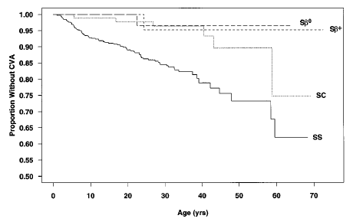
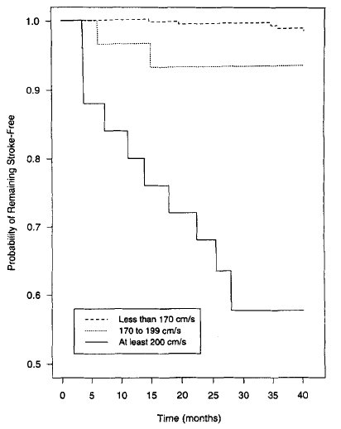
Overview
Stroke occurs by age 20 in ~11% of patients with sickle cell anemia
  Risk of recurrent stroke is estimated at 47-93%
Increased risk of stroke in patients with abnormal TCD
  Relative risk of 44
Blood. 1998; 91: 288-295.
Annals of Neurology. 1997; 42: 699-704.

Slide 21
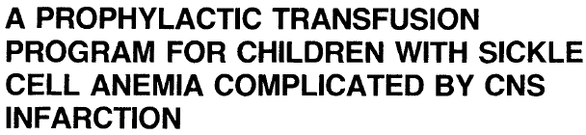
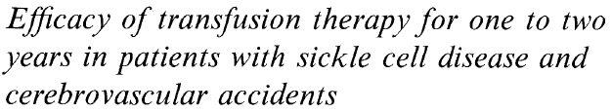
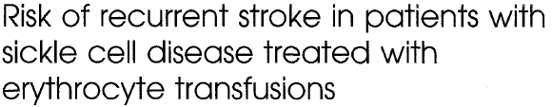
Chronic Transfusion s/p CNS Infarct
  15 children: goal < 40% Hgb S pre-transfusion
    > 9 months of transfusion therapy
    14 without new episodes of CNS infarction
  12 children; goal < 20% Hgb S pre-transfusion
    7 of 10 children had recurrent stroke after CTX stopped
  60 children; goal < 20% Hgb S pre-transfusion
    8 (13.3%) children had recurrent strokes despite transfusion therapy
Am J Hematol. 1976; 1: 265-273.
J Pediatr. 1980; 96: 205-208.
J Pediatr. 1995; 126: 896-899.

Slide 22
Purpose: to determine if chronic transfusion therapy can prevent stroke in patients with abnormal transcranial Doppler
Methods
  Prospective randomized study
  Patients: abnormal TCD x 2
    Baseline: 9.7% with abnormal TCD
  CTX: goal of pre-transfusion Hgb S < 30% and HCT 36%; Rh & Kell matched
    46 (78%) with at least one Hgb S % > 30%
NEJM. 1998; 339: 5-11.
Notes:
Note: maximum Hgb S% of 30% -- standard approach for clinical trails
Results:
130 children had abnormal TCD x 2 and agreed
63 chronic transfusions
1521 transfusions
63% simple, 12% exchange, 25% mixed
Ferritin (ng/mL): 164 (baseline) → 1804 (12m) → 2509 (24m)
10 (16%) cases of alloimmunization
Mean interval between transfusions: 25 +/- 8 days
46 (78%) with at least one Hgb S % > 30%
67 standard of care

Slide 23
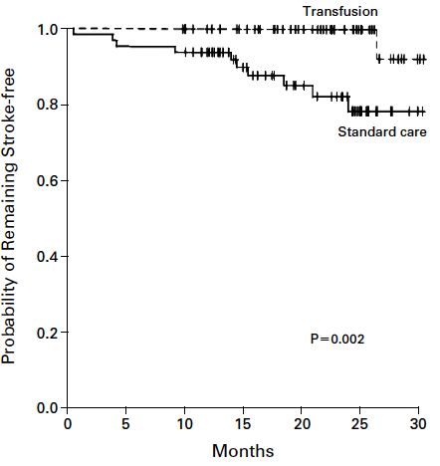
Stroke
  1/63 child CTX
  11/67 children SOC
CTX prevents stroke in children with abnormal TCD
  Mechanism is unclear
  Necessary duration is unclear
NEJM. 1998; 339: 5-11.
Notes:
Results:
130 children had abnormal TCD x 2 and agreed
63 chronic transfusions
1521 transfusions
63% simple, 12% exchange, 25% mixed
Ferritin (ng/mL): 164 (baseline) → 1804 (12m) → 2509 (24m)
10 (16%) cases of alloimmunization
Mean interval between transfusions: 25 +/- 8 days
46 (78%) with at least one Hgb S % > 30%
67 standard of care

Slide 24

Purpose: to determine if we could limit prophylaxis by monitoring patients with TCD and resuming transfusion if return to abnormal
Methods
  Prospective randomized study
  Patients: normalized TCD x 2 after 30+ months of CTX
  CTX: goal of pre-transfusion Hgb S < 30% and HCT 36 g/dL; Rh & Kell matched
  Composite endpoint: abnl TCD or stroke
NEJM. 2005; 353: 2769-2778.

Slide 25
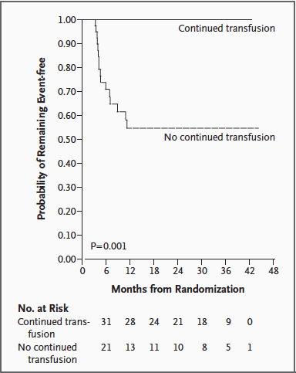
Early closure by NHLBI
  14 abnormal TCD & 2 strokes in no transfusion group
NEJM. 2005; 353: 2769-2778.

Slide 26
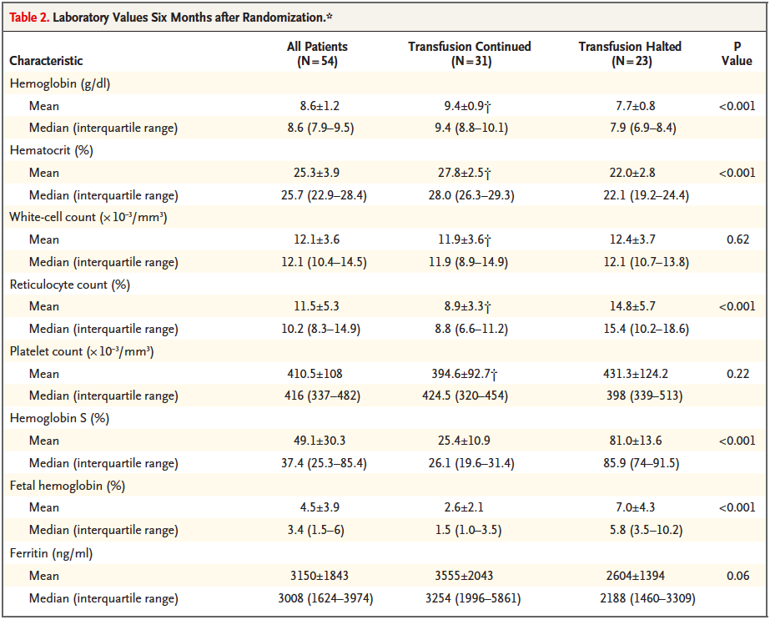
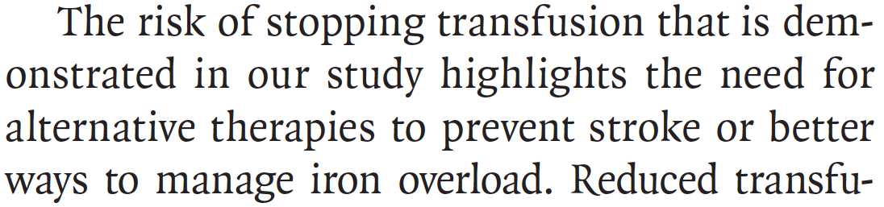
NEJM. 2005; 353: 2769-2778.
Notes:
In addition, STOP2 data was analyzed to determine the effect of discontinuing CTX on the development or progression of silent brain infarcts on MRI
21 of 79 subjects (27%) had silent infarcts
Continued transfusion
3 of 37 (8.1%) developed new brain MRI lesions
Transfusion halted
11 of 40 (27.5%) developed new brain MRI lesions

Slide 27
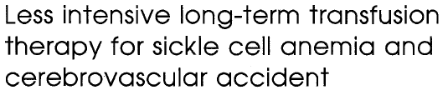
Higher Hemoglobin S % Goal
13 patients free of recurrent stroke for > 4 yrs
  Goal Hgb S % 60%
  10 pts > 1 year
No recurrent stroke
Decreased blood requirements by mean 43.9% (simple) and mean 31.4% (exchange)
15 patients free of recurrent stroke for > 4 yrs
  Goal Hgb S % 50%
  85 pt-years of follow-up
No recurrent stroke
Decreased blood requirements by mean 31% (simple) and mean 67% (exchange)
J Pediatr. 1992; 120: 54-57.
Blood. 1992: 79: 1657-1661.

Slide 28
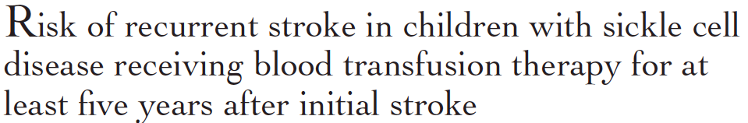
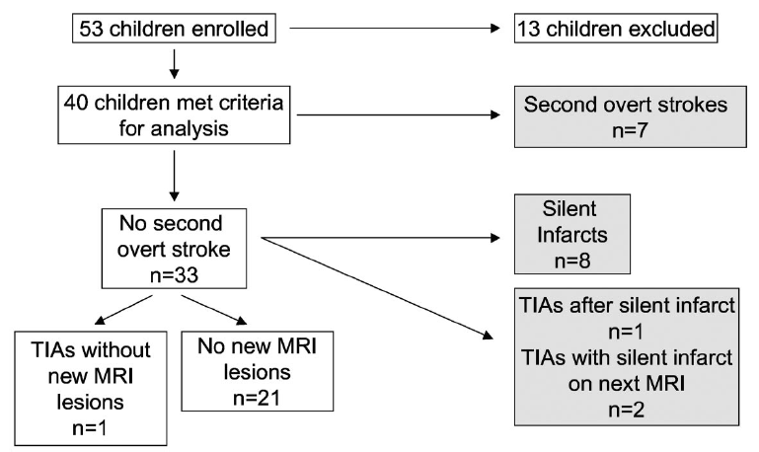
Stroke Despite Hgb S % < 30%
Retrospective cohort study
137 patients on CTX > 5 years
  Goal Hgb S % 30% x 3 years
  Goal Hgb S % at 3 years after stroke: 30 – 50%
31 (23%) had second stroke
Decreased risk of recurrent strokes if identified medical or concurrent event with initial event
Prospective cohort study
40 patients on CTX therapy
  Goal Hgb S % 30%
J Pediatr. 2002; 140: 348-354.
Blood. 2011; 117: 772-779.
Notes:
Risk of recurrent stroke:
Mean time between first and second stroke was 4.0 years (2 months – 11.5 years)
35% (11 of 31) had 2+ stroke recurrences while receiving chronic transfusion therapy
First two years, same recurrence between groups (11.5% versus 7.2%), however after two years, there were no recurrent strokes in the group that had medical or concurrent event in association with the first stroke
SIT
4 of 7 children with second strokes occurred when Hgb S % < 30% (10, 17, 21, 28)
2 of 7 children with second strokes occurred when Hgb S % > 30% (38, 48)
1 of 7 did not have Hgb S % measured
Median time between first and second stroke was 0.8 years (0.5 – 2.9 years)

Slide 29
Purpose: to determine the efficacy of hydroxyurea/phlebotomy compared with transfusions/chelation for children with SCA, stroke and iron overload
Methods
  Prospective randomized noninferiority study
  Patients: previous stroke and > 18 months transfusions and documented iron overload
  CTX: goal of pre-transfusion Hgb S < 30% + chelation at MD discretion
Blood. 2012; 119: 3925-3932.

Slide 30
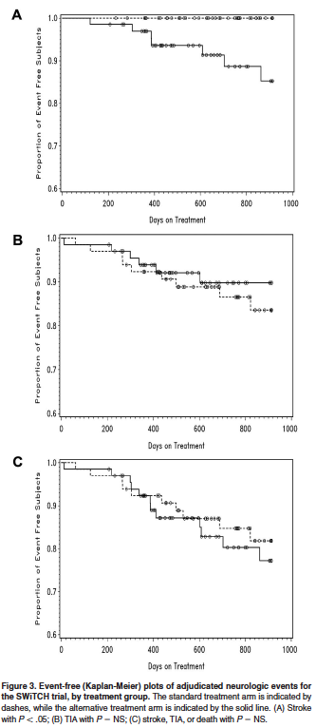
Early closure by NHLBI *
  Strokes
    7 / 67 (10%) in HU/phlebotomy
    0/66 (0%) in CTX/chelation
  Iron overload
    15.7 mg/g liver in HU/phlebotomy
    16.6 mg/g liver in CTX/chelation
* Full enrollment, 78% patient-years complete, 33% subjects with all exit data
Blood. 2012; 119: 3925-3932.

Slide 31
Summary of Stroke
Recurrence Rate
  67 % without treatment (Am J Med. 1978;65(3):461-71)
  50% with cessation of transfusions (J Pediatr 1991; 118(3):377-82.)
  22% (2.2 per 100 pt yrs) with transfusion (J Pediatr. 2002;140(3):348-54)
    Risk higher in first 2 yrs after initial stroke
Initial treatment should include exchange transfusion (J Pediatr. 2006,149(5):710-2)
Approximately 45% of the patients that are rigorously transfused will have progressive disease (overt or silent strokes) (Blood. 2011 Jan 20;117(3):772-9.
  Progressive CNS lesions based on progressive vascolopathy

Slide 32
Stroke Conclusions
Chronic transfusion therapy should maintain pre-transfusion Hgb S % < 30% and HCT 30%
  Post-transfusion goal: Hgb S% 15 to 20%, to keep maximum Hgb S% < 30%
Minimal data to support goal Hgb S % < 50% after 4 years of therapy
Transition to hydroxyurea is not supported
The major concerns for chronic transfusion therapy are iron overload and alloimmunization

Slide 33
VOC Pain and Acute Chest Syndrome

Slide 34
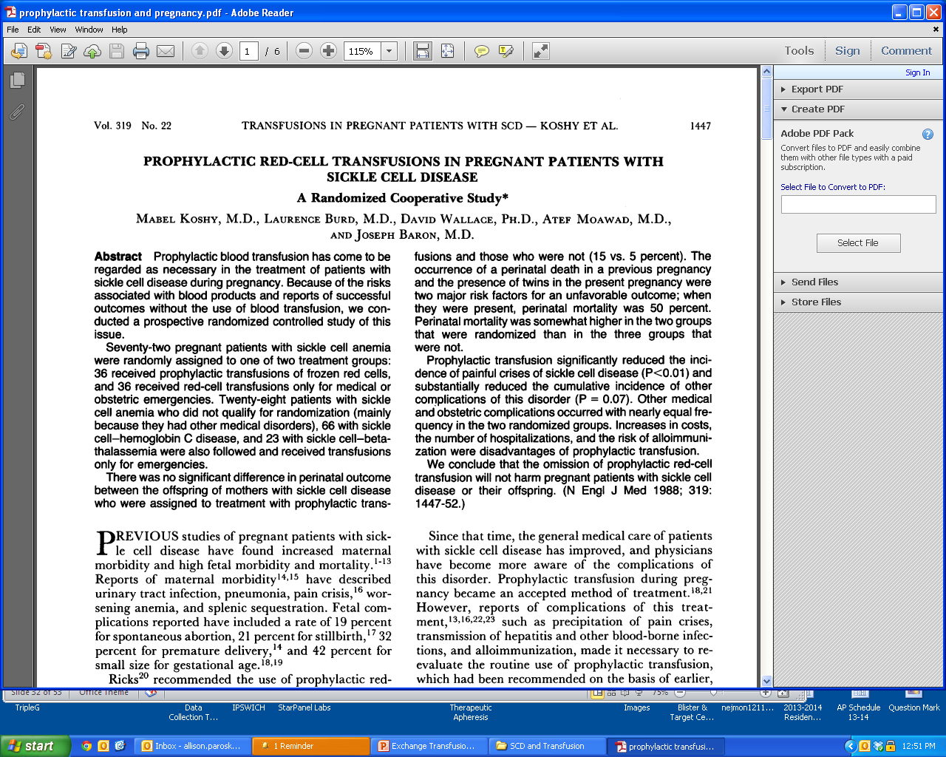
Purpose: to determine whether prophylactic blood-transfusion therapy during pregnancy reduced maternal and fetal morbidity
Methods
  Randomization < 28 weeks GA
  Patients: 36 prophylactic tx, 36 no prophylactic tx
    28 additional patients studied without randomization
  CTX: max Hgb S 35% and Hgb 10 – 11 g/dL
NEJM. 1988; 319: 1447-1452.

Slide 35
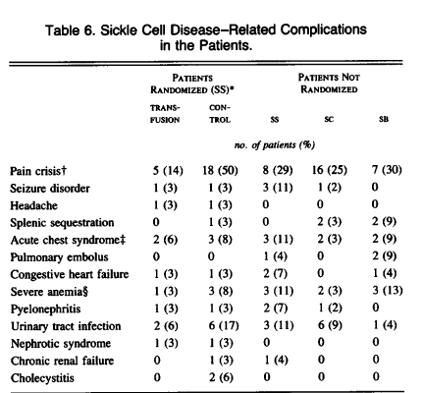
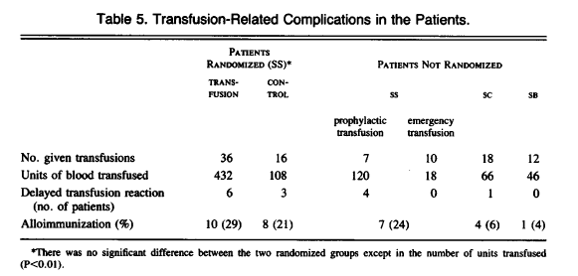
NEJM. 1988; 319: 1447-1452.

Slide 36
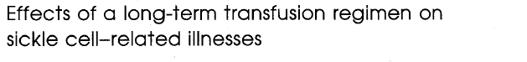
Purpose: does long-term transfusion regimen decrease hospitalizations for SCA illnesses
Methods
  Medical records review before, during and after long-term transfusion
  Patients: 13 CVA, 4 intractable pain
  CTX: monthly, goal of pre-transfusion Hgb S < 30% and Hgb 10 – 12 g/dL
J Pediatr. 1994; 125: 909-911.

Slide 37
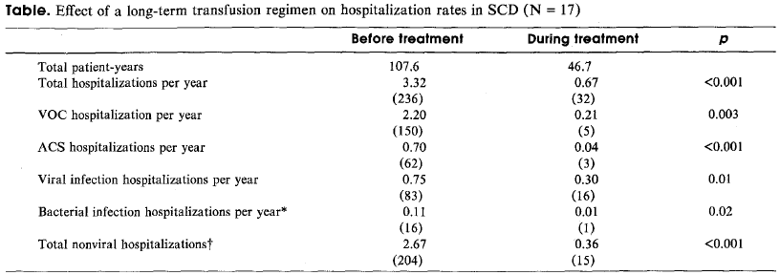
All patients demonstrated iron overload, which was controlled with chelation
J Pediatr. 1994; 125: 909-911.

Slide 38
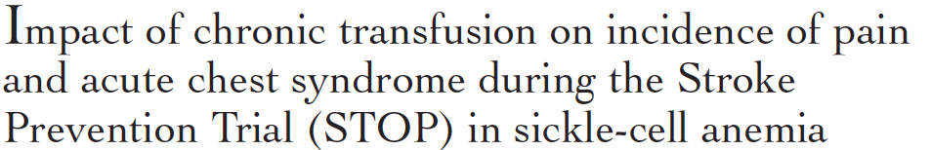
Purpose: determine the impact of chronic transfusion on the incidence and frequency of pain and ACS
Methods
  Sub-analysis of STOP trial data
  Patients: 63 chronic transfusion, 67 observation
  CTX: q21-days, goal of pre-transfusion Hgb S < 30% and HCT < 36%
J Pediatr. 2001; 139: 785-789.
Notes:
Pain: pain in the extremities, back, abdomen, chest or head for which no other explanation could be found
ACS: new pulmonary infiltrate with acute respiratory illness
*** Only hospitalized events ***

Slide 39
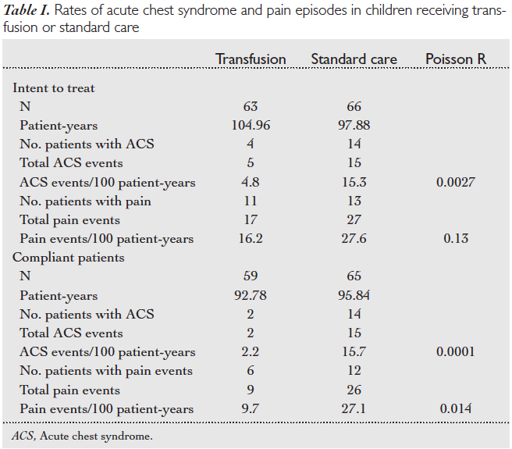
Events
  All: prior Hgb S <30%
  All – 1: tx within 30 d
Ferritin increase:
164 μg/L → 1804 μg/L
Alloimmunization: 29% versus 21%
J Pediatr. 2001; 139: 785-789.
Notes:
Point out potential confounders – e.g. compliant patients have less pain and ACS

Slide 40

Purpose: evaluation of clinical approach to manage patients with recurrent or severe ACS with chronic transfusion
Methods
  Retrospective review
  Patients: 7 single severe ACS episode, 20 recurrent ACS; CTX > 4 months
  CTX: q4-weeks, goal of pre-transfusion Hgb S % < 50%; C, E and Kell matched
J Pediatr Hematol Oncol. 2005; 27: 158.161.
Notes:
ACS: new infiltrate with consolidation on CXR along with respiratory symptoms, fever or both
Recurrent ACS: 2 or more episodes within 2-year period
Severe ACS: required ICU admission with or without intubation

Slide 41
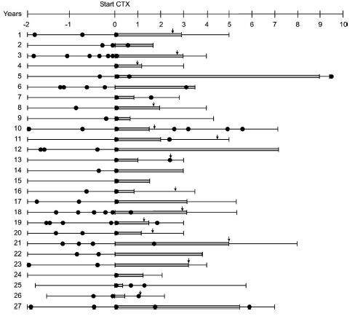
Pre-tx Hgb S %
  30-50% in 74%
  < 30% in 26%
ACS
  Pre: 1.3 episodes/pt-yr
  Post: 0.1 episodes/pt-yr
Ferritin
  Pre: 593 ng/mL
  Post: 1908 ng/mL
Alloimmunization
  4 patients (15%)
J Pediatr Hematol Oncol. 2005; 27: 158.161.
Notes:
ACS: new infiltrate with consolidation on CXR along with respiratory symptoms, fever or both
Recurrent ACS: 2 or more episodes within 2-year period
Severe ACS: required ICU admission with or without intubation

Slide 42
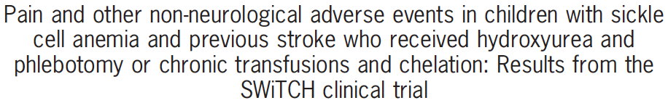
Purpose: determine whether there were differences in non-neurologic events comparing chronic transfusion & hydroxyurea
Methods
  Sub-analysis of SWiTCH trial data
  Patients: 67 chronic transfusion, 67 HU
  CTX: q4-weeks +/- 1 week, goal of pre-transfusion Hgb S < 30%
Am J Hematol. 2013; 88: 932-938.

Slide 43
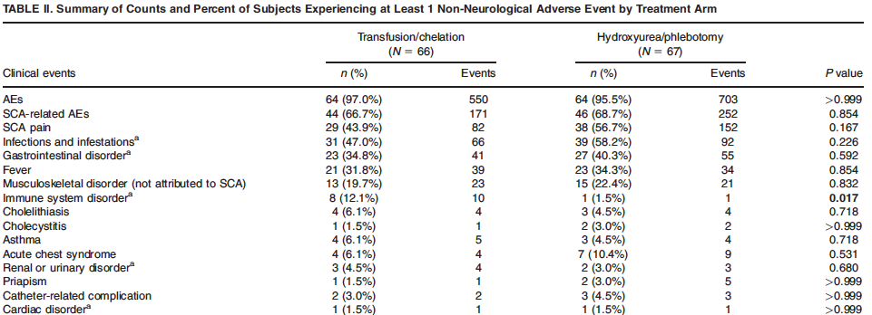
Am J Hematol. 2013; 88: 932-938.

Slide 44
Pain & ACS Conclusions
Chronic transfusion therapy may decrease incidence of VOC painful episodes and ACS however data is equivocal
  Pre-transfusion values
    Hgb S % < 30 – 50%
    Hgb < 10-12 g/dL
Larger randomized trial to demonstrate true effect of chronic transfusion for VOC & ACS

Slide 45
Complications of Transfusion

Slide 46
Alloimmunization
Development of antibodies due to antigenic differences between donor and recipient RBCs
Multi-factorial pathophysiology
  Increased number of transfusions
  Differences between immunogenic RBC antigens
    Phenotypic matching C, E and K → 3% to 0.5% per unit
  Rare antigenic variants
  Individual-specific susceptibility
    HLA genotype: HLA-DRB1*1503 (⬆ risk) HLA-DRB1*0901 (⬇ risk)
    Reduced Treg suppressive function (⬆ risk)
  SCD-specific susceptibility
    Chronic inflammation
Transfusion. 2001; 41: 1086-1092.
Am J Hematol. 2009; 84: 462-464.
Am J Hematol. 2011. 86: 1001-1006.

Slide 47
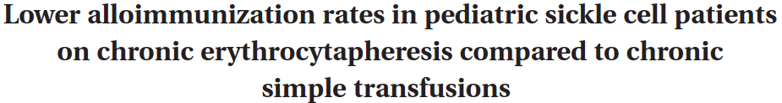
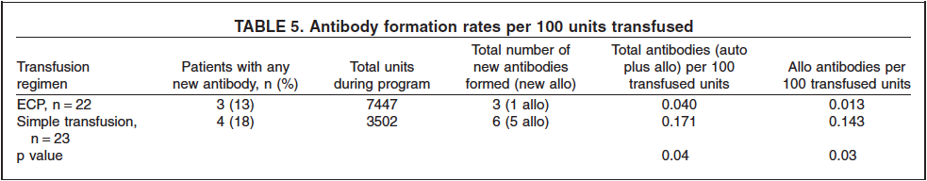
Alloimmunization
Risk ⬆ with ⬆ Transfusions
Retrospective analysis of chronic transfusion program
  (- ab) C, E and K matched
  (+ ab) Fy^{a&b}, Jk^{a&b}, S, s, M, N
45 patients on CTX
  22 ECP: 7447 units
  23 simple: 3502 units
Transfusion. 2012; 52: 2671-276.
Notes:
Decreased alloimmunization theories:
~ simultaneous exposure of a large number of antigens overwhelming the immune system
~ alterations of immune function with ECP (e.g. removal of inflammatory cells and proteins)

Slide 48
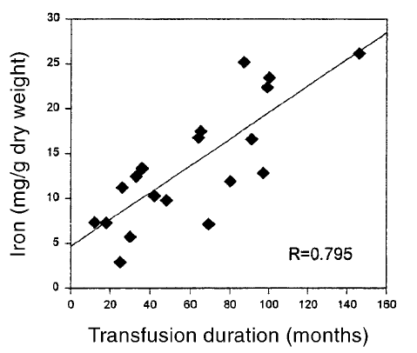
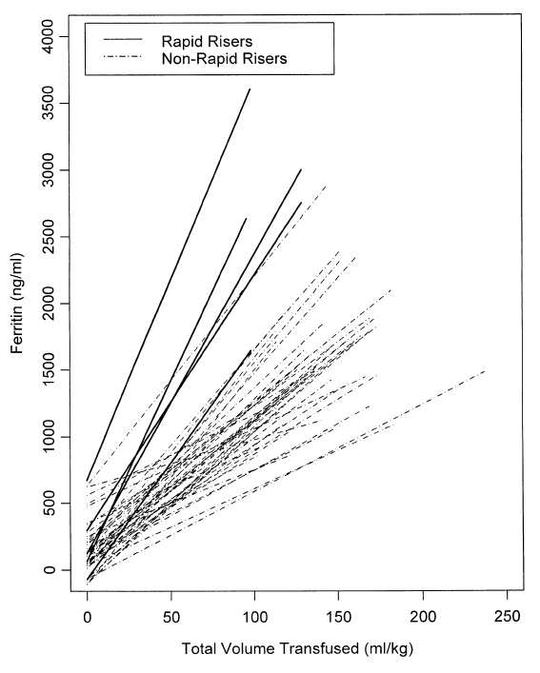
Blood Transfusion & Iron Overload
Iron accumulation is related to duration of chronic RBC transfusion / total volume of RBCs transfused
  +/- Chelation therapy with deferoxamine
Blood. 2000; 96: 76-79.
J Pedi Hematol / Oncol. 2002. 24: 284-290.
Notes:
Severity of iron overload in patients with SCD receiving chronic RBC transfusion therapy:
~ 20 patients with Hgb SS disease on chronic transfusion therapy (2-31 years old, mean 13.5 years)
- Chelation: 19 patients with deferoxamine (25 mg/kg/day 5 days per week, gradually increasing to 30-50 mg/kg/day)
- Mean duration of chronic transfusion therapy: 57 +/- 35 months
Longitudinal Changes in Ferritin During Chronic Transfusion: A Report From STOP
~ 61 patients with chronic transfusion for 8.5 – 30.2 months
- 1393 transfusions total, mean 27.9 transfusions @ 281.4 mL/kg volume
- 23 patients simple transfusion only – mean 28.3 transfusions @ 288 mL/kg
- 5 patients exchange transfusion only

Slide 49
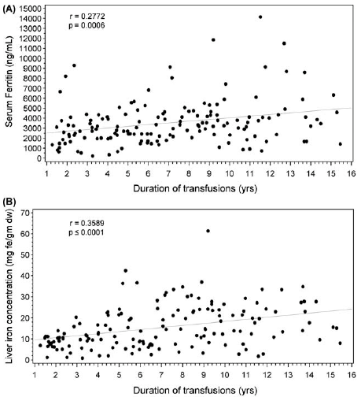
Blood Transfusion & Iron Overload
Iron accumulation is related to duration of chronic RBC transfusion
Improved chelation (deferasirox) and transfusion type (simple versus exchange) may influence affect
Am J Hematol. 2012: 87: 221-223.
Notes:
Transfusional iron overload in children with sickle cell anemia on chronic transfusion therapy for secondary stroke prevention (SWiTCH)
~ 161 patients; baseline liver iron concentration > 15 mg/g in 42.4%, serum ferritin > 2500 ng/mL in 65.6%
- Chelation: deferasirox for a mean of 2.6 years (median 2.0, range 0-12.6)
- Transfusion: simple 63.4%, partial exchange 24.8%, ECP 11.2%
- Weaker association between ferritin and liver iron than previously reported; method or transfusion and chelation

Slide 50
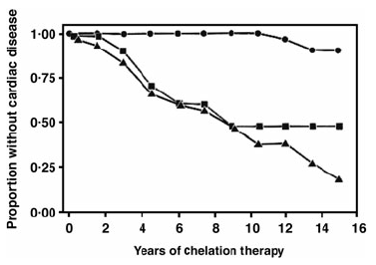
Blood Transfusion & Iron Overload
Iron accumulation results in cardiac disease
  Circles: < 33% ferritin > 2500 ng/mL
  Squares: 33-67% ferritin > 2500 ng/mL
  Triangles: > 67% ferritin > 2500 ng/mL
Vox Sang. 2009; 97: 185-197.
Notes:
Free iron accumulates in macrophages, lover and heart.
Ferritin > 1000 ng/mL is an adverse factor for survival / adverse prognostic marker for survival

Slide 51
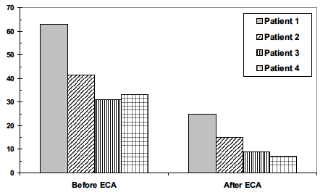
Effects of Erythrocytapheresis
Transfus Med Hemother.2008; 35: 24-30.
Notes:
Erythrocytapheresis: Do Note Forget a Useful Therapy
~ 4 patients who underwent ECP with Cobe Spectra ~ 1 total blood volume
- Goal Hgb S% < 30%
- no alloantibodies, no infections

Slide 52
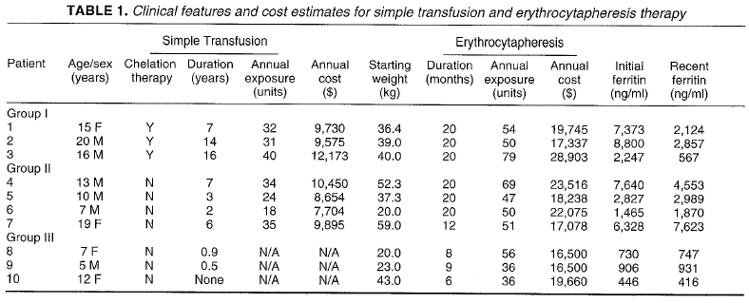
Effects of Erythrocytapheresis
J Pediatr Hematol / Oncol. 1996; 18: 46-50.
Notes:
Erythrocytapheresis Can Reduce Iron Overlaod and Prevent the Need for Chelation Therapy in Chronically Transfused Pediatric Patients
~ 10 patients who underwent ECP with Cobe Spectra for 6-10 months (mean 16 months); goal Hgb S% < 30%
- Group I: Compliant with SQ/I deferoxamine
- Group II: No chelation due to allergy or noncompliance
- Group III: No iron overload at start of study

Slide 53
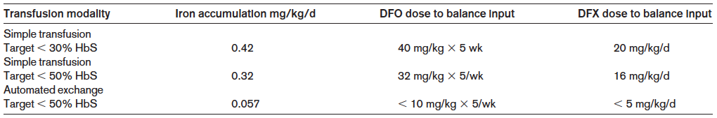
Effects of Erythrocytapheresis
Blood. 1994; 83: 1136-1142.
Hematology. 2013: 447-456.
Notes:
Erythrocytapheresis Therapy to Reduce Iron Overload in Chronically Transfused Patients with Sickle Cell Disease
~ 14 patients on ECP compared to historical controls (7 patients each with simple: < 30% and < 50%)
- 11-26 months of ECP
- 6 subjects without chelation, 5 with normal ferritin
~ ECP compared to simple < 30% and < 50% reduced iron load by 87% and 82%, respectively; however increased blood usage by 23% and 73%, respectively

Slide 54
Summary

Slide 55
Acute Transfusion
Disease Complication | Transfusion Type | Goals
Acute Anemia | Simple | Improvement of symptomatic anemia
Acute Stroke | Exchange | Minimize progressive neurovascular sickling Hgb S% < 30% Hgb 9 – 10 g/dL
Acute Chest Syndrome | Simple or exchange | Improved oxygenation Hgb 9 – 10 g/dL +/- Hgb S% < 30%
Pre-operative | Simple | Minimization of post-operative complications Hgb 9 – 11 g/dL
Priapism | N/A | Transfusion only if clinically indicated beyond priapism symptoms

Slide 56
Chronic Transfusion
Disease Complication | Transfusion Type | Goals
Stroke – primary and secondary prevention | Chronic | Pre-transfusion Hgb S% < 30% < 50 % after 4 years * Hgb S% 15-20% (post) Hgb 10-12 g/dL
Recurrent VOC Pain | Chronic ** | Pre-transfusion Hgb S% < 30-50% Hgb 10-12g/dL
Recurrent ACS | Chronic ** | Pre-transfusion Hgb S% < 30-50% Hgb 10-12 g/dL
* Based on two small studies; no randomized prospective trials
** Observational and secondary analysis data
Phenotypic matching (Rh & Kell) is of critical importance in minimization of alloimmunization
  Effect (if any) of ECP on rate of alloimmunization is currently unknown
Iron overload is a significant complication of chronic transfusion
  Chelation and/or exchange transfusion can minimize risk of iron overload

