Slide 1
Cryopreserved Platelets (CPP)
Mary-Margaret Allen
March 2015

Slide 2
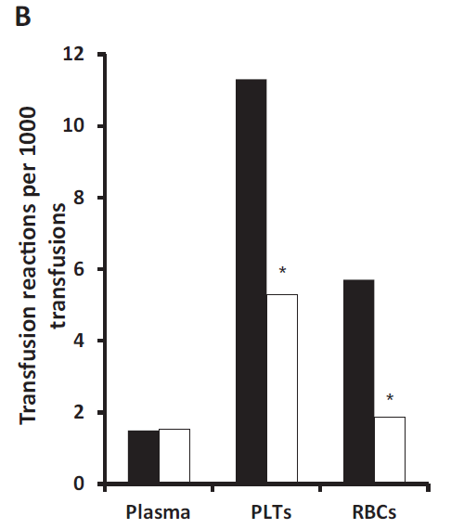
Why are platelets such a hassle?
Expensive
Short lifespan
Bacterial contamination
Activation
Greatest risk for transfusion reactions
Transfusion. 2014 Aug 22.
Notes:
Want to prevent wastage and not have them outdate
Want to ensure that there is enough product for times of need

Slide 3
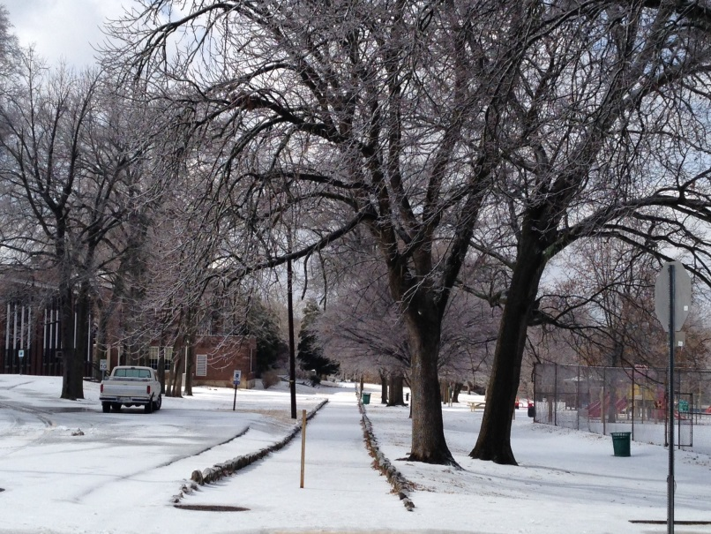
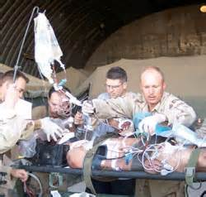
Improving storage times
Collection systems
Storage Bags
Additive solutions
Cryopreservation
Notes:
We need these products to be functional and they are so much more easily disturbed

Slide 4
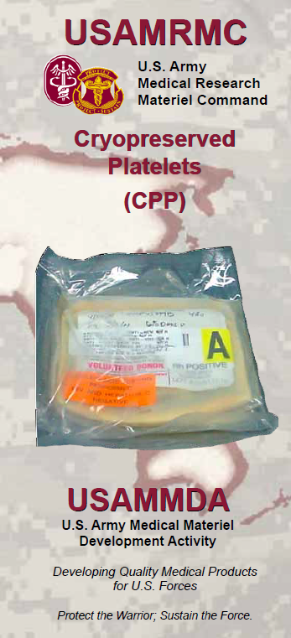
Most desired by military
Major cause of death is exsanguinating hemorrhage
Recent information from Afghanistan and Iraq have shown that up to 15% of combat casualties require massive transfusions for traumatic injuries
This is significantly higher than civilian trauma centers, reflecting the severity and polytrauma of blast-associated injuries
Rely on a “walking blood bank” for platelets
Med J Aust. 2010 Feb 15;192(4):203-5

Slide 5
What do we know about CPP?
Provides better storage time (up to 2 years)
Provides a partially activated product that appears more efficacious in actively bleeding patients – more hemostasis!
No significant adverse events to date – no recorded thromboembolic events

Slide 6
Assessing CPP’s efficacy
Platelet recovery and survival
Platelet function
In vitro testing
Platelet adhesive surface receptors (GpIb and GpIIb/IIIa)
Platelet aggregation (platelet aggregometry studies)
Thromboxane production (signal for platelet activation)
Platelet membrane procoagulant activity (phosphotidylserine expression on PLTs and PLT microparticles)
In vivo testing
Bleeding times
Cessation of bleeding and reduced blood loss/reduced blood products utilized

Slide 7
Glycoprotein 1b
Von Willebrand Factor
α_{IIB}β_{IIIA} integrin
David Gailani, MD

Slide 8
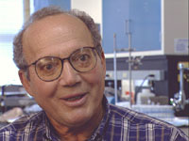
Background
Dr. Robert Valeri with the support of the US Office of Naval Research developed potential substitute for standard room temperature platelets that could be used on the battlefield
Original method, freeze platelets in 6% DMSO at -80⁰C, thaw, follow by centrifugation with washing to remove approximately 95% of the DMSO with platelets resuspended in plasma
Blood. 1972 Oct;40(4):509-13.

Slide 9
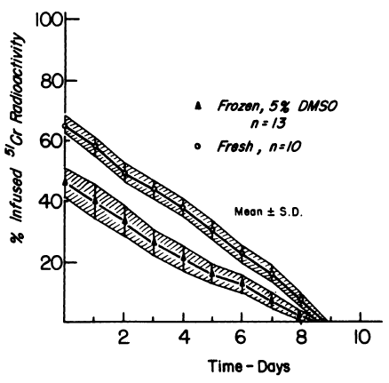
Background
Recovery of 70% of the platelets compared to fresh platelets
Lifespan 8.9 +/- 0.3 days vs 8.8 days +/- 0.3 days
Blood. 1972 Oct;40(4):509-13.

Slide 10
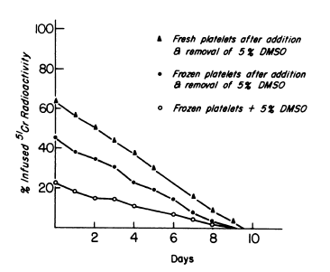
Background
DMSO
Large amounts caused nausea, vomiting, and phlebitis
This method of preparation did not cause same adverse effects
DMSO remaining in product affected the in vivo platelet recovery
Blood. 1972 Oct;40(4):509-13.

Slide 11
Old Method vs New Method
Second method developed to remove DMSO supernatant plasma before freezing
Thaw and wash time
1 hour and 15 minutes - old method
10-15 minutes – new method
Eliminates the need for centrifuges on battlefield
Small volume of each unit means less freezer space needed
Transfusion. 2005 Dec;45(12):1890-8.

Slide 12
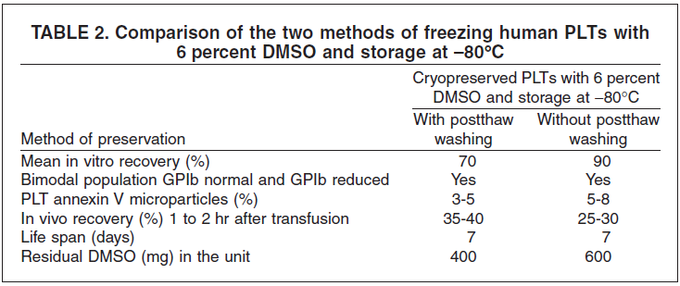
Old Method vs New Method
Transfusion. 2005 Dec;45(12):1890-8.
Notes:
**autologous plts frozen and then transfused; the recoveries are looking at radiolabeled plts and was not a function of fresh plts vs CPPs
1. Freeze-thaw-wash recovery (old method with DMSO) -- 74 +/- 2 percent with 5 percent PLT microparticles
2. Freeze-thaw recovery (new method with DMSO) -- 94 +/- 2 percent with 7 percent PLT microparticles
3. Freeze-thaw recovery (new method without DMSO) 69 +/- 9 percent with 15 percent PLT microparticles
5. In vivo recovery of PLTs frozen by the new method with DMSO and transfused into normal volunteers was 30 percent and the life span was 7 days.

Slide 13
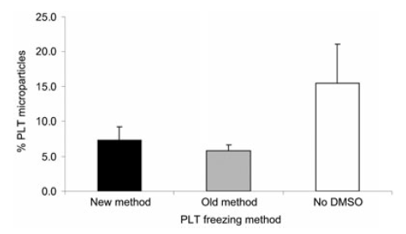
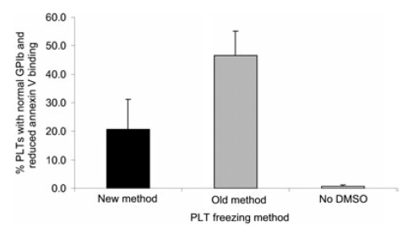
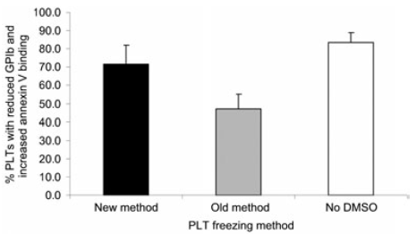
Old Method vs New Method
Transfusion. 2005 Dec;45(12):1890-8.
Notes:
Old method may be better than new method but new method may be more practical
New method with DSMO is better than without DSMO
- annexin V binding to cell surface exposed PS can be used to assess the procoagulant activity of platelets and platelet microparticles
- PS support coagulation by providing the catalytic surface on which FVa and Fxa bind and interact to catalyze later reactions in coag cascade
- annexin V binding to PS also identifies plt and plt microparticles undergoing apoptosis that are removed by tissue macrophages

Slide 14
Reconstitution after thawing
Platelets frozen in hyperconcentrated state require reconstitution
1st to study reconstitution of CPP in PAS without plasma (in vitro platelet quality)
PAS – use maximizes plasma use for other needs; greater product uniformity; reduces number of donor exposures; faster preparation
Plasma – beneficial as it is rich source of glucose and trauma patients likely require plasma in addition to platelets, potentially reducing overall volume transfused
Transfusion. 2013 Oct;53(10):2268-77.

Slide 15
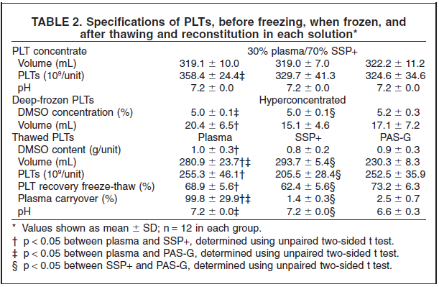
Reconstitution after thawing
Transfusion. 2013 Oct;53(10):2268-77.
Notes:
pH 5.4 vs 7.2 (PAS-G and SPP+)
PAS-G – glucose containing PAS
SPP+ no glucose and previously required plasma as well for adequate platelet recovery

Slide 16
Reconstitution after thawing
Transfusion. 2013 Oct;53(10):2268-77.
Notes:
Freezing decreases the in vitro platelet aggregation but to a lesser extent in the PAS-G (significant compared to the plasma)
Function – platelet aggregometry
CD42b – GpIb → less expression in PAS-G which may be beneficial bc this is the receptor known to increase clearing by hepatic macrophages
CD41a – GpIIb
Delta sign = signif diff bw plasma and PASG

Slide 17
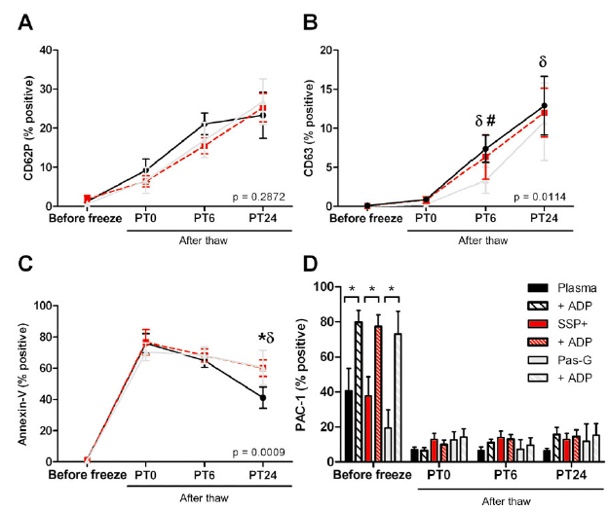
Reconstitution after thawing
Transfusion. 2013 Oct;53(10):2268-77.
Notes:
Increased markers of activation overall with the PAS-G showing less activation
Optimal time to transfuse after thawing?
All of these are markers of activation measured by flow cytometry
CD62P – p selectin
CD63 – marker of activation
Annexin-V was used as a measurement of PS expression
PAC-1 is representative of platelet activation, which recognizes a conformational epitope of GpIIb/IIIa compleex

Slide 18
In Vivo Platelet Recovery and Survival in Autologous CPP in Normal Subjects
FDA platelet acceptance criteria:
CPP recoveries should be equal to or greater than 67% of the same subject’s fresh recoveries
CPP survivals should be greater than or equal to 58% of the same subject’s fresh survivals
Transfus Med Rev. 2014 Oct;28(4):212-25.
Notes:
All apheresis platelets
no. 1 cryopreserved within 8 hours
No. 2 and 3 were stored 57 hours at 22 deg celsius followed by irradiation and then cryopreserved – thought to be a more accurate representation of routine blood center operations

Slide 19
Radiolabeled Autologous Platelet Recoveries and Survivals
Recoveries ranges from 60-73% for fresh platelets
Recoveries ranges from 32-62% for CPP
42-95% recovery compared to fresh platelets
Number of survival days were comparable between CPP and fresh platelets in almost all studies
Transfus Med Rev. 2014 Oct;28(4):212-25.

Slide 20
Using Bleeding Times to Assess Hemostasis with CPP
Normal subjects
Collect a unit of whole blood, prepare plt concentrate and cryopreserve plts for subsequent transfusion
Gave 650 mg aspirin to render their normal circulating platelets dysfunctional as evidence by the prolonged bleeding time at 24 hours
Transfuse autologous CPP and then measure a 2 and 24 hour bleeding time
Transfus Med Rev. 2014 Oct;28(4):212-25.

Slide 21
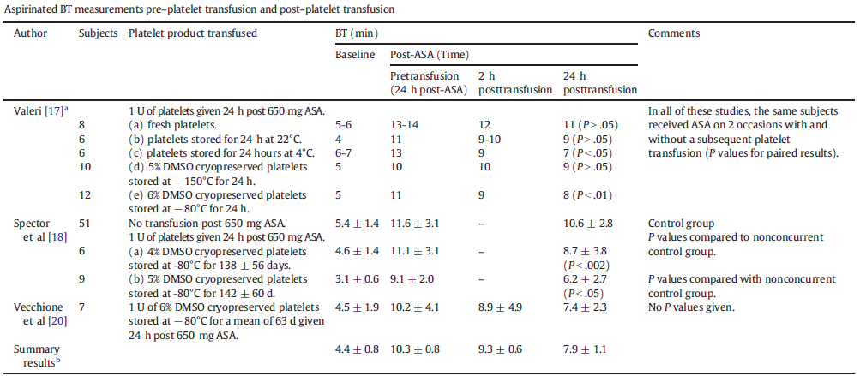
Using Bleeding Times to Assess Hemostasis with CPP
bleeding times have been shown to provide useful information during the evaluation of a patient with a bleeding history; less clear if useful in normal asymptomatic patients
Transfus Med Rev. 2014 Oct;28(4):212-25.
Notes:
At 2 hours posttransfusion, none of the CPP gave a statistically significant correction of the aspirinated BT compared to the aspirinated BT in the control nontranfused group

Slide 22
CPP superior to reduce nonsurgical blood loss
Most comprehensive study to date
Patients undergoing surgery requiring prolonged cardiopulmonary bypass
53 patients randomized to receive CPP (N=24) or liquid-preserved platelets (pooled and apheresis) (N=29)
Prepared by old Valeri method
6% DMSO + platelets → freeze → thaw → centrifuged → resuspend in plasma
J Thorac Cardiovasc Surg. 1999 Jan;117(1):172-83

Slide 23
CPP superior to reduce nonsurgical blood loss
J Thorac Cardiovasc Surg. 1999 Jan;117(1):172-83
Notes:
Patients pretty much the same
Patients with surgical bleeding were excluded

Slide 24
CPP superior to reduce nonsurgical blood loss
J Thorac Cardiovasc Surg. 1999 Jan;117(1):172-83
Notes:
no differences were noted in the hematocrit, platelet count, mean platelet volume, platelet increment, platelet survival, and bleeding time between pooled and apheresis platelets
Recovery of transfused platelet (%) = [TBV*(Posttransfusion plt count-pretransfusion plt count)]/ total plts transfused *100%

Slide 25
CPP superior to reduce nonsurgical blood loss
J Thorac Cardiovasc Surg. 1999 Jan;117(1):172-83
Notes:
Showed that the pooled and apheresis units had no significant differences except volume transfused was greater in pooled platelets
More volume and number of platelets used in liquid preserved
More blood products were used in patients receiving liquid preserved plt
Greater blood loss in patients receiving liquid preserved platelets
Repeated statistical analysis for blood loss and transfusion requirements without exclusion of any patient (intent to treat) and still found significant differences were still seen

Slide 26
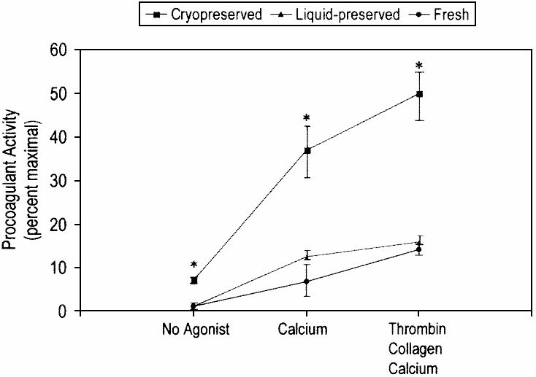
CPP superior to reduce nonsurgical blood loss
J Thorac Cardiovasc Surg. 1999 Jan;117(1):172-83
Notes:
pH signif lower than fresh and liquid preserved
Recovery from hypotonic stress lower than in fresh and liquid preserved (shown to correlate with in vivo recovery)
Plt aggregation in CPP was reduced than fresh but not diff than liquid preserved at 72 hours
Stimulation of CPP with AA or ADP resulted in significantly higher thromboxane B2 than in liquid preserved at 72 hours
Thromboxane has been shown to be reliable measure of the plts in vivo hemostatic effect
CPP had more surface procoagulant activity than liquid stored at 72 hours (measured by flow cytometry looking at platelet binding of FV-specific monoclonal antibody and then stimulating plt with thrombin, collagen, and calcium chloride compared to maximal Ab binding of plts with calcium chloride?)

Slide 27
CPP superior to reduce nonsurgical blood loss
CPP are superior to liquid-preserved platelets in reducing nonsurgical blood loss and need for blood products following CPB
Reduction in nonsurgical blood loss seen with pts who received CPP probably reflects improved in vivo hemostatic function of CPP
Some in vitro measures of plt quality (aggregation, pH, hypotonic stress) may not reflect in vivo quality after CPB, whereas other in vitro measures (platelet procoagulant activity and thromboxane production) do reflect this
J Thorac Cardiovasc Surg. 1999 Jan;117(1):172-83

Slide 28
Hemostatic activity of CPP is mediated by PS-expressing platelets and platelet microparticles
In vitro characterization of CPPs prepared by Valeri’s newer pre-freeze wash method
Platetets were pooled from buffy coats and initially suspended in 70% PAS/30% plasma
After thawing, CPPs were resuspended in large volume of plasma or in PAS
Evaluated for hemostatic activity at 0, 6, and 24 hours postthaw
TEG, thrombin generation, clot formation, and flow cytometry for PS expression, PLT microparticles, and other PLT characteristics
Transfusion. 2014 Aug;54(8):1917-26.
Notes:
TEG, clot formation, and thrombin generation measure the PS inducing clot formation

Slide 29
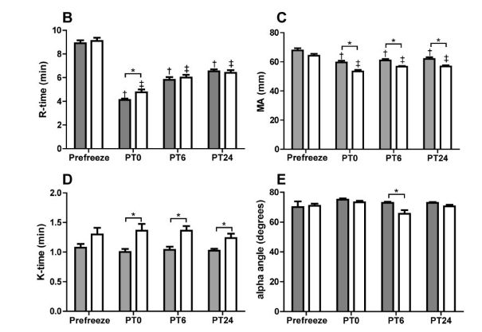
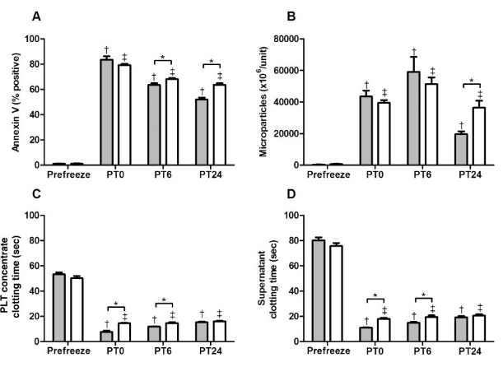
Hemostatic activity of CPP is mediated by PS-expressing platelets and platelet microparticles
K – speed of clot formation, alpha angle – clot growth, R-time - clot initiation and MA - clot strength
Transfusion. 2014 Aug;54(8):1917-26.
Notes:
K – speed of clot formation, alpha angle – clot growth
Significant decrease in time to clot initiation (R-time) and clot strength (MA – maximal amplitude)
faster clot time plasma vs PAG-G immediately after thawing
Plt in plasma had higher clot strength
R-time has previously been assoc with plt activation
High number of plt expressing PS and microparticles expressing PS
Plt in plasma showed gradual decline of PS which was lower than PAS-G

Slide 30
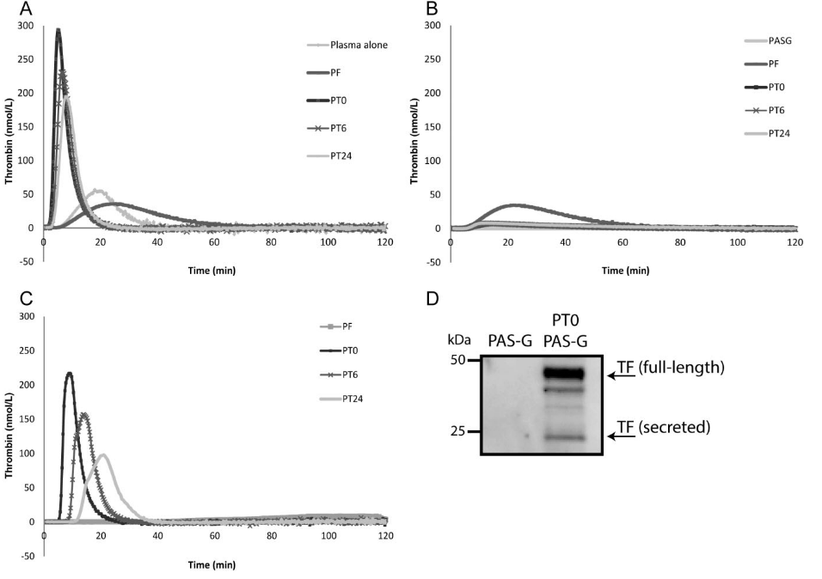
Hemostatic activity of CPP is mediated by PS-expressing platelets and platelet microparticles
CPP supernatant reconstituted in plasma + TF
CPP supernatant reconstituted in PAS-G + TF
CPP supernatant reconstituted in plasma + PL
Transfusion. 2014 Aug;54(8):1917-26.
Notes:
To determine whether the presence of exposed phospholipid on either Plt or microparticles contribute to coagulation, a Factor Xa-based phospholipid dependent clotting assay was performed
Looked at plt concentrate as well as the supernatant
CPP significantly reduced clotting times; additionally, the supernatant alone showed similar results suggesting that the microparticles are important for PL dependent clotting
Plt in plasma showed very strong thrombin generation while plt in PAS-G elicited minimal thrombin generation (absence of plasma clotting factors)
Supernatant from PAS-G was not able to generate thrombin although there was tissue factor present by western blotting

Slide 31
Armed Services Blood Program and CPP
“Frozen platelet-derived haemostatic agents are now being used by the Dutch military in Afghanistan. In fact, they’ve gone to a completely frozen blood bank. The disadvantage to a frozen product is that you need freezers…But one of the biggest advantages is that [frozen platelets] work and allow you to project a quantity of platelets to a combat surgical facility to be ready for use for incoming casualties”
Victor Macdonald, PhD, chief of the department of blood research at Walter Reed Army Institute of Research

Slide 32
Experience with frozen blood products in the Netherlands military
In 2001, frozen platelets were implemented in Bosnia
Within 6 months, 2 patients were treated
One elderly woman with GSW
One younger soldier with ITP secondary to viral infection
Both has unstoppable bleeding and platelet count barely rose with 1 CPP transfusion but bleeding stopped in 20 minutes
3 studies show effective hemostasis and reduced mortality in massively transfused patients (>10 U of RBCs), when higher number of platelets were given per patient
34 patients given mean of 5 +/- 2 U of CPP → survival 74%
12 patients given 1 CPP → survival was 50%
CPPs resuspended in plasma
Transfus Med Rev. 2014 Oct;28(4):212-25.
Transfus Apher Sci. 2006 Jun;34(3):289-98.

Slide 33
US Experience
Bilateral agreement on mutual support between the US and the Netherlands blood program
Very effective in Iraq
Dutch gets liquid RBCs from the Americans when they need RBCs faster than they could thaw and deglycerolize the cells
Americans get frozen platelet from the Dutch
Apheresis program was implemented in Baghdad in 2004, now with 4 collection sites in Iraq and Afghanistan
Transfus Apher Sci. 2013 Dec;49(3):380-6.

Slide 34
What are cryopreserved platelets?
http://www.usammda.army.mil/documents/CPP.pdf
http://www.usammda.army.mil/documents/CPP.pdf

Slide 35
Future study data to look out for…
Australian Red Cross Blood Service planned and funded a pilot study in bleeding patients after cardiac surgery
CLIP – Cryopreserved vs Liquid Platelets
Multicenter RCT evaluating safety and effectiveness in controlling coagulopathy and hemorrhage
In US, there is a Phase I, dose-escalation safety trial comparing CPP to liquid-stored standard platelets in patients who have continued WHO grade 2 bleeding despite transfusion
Notes:
CLIP - 12 months beginning mid 2014, 4 centers with 90 patients
Phase I trial – also began mid 2014 and goes for 18-24 months; phase 2 and 3 efficacy trials in patients with thrombocytopenia to follow

Slide 36
Why are they not available for routine use in the US?
“Specific preparation methods of CPP have been diverse, posttransfusion responses are often anecdotal, and outcomes have not always been rigorously and systematically compiled.”
Concern about the potential procoagulant phenotype
Procoagulant = prothrombotic
Also, not enough studies showing platelet recovery levels that would satisfy the FDA requirements
CPP recoveries should be equal to or greater than 67% of the same subject’s fresh recoveries
Transfusion. 2014 Aug;54(8):1907-10.

Slide 37
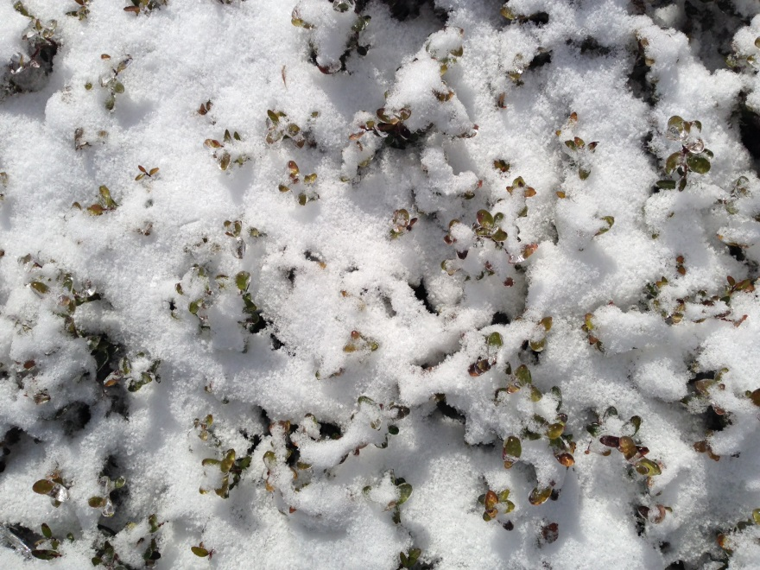
Pros
Improved availability (military operations, rural medical facilities, bridging inventory during weekends, holidays, weather, and unexpectedly high demands)
Reduce risk for bacterial overgrowth
Promising hemostatic effect

Slide 38
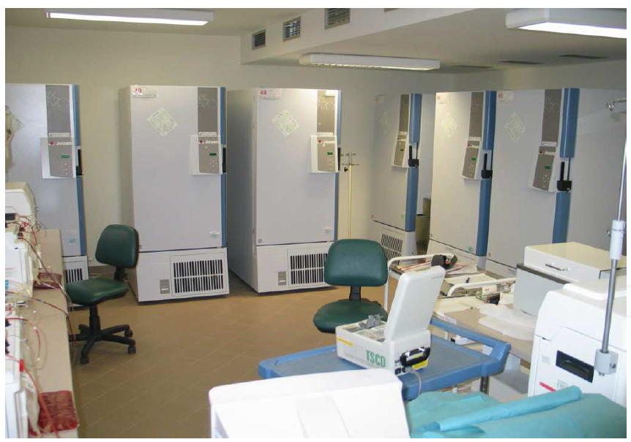
Cons
Cost of Storage
Freezer
Space
More expensive
Prothrombotic?
Unknown risk for patients who are transfused prophylactically
In review of in vivo CPP, no thromboembolic events were reported
Transfus Med Rev. 2014 Oct;28(4):212-25.
http://www.intechopen.com/books/blood-transfusionin-clinical-practice/cryopreservation-of-blood

Slide 39
Questions?

Slide 40
Resources
Oakley FD¹, Woods M, Arnold S, Young PP. Transfusion reactions in pediatric compared with adult patients: a look at rate, reaction type, and associated products. Transfusion. 2014 Aug 22.
Slichter SJ, Jones M, Ransom J, Gettinger I, Jones MK, Christoffel T, Pellham E, Bailey SL, Corson J, Bolgiano D. Review of in vivo studies of dimethyl sulfoxide cryopreserved platelets. Transfus Med Rev. 2014 Oct;28(4):212-25.
Handin RI, Valeri CR. Improved viability of previously frozen platelets. Blood. 1972 Oct;40(4):509-13.
Valeri CR¹, Ragno G, Khuri S. Freezing human platelets with 6 percent dimethyl sulfoxide with removal of the supernatant solution before freezing and storage at -80 degrees C without postthaw processing. Transfusion. 2005 Dec;45(12):1890-8.
Miloš Bohoněk (2012). Cryopreservation of Blood, Blood Transfusion in Clinical Practice, Dr. Puneet Kochhar (Ed.), ISBN: 978-953-51-0343-1, InTech, Available from: http://www.intechopen.com/books/blood-transfusionin-clinicalpractice/cryopreservation-of-blood
Khuri SF¹, Healey N, MacGregor H, Barnard MR, Szymanski IO, Birjiniuk V, Michelson AD, Gagnon DR, Valeri CR. Comparison of the effects of transfusions of cryopreserved and liquid-preserved platelets on hemostasis and blood loss after cardiopulmonary bypass. J Thorac Cardiovasc Surg. 1999 Jan;117(1):172-83; discussion 183-4.

Slide 41
Resources
Dumont LJ¹, Slichter SJ, Reade MC. Cryopreserved platelets: frozen in a logjam? Transfusion. 2014 Aug;54(8):1907-10.
Johnson L¹, Coorey CP, Marks DC. The hemostatic activity of cryopreserved platelets is mediated by phosphatidylserine-expressing platelets and platelet microparticles. Transfusion. 2014 Aug;54(8):1917-26.
Johnson L¹, Reid S, Tan S, Vidovic D, Marks DC. PAS-G supports platelet reconstitution after cryopreservation in the absence of plasma. Transfusion. 2013 Oct;53(10):2268-77.
Lelkens CC¹, Koning JG, de Kort B, Floot IB, Noorman F. Experiences with frozen blood products in the Netherlands military. Transfus Apher Sci. 2006 Jun;34(3):289-98.
Neuhaus SJ¹, Wishaw K, Lelkens C. Australian experience with frozen blood products on military operations. Med J Aust. 2010 Feb 15;192(4):203-5.
Hess JR¹, Lelkens CC, Holcomb JB, Scalea TM. Advances in military, field, and austere transfusion medicine in the last decade. Transfus Apher Sci. 2013 Dec;49(3):380-6.

