Slide 1
Pre-analytic error in Transfusion MM&I Blood Bank
Garrett S. Booth M.D., M.S.
Associate Medical Director VUMC Blood Bank

Slide 2
VUMC Pre-Analytical Error
HPI: 16 year old female brought to VUMC given motor vehicle collision
Upon arrival to VUMC ED patient was being transfused with group O Rh negative RBCs
Bilateral venous access in the dorsal veins of the hand
Tenuous clinical status with emergent need for continual transfusion support
Notes:
MRN33269051

Slide 3
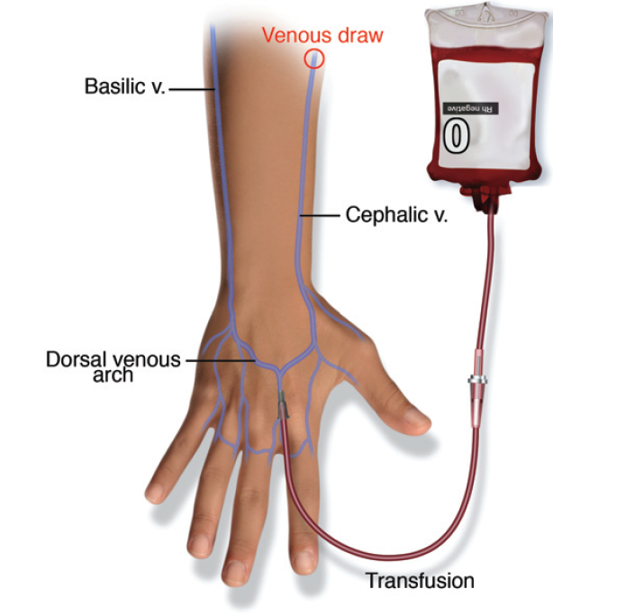

Slide 4
Specimen Testing

Slide 5
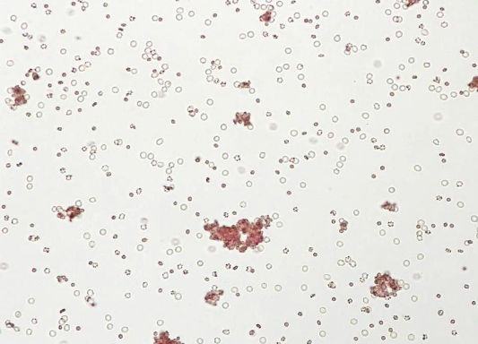
Mixed Field (MF)
More than one RBC population identified using monoclonal reagents

Slide 6
Blood Type Discrepancy?
The forward and reverse type discordance was the result of obtaining blood downstream from the transfusion site with the blood sample consisting predominantly of donor RBCs with minimal plasma
Specimen with abnormally elevated HCT
Repeat sample from the patient was requested and additional group O Rh negative RBC units and group AB FFP units were released for ongoing resuscitative efforts
AB plasma is devoid of isohemagglutinins (anti-A, anti-B, and anti-A,B), thus, the AB FFP is the universal plasma donor product
The repeat sample from the femoral vein of the patient revealed a mixed field (MF) consistent with the blood group A Rh positive

Slide 7
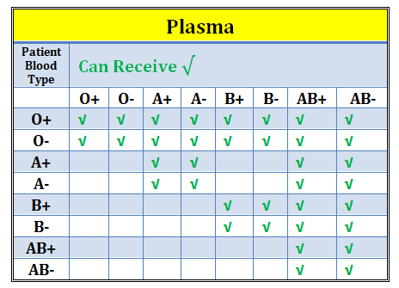
The patient was subsequently transitioned to blood type–specific products for additional transfusions and thus any potential ABO-incompatible plasma transfusion was successfully avoided
What if I can’t remember the universal donor blood types? Incompatibilites?
The VUMC blood bank will!
Massive Transfusion Protocol (MTP) uses universal donor RBC (O) and plasma (AB)
Additional truth tables are available on the VUMC blood bank website
https://www.mc.vanderbilt.edu/root/vumc.php?site=vmcpathology&doc=39082

Slide 8
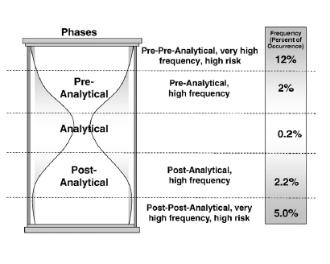
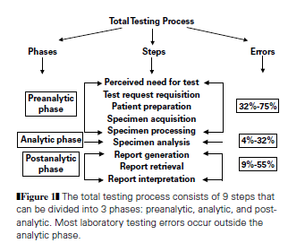
Error Phases
Notes:
Am J Clin Pathol. 2004 Jun;121 Suppl:S105-12.

Slide 9
Blood Utilization in the US
~10 million blood donors in the United States
20% of which are first time donors
38% of the US population is eligible to donate blood at any given time, less than 10% do so annually
16 million units of whole blood and red blood cells collected in the US
Every day in the US, approximately 40,000 units of blood are required in hospitals and emergency treatment facilities for patients
VUMC transfused ~70,000 units in 2011
Notes:
2006 data, which is latest available per AABB.
Previously the typical donor was a white middle aged male, now state laws are lowering age of consent for donation to 16 years of age, in an attempt to find me healthy donors

Slide 10
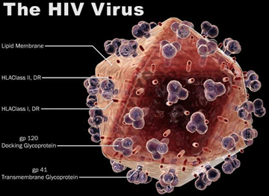
Shouldn’t We Worry about Pathogens?
The risk of noninfectious hazards, including risks related to hospital-based steps in transfusion care, is at least 100 times greater than the risk of acquiring human immunodeficiency virus (HIV) or hepatitis C virus infection through blood components
Dzik WH. Emily Cooley lecture 2002: transfusion safety in the hospital. Transfusion 2003;43:1190-8.

Slide 11
Near Miss
Pre-analytic errors can theoretically result in the release of ABO-incompatible blood products, which have the potential to cause hemolytic transfusion reactions
Hemolytic transfusion reactions are a source of morbidity and are the second leading cause of transfusion-related fatalities, accounting for 25% of transfusion-related deaths since 2005
Center for Biologics Evaluation and Research. Fatalities reported to FDA following blood collection and transfusion: annual summary for fiscal year 2010. Rockville (MD): FDA/Center for Biologics Evaluation and Research, Office of Compliance and Biologics Quality, May 2011.

Slide 12
Institutes of Medicine (IOM)
A 1999 report from the Institute of Medicine (IOM) featured a now-familiar statistic: 44,000 to 98,000 people die in hospitals each year because of preventable medical errors
Making hospital-based errors alone the eighth leading cause of death in the United States, ahead of breast cancer, AIDS, and motor vehicle accidents!
Notes:
That IOM report was the most closely followed health policy story of the year

Slide 13
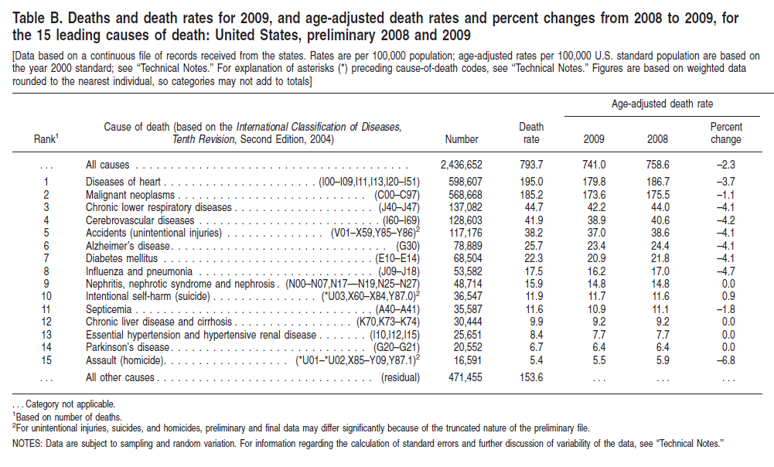
Notes:
National Vital Statistics Reports, Vol. 59, No. 4, March 16, 2011

Slide 14
Is the hospital laboratory to blame?
As hospitals evolve, there has been an increased focus on quality care, transparency, and accountability for patient care outcomes
What role does the laboratory play?
Most medical errors focus on medication related errors (typically hospital based) and their related adverse events
Yet, diagnostic errors are an area of concern!
NEJM 2002;347:1933-40.

Slide 15
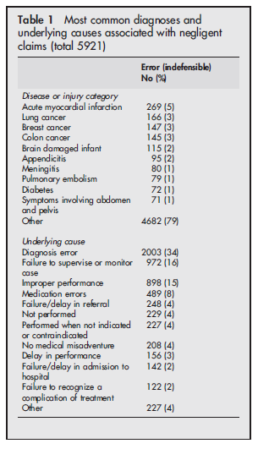

Slide 16
So how does the lab work?
The diagnostic process is highly complex!
Requires multiple disciplines!
Anatomic Pathology, Clinical Pathology
If the specimen(s) is/are mishandled, mislabeled, or mixed up, the result can be devastating!
Incorrect specimen
Incorrect patient
Incorrect blood product

Slide 17
The Lab
Laboratory tests have also evolved to incorporate quality indicators
Determine analytical performance
Turn around time
Cost effectiveness
All of these (and those not listed) have the same goal in mind-deliver laboratory services in a safe, rapid, efficient, effective, and equitable way to enable to best patient care possible (in an effort to stay in line with the IOM report, hospital policy, and regulatory requirements!)

Slide 18
Simple system…many errors
Blundell's gravitator: Blood from the donor dripped into a cup fixed several feet above the arm of the recipient and was directed through tubing into the recipient's vein.
Blood. 2008 October 1; 112(7): 2617–2626
Notes:
From 1873 to 1880-cow, goat, and human milk were transfused as a blood substitute

Slide 19
Specimen collection
Specimen transport
Blood Bank Receipt
Analytical testing of donor blood product
Patient
Analytical testing of patient sample
Cross-match
Analytical data entry
Medical technologist check and re-check
Blood bank electronic and physical issue of blood product
Receipt of blood product (pneumatic tube or cooler
Blood product two-person check
Blood product and patient check (wristband)
Transfusion of blood product. Documentation.

Slide 20
Pre-Analytical
UK Serious Hazard of Transfusion (SHOT)
60% of the near-miss events reported were errors made at time of sample collection
Phlebotomy
US
Long standing requirement to report transfusion related fatalities (FDA CEBR), yet this is a post-analytical error
Since 2001-biologic product deviations (BPDs)
Requires reporting from time of component issue (i.e. when it leaves the blood bank)-therefore capturing analytical and pre-analytical error
AABB requirement since 2005 to monitor near misses

Slide 21
Pre-analytical
Specimens that failed to meet the criteria for specimen acceptance were 40 times more likely to have a blood grouping discrepancy.
Strict adherence to the labeling requirements results in a significant decrease in erroneous blood grouping. This would accordingly diminish the likelihood of transfusing out-of-group blood components
Transfusion. 1997 Nov-Dec;37(11-12):1169-72.

Slide 22
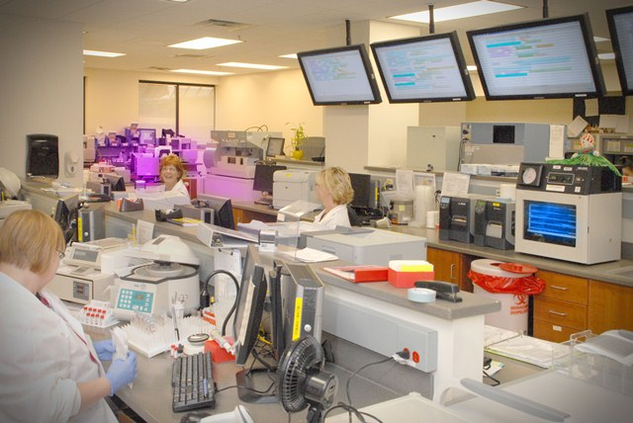
Thank you for your continued commitment to excellence in patient care and quality control!

Slide 23
Acknowledgements
Thank you to all those involved in the rapid identification of the pre-analytic error and subsequent refresher training
Penny Szklarski, Chaitali Patel, Dr. Colt McClain, Dr. P. Young, Stephanie Sephel, Mary Johnson, Kevin High, and Susan Cortez

