Slide 1
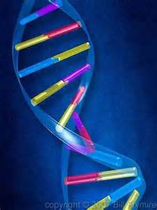
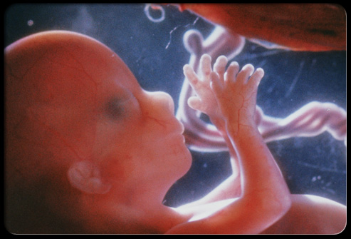
Noninvasive prenatal testing for determination of fetal blood groups
Laurie Lee, MD, PhD
Blood Bank Rotation
May 2016

Slide 2
Tumors release cell-free DNA (cfDNA) into circulation
Mandel P, Metais P. Les acides nucleiques du plasma sanguin chez l'homme. C R Seances Soc Biol Fil 1948;142:241–3
cfDNA present in blood of healthy individuals
Leon SA, Shapiro B, Sklaroff DM, Yaros MJ. Free DNA in the serum of cancer patients and the effect of therapy. Cancer Res 1977;37:646–50
Increased concentrations of cfDNA in circulation of cancer patients
Stroun M, Anker P, Maurice P, Lyautey J, Lederrey C, Beljanski M. Neoplastic characteristics of the DNA found in the plasma of cancer patients. Oncology 1989;46:318–22
cfDNA from cancer patients shares features of tumor DNA

Slide 3
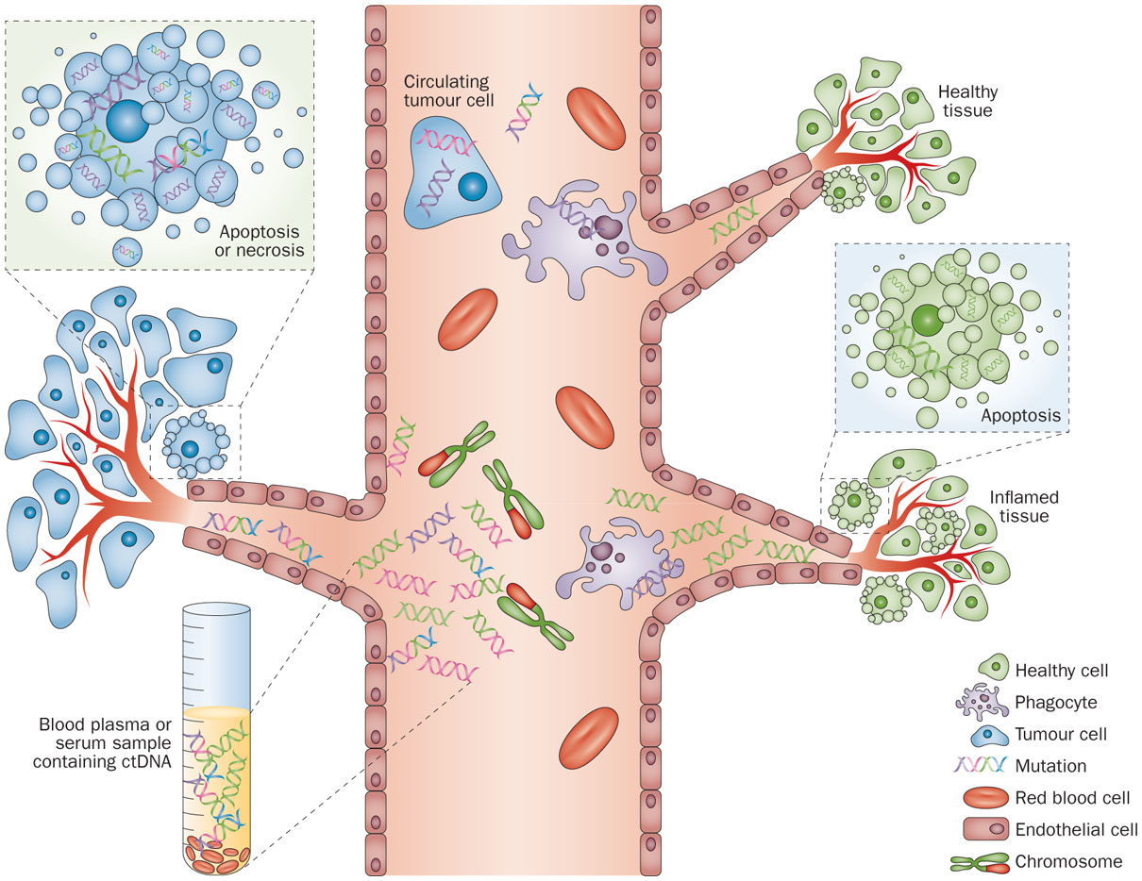
The liquid biopsy: monitoring cancer genetics in the blood
Crowley, E. et al. (2013) Nat. Rev. Clin. Oncol. doi:10.1038/nrclinonc.2013.110

Slide 4
“Traditional” prenatal testing for fetal chromosomal and genetic disorders
Utilizes maternal age, biochemical, and ultrasound markers
Positive screening leads to further diagnostic testing to obtain fetal DNA for definitive diagnosis
Involves invasive procedures (e.g., chorionic villus sampling, amniocentesis) with risk of miscarriage (0.5-1%)
Suboptimal → Efforts to find non-invasive approaches to directly interrogate fetal genetic material

Slide 5
The advent of non-invasive prenatal testing (NIPT) of cell-free fetal DNA (cffDNA)
Early research focus: maternally circulating fetal cells (rare)
Breakthrough: identification of cell-free fetal DNA in maternal circulation
Led to development of NIPT for detection of paternally inherited genetic features not present in the maternal genome
First application of NIPT – fetal sex determination
Conventional PCR to detect Y chromosome sequences
Positive result → indicative of male fetus

Slide 6
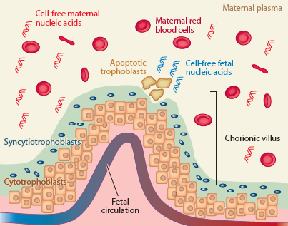
Cell-free fetal DNA in maternal circulation
Wong and Lo (2016) Annu Rev Med 67: 419-32

Slide 7
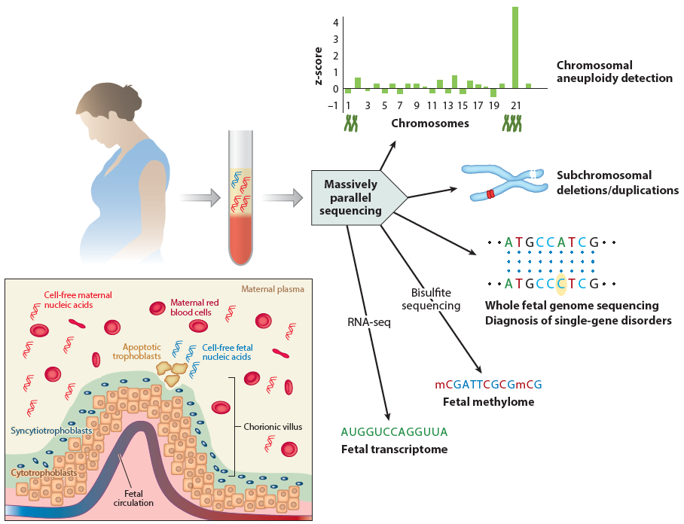
Overview of currently available applications of MPS-based NIPT
Wong and Lo (2016) Annu Rev Med 67: 419-32

Slide 8
Characteristics of cell-free maternal versus fetal DNA
Liao et al (2014) Clin Chim Acta 428: 44-50
Notes:
Fetal cfDNA peak 143 bp
Maternal cfDNA peak 166 bp
Stable – blood samples can be transported for several days in EDTA tubes

Slide 9
Avoiding false negatives: Methods for determining fetal fraction of cell-free circulating DNA
-Y chromosome markers (but only useful for male fetuses!)
-Fetal epigenetic markers
RASSF1A promoter (tumor suppressor gene)
Hypermethylated in placental cells
Hypomethylated in maternal cells
Methylation-sensitive restriction enzymes followed by PCR → Allows detection of placental-derived hypermethylated RASSF1A sequences in maternal plasma
Has proven to be reliable and practical universal marker for the presence of fetal DNA in clinical assays
And another strategy:
Straver et al (2016) Prenatal Diag 36, 1–8

Slide 10
The RhD blood group is the major cause of HDFN
If fetal blood enters maternal circulation → Pregnant woman can become immunized to a paternally inherited fetal antigen →
Upon 2nd stimulus (current or future pregnancy), woman produces
IgG antibodies that cross placenta and promote RBC destruction →
Hemolytic disease of the fetus and newborn (HDFN)
Blood group families most important in HDFN: Rh, Kell, Kidd, Duffy
Introduction of prenatal RhD prophylaxis in the late 1960s → reduced RhD immunizations from ~17% to 0.8-1.5%
(and further reduced to ~0.2-0.4% with both prenatal and
postnatal RhD prophylaxis)

Slide 11
Second application of NIPT (after fetal sex determination) – Fetal RHD typing
Fetal RhD type can be prenatally determined based on detection of the fetal RhD gene (RHD)
The most common molecular basis of the RhD negative blood type is a complete absence of RHD
Therefore, the presence of RHD in an RhD negative pregnant woman is indicative of an RhD positive fetus
2006-2008: Three large-scale feasibility studies demonstrated the high accuracy of noninvasive fetal RHD typing applied as a prenatal screening method

Slide 12
Targeted prenatal RhD prophylaxis based on fetal RHD testing
In the United States:
~528,000 pregnancies in RhD negative women each year
Most RhD negative pregnant women are managed without knowing the fetal RHD status
Clinical benefits of fetal RHD testing + targeted RhD prophylaxis:
RhD negative women carrying an RHD negative fetus can avoid unnecessary exposure to a blood-derived product (RhD)
Reduced surveillance activity for RhD negative women carrying RHD negative fetus
Intensified monitoring for RhD negative women carrying RHD positive fetus (serial titers; middle cerebral artery Dopplers)
Cost saving (?) – use less RhD versus cost of fetal RHD testing
Psychological benefits of having this information
Reduced need for cord blood typing

Slide 13
Fetal RHD testing: the European experience
2001: Real-time PCR-based prenatal testing of RhD immunized women first implemented as a routine clinical service in England
On the heels of large-scale feasibility studies (2006-2008):
Noninvasive fetal RHD typing applied as a screening method adopted nationally in Denmark and The Netherlands (and parts of Sweden, Belgium, France, and England)
In Sweden, introduction of early prenatal screening of fetal RHD in combo with targeted prenatal prophylaxis → reduced immunization incidence from 0.46% to 0.26% within <5 years
2013-2014: Cord blood RhD typing terminated in The Netherlands and Denmark (considered redundant with prenatal fetal RHD typing)

Slide 14
Prenatal fetal RHD typing: assay design considerations
The “easy” part (at first glance):
Looking for presence of RHD sequence in an RhD negative mother
Lends itself well to PCR-based assay design
Why it is not so easy:
>200 variants of RhD: may be gene-positive but phenotypically RhD negative due to “silent” RHD variant
Assay must navigate among these variants, avoiding both false-negative and false-positive predictions of fetal RhD type (typically sample several exons of RHD gene)
Assay must avoid targeting the homologous RHCE gene in the Rh blood group system that shares ~94% sequence identity with RHD

Slide 15
Prenatal fetal RHD typing: Avoiding false-positive and false-negative results
False-negative results (fetus – RhD positive; test result – RhD negative)
Central objective of fetal RHD typing: AVOID false-negative results
Most common causes:
Low levels of cffDNA
Failed DNA extraction
Human error
False-positive results (fetus – RhD negative; test result – RhD positive)
Most commonly related to RHD complexity – may have mutation not sampled by assay

Slide 16
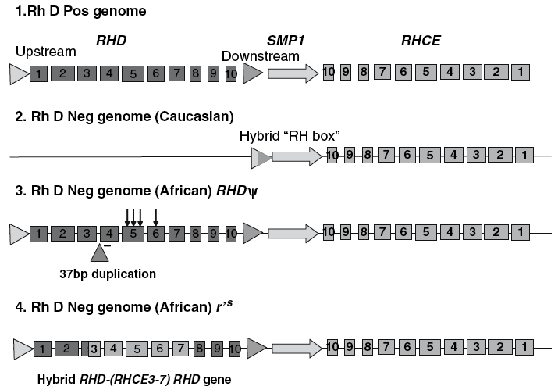
RH locus structures of common RhD phenotypes
Avent (2008) Methods Mol Biol 444: 185-201
Notes:
Fig. 1. RH locus structures of the common RhD phenotypes. Illustrated are the
genomic structures of the RH genes (located at 1p34-36) in 1) normal D-positive
individuals; 2) most Caucasian D negatives and a high proportion (approx 20%) of
Europeans and North Americans of African descent; 3) RHD pseudogene found in
individuals of African descent; 4) gene structure of the hybrid RHD-RHCE-RHD gene
found in r’s (Cdes) phenotypes; and 5) RHCE gene (and derived in r’s) exons (depicted
as blue boxes) and RHD (red). Mutations in RHD (missense in exon 5, nonsense in
exon 6) are depicted as arrows.

Slide 17
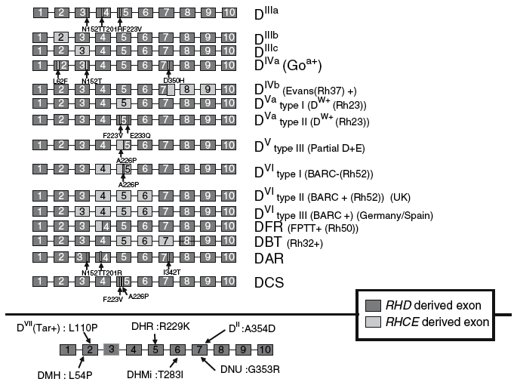
Molecular bases underlying some partial D phenotypes
Avent (2008) Methods Mol Biol 444: 185-201
Notes:
Fig. 2. Molecular bases underlying some partial D phenotypes. Depicted are some of
the first described partial D phenotypes, generated to two different genetic mechanisms:
hybrid RHD-RHCE genes (top) and by SNPs in the RHD gene (bottom). RHD exons
are represented as red boxes and RHCE as yellow. The pertinent amino acid exchanges
that result from the SNP are indicated by an arrow, as are the partial RHCE-to-RHD
exchanges. The name of each partial D is indicated to the right of the panel and
indicates which low-frequency Rh antigen the phenotype expresses. A full list of partial
D alleles is available at http://www.uniulm.de/%7Efwagner/RH/RB/).

Slide 18
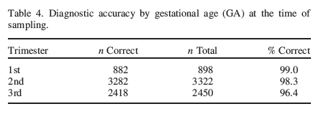
“Diagnostic accuracy of non-invasive fetal RhD genotyping using cell-free fetal DNA: a meta analysis” (41 studies; 1998-2013)
352 “substandard samples” excluded
Yu-juan et al (2014) J Mat-Fetal & Neonatal Med 27: 1839-44
Notes:
To cite this article: Yu-juan Zhu, Ying-ru Zheng, Li Li, Hao Zhou, Xi Liao, Jian-xin Guo & Ping
Yi (2014) Diagnostic accuracy of non-invasive fetal RhD genotyping using cell-free fetal DNA:
a meta analysis, The Journal of Maternal-Fetal & Neonatal Medicine, 27:18, 1839-1844

Slide 19
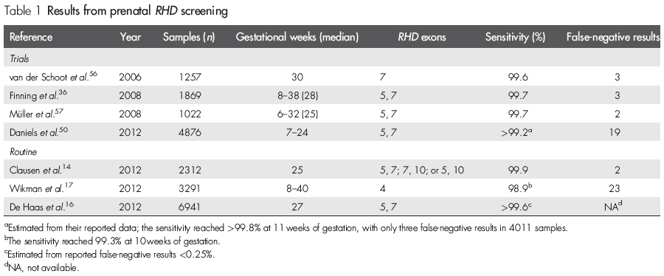
Published reports of results from prenatal RHD screening
Clausen et al (2014) Prenat Diagn 34: 409-15

Slide 20
Sequenom, Inc.
In recent press release from company:
Based in San Diego, CA
Sequenom Laboratories, a CAP-accredited and CLIA-certified molecular diagnostics laboratory, has developed a broad range of laboratory tests, with a focus principally on prenatal care
First quarter 2016 revenues of $27.6 million

Slide 21
Sequenom’s SensiGeneTM Fetal RHD Genotyping assay: Exons tested
Controls:
TGIF (control for successful cell-free DNA extraction)
Y-chromosome markers: SRY, DBY, and TTTY2
Tynan et al (2011) Am J Obstet Gynecol 204: 251.e1-6

Slide 22
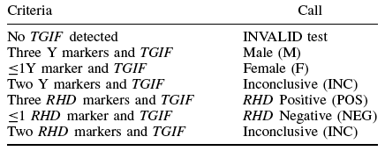
Sequenom’s SensiGeneTM Fetal RHD Genotyping assay: Calling rules
Bombard et al (2011) Prenat Diagn 31: 802-8

Slide 23
SNP analysis by single base primer extension and MALDI-TOF mass spectrometry
Oeth et al (2009) Methods Mol Biol 578: 307-43
Notes:
Fig. 20.3. The iPLEX genotyping reaction. Each single nucleotide polymorphism (SNP)
locus is amplified via PCR in a multiplexed reaction using site-specific forward and
reverse primers containing a 10-bp mass tag which increases the mass of each PCR
primer to prevent their interference with the post-PCR primer extension product resolution
of the MALDI-TOF MS system. Following PCR, the reactions are incubated with
shrimp alkaline phosphatase to dephosphorylate any unincorporated dNTPs prior to
primer extension. Single base primer extension reactions are then carried out in an
allele-specific manner using terminator nucleotides so that all four bases can be
resolved on the basis of their mass relative to their primer and all other products
generated in the reaction. Primer extension products are then desalted via cation
exchange, dispensed onto a silicon array preloaded with matrix and genotype products
masses (in daltons), and their allele ratios resolved with a MALDI-TOF MS system.

Slide 24
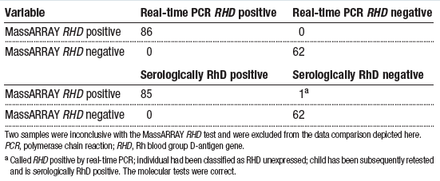
Validation of Sequenom’s MassARRAY-based RHD assay in 150 pre-characterized clinical samples
Tynan et al (2011) Am J Obstet Gynecol 204: 251.e1-6

Slide 25
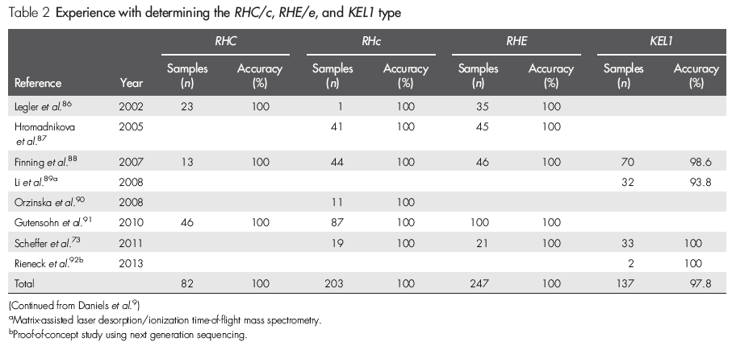
Non-invasive prenatal genotyping of other (non-RHD) fetal blood group antigens
Clausen et al (2014) Prenat Diagn 34: 409-15

Slide 26
Next-generation sequencing-based assays for noninvasive prenatal testing of fetal blood group genotypes: Rationale
Fetal RhD typing
Easily detected against the complete absence of maternal RHD
RHD possesses several differences from RHCE
Fetal RhC/c, RhE/e, and KEL1/2 typing
Phenotypes determined by single nucleotide polymorphisms (SNPs)
Using PCR – difficult to maintain high specificity of allele-specific amplification (due to high maternal DNA background and only the SNP difference between fetal and maternal targets) → maternal DNA interference may cause false-negative results

Slide 27
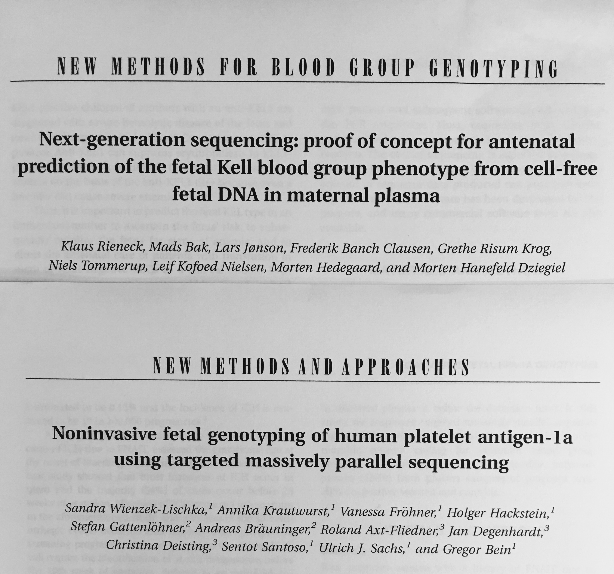
Next-generation sequencing-based assays for noninvasive prenatal testing of fetal blood group genotypes
Rieneck et al (2013) Transfusion 53: 2892-8
Wienzek-Lischka et al (2015) Transfusion 55: 1538-44

Slide 28
Questions?
http://www.illustrationsource.com/stock/image/520612/dna-double-helix-in-the-shape-of-a-question-mark/?&results_per_page=1&detail=TRUE&page=1

