Slide 1
ABO Incompatible Renal Transplants
End of Rotation Talk
Margaret L. Compton
4/1/16

Slide 2
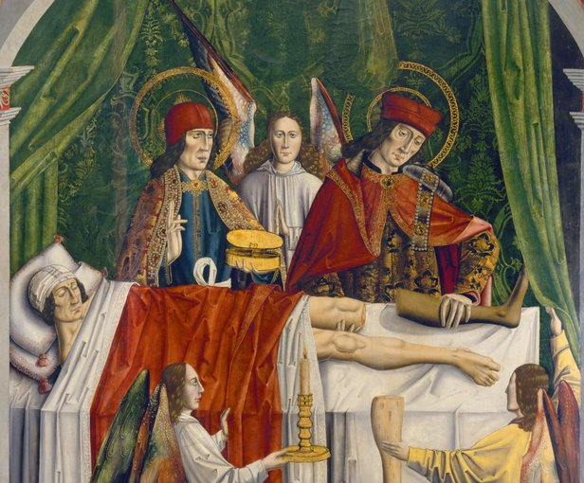
The Early Years
Notes:
St. Cosmos and Damien: Physicians and early Christian martyrs who died in Syria in 278 AD. They are shown here performing a leg graft. They are the patron saints of physicians and surgeons and are venerated in Utica, NY during a 2 day celebration.

Slide 3
History of Solid Organ Transplants
Graz 1901: Erwin Payr develops new methods of vascular suturing
Vienna 1902: Emerich Ullmann transplants a dog kidney into the neck of another dog
Lyons 1906: Mathieu Jaboulay grafts a pig kidney and a sheep kidney to the brachial artery of two human patients using graft techniques described by Alexis Carrell
Morris, PJ N Eng J Med, 2004 (351;26)
Notes:
Neither patient did well.

Slide 4
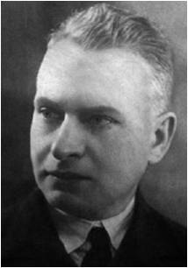
History of Solid Organ Transplants: Allografts
Kherson Ukraine 1933: Yu Yu (Yurii) Voronoy performs first cadaveric renal allograft
26 year old female with renal failure secondary to suicide attempt by mercury poisoning
6 hour warm ischemic time, ABO mismatch, no immunosuppression: graft lasted 2 days
5 more allografts with graft survival of 2-7 days
Matevossian E Int. J. Transplant. 2009 (1132-1139)
Notes:
Concept of blood groups had been described by Landsteiner in 1901 and the 4 blood groups were described by Jan Jansky in 1907 ( in fact Voronoy had been an active research participant in blood transfusion, as well as the dubious field of testicular xenografts)

Slide 5
History of Solid Organ Transplants: Early Immunology
“Our previous work allows the overall conclusion that one of the reasons for an allograft rejection is the existence of a local mesenchymal, as well as general, immunobiological reaction, which led to the formation of specific antibodies and finally to the elimination of the allograft”
Y.Y. Voronoy
Matevossian E Int. J. Transplant. 2009 (1132-1139)
Notes:
Voronoy aware of ABO mismatch, but felt the blood of the recipient (group O) would perfuse the organ (group B) and “by the… rules of Landsteiner would cause no agglutination”

Slide 6
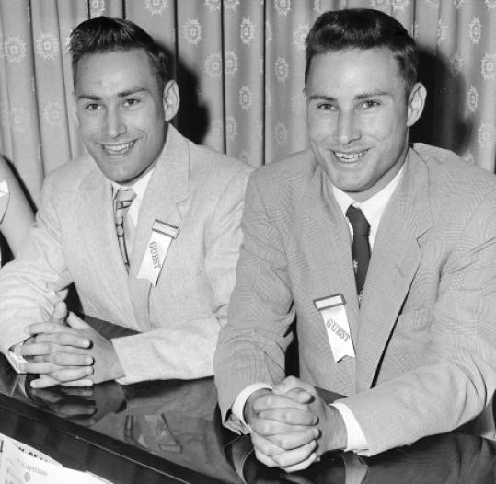
History of Solid Organ Transplants: Postwar
1950s: total body irradiation as immunosuppression
1954: Living donor transplant between twin brothers, Richard and Ronald Herrick
1960s-1980s: Introduction of 6-MP, corticosteroids, azathioprine, cyclosporine, mycophenolate, tacrolimus, sirolimus, OKT3...
Boston.com
Morris, PJ N Eng J Med, 2004 (351;26)
Notes:
Herrick twins: Richard Herrick (recipient) would go on to live 9 more years following the transplant

Slide 7
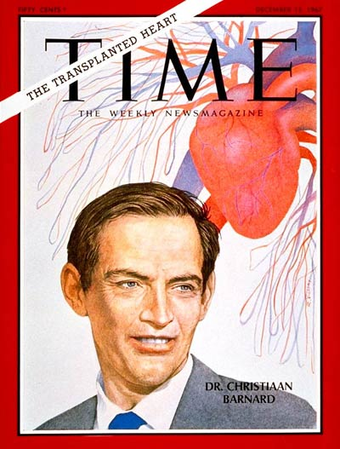
Other History of Solid Organ Transplants
1963: Startzl et al. perform a series of 5 liver transplants at UC Denver. None lived past 23 days.
1963: Dr. James Hardy performs the first lung transplant at the University of Mississippi. Patient dies of other medical issues shortly afterward.
1967: Dr. Christiaan Barnard performs the first heart transplant at the Groote Schuur Hospital, South Africa. Patient died due to pneumonia 18 days later
Lungtransplantfoundation.org
Mazza G et al. Journal of Hepatology 63 (2): 523–524.
Columbiasurgery.org/hearttransplant

Slide 8
Pediatric Heart Transplant: Challenges
Size mismatch
Difficulties of using VAD as a bridge to transplant (use of ECMO)
Other anatomical complexities

Slide 9
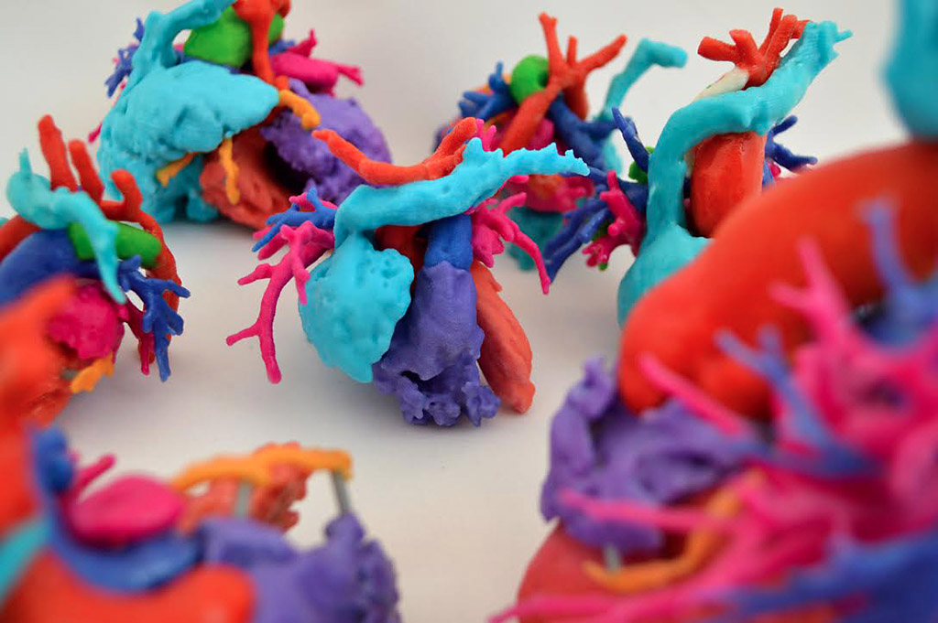
Pediatric Heart Transplant: Challenges
Phoenix Children’s Hospital Heart Center Cardiac 3D Print Lab
Notes:
Technical challenges due to complex anatomy of congenital heart defects

Slide 10
Pediatric Heart Transplant: ABO Incompatible
Newborns do not have pre-formed ABO antibodies, do not develop them until 6-18 months of age
Wait list mortality: ~½ of children died waiting for transplant, so Drs. West and Rebeyka at Sick Children in Toronto performed ABOi transplants on 10 children (reported in 2001)
8 survived for at least 11 months
None of the 8 had AMR, even the 2 patients who developed alloantibodies against donor blood type
West L et al. NEJM 2001 Mar 15; 344(11):793-800.
Fan XH et al. Nature Medicine. 2004 Nov;10(11):1227-33.
Notes:
Patients aged 4-14 months, with defects including multiple types of anatomic defects (some with prior attempts at surgical palliation), restrictive cardiomyopathy, dilated cardiomyopathy, and endocardial fibroelastosis. The two patients who died had grafts that lasted 24 and 29 days respectively. One patient died due to aspiration pneumonia (evidence of mild cellular and humoral rejection), the other due to poor graft function thought to be drug related.

Slide 11
Pediatric Heart Transplant: ABO Incompatible
Demonstration of tolerance:
Much lower titers (1:32) than average age matched controls (1:256)
Patients receiving A hearts had low levels of A antibodies and normal levels of B antibodies
In addition, there appeared to be some immunomodulatory effect on HLA antibodies
Success of Toronto group was replicated in the US (patients limited to <1 year of age with titers <1:4)
Urschell S et al. Am J Transplant. 2010 Jan;10(1):149-56.

Slide 12
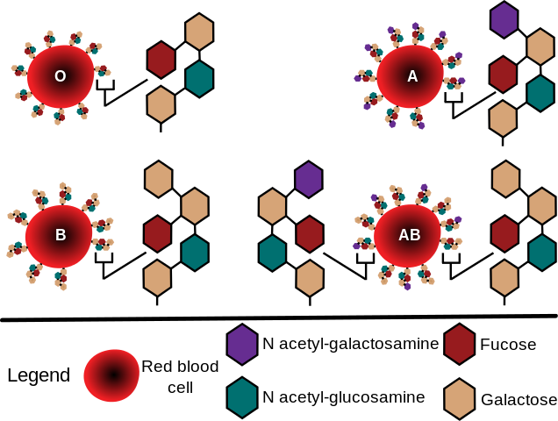
Immunobiology: Correlation with Vaccine Research
Notes:
Many pathogenic bacteria contain polysaccharide capsules with similarity to blood group antigens. It is noted that infants do not develop immune response to polysaccharide based vaccines (without conjugation) until later in life

Slide 13
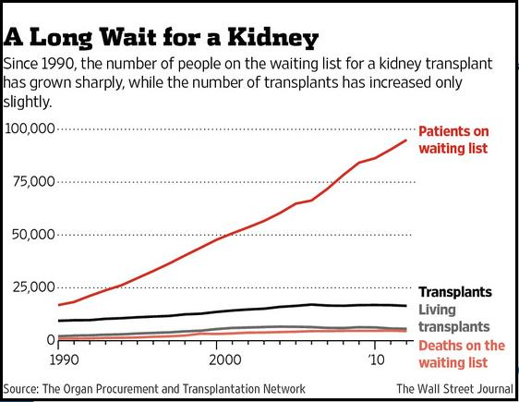
ABOi Transplants in Adults
Need for transplant is higher than supply of organs: Can the ABO barrier be crossed?

Slide 14
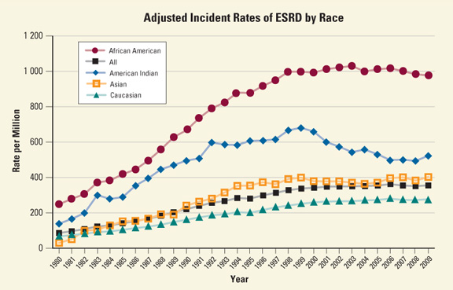
ESRD Rates
http://www.niddk.nih.gov/health-information/health-statistics/Pages/kidney-disease-statistics-united-states.aspx

Slide 15
Renal Transplantation
1 in 10 Americans have some degree of CKD
398,861 patients on dialysis (as of 2008)
As of 3/31/16, the OPTN has 100,419 people listed awaiting renal transplant, ~5,000 patients per year die awaiting transplant
In 2 years, the following percentage of eligible patients were transplanted by blood type per OPTN (2003-2004 data)
33.7% A recipients
18.4% B recipients
45.4% AB recipients
19.9% O recipients
http://www.niddk.nih.gov/health-information/health-statistics/Pages/kidney-disease-statistics-united-states.aspx

Slide 16
ABOi Renal Transplantation
Some initial work performed in Japan due to absence of deceased donor program until 1997
Heart transplant in 1967 by Dr. Wada at Sapporo University heavily criticized, particularly with regard to criteria of brain death and Shinto religion
Long term results from 1988 to 2003 (n=564) was reported by Takahashi et al. (Xenotransplantation. 2006 Mar;13(2):118-22.) with good graft survival
Methods of immunosuppression varied
Graft survival rates at 1, 3, 5, and 10 years were 86, 82, 74 and 53% respectively
http://www.jotnw.or.jp/english/01.html
Notes:
Cadaveric donation is still extremely rare, and over 80% of kidney transplants are living related donors (compared with about ⅓ in the US)

Slide 17
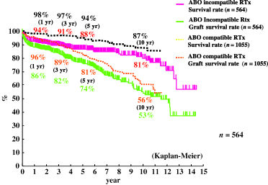
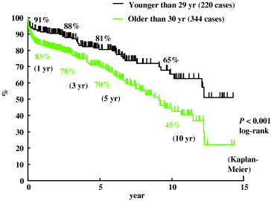
ABOi Renal Transplantation
Good survival compared to historical ABO matched controls
Better survival in younger patients, especially pediatric patients <15 years of age
No significant differences in survival based on ABO type (A vs. B incompatible)
Applicability to patients in the US?
Higher rates of deceased donor transplant
Higher rates of transplantation in general
Xenotransplantation. 2006 Mar;13(2):118-22

Slide 18
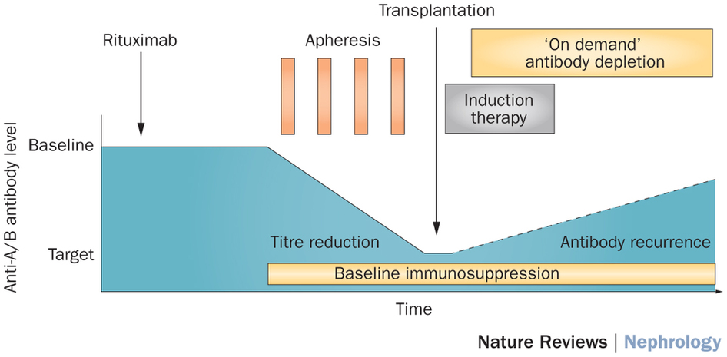
Methods of Immunosuppression
Bohmig et al. Nature Reviews Nephrology 11, 732–747 (2015)

Slide 19
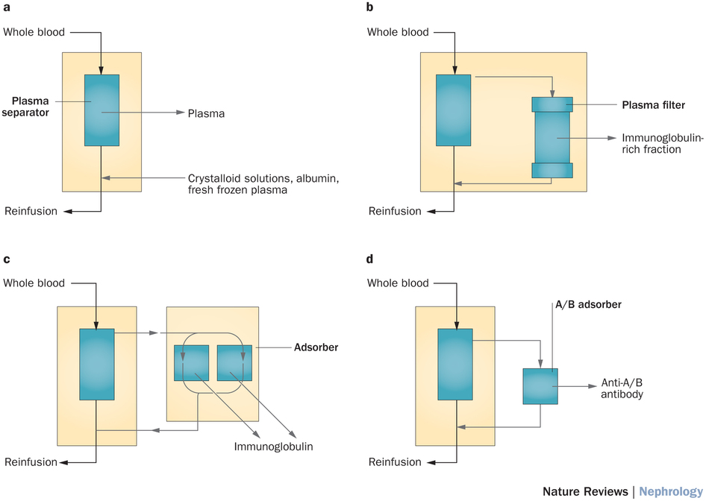
Methods of Immunosuppression
Bohmig et al. Nature Reviews Nephrology 11, 732–747 (2015)

Slide 20
Standardizing Immunosuppression: Swedish Method
Introduced in 2001, consists of:
Antigen specific immunoadsorption
Rituximab (not splenectomy)
tacrolimus, mycophenolate mofetil, and prednisolone
3 center experience with 60 patients
58 grafts still functioning follow-up of up to 61 months
One graft lost due to medication non-compliance, one death unrelated to renal function (C. difficile infection)
7 patients in the ABO compatible arm had acute humoral rejection (n=274)
Now used in many European transplant centers
Tyden G, et al. Transplantation 2007. 83(9): 1153-1155
Notes:
As an aside, one interesting finding was the wide variation in pre-op titers between centers (1:4 vs. 1:128). Difference due to lab methods?

Slide 21
Rituximab Results
5 year survival of Japanese cohorts were:
ABO compatible (88.4%)
ABOi with splenectomy (90.3%)
ABOi with Rituximab (100%)
After a relatively few number of cases performed in the US, cases have been increasing since 2010
Fuchinoue S, et al. Transplantation, 91 (2011), pp. 853–857

Slide 22
Adult ABOi Renal Transplant in the United States
738 cases between 1995 and 2010
Overall survival not significantly different (p=0.2) than matched controls, but noted higher graft loss in first 14 days
Collaborative transplant study: 1420 patients at 101 centers (only 2 sites in US)
Similar findings to above study
Other areas of research: HLA mismatch (Orandi et al. N Engl J Med 2016; 374:940-950)
22 center trial with 1025 recipients of kidney transplants from HLA-incompatible live donors
Higher survival (95.0%, vs. 94.0% for the waiting-list-or-transplant control group and 89.6% for the waiting-list-only control group)
Significant across all pre-op levels of DSA
Montgomery JR et al. Transplantation. 2012. 93: 603–609
Opeltz G et al. Transplantation. 2015. 99:400–404
Notes:
Collaborative transplant study showed virtually identical survival, with the exception of immediate post-op survival in ABOi recipients. Most common cause of death in this period was due to infectious causes.

Slide 23
Mechanism of Tolerance
Graft accommodation
expression of antiapoptotic genes (heme oxygenase-1, A20, bcl-2, and bcl-xL)
Upregulation of complement regulatory proteins (CD45, CD55, and CD59)
Suppression of B cells
Immunomodulatory effect of IVIG?
Koo TY and Yang J. Kidney Research and Clinical Practice 2015. 34 (3):170–179

Slide 24
Controversies
Variability of lab testing for antibody titers, prognostic value of pretransplant titers unclear
Intensity of immunosuppression with risk of infection, malignancy
Some patients require chronic steroid therapy
$$$ ($90,300 compared to $52,500 in the US)
However, likely cost effective when compared to maintaining patient on dialysis (Schwartz J et al. Transplantation. 2006. 82: 155–163)
Notes:
This last point is somewhat controversial. Axelrod et al “estimated Medicare spending for all covered services for 270 ABO-incompatible (ABOi) and 27 000 ABO-compatible (ABOc) transplants for the period 30 days before transplant through 3 years after transplant and found that costs for ABOi transplants were 74% higher than those for ABOc transplants. The Cox results showed that ABOi-transplanted patients had 1.9 times the risk of both death and graft failure compared with ABOc patients.”
Their analysis has been disputed by Held and McCormick (above quote): They ignore early mortality, and they compare it to the cost of ABOc transplant instead of being maintained on dialysis
A question of equality- ABOi transplants are being performed more frequently on patients with private insurance (likely due to centers passing off costs to that instead of lower reimbursement from Medicaid/Medicare)

Slide 25
Questions?

