Slide 1
Finding e-CDR Data – during and post hospitalization
1-29-15

Slide 2
New ! – CDR Report
In order to monitor or trouble-shoot issues with controlled substance documentation, a new report is available in HED effective 2-3-15 – CDR Med Status
During an admission and for approx. 48 hrs. after discharge, the report can be printed (but NOT viewed) from within HED.
From approx. 48 hrs. post discharge, the report will be available to view or print from StarPanel. (The report will be available for patients discharged after Feb. 3 when the report goes live so should be available post discharge for some patients later this week.)

Slide 3
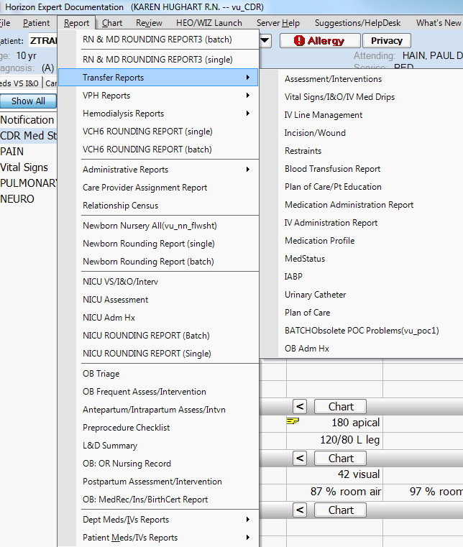
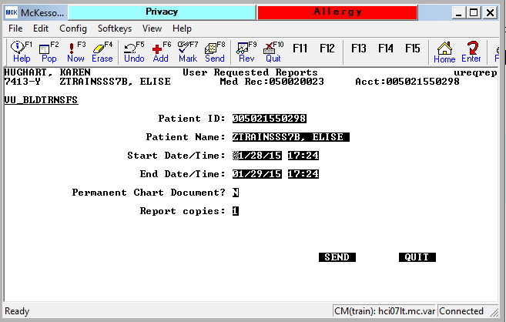
New CDR Report in HED
1. From Report link top of screen, click on Transfer Reports.
2. CDR Med Status report will display.
3. Enter Start and End date/time for time range you need to review.
4. Click Send.
5. HED reports print on Critical Printer (generally printer by MR where HEO/Wiz order documents print).
CDR Med Status
Hint: Sometimes this print dialogue box is buried behind other windows on your computer so you may need to minimize other windows before you see it.

Slide 4
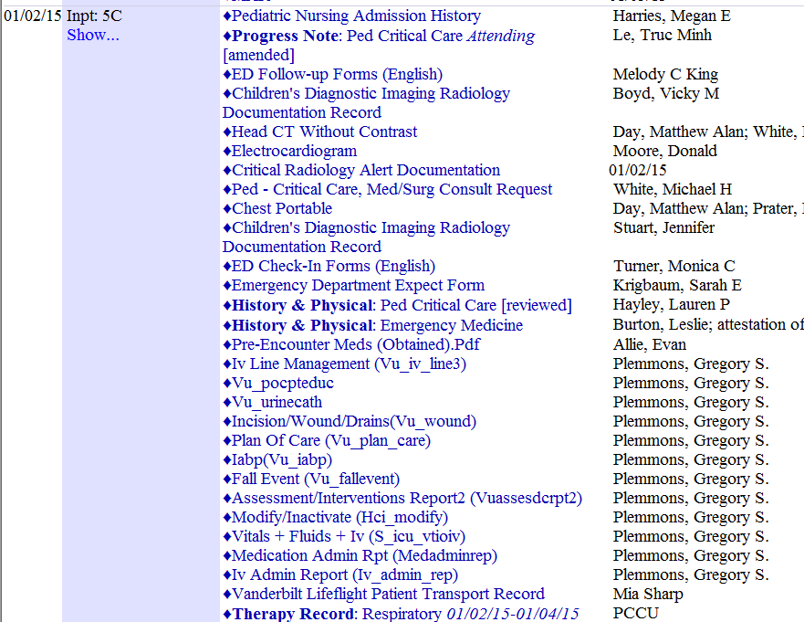
To access New CDR Report in StarPanel > 48 hrs. post Discharge
Enter MR# to select patient.
Click on AllDocuments
3. Scroll down to find admission (look for light blue bar that borders Inpatient Admission episodes of care.
4. Scroll to date of admission for hospitalization in question.
HED documents will display as a block under the name of the Attending Physician on day of admission.
5. New CDR Med Status report will be listed with other reports in this section.
CDR Med Status

Slide 5
StarPanel CDR Flowsheet
Can access by entering MR # or by selecting patient from a list by clicking on MR#
CDR data does NOT age off Flowsheets like it ages off of OPC. CDR data will remain for future reference indefinitely.
Limitations:
Co-signatures not visible from CDR Flowsheet. (All other required data is here.
Flowsheets are not designed to be printed. You may be able to capture needed information from a screen shot but the Flowsheets are designed to be viewed on line and not to be printed.

Slide 6
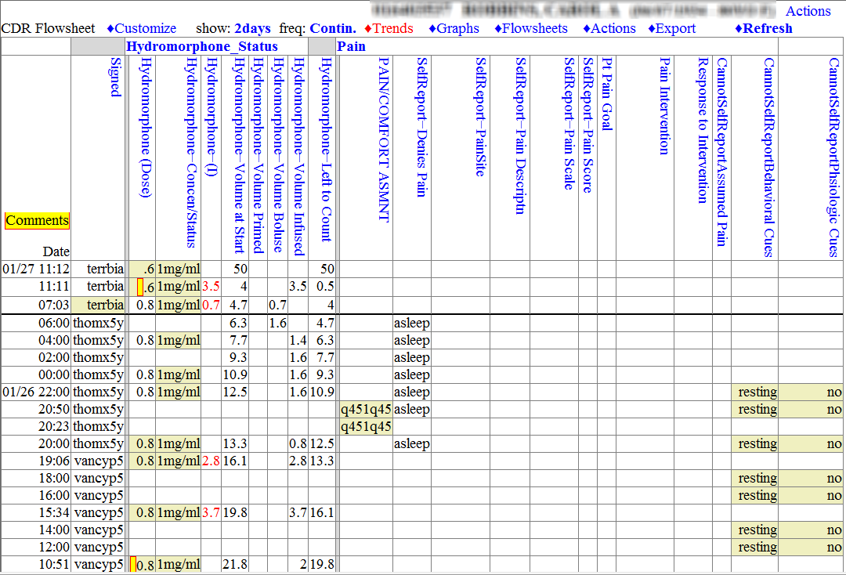
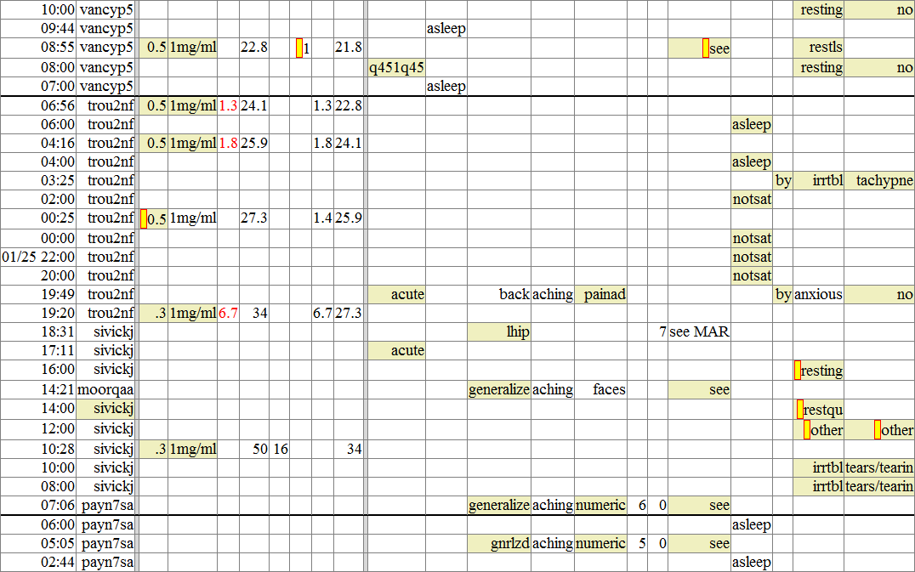
Click to open all Comments

Slide 7
Example of all Comments opened to read. (Note click to hide hyperlink is available to close pop-up window when you are done.)

Slide 8
Correcting CDR Documentation After the Fact
The original author of CDR documentation in HED may alter the documentation for up to 30 hrs. after it’s entered (remove, modify).
Entries may also be co-signed in HED up to 30 hrs. after the original entry.
Late entries may be made up to 72 hrs. after the fact.
From the time of discharge, documentation can be entered (or corrected by original author) from approx. 48 hrs. before charting is “closed”. [To access patient during 48 hrs. post discharge to completed charting, pull up census for unit from which patient was discharged and scroll to bottom of list to see all recently discharged patients.]
When you cannot add to or correct charting in HED (because it’s been too long since original entry or because charting is already closed post discharge), you may document late entries in StarPanel.

Slide 9
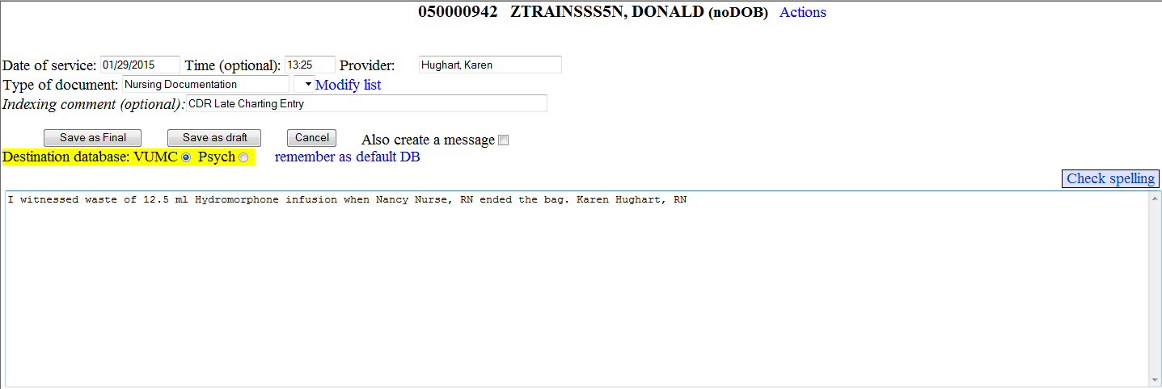
To Make Late Entries in Starpanel …
Select patient from List or by entering MR#.
Select Enter Data option TypeNewDocument
Change date of service & time to reflect time of e-CDR entry that needs to be modified or co-signed.
Type of Document = Nursing Documentation
Indexing Comment = CDR Late Charting Entry
Briefly enter documentation change or statement about observing waste or participating in handover communication about quantity left to infuse & enter full name and title.
Click Save as Final button.
Other sample entries:
I witnessed that 48.25 ml. remained in PCA syringe at change of shift
Completed/Denied for 7a-7p shift: 32/36
I witnessed that bag was empty after 48 ml. had infused.

Slide 10
Questions? Need Help?
Call Help Desk –343-4357 or 3/HELP
Ask for Systems Support Services on call.

