Slide 1
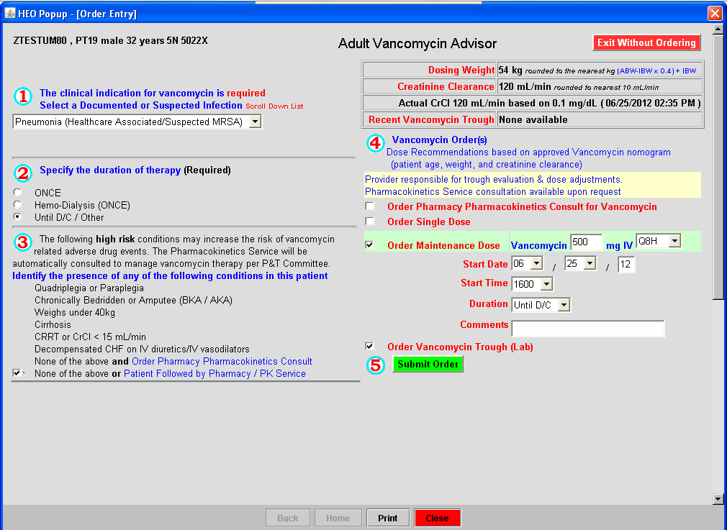
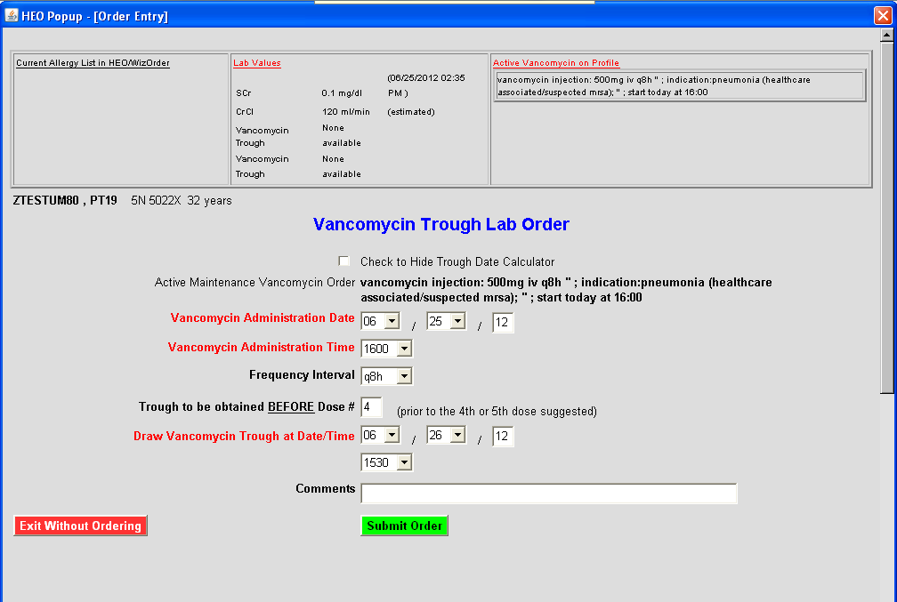
Vancomycin Dosing Advisor 7/9/2012/hf
Initial dose recommendation based on height, weight, and creatinine clearance (calculated from SCr)
Obesity factored into dose calculation
Serum creatinine must be current (within 48 hours)
If SCr is not available to calculate a CrCl the advisor will allow a one-time Vancomycin dose to be ordered
For maintenance Vancomycin dosing the physician will have the following options:
Pharmacokinetics consults for dosing:
Should be reserved for patients meeting exclusion criteria or provider requested consult
Consults with team about Vancomycin dosing
Responsible for Vancomycin dosing and monitoring (Vancomycin troughs, serum creatinine)
Pharmacy to dose = pharmacy managed care
Pharmacy will enter the maintenance dose using the Wiz Vancomycin dosing advisor once the SCr is available
Pharmacy will enter order for Vancomycin trough prior to 4th dose
Physician to dose
Physician can enter maintenance dose once SCr is available
When maintenance dose is selected, provider will be directed to Vancomycin Trough Lab order screen
Physician is responsible for trough evaluation and dose adjustments

