Slide 1
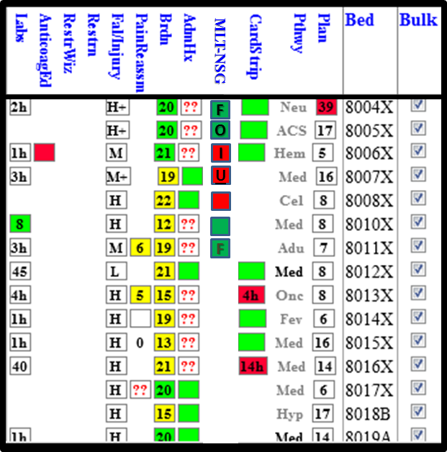
Is the MLT Complete? NEW MLT Nursing Indicator (MLT-NSG) Look for it on the Inpatient Whiteboard Whenever possible, go for the Green!!
Hover over indicator for status & date/time edited
F = Finalized by physician
Click indicator to launch the MLT form to make edits
O = Obtained by nurse
I = In progress
U = Unable to obtain
Blank Red = MLT not
started this admission
Begins Jan 20th @ 0645
SSS will be making rounds
Call HELP DESK ( Press 1) for issues

