Slide 1
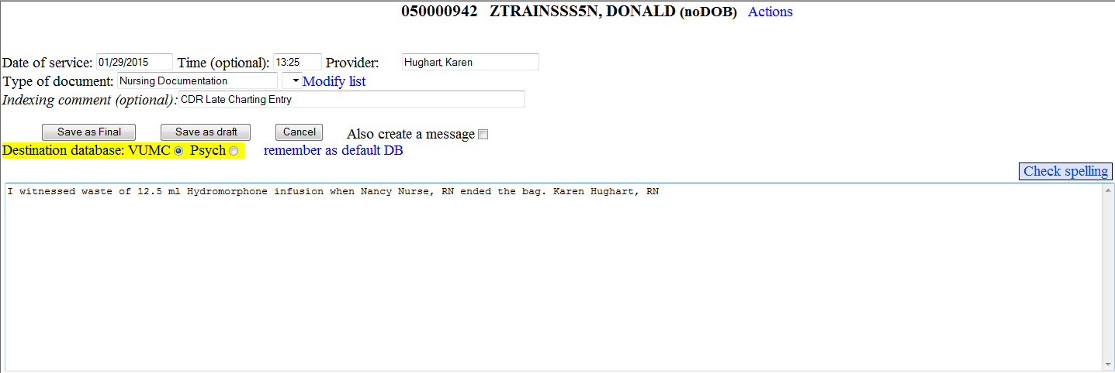
How to Enter Late Entries to Patient Documentation in StarPanel– only use if past the HED 72h limit or patient is discharged
Select patient from List or by entering MR#.
Select Enter Data option TypeNewDocument
Change date of service & time to reflect time of entry that needs to be modified or co-signed.
Type of Document = Nursing Documentation
Indexing Comment = CDR Late Charting Entry (or appropriate entry)
Briefly enter documentation change or statement about observing waste or participating in handover communication about quantity left to infuse & enter full name and title.
Click Save as Final button.
Other sample entries:
I witnessed that 48.25 ml. remained in PCA syringe at change of shift
Completed/Denied for 7a-7p shift: 32/36
I witnessed that bag was empty after 48 ml. had infused.

Slide 2
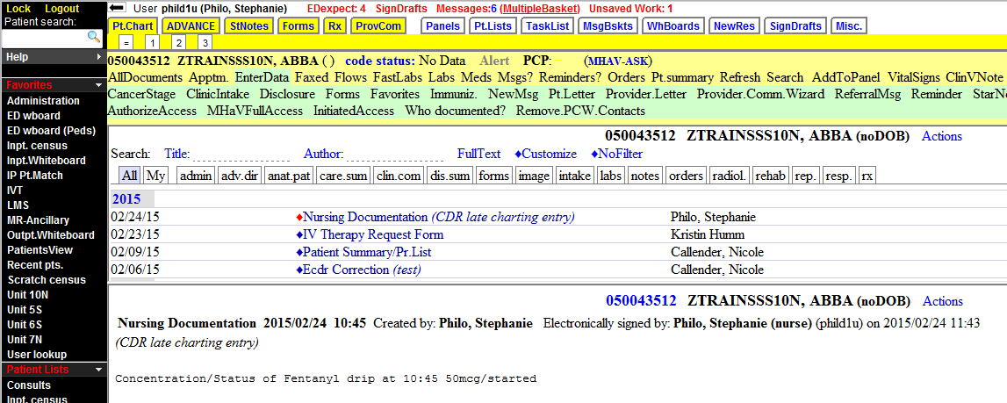
Document Displays in All Documents By Type of Document with Indexing Comment:

