Slide 1
Inquiring Minds Want to Know:
Where Can You Find Inpatient Data?
Debi Camp
2013

Slide 2

Accessing Data
Desired outcomes: By the end of the session, participants will:
Have increased comfort level accessing data documented in HED and StarPanel
Be knowledgeable of indicators
Have a broad understanding of where to go to look for inpatient data
Be able to find the data you need to document compliance with regulatory requirements, quality improvement efforts, and personnel management
Notes:
to support compliance with regulatory standards, quality improvement efforts, and management decision making
for helping staff document correctly and timely, chart audits for evaluations, follow-up on Veritas or sentinel events, and other Continuous Quality Improvement projects

Slide 3
Introduction
Today will be a brief introduction
We will not cover all the material in your handout
You will have the info on specific steps as you need them to access at your office
This icon indicates homework or info for you to help you get set up to access data on your own

Slide 4
Multiple Points of Access to HED Data
Reviews and Reports in HED
Flowsheets, Dashboards and Indicators in StarPanel
EDW DATA
Business Object Reports
NDNQI / SciHealth Data– Quality Data

Slide 5
Nursing Documentation Reports
REPORTS FOR PATIENT DOCUMENTATION
REPORT NAME (examples - see Reporting source for full list) | REPORTING SOURCE | METHOD TO OBTAIN | WHEN TO USE
Administrative Reports (modify/inactivate, fall event, etc.) | HED Reports | Click on Reports in HED
Patient Med Admin Report | HED Reports | Click on Reports in HED | defaults to last 24h but can change to future date during this stay, must print to see data
Transfer Reports | HED Reports | Click on Reports in HED | change date for dates needed to print for outside facility
Assessment, Pain, Restraints, VS/ I and O, Hemodialysis, CRRT, etc. | HED Reviews | Click on Reviews in HED | during pt stay to see documenation in flowsheet fashion, followtrends, find missing documentation
Fix-IT-Now Pain, Restraints, POC | Business Objects | go to BO and "pull "report | Current -use to fix missing documentation this shift
Admin-Rx Scan reports | Business Objects | Emailed daily to unit manager if unit falls below 90% for scanning armband or scanning med, Can also see the same data in Business Object Reports | DAILY - can go back 3 months to do a chart audit
Admin-Rx Near Miss | Business Objects | go to BO and "pull "report | DAILY - can go back 3 months to do a chart audit
Admin-Rx Overrides for No Med Order Found | Business Objects | go to BO and "pull "report | DAILY - can go back 3 months to do a chart audit
Plan of Care -Priorities | Business Objects | go to BO and "pull "report | DAILY - can go back 3 months to do a chart audit
Pillar metrics, Pain, Restraints etc. | Sci-Health | Sign on to Sci-Health and "pull"report | Retrospective for self defined time period
Pain Corrective Action Audit | EDW | Emailed daily to unit manager if unit falls below 90% for documentation of pain reassessment in 2h | WEEKLY - emailed on Wednesdays through January 2013 (use fix it now and HED reports to resolve issues)

Slide 6
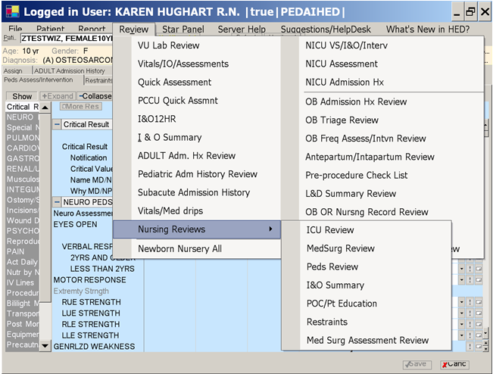
Reviews in HED
(view only – can not print!)
Categories display only when charted against

Slide 7
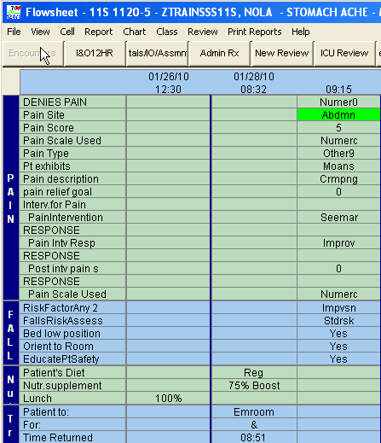
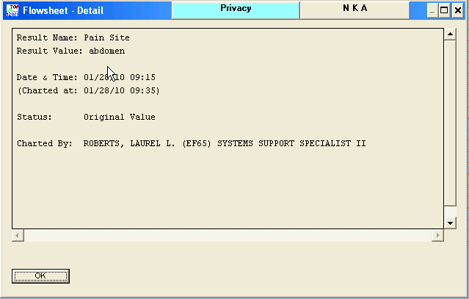
HED Review Screen
Right click on pain site “Abdmn” and box displays with documentation details
Not printable!
Parentheses around result indicates modified entry
Asterisk (*) beside entry indicates annotation
Configurable- must configure with each viewing
  Choose number of days to see 3-30 days
  Frequency of data to display i.e. qh or q12h
Notes:
You can configure the Review screen to show your data for specific lengths of time, defaults to show your 3 days of data

Slide 8
HED Reports
(print only – cannot view on line)
Patient-specific rather than population-specific
Defaults to print for last 24 hours, can change date and time to print
Sent in PDF format to StarPanel 48 hours after discharge and include ALL documentation during the patient stay
Reports can be very long and difficult to read- use Control F to type in and then find a specific parameter

Slide 9
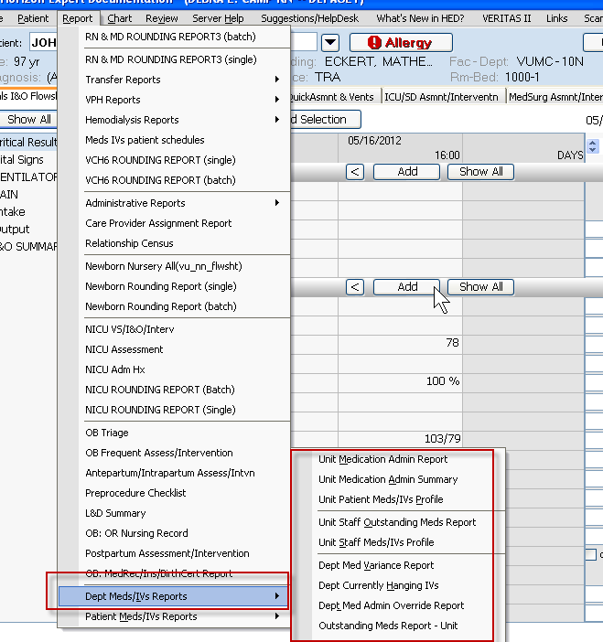
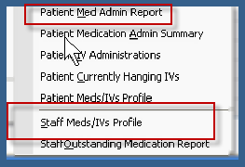

Slide 10
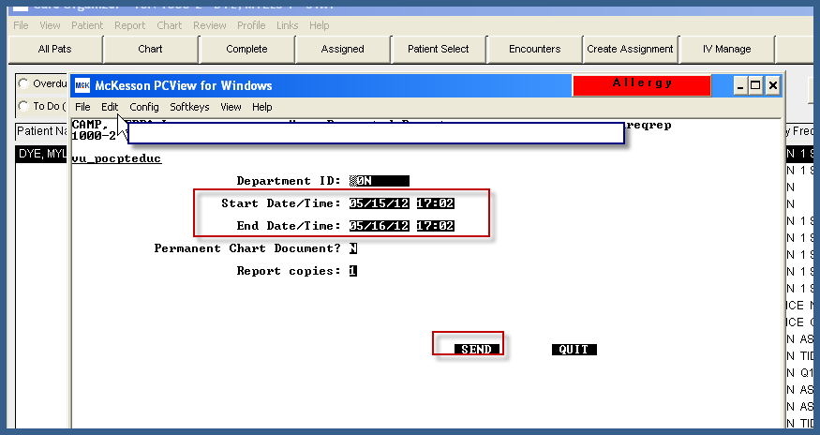
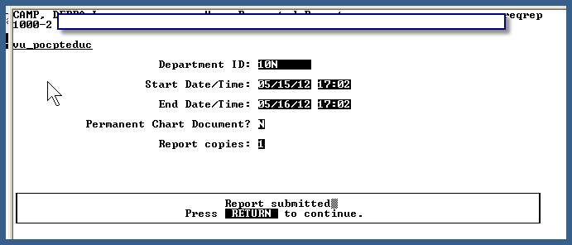
Printing an HED Report
Select the patient
Click on Report
Click on specific report you want to print
Verify date and time cover period you need to see (sometimes this popup comes up behind HED so if you don’t see it – minimize HED and it will be there)
Click on Send
Click on Return and report will print
Default is the last 24h

Slide 11
Business Object Reports
Cover populations of patients
Can be accessed
  from Reports link in HED (under Administrative Reports)
  or from Business Objects URL directly:
  https://prodxireports.mis.vanderbilt.edu/businessobjects/enterprise115/desktoplaunch/InfoView/logon/logon.do
  Sign in with your VUNET ID
Access: E-mail Connie Huff-Simmons and cc Johniene Doran.
  Ask for access to Business Object Reports
  Or to be put on email distribution list for reports your role

Slide 12
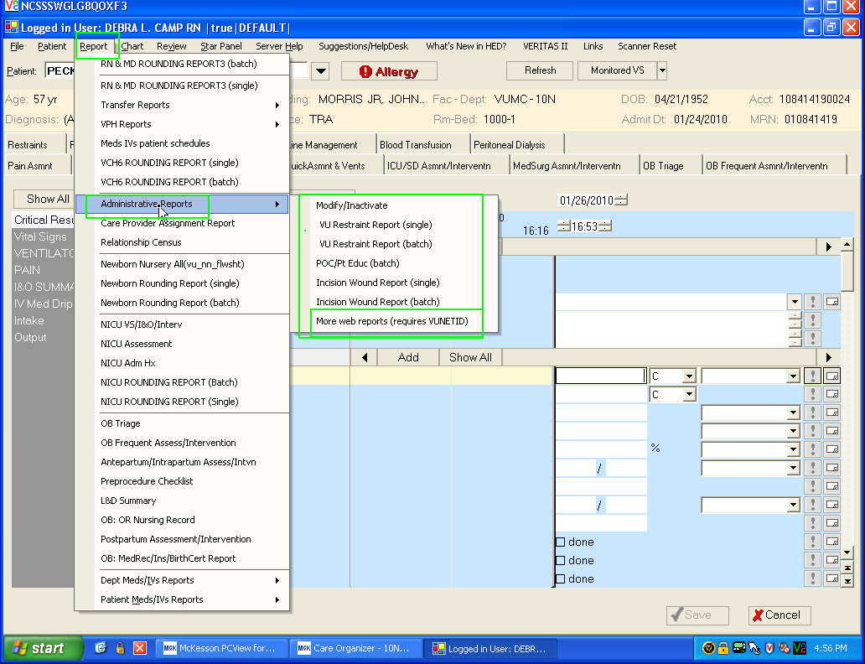
Accessing Business Objects Reports from within HED

Slide 13
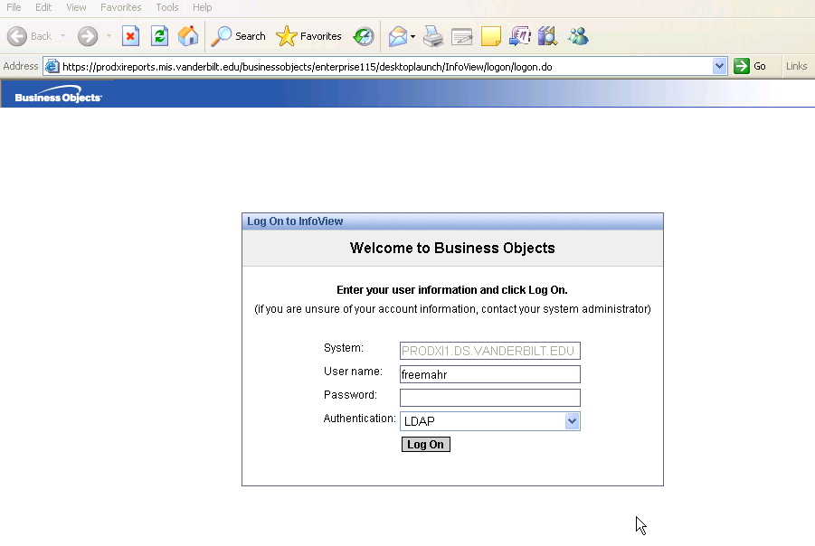

Sign On to Business Object Reports
Here’s a shortcut tip:
Click here and sign on with your VUnet ID (email ID) and password.
You can sign on to HED from a CWS and get here as shown above OR sign on to this URL directly so save it in your favorites to use on your office computer!

Slide 14
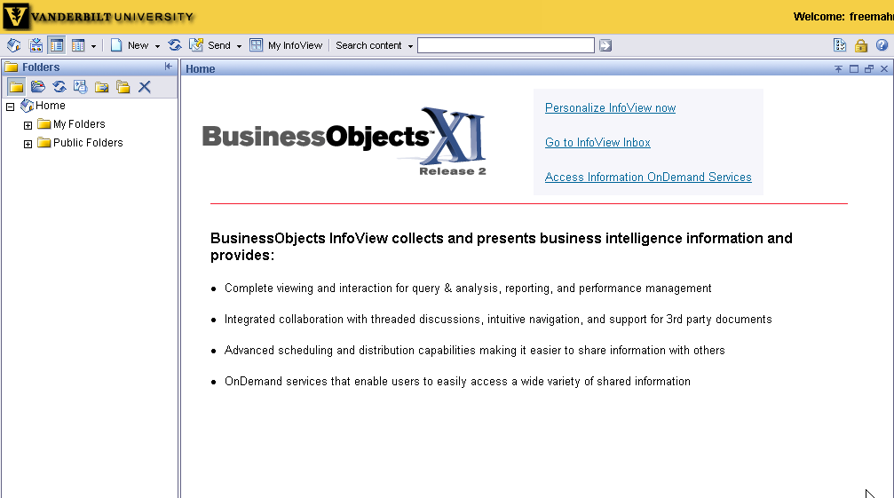
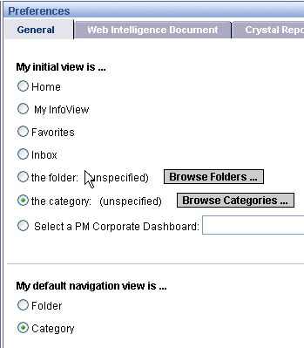
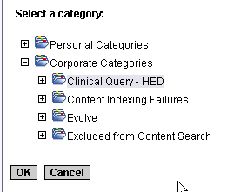

Customize Your View With Initial Log On:
Logoff
1
Select “Personalize InfoView now”
2
Select this view and click “Browse Categories
3
Select “Clinical Query – HED” and click “OK”
4
Scroll to bottom and
Click “Apply”

Slide 15
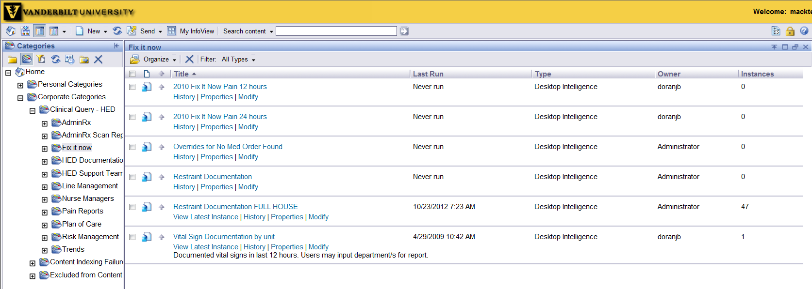



To view “Pain” reports, click the plus (+) next to “Clinical Query-HED”
then click directly on “Fix it now”
Click on “2010 Fix It now Pain 12 hours” to view report
FYI: Restraint reports are also located in this section

Slide 16
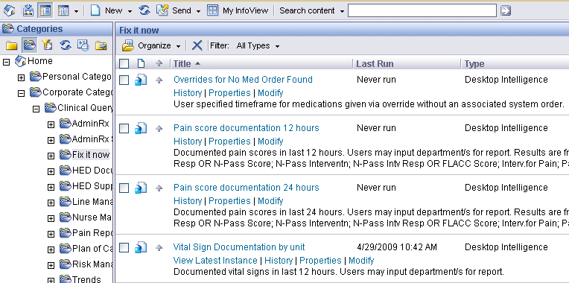
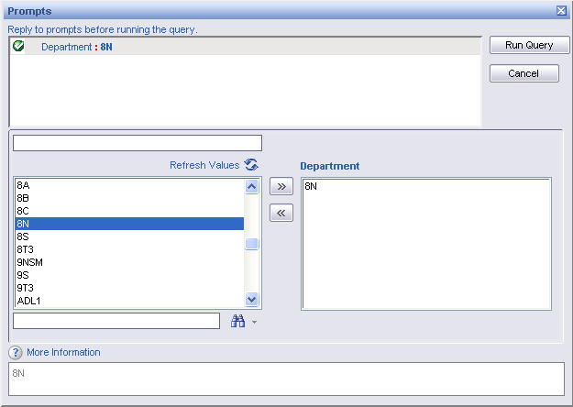
“Fix it Now” Reports
1
Click on name of report to receive prompt for unit
4
Select “Run Query”
2
Select unit
3
Use toggle to add or remove from
“Department”

Slide 17
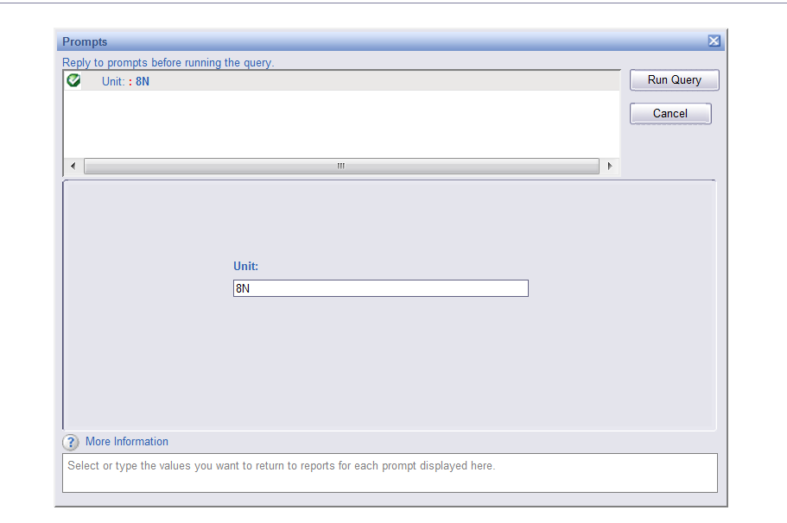


Fill in your unit location
Be sure to use Capital letters

Slide 18

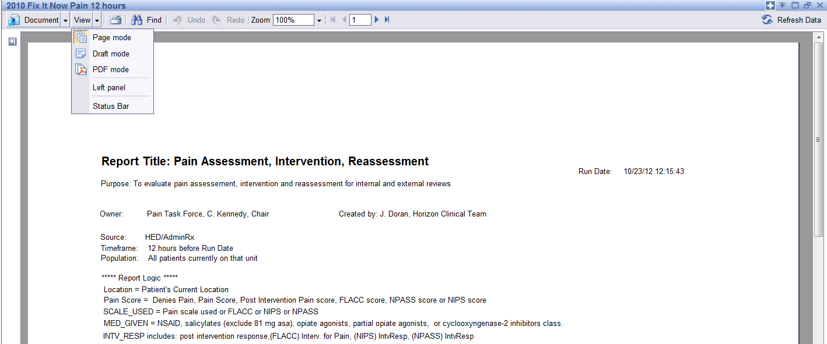
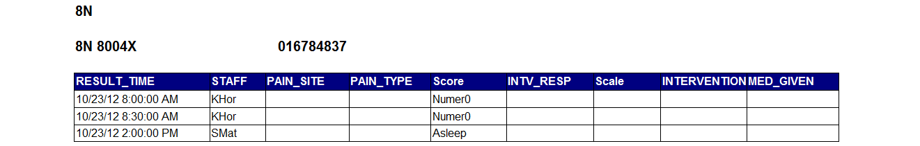

Click View and PDF mode to print report

Slide 19
Business Object Reports
Business Object reports go 3 months back
“Fix it Now” Reports – designed to be used at end of shift to determine if there is missing documentation before nurses leave
  Pain Score Documentation- some units get via email
  Restraint Documentation
  Vital Sign Documentation
Plan of Care
  Plan and Priorities -shows 36h and emailed to managers
  Measures of success

Slide 20

Reporting Process for Admin-Rx
Armband and Meds Not Scanned Reports shows 24h of data, emailed to managers daily
  Armband report sent daily to all units showing unit compliance
  Meds Not Scanned Report Sent out daily to units who fall below 90% on Report
  Meds Not Scanned Report includes:
    Armband not scanned
    Medication not scanned
    Total percent of time nurses followed complete correct process
    Detail of instances where it is not followed
    Breakdown of medications not scanned and armbands not scanned

Slide 21
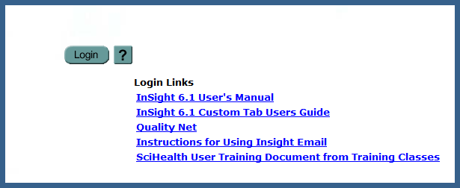
NDNQI/SCI-HEALTH INSIGHTDATA
DATA is displayed as an indicator
Approx. 100 active indicators at this time
Managers log in to view data
The website is: https://insight.mc.vanderbilt.edu
Login with VUnet ID and password.
To get access contact: Julia Matthews, Marcella Woods, or Martha Newton and ask to be added by CCI to the user list
To see full list of available indicators: log in, select “Display All’ under the Indicators tab.
There are also Custom Tab views including the Pillar metrics and a Dept. of Medicine dashboard that is in progress, click ‘Custom Tab’
SciHealth tutorials available on signin page:
Notes:
everyone who has access to Sci-Health has access to all indicators.
with Hand Hygiene as an exception – it is a report
Reports have also been developed to help track measures for NDNQI (required for Magnet)
These include nursing centric measure including:
Falls
PUPs
Restraints
UTI
Etc.
These are automatically mailed out to managers,
Some are still in development as committee work continues

Slide 22
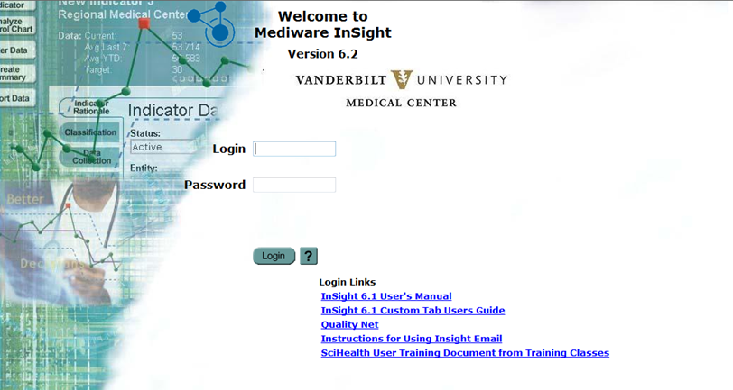
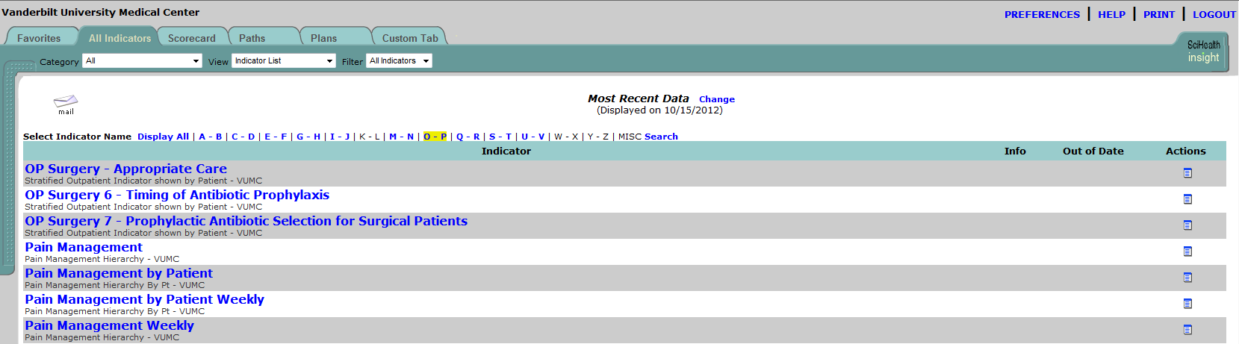
Sci-Health Reports
https://insight.mc.vanderbilt.edu/AllTab.jsp
Create and Print a Graph Trending Compliance with Reassessment of Pain
Use VuNet ID to log in
Start off by clicking on the “P”
1

Slide 23

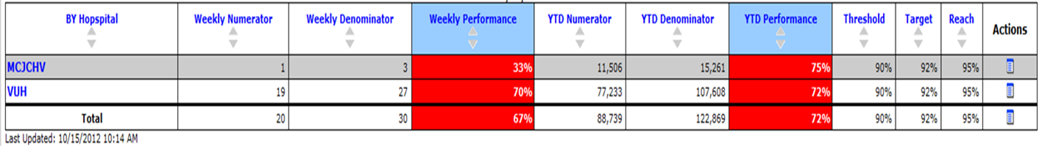

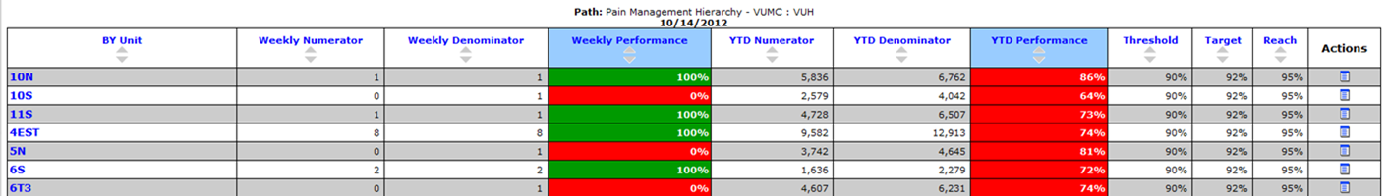
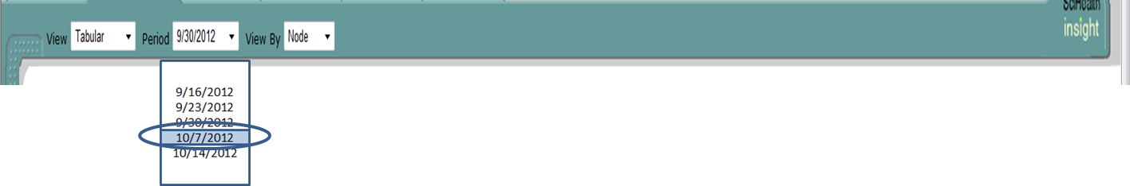
Select VUH
Select location
Click on the View dropdown menu, select Run Chart
Click on the Period dropdown menu, select the previous week to get a whole weeks worth of data
Click on the View By dropdown menu, select History
4
Tabular
Run Chart
SPC Chart
Node
History

Slide 24
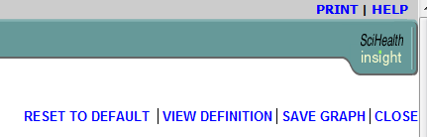
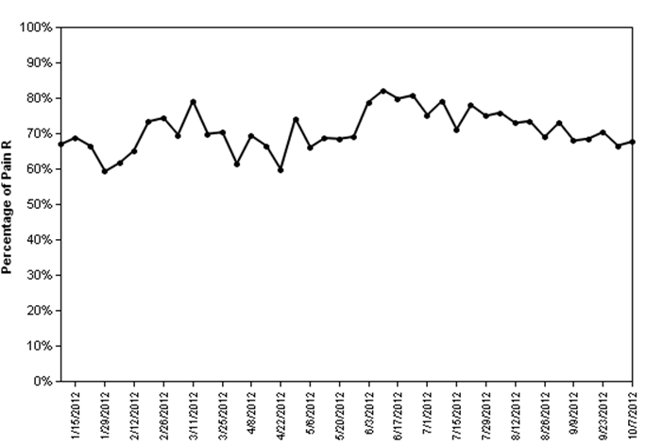
5

Slide 25
EDW REPORTS
Enterprise Data Warehouse
Data goes from our documentation, orders, etc. to the Enterprise Data Warehouse for storage
Reports from the EDW can be more flexible in length of time, data points to collect etc.
Reports are usually based on indicators in StarPanel
Some emailed to specific managers:
  Falls and PUPS report (sample next slide)
  VAP – to all ICU’s except NICU
  To get on distribution list email: EDW Support and ask to be put on the distribution list for the Nursing Care Indicator Report (PUPS/Falls) or VAP Report

Slide 26
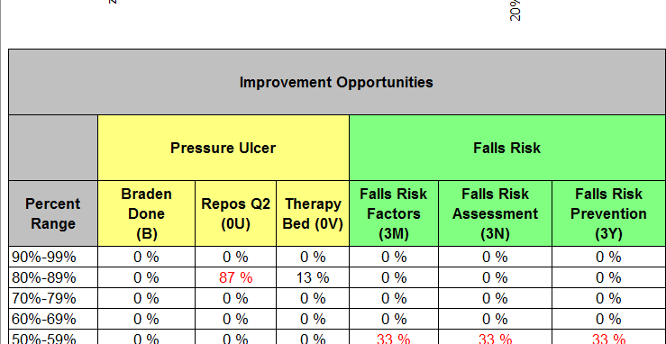
Sci-Health: PUPS AND FALLS
(uses data via EDW)

Slide 27
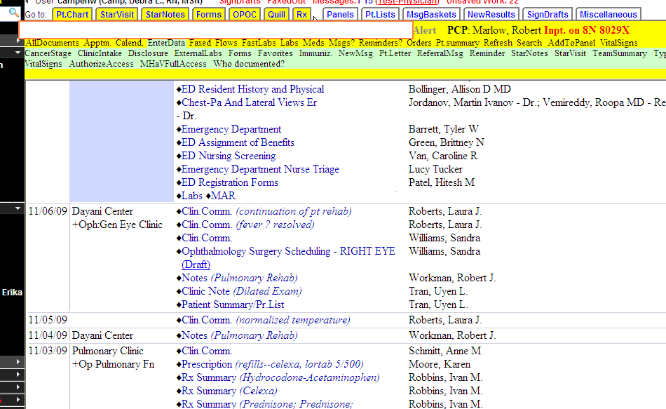
STARPANEL:
THE OFFICIAL ELECTRONIC MEDICAL RECORD - THE EMR
All patient data displays in StarPanel, It is the official medical record for the patient.
Inpatient data has a blue bar for the entire length of inpatient stay.

Slide 28
StarPanel: Flowsheets, Dashboards and Indicators
Flowsheets display a subset of HED charted data AS IT IS CHARTED.
Data to display was determined by physician groups – info they need to make clinical decisions
Three main flowsheets:
  Nursing flowsheet (adult)
  Pediatric flowsheet
  Obstetrical summary
  [Data for VPH would appear on Adult or Peds Flowsheet]
Configurable; settings hold until changed
Annotations and comments can be viewed as a block or with the individual data to which they were attached
New Trends feature shows graphical display of multiple data elements
A condensed version of the flowsheet can now be viewed via the Inpatient Whiteboard screensavers

Slide 29
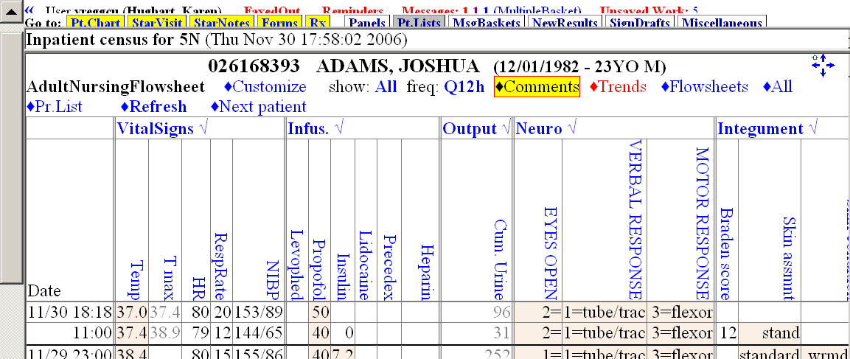
Nursing Flowsheet Features:
1) Trends
2) Ability to view all annotations (“post-it notes”) entered with any result, display when you click on “Comments”. Display order is reverse chronological.
3) When viewing from Patient List (instead of individual patient record), click on Next Patient to display flowsheet for next patient on list.

Slide 30
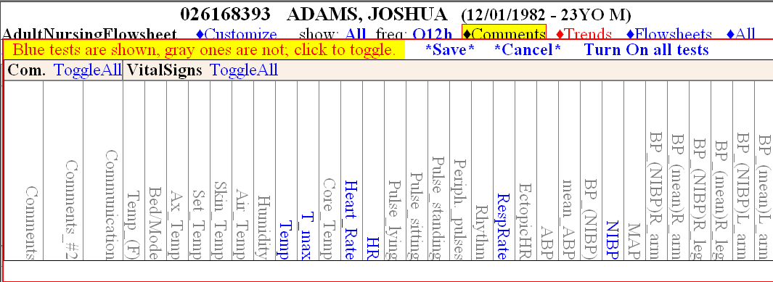
To customize a flowsheet: 1) Click customize button and all HED elements that have been mapped will display by category (eg. Com., VitalSigns, Cardiac/Resp, etc. are sample categories). 2) To turn off a few items, click on the individual item to turn color from Blue (on) to Gray (off) 3) To turn off many items, click on Toggle All for that category to turn all items Gray then click on only those items you want to display for that category. Only the items that display in Blue will be active. 4) Click on *Save*. You will have to reload or refresh the flowsheet for new settings to take effect.
Take time to customize your own view for your pt population!

Slide 31
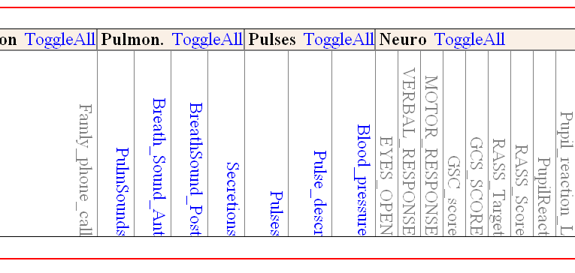
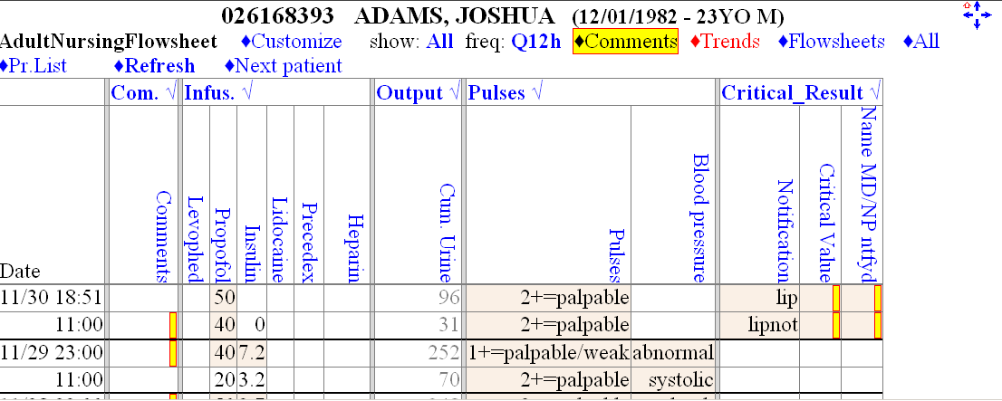
Important Considerations
Once a new configuration is set, it will be the same for all patients until the parameters are changed.
New items are being mapped in StarPanel all the time so ongoing maintenance will be needed to keep the Flowsheet narrowed to the select items.
Why no data displaying under the pulmonary section since it was turned on to display? Nothing was charted on this patient in that section so nothing displays
ON
Off

Slide 32
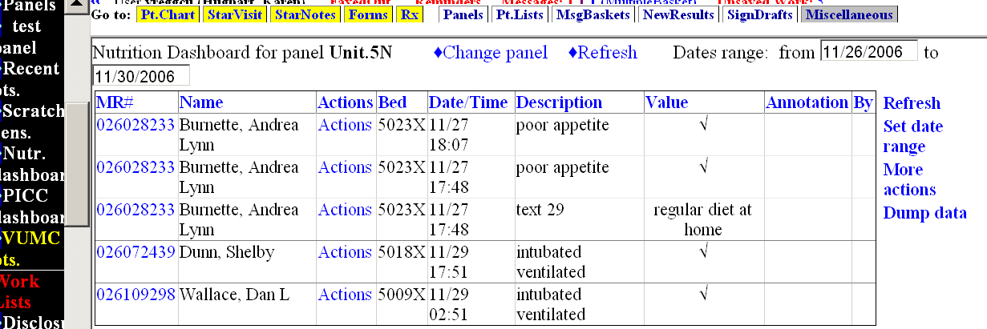
DASHBOARDS
Dashboards are a quick way to see specific data about a subset of patients
Available in black bar in StarPanel
Current Dashboards include:
  Nutrition, PreOrders, Dialysis preorders, PICC, Newborn Nursery, CM, SW, Chaplain, Interpreter, Childlife, WIC/Lactation, Respiratory Therapy, Medical Receptionists
  (pulls data from WIZ , Medipac, and Admission History) etc.

Slide 33
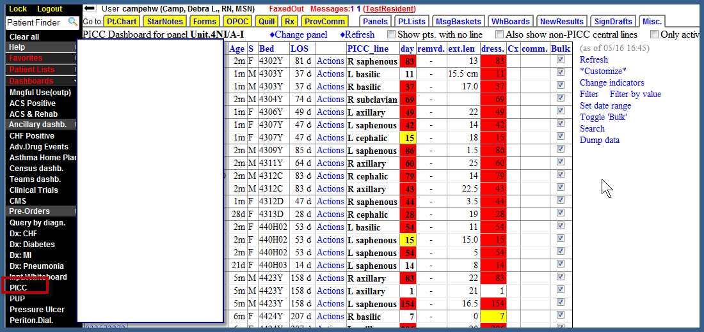
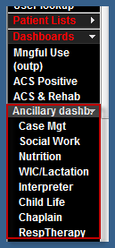
PICC Line Dashboard allows the PICC Team to better monitor lines regardless of patient movement.
Ancillary Dashboard informs them of admissions with positive findings (serves as a consult order for a Chaplain on admission) and/or Orders in HEO for their service.

Slide 34
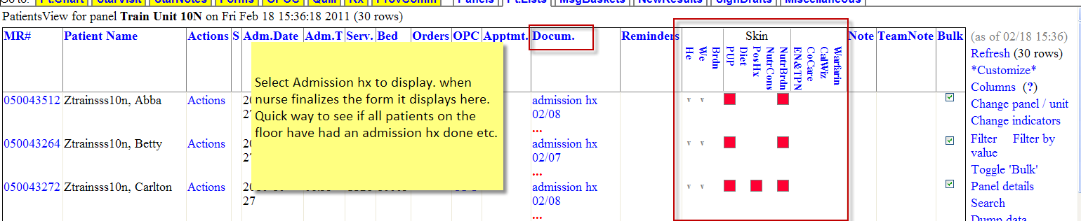
Indicators
Indicators in StarPanel display: on the inpatient whiteboard and can be added to an Inpatient Census or Pt. view
Show in real time, specific items that have not been charted –
  red if not charted within specified time frame,
  yellow is getting close to noncompliance,
  green is charted within time frame specified

Slide 35
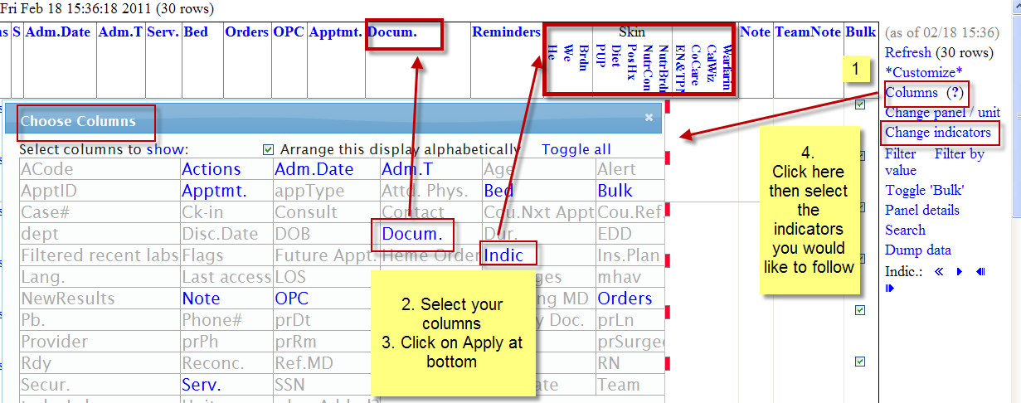
Set Up Inpatient Census or Pt View to See Documents and Indicators Columns
To select the documents you want to pull into the docum column, click on the blue Docum and select from items in frame below. Easy way to see if Admission Histories are completed!

Slide 36
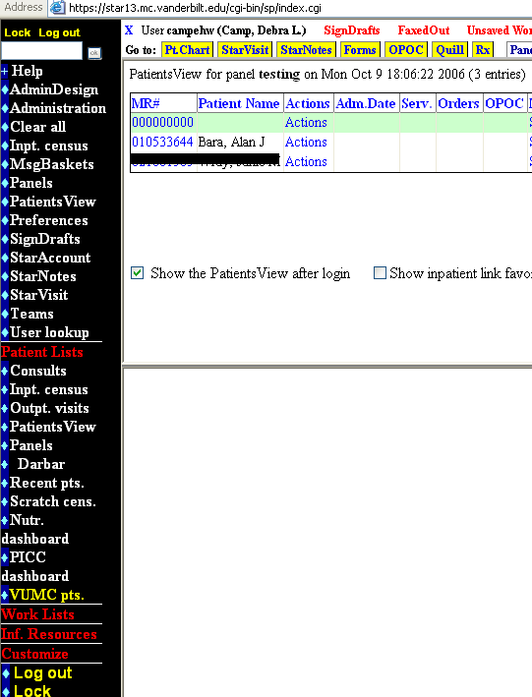
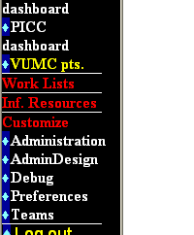
Customize Your StarPanel View
Each user must set up their own Preferences in StarPanel
Step 2 click on Preferences
Step 1 click on Customize

Slide 37
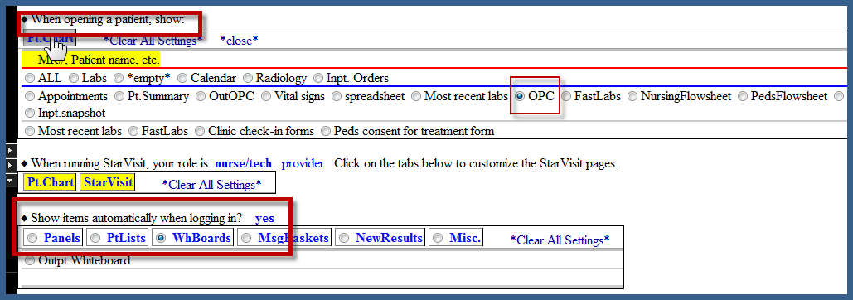
Step 3: When opening a patient chart for Inpatient: select the OPC
Step 4: Inpatient: Set up PatientsView by clicking on it

Slide 38
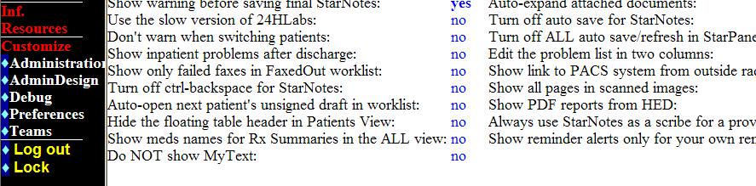
yes
You must change this setting to see reports from HED in StarPanel after discharge. Nurses have 47h to complete documentation after Discharge in HED. All data documented in HED goes to StarPanel via these reports(except line management) 48h after DC.
5. In the right column of preference options, click on Yes beside “Show PDF reports from HED”

Slide 39
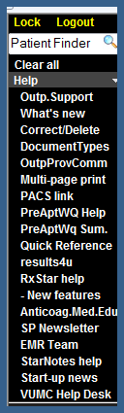
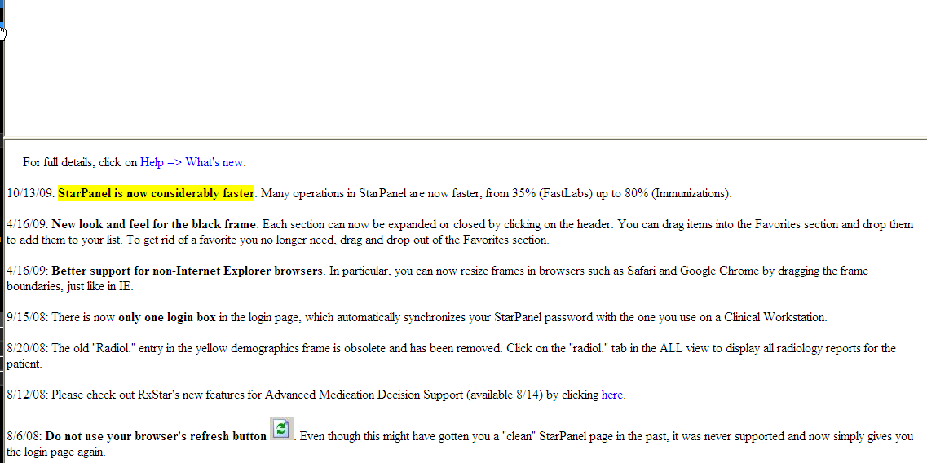
StarPanel Updates
To see the latest changes,
Take a quick look at the entries if something doesn’t function the way you expect it to!

Slide 40
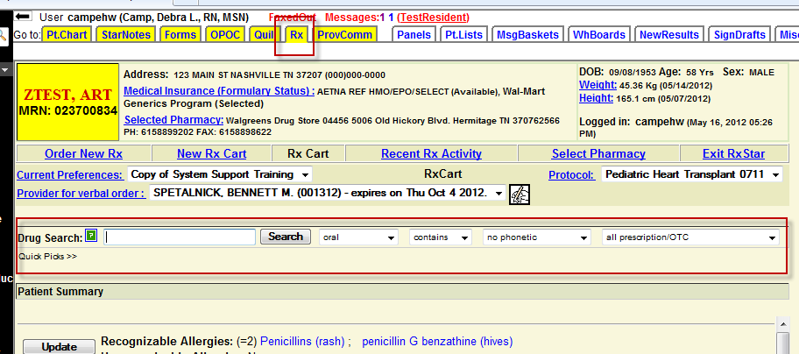
RxStar
RxStar is the application used to write electronic prescriptions
It can be accessed in the yellow tabs or Action button in StarPanel
It is also embedded in our discharge tools – the Discharge Process

Slide 41
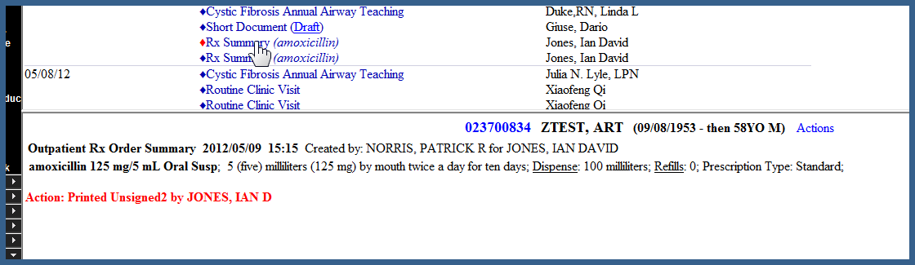
RxStar cont.
Scripts can be faxed, sent electronically or printed
  Inpatient prescriptions will print to the script printer where the patient is located- by design so MR/RN can get to the patient
  If a provider wants to print to his/her office instead they can select a different printer
  Updates the patients Problem list in StarPanel
An RxStar Summary is sent to StarPanel and displays on the date written, verifies script written and gives the details

Slide 42
Q & A

