Slide 1
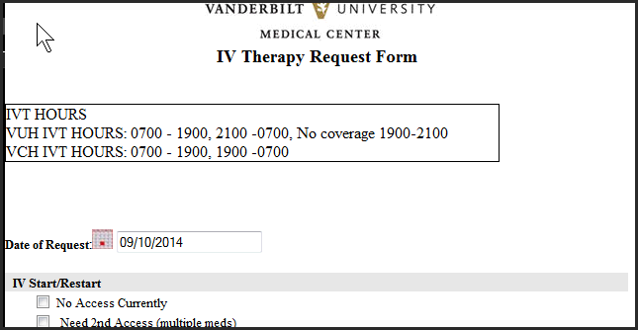
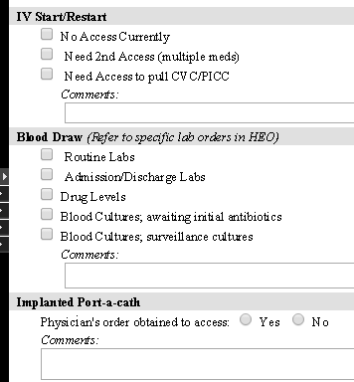
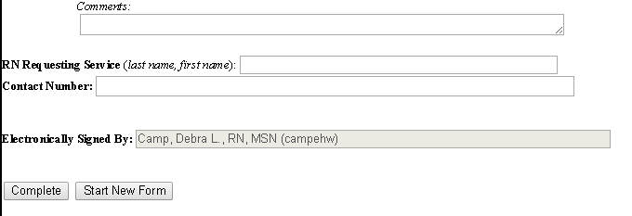
IVT Request Form Tip Sheet
To access the form: From the inpatient’s Actions menu Click “IV Therapy Request Form”
1
IVT does not have 24 x 7 coverage. Their availability will posted in the dashboard and display in the form.
The nurse CAN enter request for next shift but need to put in comment "Please complete next shift”
All information entered will display on the IVT Dashboard for IV therapy to prioritize and complete the request without a phone call.
Only fill out sections pertinent to the patient's situation
RN’s contact name and number must be filled in to complete the form
See reverse side to setup IVT Dash-board

Slide 2
IVT Request Form Tip Sheet
Save IVT Dashboard to Favorites
Click on Dashboards to expand dashboards list, click Ancillary dashboards
left click and hold on IVT, drag up to favorites until favorites section turns green
Release left click
Configure to see VUH or VCH
Click change panel
Choose VUH or VCH (to see all requests and their priority for VUH or VCH)
View Dashboard
3
1
Dashboards
2
4
5
6
RN should enter a note in the dashboard to communicate to IVT if pt has to leave the floor before the request is completed
RN SHOULD click the REMOVE link to remove the patient request from the dashboard IF they are able to use another resource to complete the request prior to IVT arriving
Important For VCH only – to see all possible Peds user requests, when changing panel (step 4), click in the Multi Panels Mode checkbox, highlight VCH, 11N, S31. Sort by age to identify Peds patients

