Slide 1
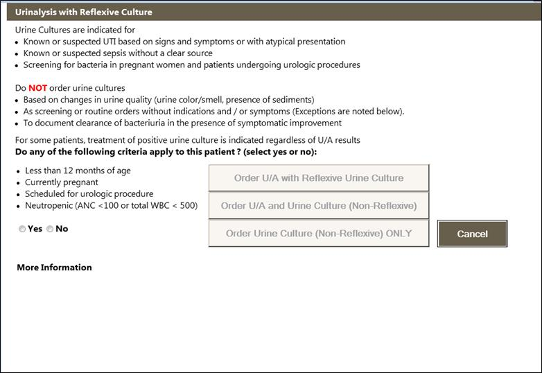
Overview of Decision Support for Urinalysis Cultures
Click more information to learn about the two step process.
This is the view of the urine culture decision support when first opening.

Slide 2
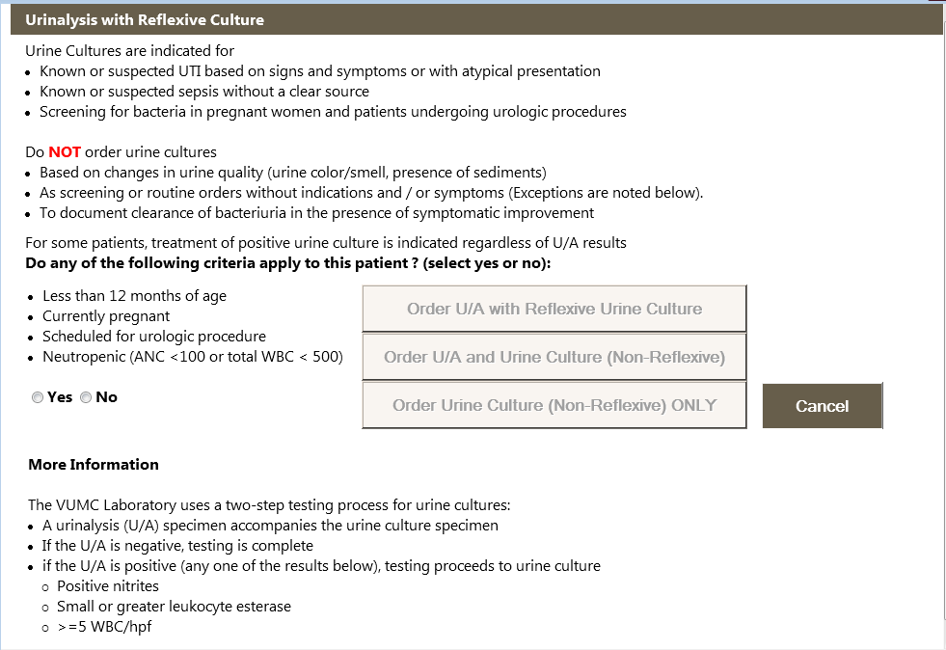
Clicking More Information details how the two-step testing process works.

Slide 3
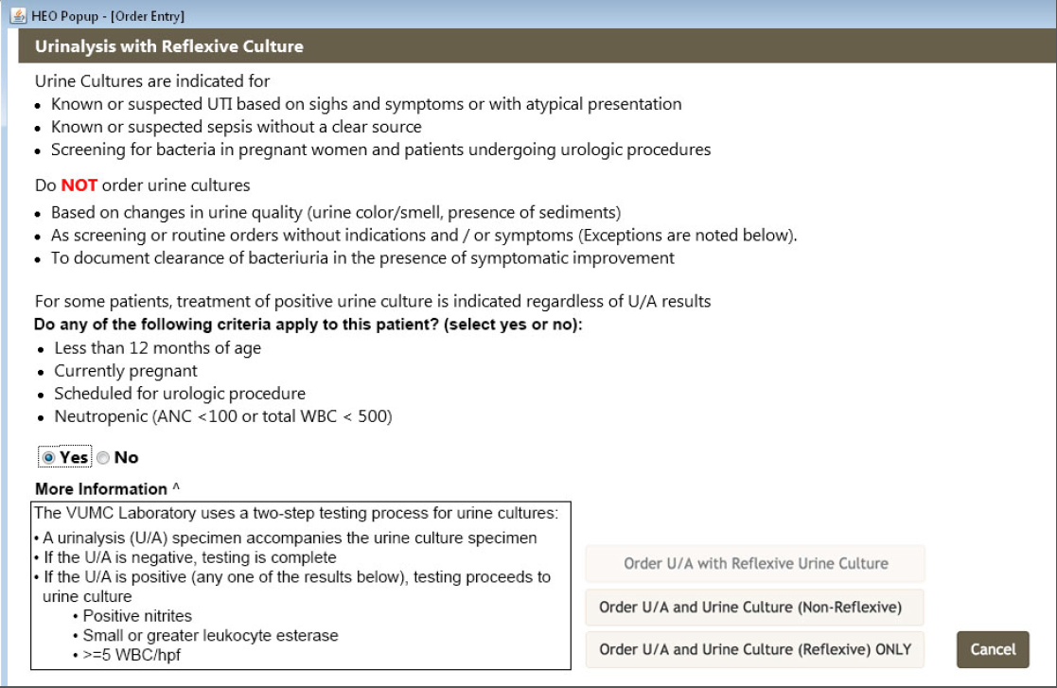
Choosing Yes allows the provider to only select two options.

Slide 4
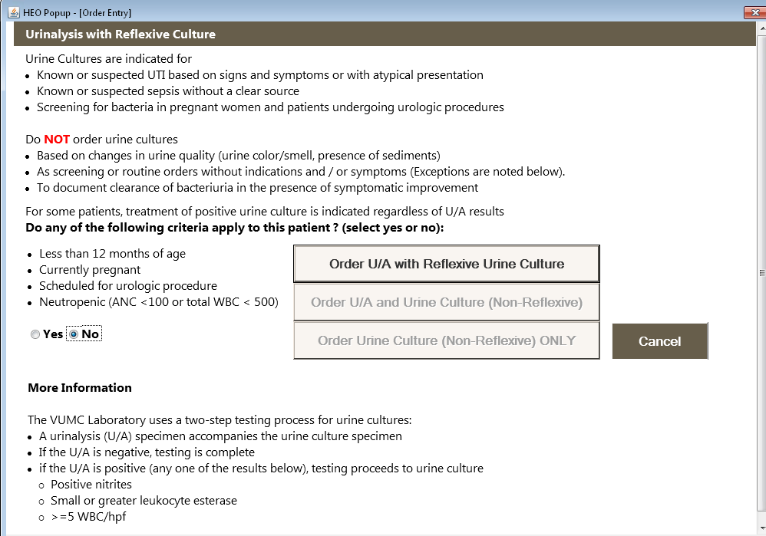
Choosing No allows the provider to select one option.

