Slide 1
Adult Express SQ (Subcutaneous) Insulin Advisor
Go live 2/3/2015
Notes:
The Adult SQ Insulin Advisor provides decision support and guidance to the ordering provider.

Slide 2
Learning Objectives
Demonstrate the new Adult Express SQ Insulin Advisor launched through HEO/Wiz
Describe the steps to discontinue current SQ Insulin orders
Demonstrate the process to navigate the advisor
Identify how to complete the advisor and submit the Insulin orders
Notes:
The learning objectives for this training include demonstrating the new adult express SQ insulin advisor, describe the steps to discontinuing current SQ orders, demonstrate the process to navigate the advisor, and identify how to complete the advisor and submit the insulin orders.

Slide 3
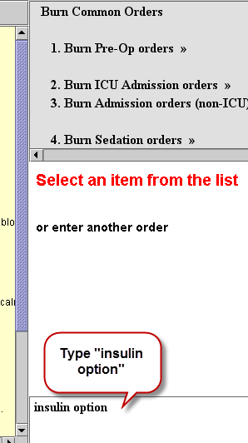
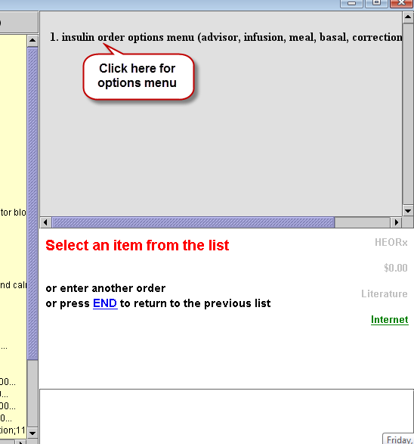
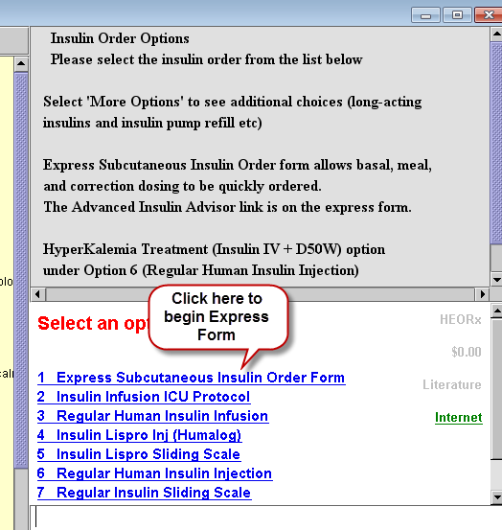
Getting Started
Through Wiz, begin entering orders normally as instructed below to direct you to the new Express SQ Insulin Advisor.
Step 1
Step 2
Step 3
Notes:
Through WIZ, begin entering orders normally. ***On the first order screen, type insulin option and ***choose the insulin order options menu. ***Next click on the Express Subcutaneous Insulin Order form.

Slide 4
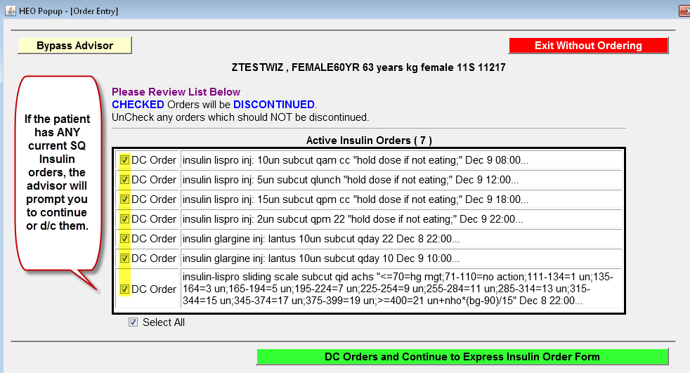
Discontinuing Current SQ Insulin Orders
Notes:
You will be prompted to review any existing SQ insulin orders. At this point, you have the option to leave the orders in place or discontinue them and proceed to the express advisor screen. ***On this screen, note only orders that are checked will be discontinued. Review this information carefully before ordering additional SQ insulin. Once reviewed, click DC orders and continue to Express insulin order form bar, shown in green.

Slide 5
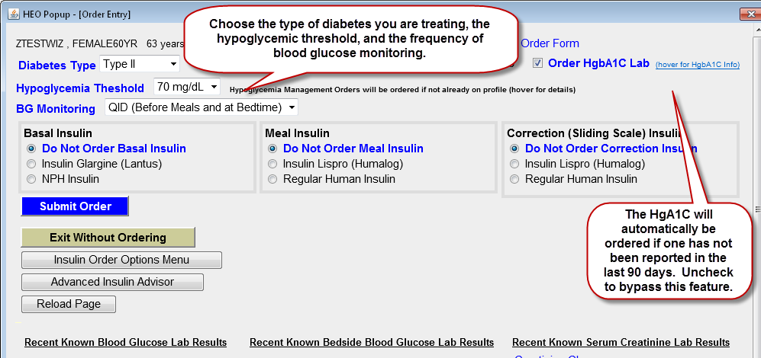
Express SQ Insulin Advisor
Notes:
To begin, please denote the ***type of diabetes you are treating. Choose the hypoglycemic threshold and the timing of the blood glucose monitoring. The advisor will now allow you to order ***basal, ***meal time and ***correction insulin. Note in the top right corner, if a HgA1c is not reported on the patient in the last 90 days, an order for a HgA1C will be generated by default. You may choose to uncheck the box and bypass this default.

Slide 6
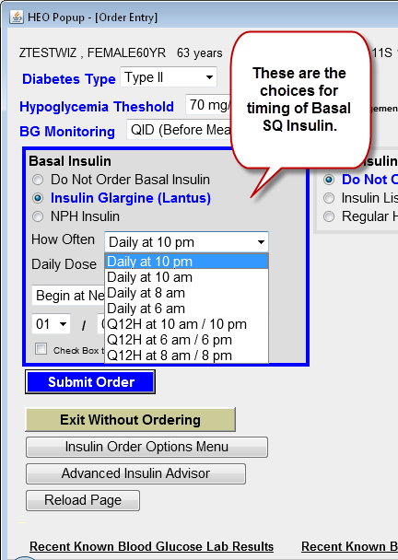
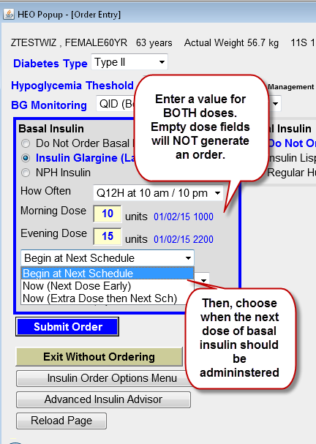
Basal SQ Insulin Ordering
Step 1
Step 2
Notes:
Basal insulin ordering begins by ***choosing the type, how often, and dose. If the dosing is twice daily, a value must be entered for both doses or an order will not generate. Next ***you must decide when to begin the basal dosing. If you decide to include an “extra dose” as the initial dose, a value for that dose must also be entered. This will instruct the nurse to give a dose in addition to the scheduled doses. This feature is used if a patient is admitted with a high blood glucose in the middle of night, when it might be hours before the next scheduled basal dose is given. If “next dose early” is chosen, the nurse will administer this insulin off schedule for this one dose and then resume the ordered schedule with next dose. These rules apply for basal, meal time and correction insulin off schedule dosing.

Slide 7
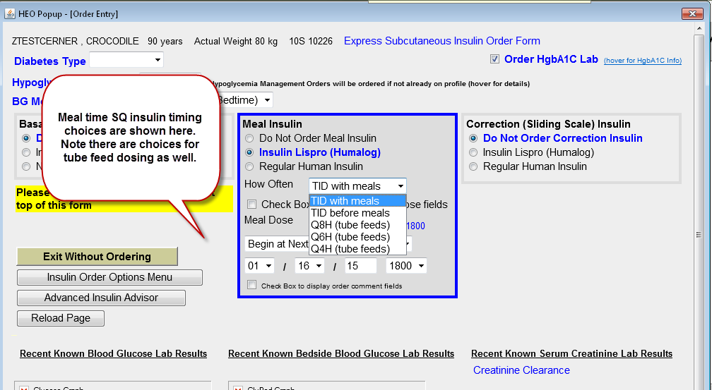
Meal time SQ Insulin Ordering
Step 1
Notes:
Mealtime insulin is ordered from the ***middle box of the advisor screen and works similarly to basal dosing. Choose the type, frequency and dose as before.

Slide 8
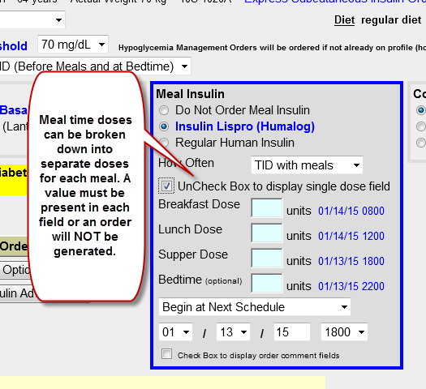
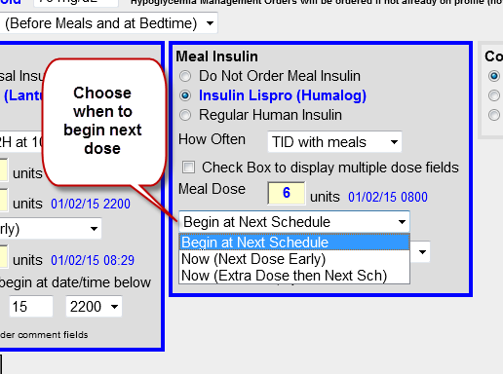
Meal time SQ Insulin Ordering
Step 2
Step 3
Notes:
Mealtime insulin scheduling can also be broken down into separate doses for each meal by ***clicking the “check box to display multiple dose fields.” Each meal time requires a value to be entered or an order will not be generated for that time slot. *** Also note that the start and date times are shown in BLUE as the matrix is built. After completing the dosing matrix, ***choose when to begin the mealtime regimen.

Slide 9
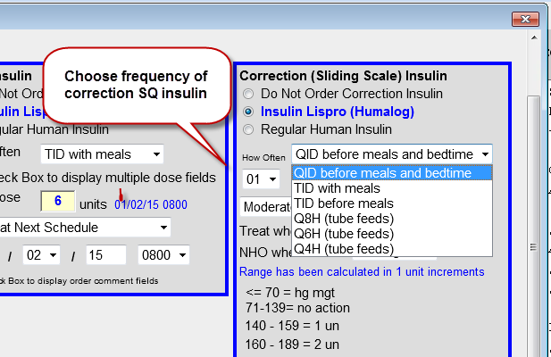
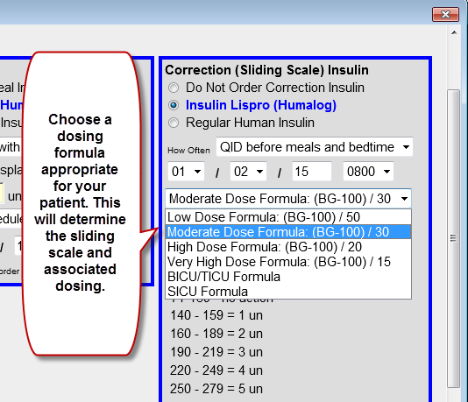
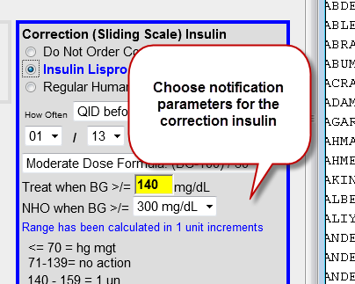
Correction (Sliding Scale) SQ Insulin Ordering
Step 1
Step 2
Step 3
Notes:
Additionally, correction or sliding scale insulin, is also entered from this screen. ***Mealtime and correction insulin, when ordered together, will only allow the same type of insulin to be ordered. After choosing the insulin, ***choose a dosing formula that is appropriate for your patient. The formula will determine the sliding scale and associated dosing matrix. ***Lastly choose the blood glucose notification parameters.

Slide 10
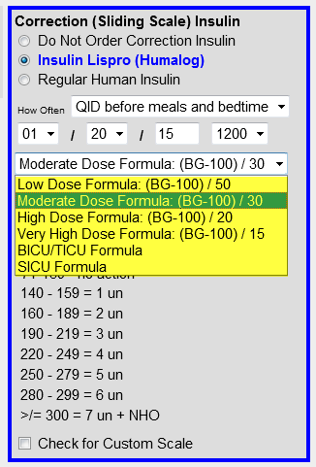
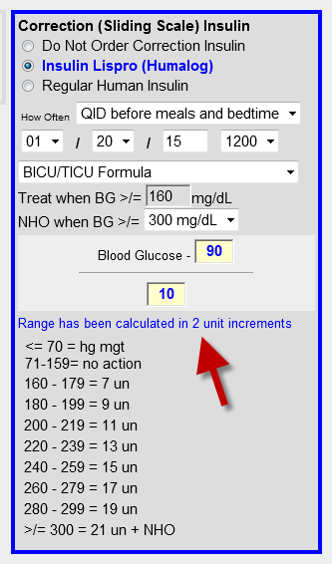
Ordering Correction (Sliding Scale) for Special Populations
The dosing formula is preset, as a guide, based on the dosing matrix chosen. There are choices for a variety of special circumstances shown here in highlight. However, changing the formula values will change the sliding scale doses and can result in dosing increments of 1 or 3 units.
Notes:
The dosing formula is preset, as a guide, based on the dosing matrix chosen. There are choices for a variety of special circumstances shown here in highlight including those for low, moderate, high and very high dosing. Also included are preset dosing matrices for the BICU/TICU and SICU. Formula values are adjustable. Changing formula values will change the sliding scale doses and can result in dosing increments from 1 to 3 units.

Slide 11
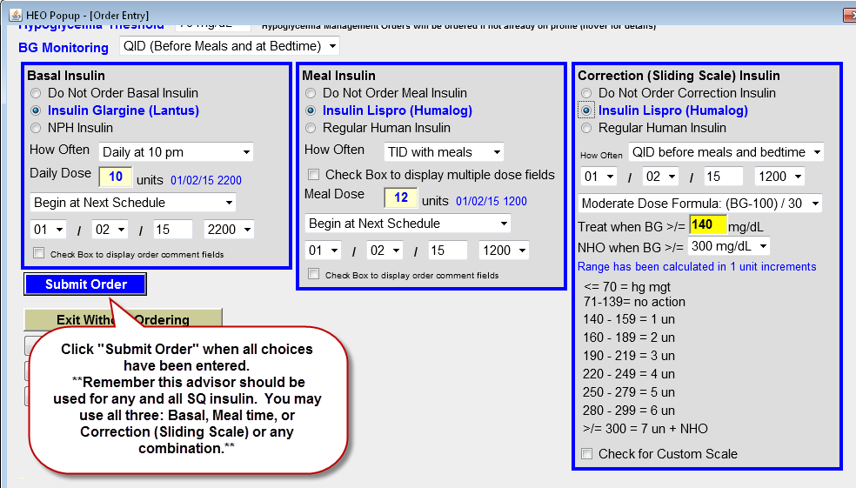
Completing the Advisor
Notes:
To complete the advisor, click Submit order, in blue. This advisor should be used for all Adult SQ insulin orders. You can use any or all of the sections in any combination.

Slide 12
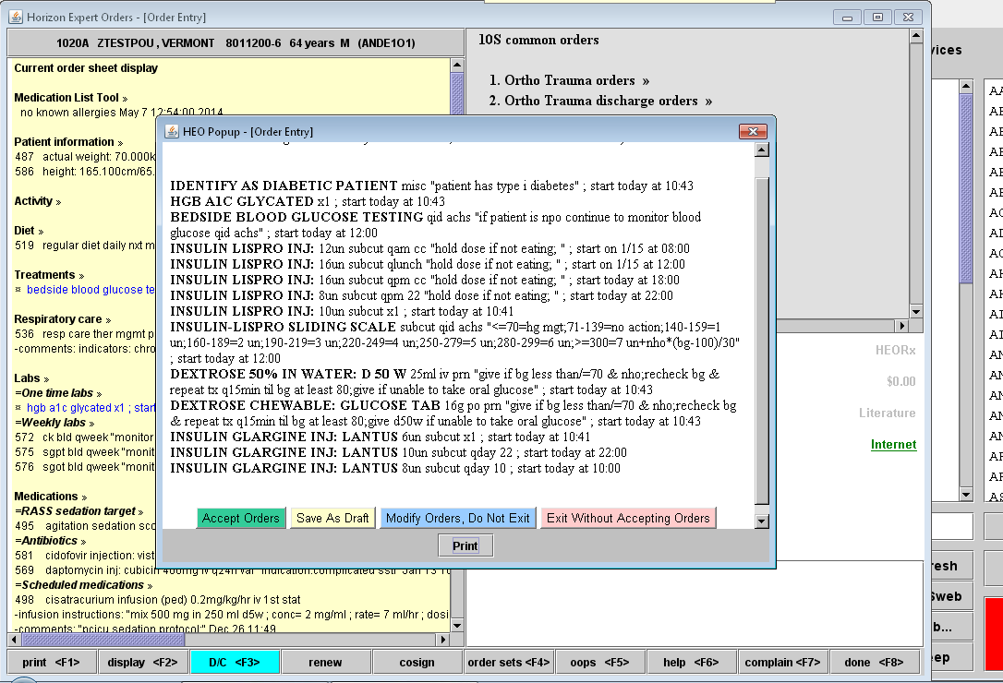
Review your orders
Notes:
After submitting the insulin orders from the advisor screen, you will be prompted to review and accept your orders. This allows you to review how the orders will appear to the nursing staff as they administer the insulin to your patient.

Slide 13
Conclusion
The Adult Express SQ Insulin Advisor will replace the current advisor on the go-live date of 2/3/2015.
This advisor is intended to make ordering SQ insulin easier and reduce duplicate orders and confusing nursing instructions for administration.
Any issues or difficulties with the Express SQ Adult Insulin Advisor should be reported to the HelpDesk at 3-HELP 24/7 or place a ticket electronically from the HelpDesk icon on the desktop.

