Slide 1
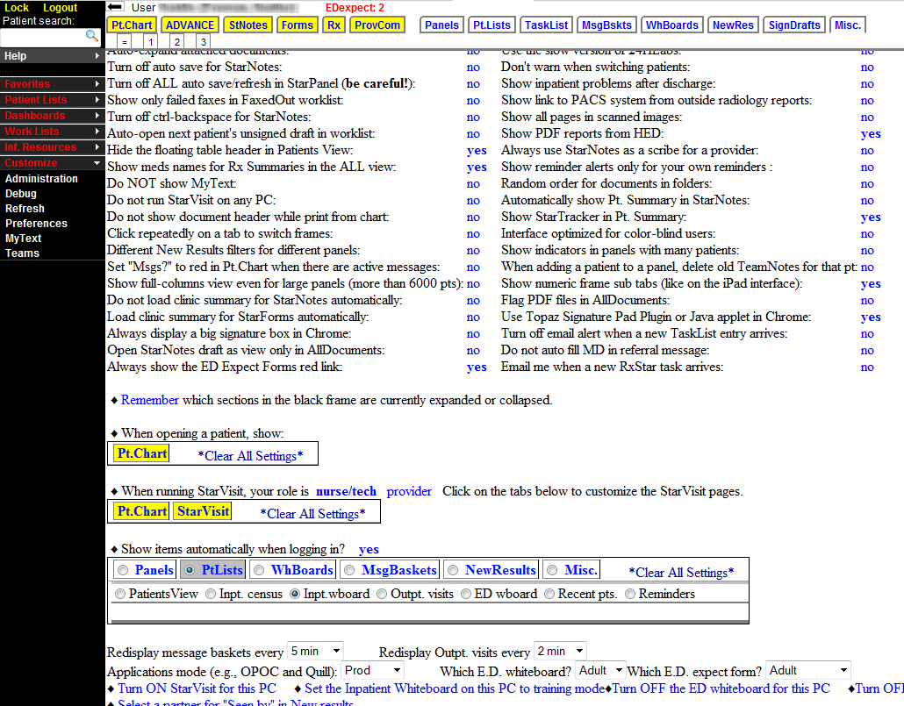
Setting Preferences To Show EDexpect Indicator
Scroll down and find:
“Always show the ED
Expect Forms red link” Click on no to change to yes.
2
Make sure that you are set to view the correct ED Whiteboard and ED Expect Forms. Select Peds or Adult from the dropdown menu.
1
3
Why should you set your preferences? After April 14th you will no longer see ED Expect Indicator if preference is not set
Under Customize on the left hand black bar, select Preferences.

