Slide 1
Emergency Department Discharge Form for Treat and Release Patients:
Emergency Department Discharge Processes for Boarded and Treat and Release Patients
For patients who are stable for discharge
All patients must have a signature from the ED attending/Nurse Practitioner attesting that a Medical Screening Exam (MSE) has been completed and the patient is medically stable for discharge.
This box must be checked and signed at the time of patient discharge by the attending physician. Signatures must also be printed legibly and timed.
Once the form is signed by an attending, the RN must verify the box has been checked prior to discharge. (see following slide for example)
6/13 SM

Slide 2
Emergency Department Discharge Form for Treat and Release Patients cont.
For patients with unusual circumstances that prevent stability at discharge (ie: Hospice discharges)
All patients must have a signature from the ED attending/Nurse Practitioner attesting that a medical screening exam (MSE) has been completed and the patient will be discharged without stabilization.
Provider must check the “other” box and describe the reason for discharge without stabilization.
This must also be described in the history and physical.
other box must be checked and signed at the time of patient discharge by the attending physician.
Signatures must also be printed legibly and timed.
Once the form is signed by an attending, the RN must verify the box has been checked prior to discharge. (please see next slide for example)

Slide 3
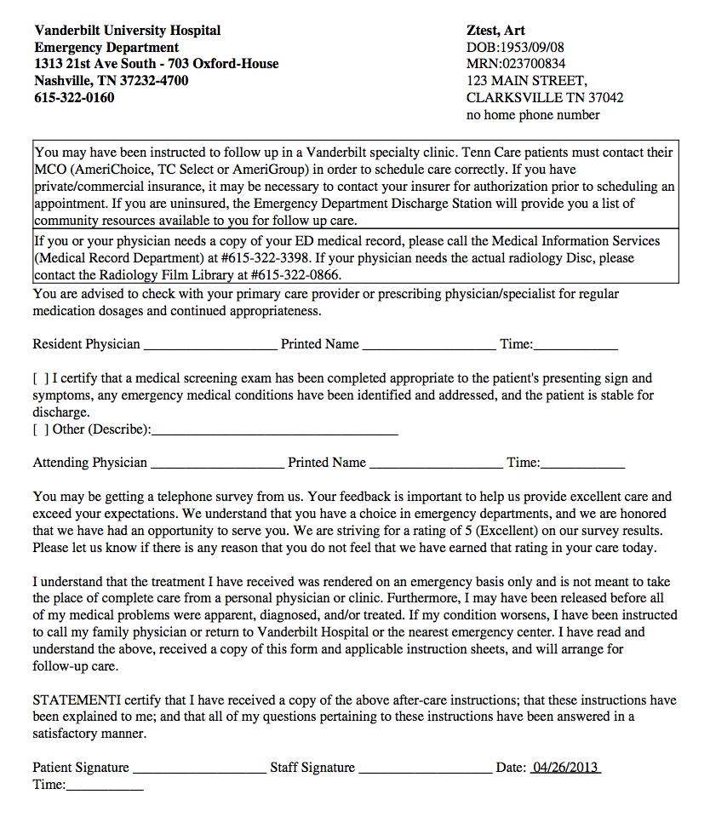
What you MUST have prior to discharging a Treat and Release patient:
All TREAT AND RELEASE patients must have the following before leaving the department:
1. The box must be checked.
The attending physician must:
Sign
Print their name LEGIBLY
Put the time
3. The Patient must sign.
4. The nurse must sign, print, and time.

Slide 4
Discharge for BOARDED PATIENTS in the Emergency Department
ALL patients discharged from the Adult or Pediatric ED, in admitted status (inpatient or observation), will require the following:
All patients admitted in the ED will have an assigned attending physician who will take sign out and review the handover documentation on the patient.
Patients discharged from the ED by admitting teams will have a StarForm completed by the admitting team.
The ED attending will be notified by a member of the admitting team that a patient has been discharged and will review relevant documentation to ensure that the form has been completed and will electronically sign the document in StarPanel.
The RN will only discharge an admitted patient when the ED attending review of the ED discharge form has been completed.
The RN must verify the document has been electronically signed prior to discharge. (see next two slides for examples)

Slide 5
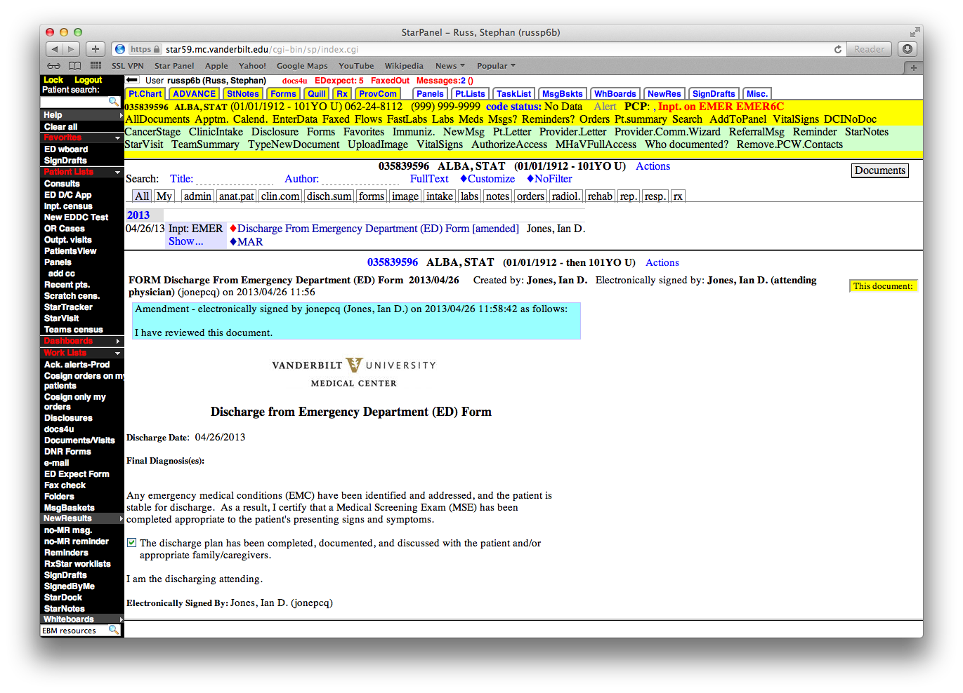
Confirm The Form is Completed:
In StarPanel – Find “Discharge from Emergency Department (ED) Form.”

Slide 6
There must be a blue amendment box that states the document has been reviewed.
The box should be checked.
Electronically signed by an attending physician.

Slide 7
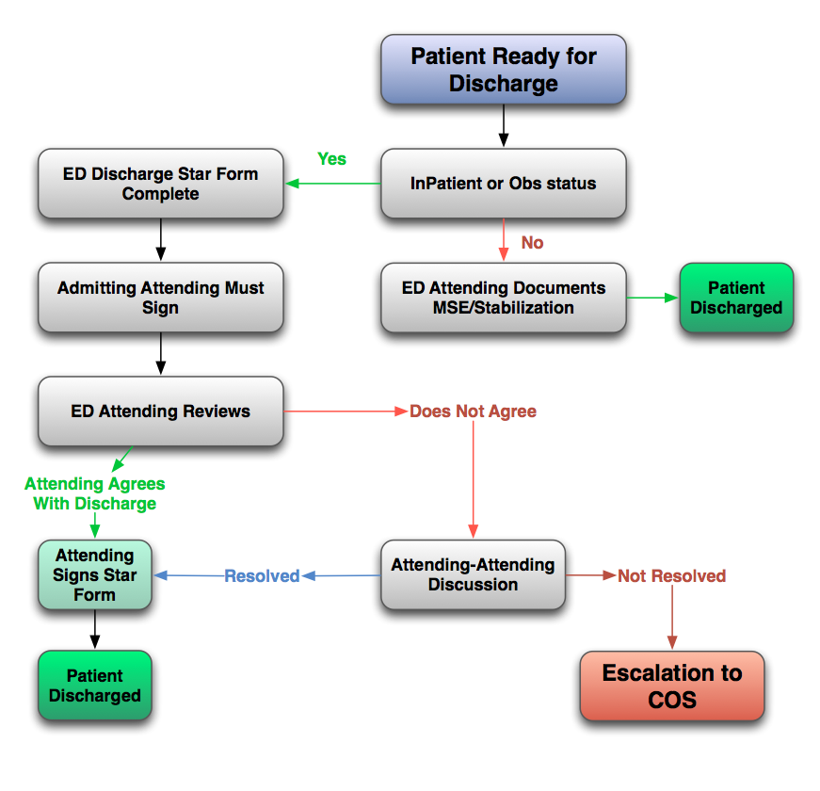
ED Discharge Flow Chart

