Slide 1
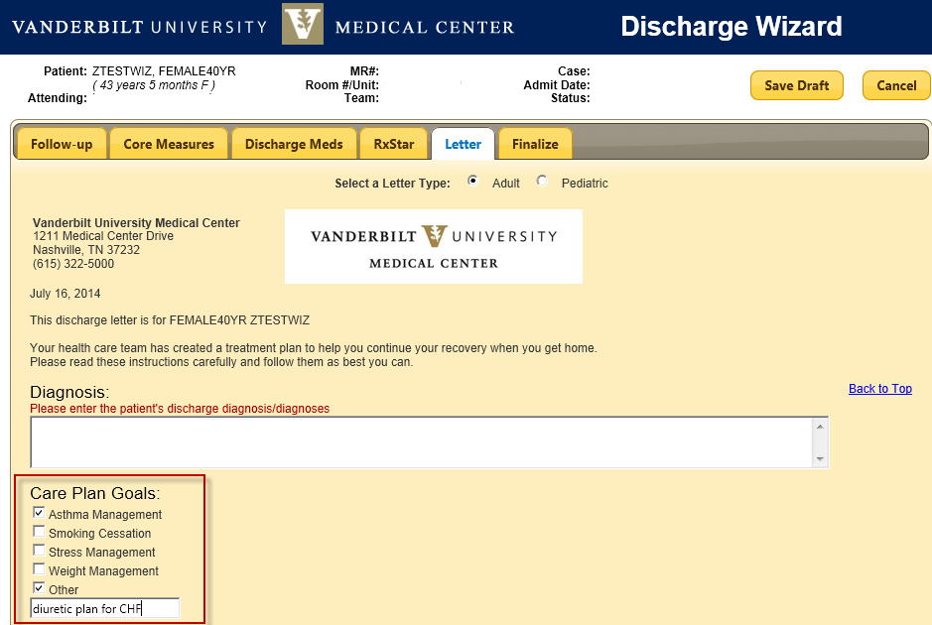
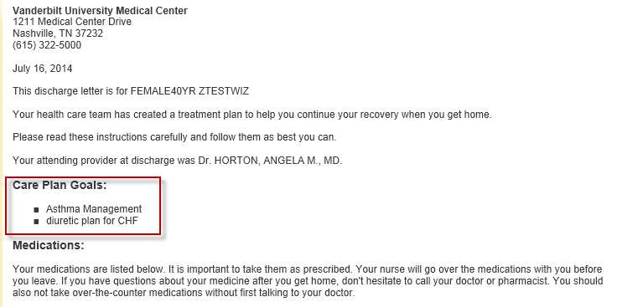
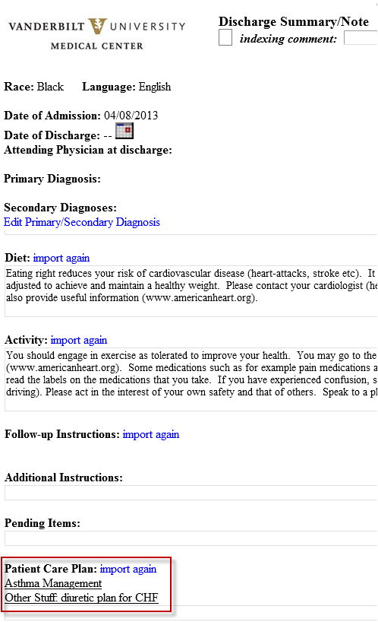
Care Plan Goals in Discharge Wizard Display in Discharge Letter and Discharge Summary StarForm
Discharge Wizard
Care Plan Goals when checked
Appears in
Discharge Letter
Appears in
Discharge Summary StarForm
For questions or issues, call the HelpDesk 34(3)-4357

