Slide 1
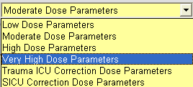
1. Diabetes Type-
- Gestational & Not Diabetic added
- HgbA1C ordered if none in 90 days
Dosing Level
Defaults to Moderate Dose
Trauma and SICU parameters will calculate sliding scale for nurse
Adult Insulin Subcutaneous Advisor
1
Changing selections on screen will update dose calculations
2
2. Basal Insulin, Meal, and Standard
Screen will change and display units based on weight
Glargine rounds to nearest 5 units for dose greater than 20 units
Custom dosing option
Default start date/time; “Now Dose” & custom start date options available
3. Meal Insulin
Tube Feeding q6H and q8h options
Custom & Carb- Ratio option
4. Sliding Scale
Calculated Scale
Hypoglycemia options for
IV D50W OR chewable tablets
3
4

Slide 2
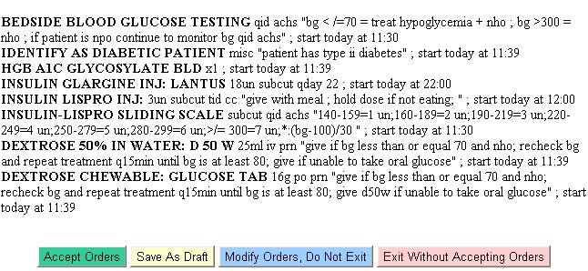
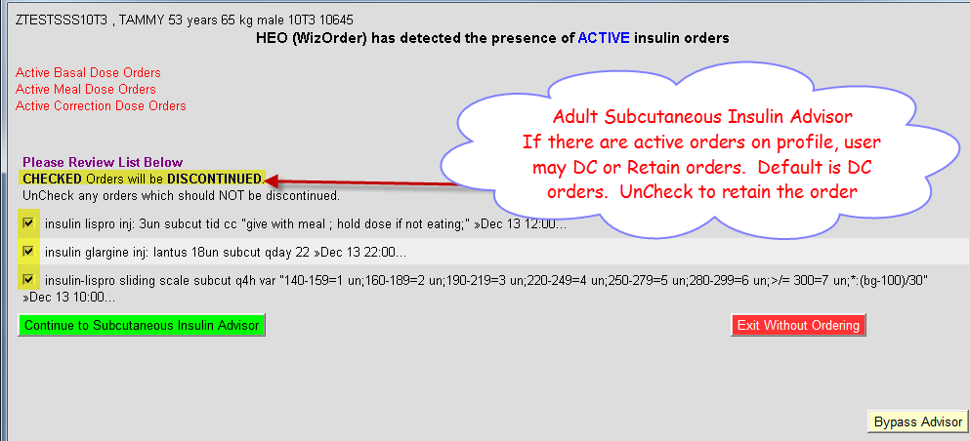
Adult Insulin Subcutaneous Advisor
5. Changes to “when to treat” parameters requires re-calculation of sliding scale
6. Orders
A1c lab order
basal, meal, and scale doses
hypoglycemia options:
D50W
OR
Chewable tablets replaces oral gel
5
6
7. Updating Insulin Orders
- active orders will be discontinued when checked
-Continue to Subcutaneous Insulin Advisor to place updated orders
7

Slide 3
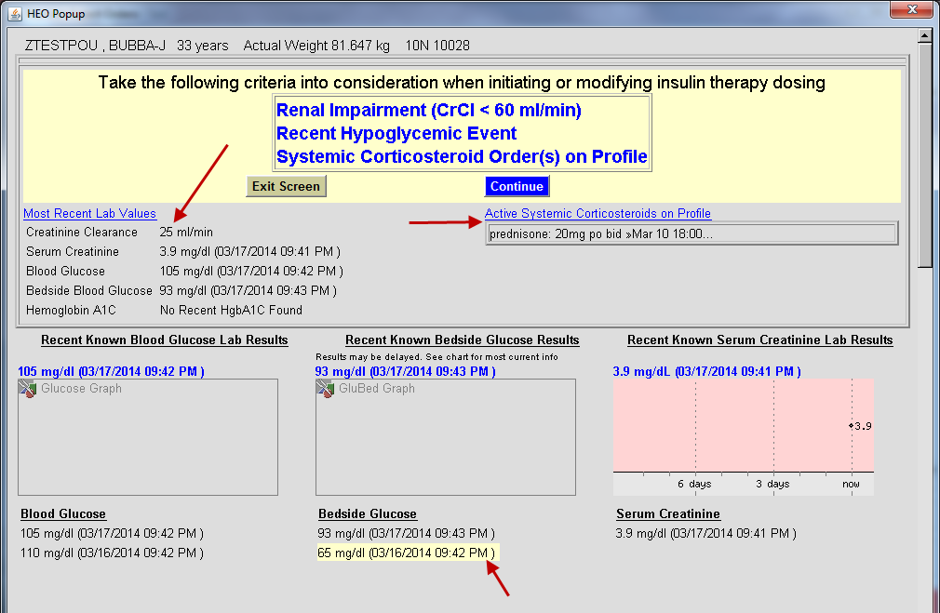
Adult Insulin Subcutaneous Advisor
8
8. Prescreening form
Providers will receive latest lab information and meds that are relative to insulin ordering before modifying orders in advisor
9. To proceed to the insulin advisor click “Continue”
9
For assistance: Call the HelpDesk at 34(3) HELP OR place an online HelpDesk ticket via the HelpDesk icon on a clinical workstation.

