Slide 1
Planning for Retirement: Depression
Richard C. Shelton, M.D.
James G. Blakemore Research Professor
Vice Chair for Clinical Research
Department of Psychiatry
Professor, Departments of Pharmacology and Psychology
Vanderbilt University

Slide 2
Depression is a Stress Disorder
Psychology
Perceived
Stress
Coping
Capacity
Physiology
Anxiety
Environment
Depression

Slide 3
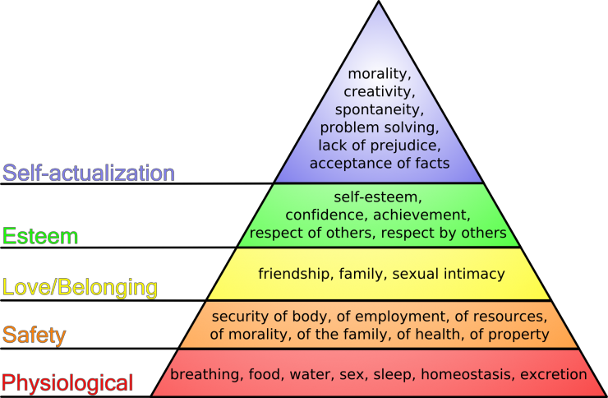
Why Depression
in Retirement?
Abraham Maslow:
Hierarchy of Need

Slide 4
Top 20 Stressful Live Events
Hurst MW, et al. Psychosomatic Med 1978; 40:126-141

Slide 5
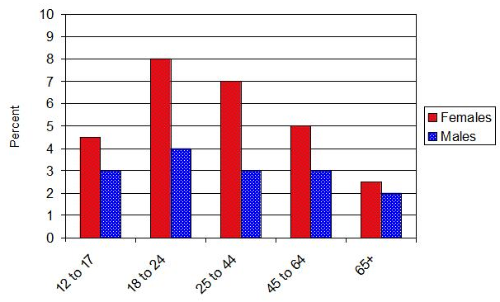
Rates of Depression, Past Year by Sex and Age

Slide 6
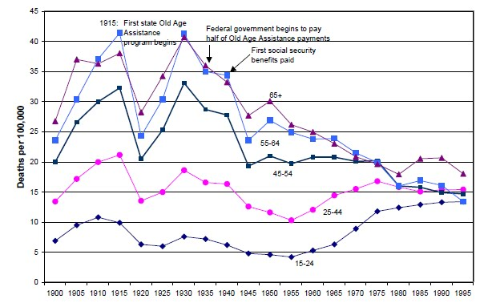
Annual Rates of Suicide by Age
-56%
Cutler D, Meara Ehttp://www.nber.org/cgi-bin/printit?uri=/digest/mar02/w8556.html

Slide 7
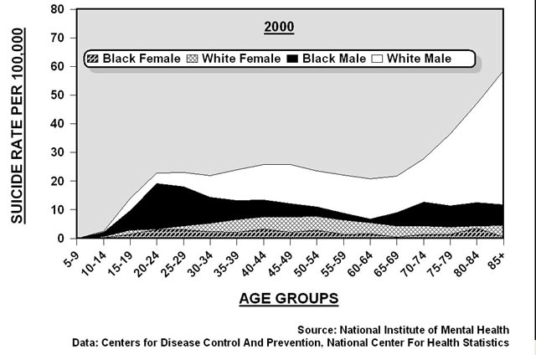

Slide 8
Retirement and Depression: Factors
Primary independent variables
Work/retirement variables
Work continuity versus relationships
Life transition
Personal variables (prior/current depression)
Contextual (mediating) variables
Change in income adequacy
Subjective health
Marital quality
Personal control (perceived)
Kim JE, Moen P. J Gerontology 2002; 57B:P212-P222

Slide 9
Retirement: Dealing with Depression
Key: Be planful
Retire from work…but don’t really
Transitional employment
Tapering work schedule
Consulting, etc.
Community involvement
Retire…but not from relationships
Cultivate relationships
Balance relationships
Anticipate problems – deal with them now
Personal/Spouse-SO illness
Get in good shape
Focus on abdominal obesity
Transitional living
Alcohol/drug misuse
Deal with your current depression first
Medications
Cognitive-behavioral therapy
EAP/Life coach
Is it a cognitive disorder?

Slide 10
Cognitive Behavioral Therapy
CBT seeks to produce change in emotions and behavior by systematically evaluating thoughts and beliefs and changing repetitive behavior patterns to produce more adaptive responses.

Slide 11
Cognitive Behavioral Therapy
Stimulus
(Event)
Emotions
Behaviors
Thoughts
(“Automatic”)
Beliefs
“I am a failure”
“I’m useless”
“I’ll never succeed”
“No one will ever love me”
“I am ugly”
“I am stupid”

Slide 12
Cognitive therapy vs medications in the treatment of moderate to severe depression (CPT II)
Follow-up Phase (12 months)
Acute Phase (16 weeks)
Continuation Phase (12 months)
3 booster sessions
Prior CT
(N=33)
CT
(N= 60)
ADM
(N=34)
*ADM
(N= 120)
PLACEBO
(N=34)
PLACEBO
(N= 60)
ADM = Paroxetine 10-50 mg./day (+augmentation)
DeRubeis Arch Gen Psychiatry 2005; 62:409-416

Slide 13
CPT-II: Percent Responders (HRSD < 12) (CT vs. Paroxetine vs. Placebo)
DeRubeis RJ, et al. Arch Gen Psychiatry 2005;62:409-416

Slide 14
Prevention of Relapse and Recurrence Following Successful Treatment
Continuation
Followup
Slide courtesy of Steve Hollon, Ph.D.

Slide 15
Antidepressants: Myths and Misconceptions
Myth: Antidepressants don’t work better than placebo
Fact: Drug/placebo differences in short term studies are greater in moderate to severe depression
Fact: Antidepressants beat placebo in longer-term treatment
Myth: Antidepressants increase risk for suicide
Fact: Antidepressants dramatically reduce risk for suicide
Fact: Antidepressants may increase risk for self injury (not suicide) in the short-term

