Slide 1
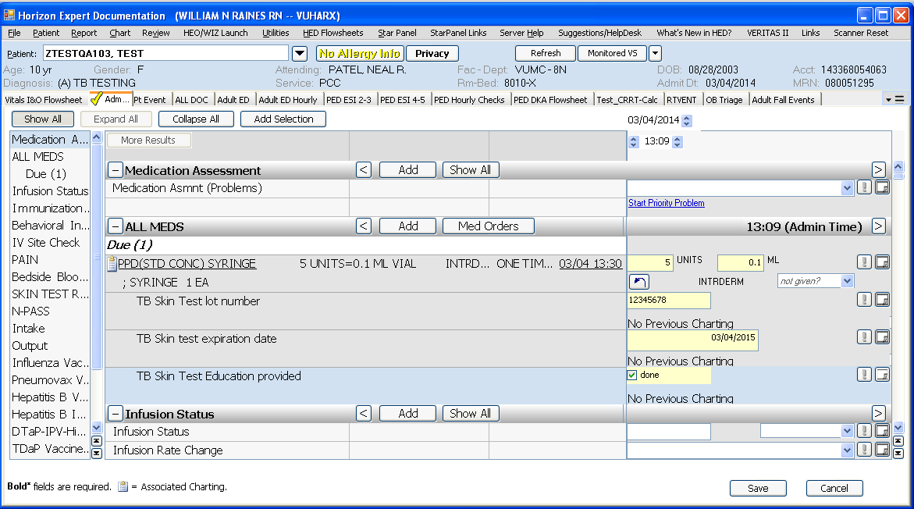
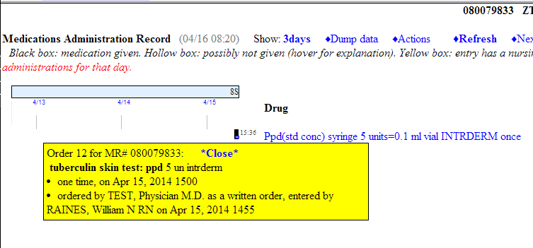
TB skin test with lot number, expiration date and education fields
TB skin test administration information populates the eMAR and the TB Test portion of immunization record

Slide 2
48 hours later the “Read TB Skin test” order displays in AdminRx
TB Test induration field charting updates the TB test area of
StarPanel Immunization record

