Slide 1
Interesting Case
E.C. 041088600
Monday, February 27th
Donna Ferguson, M.D.

Slide 2
Presentation
37 year old G:6 T:2 P:0 A:3 L:2 female admitted 2/1/17 at 32 6/7 weeks gestation for IV hydration.
Pregnancy complicated by suspected placenta increta/percreta; fetus with omphalocele.

Slide 3
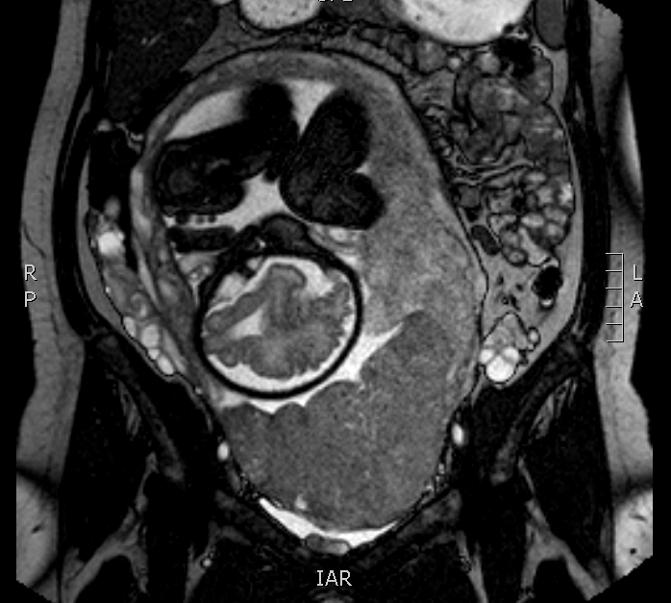
MRI
2/5/17
The placenta is anterior and inferior. The posterior margin of the placenta appears to reach and partially cover the internal cervical os (partial previa). The placenta is heterogeneous with multiple T2 dark bands, dilated vessels, rounded edges and lumpy contour . There is a nodular contour at the placenta-bladder interface with findings suggestive of complete invasion through the bladder wall.

Slide 4
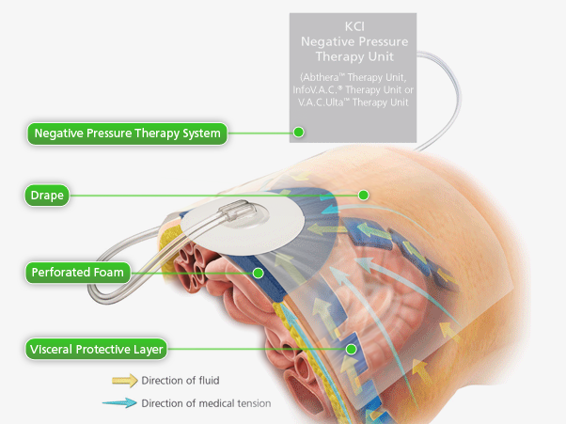
Surgery
C-section 2/8/17
C-section: performed without complication.
Hysterectomy: Placenta adherent to the lower uterine segment, posterior bladder and anterior abdominal wall. Continued hemorrhage despite surgical attempts to control bleeding.
Trauma: 20 minutes of aortic cross clamping, ligation of additional vessels, packing of pelvis, ABThera dressing.
Urology: bilateral ureteral stent placement.
21L estimated blood loss

Slide 5
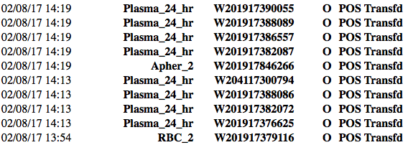
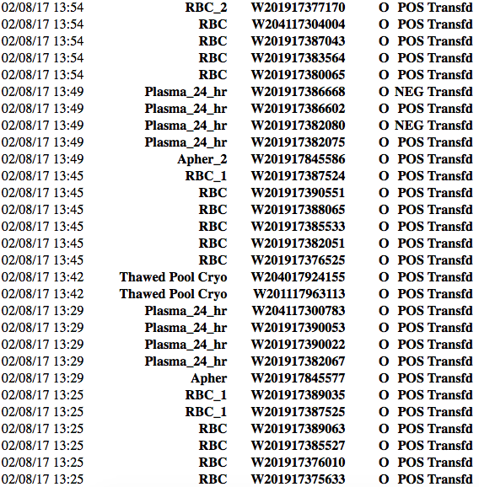
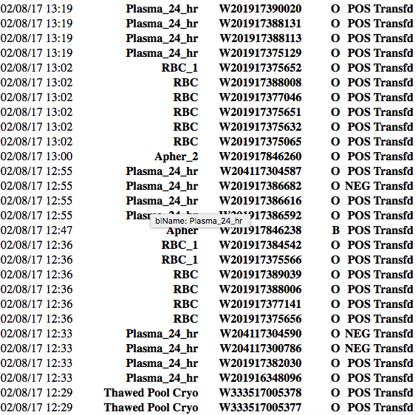
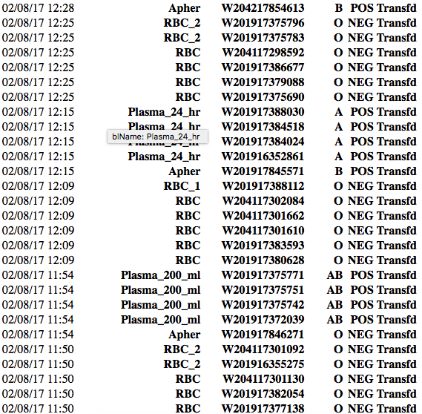
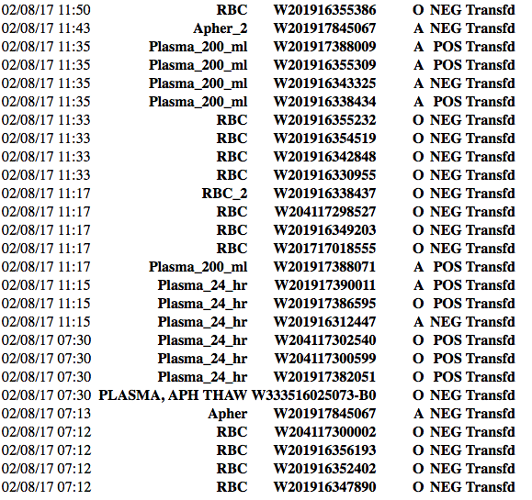
Products
30 units O+ RBC
4.5L albumin
6.7L crystalloid
58 RBC
44 FFP
9 platelets
4 cryoglobulin
3.9L cell saver

Slide 6
Outcome
Admitted to SICU with open wound; back to OR for primary closure 2/9.
Extubated 2/10.
Transferred to floor 2/11.
Discharged 2/16.
Readmitted 2/21 for diarrhea and vaginal bleeding.

Slide 7
Does the patient need RhIG?
30 units x 300 mL = 9000 mL = 9 L (only 5 L in body)
5000 mL/ 30 mL = 167 vials

Slide 8
Does the patient need RhIG?
10,000 donors x 167 vials = 1,670,000 exposures

Slide 9
Does the patient need RhIG?
2 volume RBC exchange to decrease D+ 85-90%
RhIG administration after that (calculate D+ blood by flow cytometry)
8 days had past since transfusion

Slide 10
Does the patient need RhIG?
Possible inverse correlation between units given and allo-immunization rate: 80% for 1-2 units, 30% for trauma patients

Slide 11
Does the patient need RhIG?
Hysterectomy

Slide 12
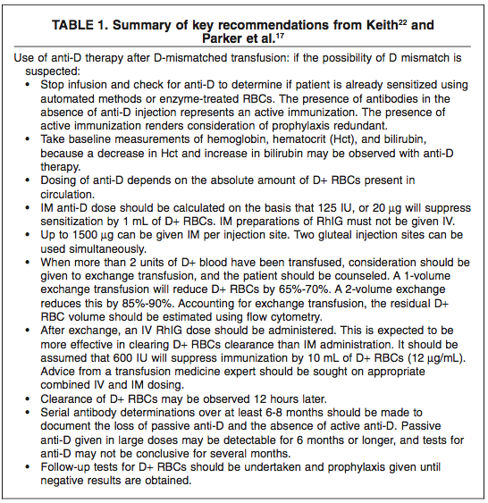
RHIG Incompatible Transfusion
Study of allo-immunization after D-mismatched transfusion is not common since it is a sporadic event and controlled studies are impossible
Aache, S. and Herman, JK. 2008

